Slide 1
Robot Localization
Yang Kai
2019-12

Slide 2
Outline
Motivation
Proposed Technical Framework
Related Research
Proposed System Architecture

Slide 3
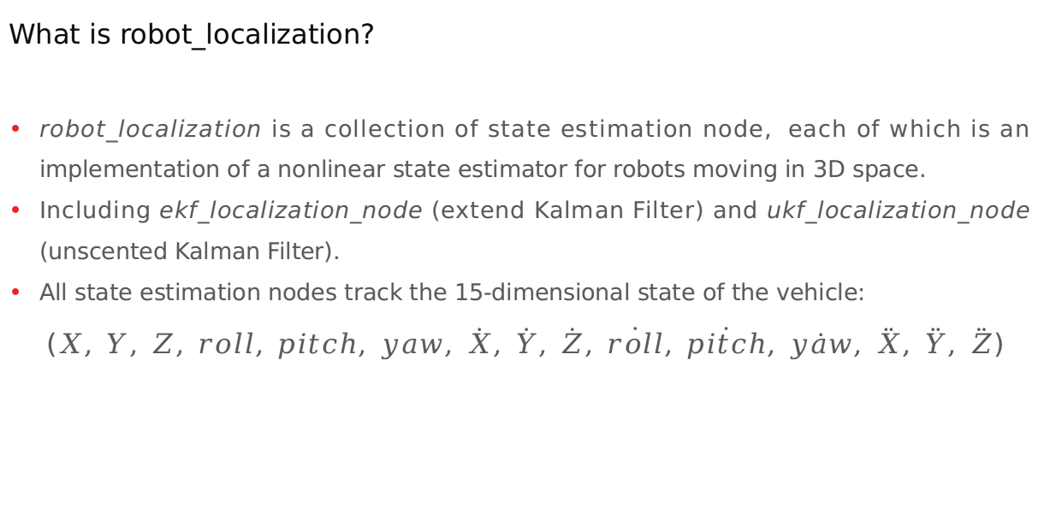
Introduction
What is robot_localization?
robot_localization is a collection of state estimation node, each of which is an implementation of a nonlinear state estimator for robots moving in 3D space.
Including ekf_localization_node (extend Kalman Filter) and ukf_localization_node (unscented Kalman Filter).
All state estimation nodes track the 15-dimensional state of the vehicle:
($X, Y, Z, roll, pitch, yaw, \dot{X}, \dot{Y}, \dot{Z}, \dot{roll}, \dot{pitch}, \dot{yaw}, \ddot{X}, \ddot{Y}, \ddot{Z}$)
Notes:
Data driven perception (multi-modal)
Perception driven planning
Assembly -> Sub task -> plan
Assembly oriented
Technical framework
Multi-modal fusion
RL based planning
Challenging problem

Slide 4
Introduction
ekf_localization_node
is an implementation of an extended Kalman filter. It uses an omnidirectional motion model to project the state forward in time, and corrects that projected estimate using perceived sensor data.
ukf_localization_node
is an implementation of an unscented Kalman filter. It uses a set of carefully selected sigma points to project the state through the same motion model that is used in the EKF, and then uses those projected sigma points to recover the state estimate and covariance. This eliminates the use of Jacobian matrices and makes the filter more stable. However, it is also more computationally taxing than ekf_localization_node
Notes:
Data driven perception (multi-modal)
Perception driven planning
Assembly -> Sub task -> plan
Assembly oriented
Technical framework
Multi-modal fusion
RL based planning
Challenging problem

Slide 5
Support Messages
robot_localization support the following ros messages as input:
nav_msgs/Odometry
Sensor_msgs/Imu
geometry_msgs/PoseWithCovarianceStamped
geometry_msgs/TwistWithCovarianceStamped
Notes:
Data driven perception (multi-modal)
Perception driven planning
Assembly -> Sub task -> plan
Assembly oriented
Technical framework
Multi-modal fusion
RL based planning
Challenging problem

Slide 6
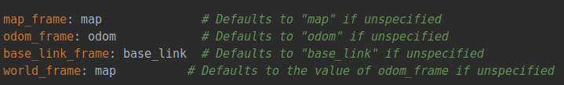
Parameters
world_frame: map or odom
odom: get all continuous inputs (acceleration and linear and gngular velocity)
map: get all (both continuous and non-continuous) inputs (acceleration, linear and angular velocity, position and orientation)
Notes:
Data driven perception (multi-modal)
Perception driven planning
Assembly -> Sub task -> plan
Assembly oriented
Technical framework
Multi-modal fusion
RL based planning
Challenging problem

Slide 7
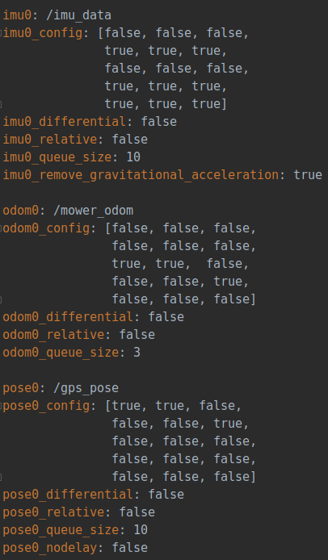
Parameters
Notes:
Data driven perception (multi-modal)
Perception driven planning
Assembly -> Sub task -> plan
Assembly oriented
Technical framework
Multi-modal fusion
RL based planning
Challenging problem

Slide 8
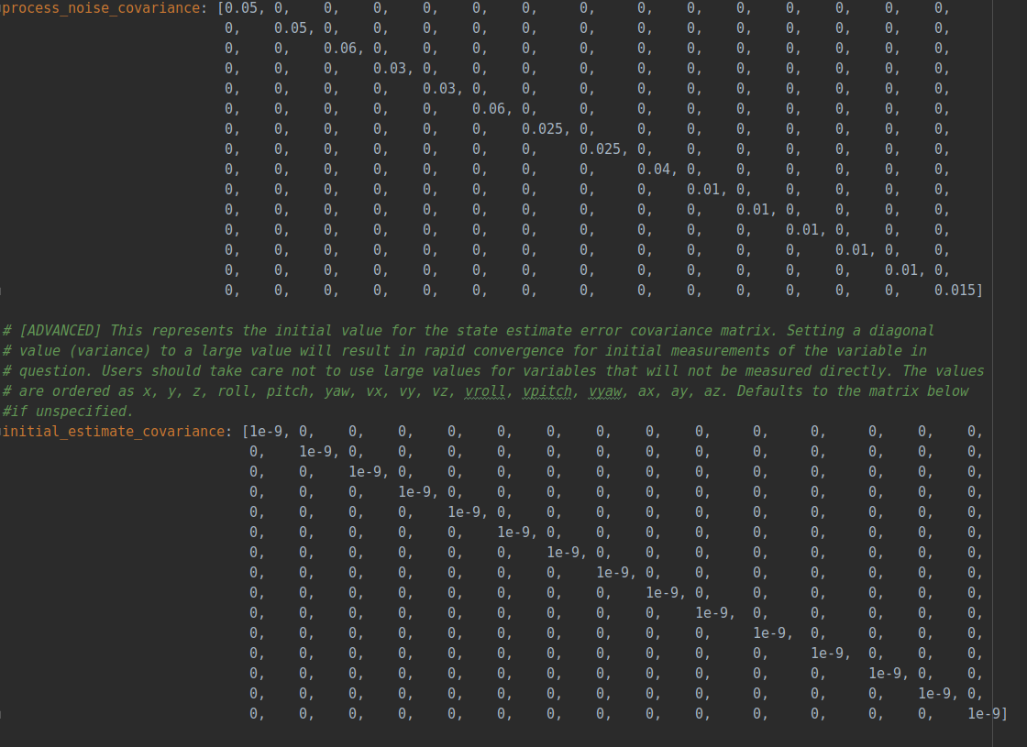
Parameters
Notes:
Data driven perception (multi-modal)
Perception driven planning
Assembly -> Sub task -> plan
Assembly oriented
Technical framework
Multi-modal fusion
RL based planning
Challenging problem

Slide 9
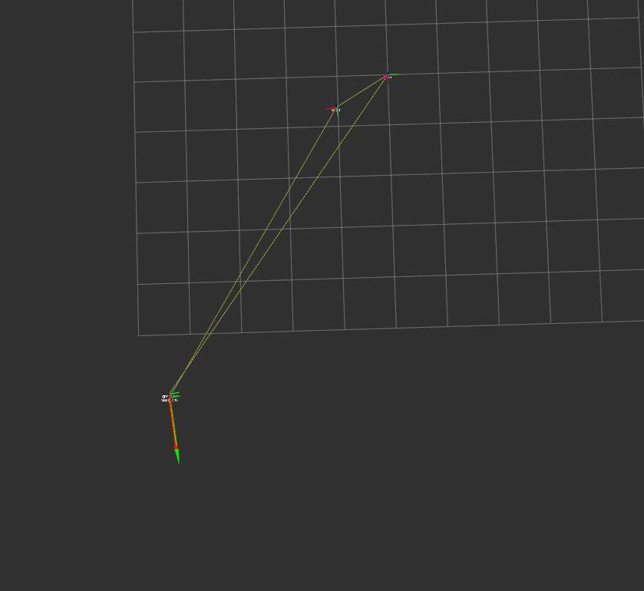
Result
map
odom
world_frame: map
odom->base_link: /mower_odom and /imu_data
map->base_link: /gps_pose
ekf_estimate: map->odom
base_link
Notes:
Data driven perception (multi-modal)
Perception driven planning
Assembly -> Sub task -> plan
Assembly oriented
Technical framework
Multi-modal fusion
RL based planning
Challenging problem

