Slide 1
Integrated Weather Alert and Disaster Response Platform
By Mahidhara Reddy Kankara
Lin Shi

Slide 2
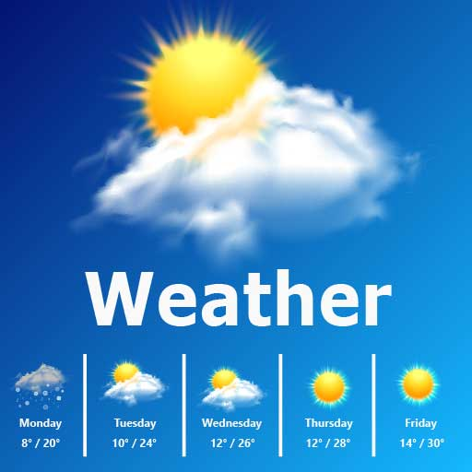


Comprehensive disaster response platform
Weather forecast
Weather alerts
Disaster checkin
Communication with rescue team

Slide 3
Components
React, frontend
Flask, backend
MongoDB, database
rabbitMQ, messaging
REST: API
Kubernetes, deployment and scalability

Slide 4
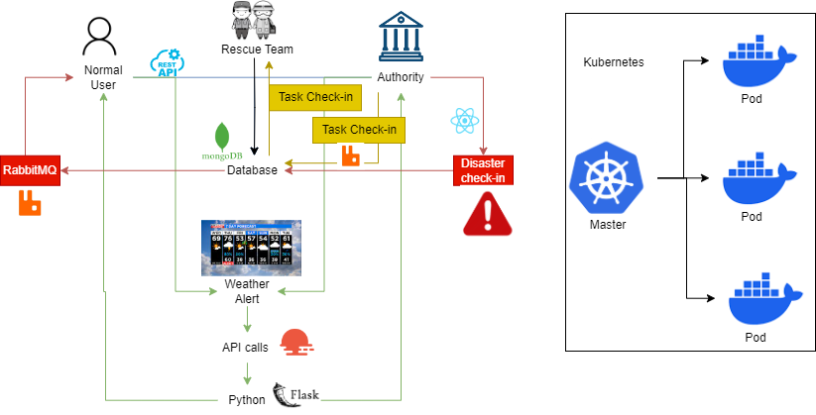
Architectural Diagram

Slide 5
Debugging
Logging with RabbitMQ, Console, Kubernetes
Postman to test REST API
GitHub versioning
Cloud MongoDB for collaborative testing
End-to-end testing
Documentation

Slide 6
Learnings
Efficiency of the program
Workload using Kubernetes and RabbitMQ
Keep tables in database in similar format

Slide 7
Demo

Slide 8
Thank You!

