Slide 1
MD5 Encryption Algorithm Improvements
Group 8
Sirui Li / Zizhe Wang / Kaize Yao
Xinyi Huang / Lincheng Shi / Ziyu Xiong

Slide 2

Introduction
• Definition: MD5 is a widely used hash function to ensure the integrity of information transmission.
• Application: Digital signatures, Consistency verification, and Secure access authentication.
• Core operation function:
a=b+((a+(F(b,c,d)+M_{i}+T_{j})<<< s)

Slide 3
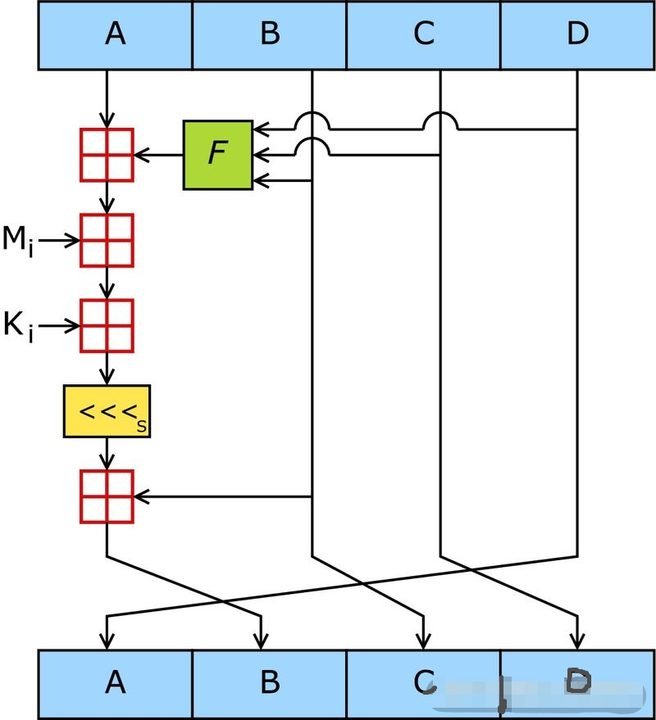
Improvements
collision resistance, time efficiency and avalanche effect
• Improved in 3 aspects:
As we can see in the slide, the MD5 calculation
is in the left. In each encryption, we first pre-
determine the value of A B C D. Next, we start a 64 loop, each time, A needs to add F function value, the i-th plaintext byte (0≤i≤15), a given constant and a B after A moving certain digits to the left. Finally, ABCD are swapped.

Slide 4
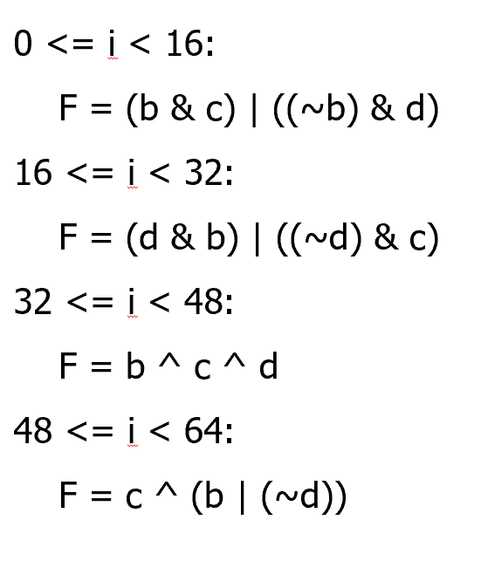
Improvements
Specially, the value of F transforms each 16 turns.

Slide 5
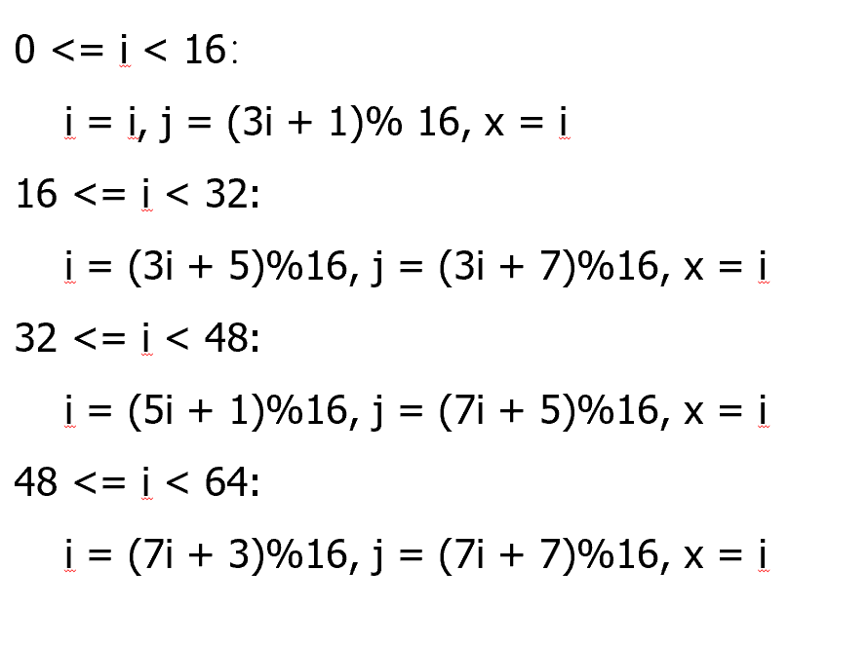
Improvements
• Preprocess plaintext

Slide 6
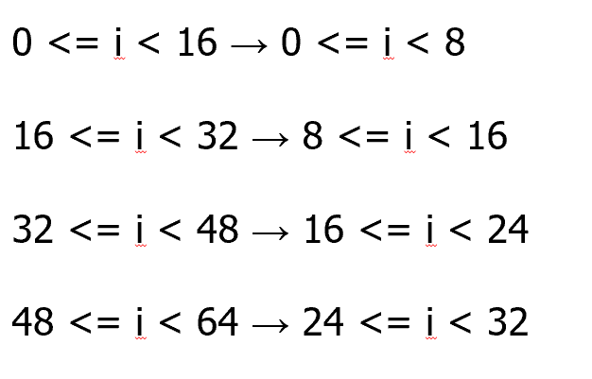
Improvements
• Reduce the number of main cycles

Slide 7
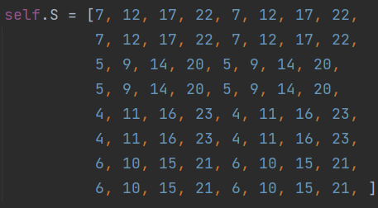
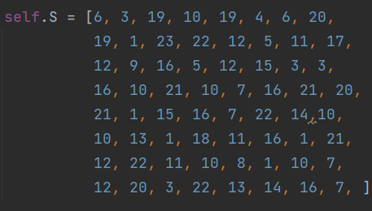
Improvements
• Change the random array of left shifts
Old Array New Array

Slide 8
Results
• standard of comparison
1. Letter repetition rate:
Rate = Number of occurrences of the same letter / Total number of letters
2. Avalanche effect degree value:
Value = 1 - Number of identical letters in the corresponding position / Total number of letters

Slide 9
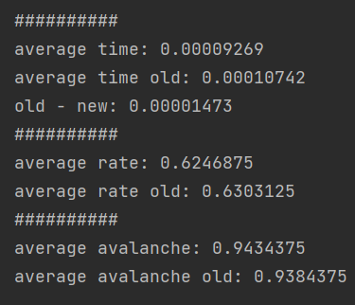
Results
Increased encryption efficiency --- Average encryption time has been reduced
Increased confusion of cipher text --- Cipher text letter repetition rate has been reduced
Reduced collision occurrence --- The degree of avalanche effect has been enhanced

Slide 10
Conclusion
① Preprocess plaintext
② Reduce the number of main cycles
③ Change the random array of left shifts
① collision resistance↑
② time efficiency↑
③ avalanche effect↑

Slide 11
Q & A

