Slide 1
CPT208 Portfolio Presentation 01 Introduction to the topic-Interactive Learning System for Chinese History and Culture
Group Number: 15
Group Members:
Yueran Cao 1930115
Yetong Wang 1930253
Lincheng Shi 1927978
Hao-Hsiang Yu 1927488
Qinchuan Zhu 1930549
Notes:
English Title: Uppercase, Calibri size 60, XJTLU Navy
English Subtitle: Uppercase, Calibri size 36, XJTLU Navy

Slide 2

CONTENTS
Background
Potential requirements and proposed functions
Statement of proposed issues
Solutions to corresponding issues
Challenges may caused by proposed solutions
References
Q&A section
Notes:
Header: Uppercase, Calibri size 28, XJTLU Navy
Body Text: Sentence case, Calibri size 14, Black

Slide 3
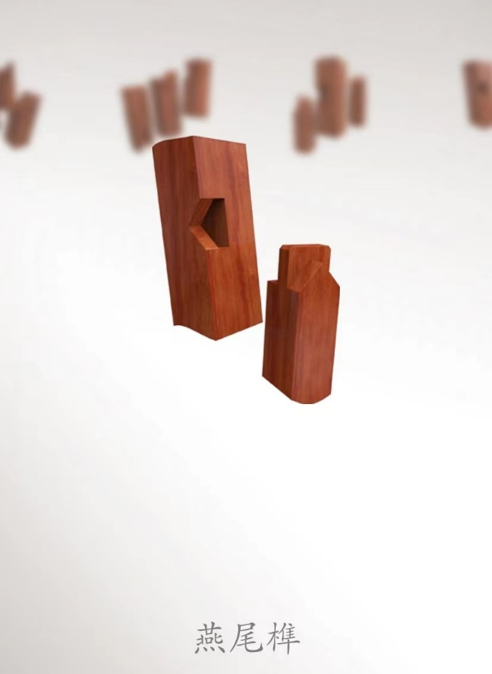
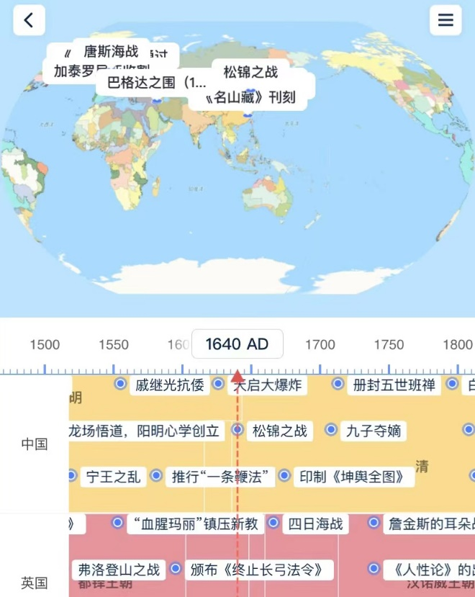
Background
Related applications
Wood Joints
Folding Fan
Full History
Motivation
Rare finished product
Not comprehesive
Figure1. Wood Joints Figure2. Full History
Notes:
Header: Uppercase, Calibri size 28, XJTLU Navy
Body Text: Sentence case, Calibri size 14, Black

Slide 4
Potential requirements and proposed functions
Aim people
Students: learning requirements and interests
Teachers: teaching materials
Functions
Showing objects using 3D modeling, AR
Quizzes for interactive
Notes:
Header: Uppercase, Calibri size 28, XJTLU Navy
Body Text: Sentence case, Calibri size 14, Black

Slide 5
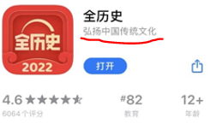
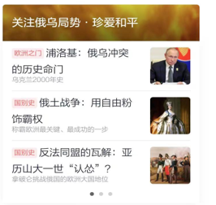
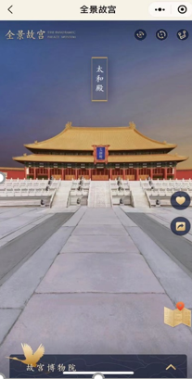
Statement of proposed issues (3)
Go off the rails for commercial value
A lot of things outside traditional Chinese culture and articles with subjective color
2. AR experience wasn’t fun enough
Only stand in a fixed place to visit the scenic spots
3. The lack of knowledge of domestic workers
Few talents who have both development and culture ability
Notes:
Header: Uppercase, Calibri size 28, XJTLU Navy
Body Text: Sentence case, Calibri size 14, Black

Slide 6
Solutions to corresponding issues
Provide compensation & Restricted commercial use
Origin: such software is hard to make money from
2. Virtual character & Set up a question system
Add a wheel to control character movement
Rank the participants
Leader with more knowledge
“Wood Joints”: mark out all relevant content and assign tasks to team members[3]
Notes:
Header: Uppercase, Calibri size 28, XJTLU Navy
Body Text: Sentence case, Calibri size 14, Black

Slide 7
Challenges may caused by proposed solutions
Theoretical VS Practice
Relevant departments to provide compensation is difficult to achieve
Finding a leader with a lot of knowledge is a rare thing
2. Cultural difference
Some aspects such as thinking mode, values, behavior habits have difference[4]→
Developers: study the impact of cultural factors such as language, color on interface design
Notes:
Header: Uppercase, Calibri size 28, XJTLU Navy
Body Text: Sentence case, Calibri size 14, Black

Slide 8
References
[1] https://www.ifanr.com/432553
[2] http://www.doc88.com/p-6778258763676.html
Notes:
Header: Uppercase, Calibri size 28, XJTLU Navy
Body Text: Sentence case, Calibri size 14, Black

Slide 9
Q&A Section
Notes:
Header: Uppercase, Calibri size 28, XJTLU Navy
Body Text: Sentence case, Calibri size 14, Black

Slide 10
Thank You!
Notes:
Header: Uppercase, Calibri size 28, XJTLU Navy
Body Text: Sentence case, Calibri size 14, Black

