Slide 1
Lin Yang
Fetching the Data from Bluetooth Device

Slide 2
Introduction
Bluetooth is a wireless technology standard for exchanging data over short distances from fixed and mobile devices, and building personal area networks.
In this demo, we try to explore how to exchange data between two devices based on Bluetooth technology.

Slide 3
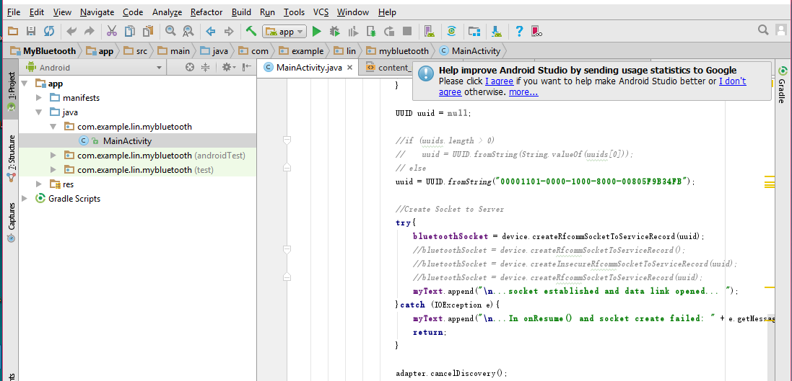
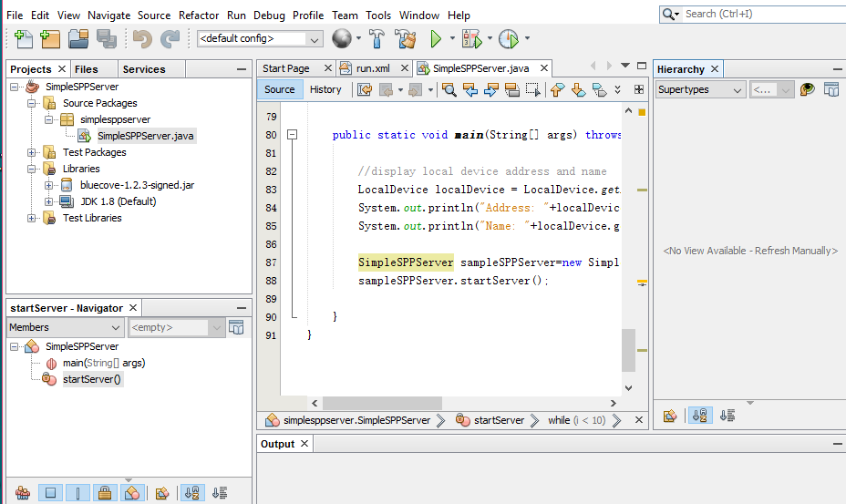
Tools
Programming Language: Java
Phone Operation System: Android
IDE: NetBeans and Android Studio
Emulator: SM-T210R

Slide 4
Processing
Server
Client
Set up Server
Set up Client
Bluetooth Socket
Create UUID
Connect to Server by UUID
Write Thread
Read Thread
Read Thread
Write Thread

Slide 5
How does client connect to server
Adapter = null?
Make sure device has Bluetooth
Yes
No
Adapter is Enabled
No
Start Bluetooth Device
Yes
Find Server’s UUID
No
Make sure server’s UUID
Yes
Start writing and reading thread

Slide 6
Future work
Using Object-C to develop iOS version.
Develop BLE (Bluetooth Low Energy) version.

