Slide 1
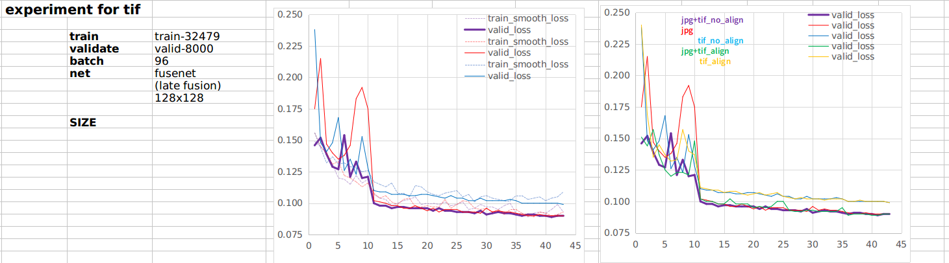
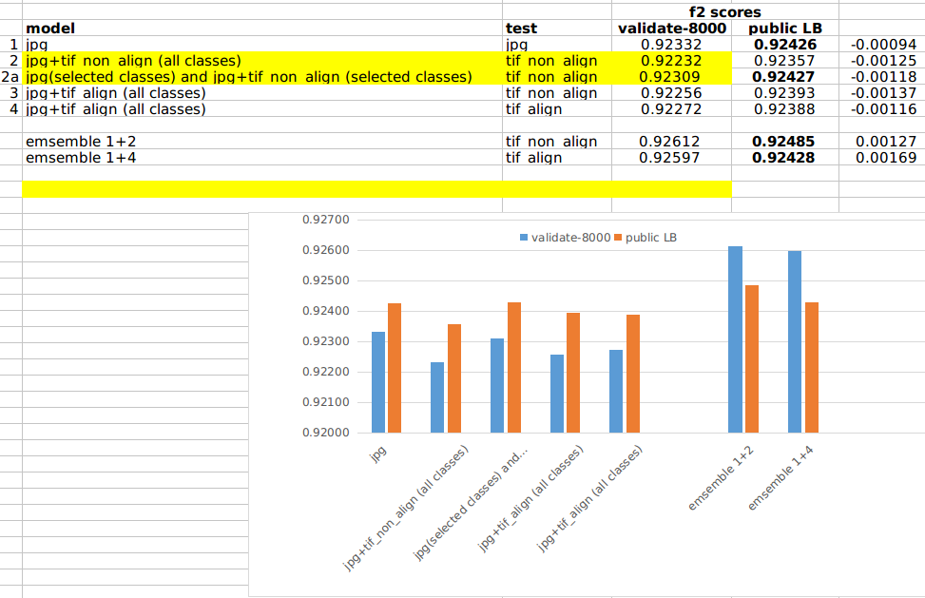
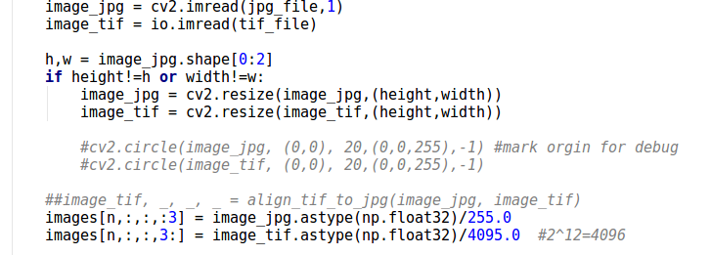
no advantage to align the tif or not
but LB score still can be improved.
raw values of jpg and tif used

Slide 2
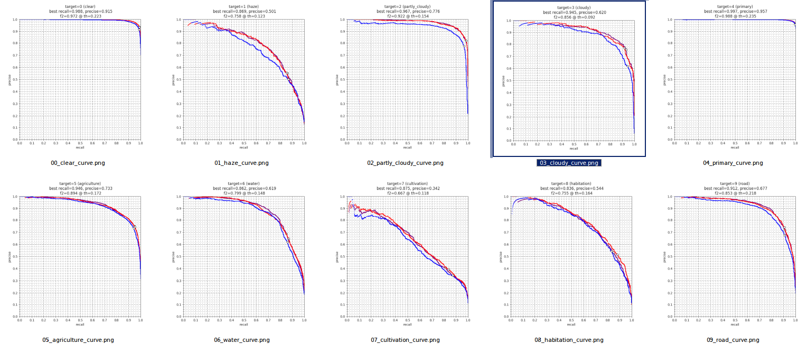
jpg+tif_no_align
jpg
tif_no_align
combine is slightly better than jpg
combine is slightly better than jpg
combine is slightly better than jpg

Slide 3
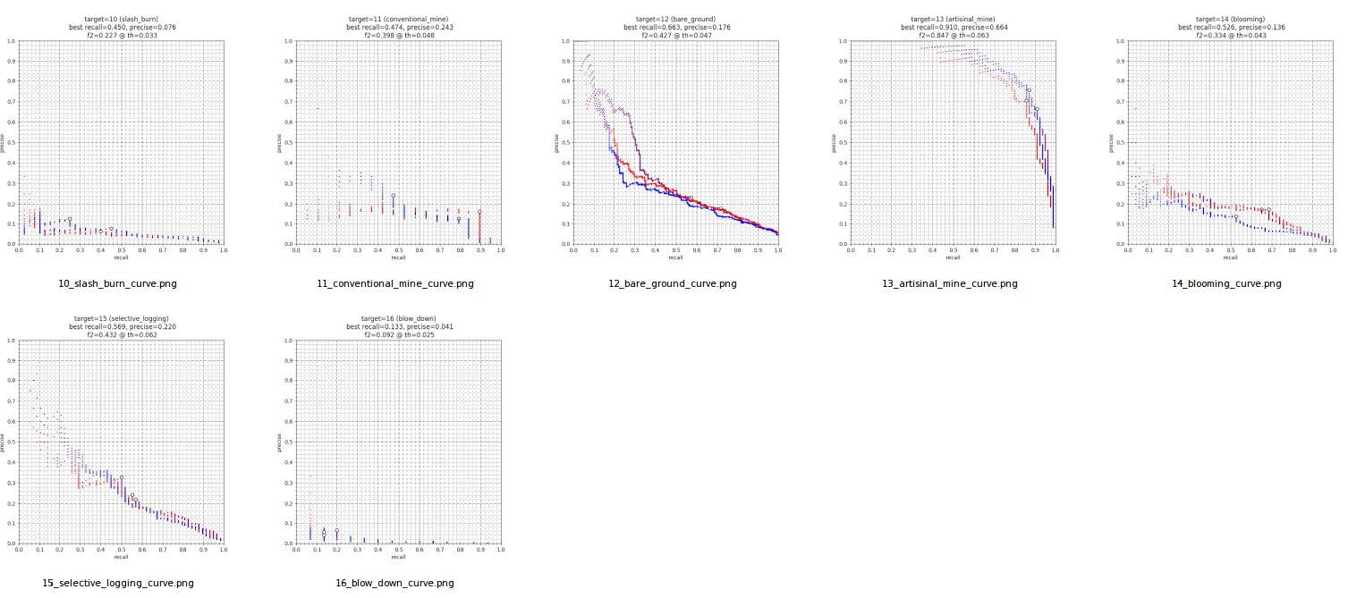
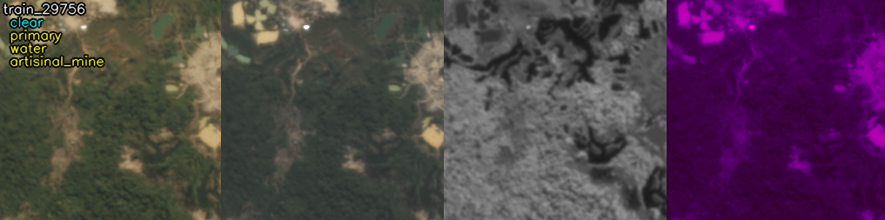
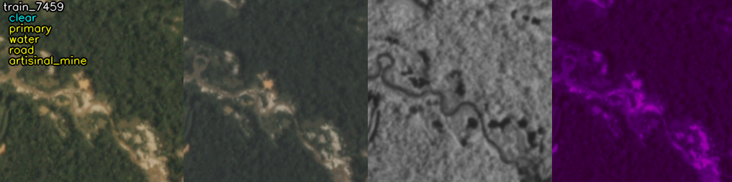
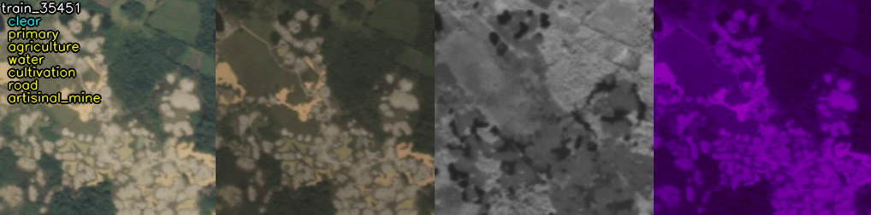
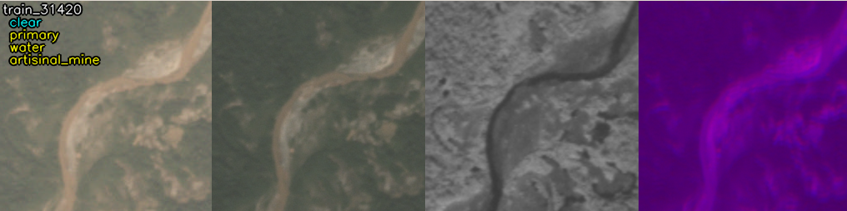
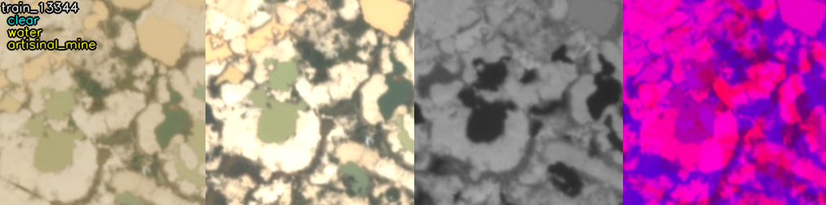
jpg+tif_no_align
jpg
tif_no_align
combine is slightly better than jpg
*tif/combine is significantly better than jpg

Slide 4
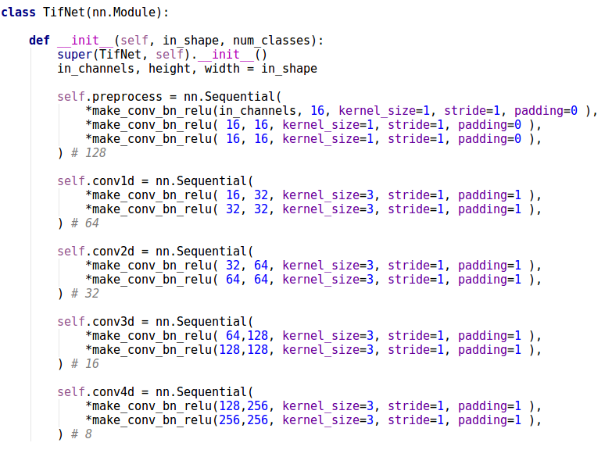
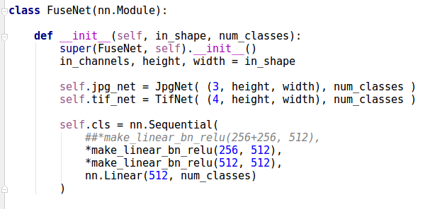
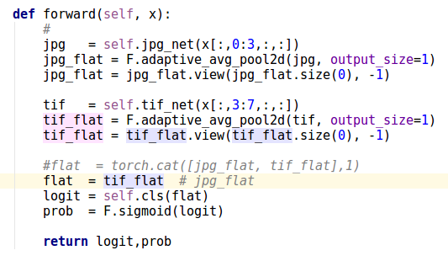
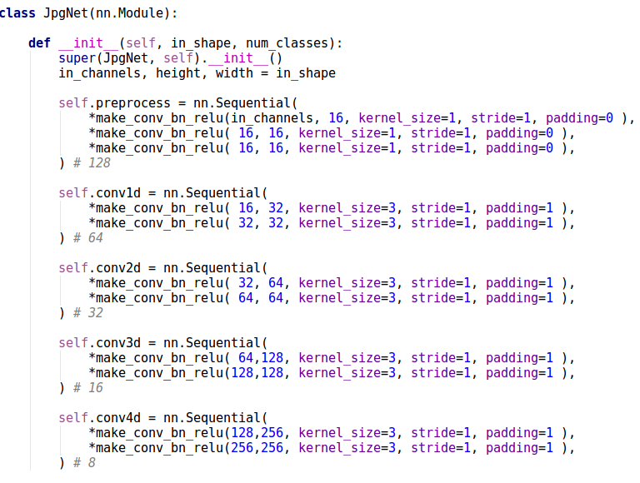
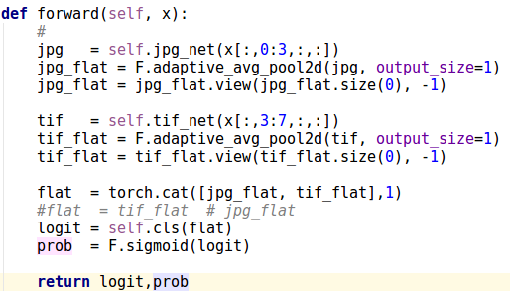
network (late fusion)
TifNet (conv)
JpgNet (conv)
ave pool
ave pool
FuseNet (fc)
toggle this to decide to use tif, jpg or both

Slide 5
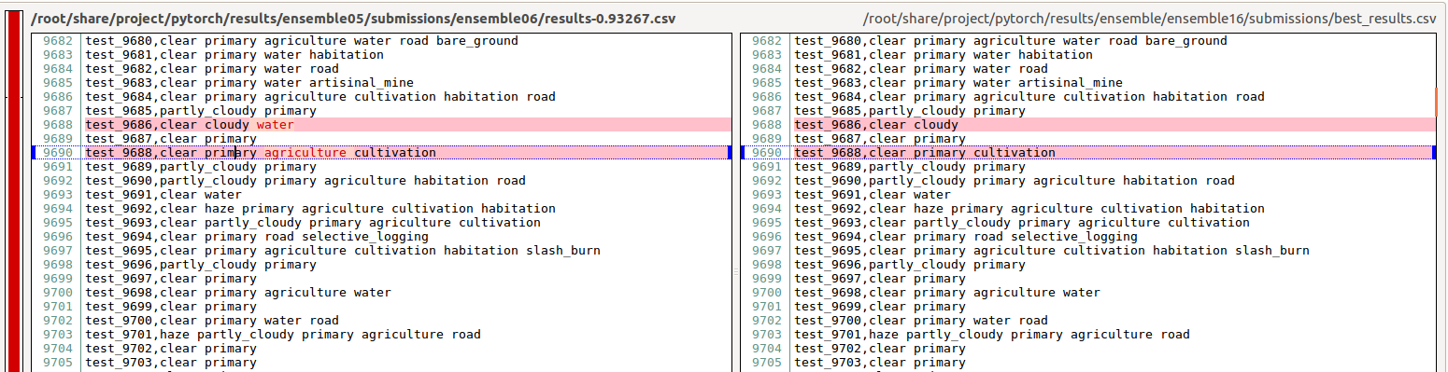
based on fixed threshold=0.4
based on best threshold per class
note that most enteries are the same ....

Slide 6
based on fixed threshold=0.4
based on best threshold per class

