Slide 1
Team D
Aravindan Balasubramanian
Lin Zhu
Romil Bandi
Safan Maredia
Shivangi Rathore
Qing Sun

Slide 2
INTRODUCTION
Presenter: ????

Slide 4
PROBLEM STATEMENT
Presenter: ????

Slide 6
POTUM ALGORITHM
Presenter: Lin Zhu

Slide 7
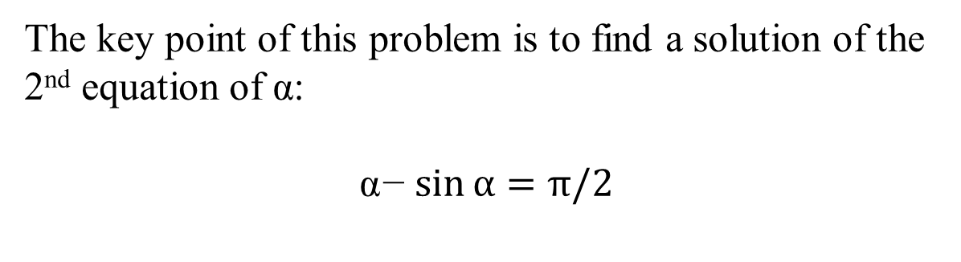
Problem Analysis
The key point of this problem is to find a solution of the 2nd equation of $\text{α}$:
$$\text{α}\text{−}\sin{α=π/2}$$

Slide 8
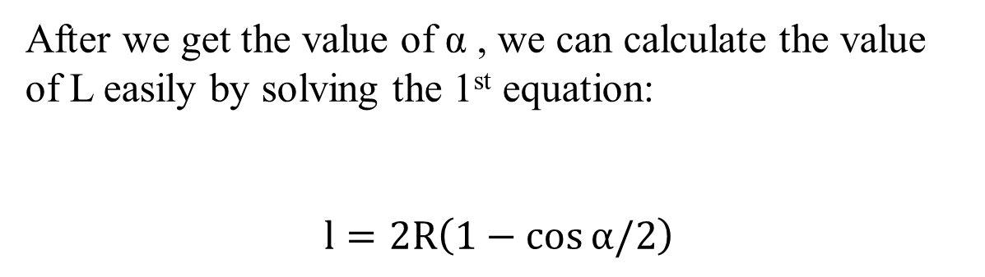
Problem Analysis
After we get the value of $\text{α}$ , we can calculate the value of L easily by solving the 1st equation:
$$l=2R\left(1−\cos{α/2}\right)$$

Slide 9
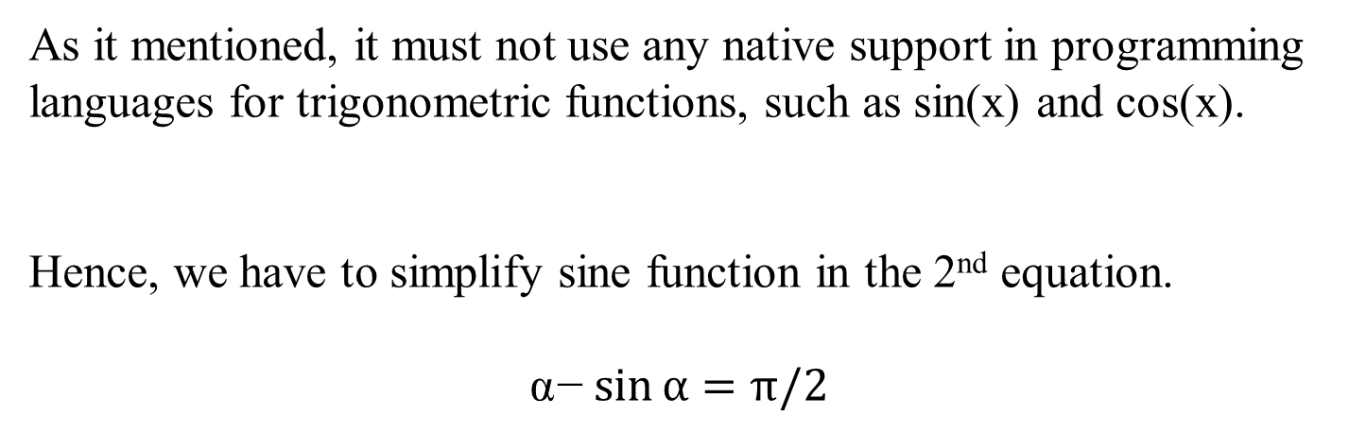
Simplify Sine Function
As it mentioned, it must not use any native support in programming languages for trigonometric functions, such as sin(x) and cos(x).
Hence, we have to simplify sine function in the 2nd equation.
$$\text{α}\text{−}\sin{α=π/2}$$

Slide 10
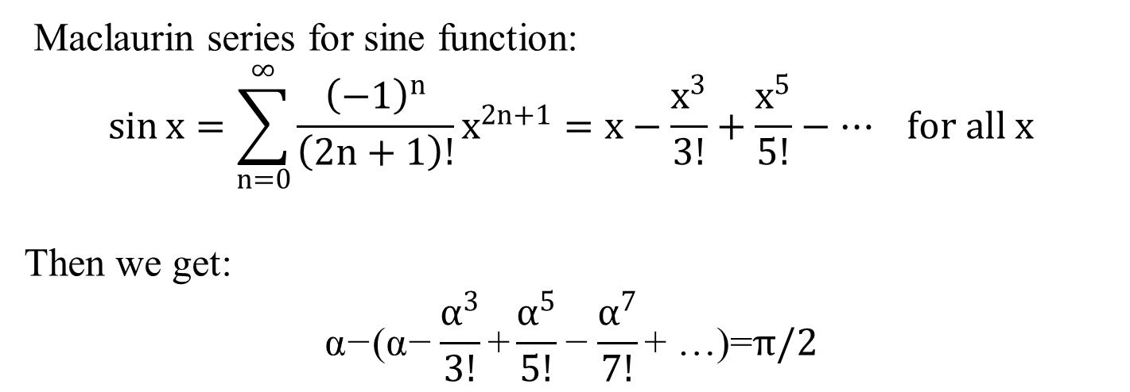
Simplify Sine Function
Maclaurin series for sine function:
$$\sin{x}=\sum_{n=0}^{∞}{\frac{{\left(−1\right)}^{n}}{\left(2n+1\right)!}x^{2n+1}=x−\frac{x^{3}}{3!}+\frac{x^{5}}{5!}}−⋯ for all x$$
Then we get:
$$\text{α}\text{−}\text{(}\text{α}\text{−}\frac{α^{3}}{3!}\text{+}\frac{α^{5}}{5!}\text{−}\frac{α^{7}}{7!}\text{+ …)=}π/2$$

Slide 11
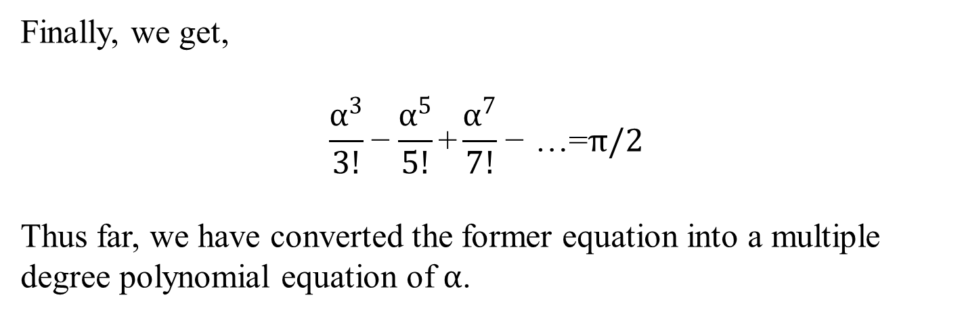
Simplify Sine Function
Finally, we get,
$$\frac{α^{3}}{3!}\text{−}\frac{α^{5}}{5!}\text{+}\frac{α^{7}}{7!}\text{−}\text{ …=}π/2$$
Thus far, we have converted the former equation into a multiple degree polynomial equation of $α$.

Slide 12
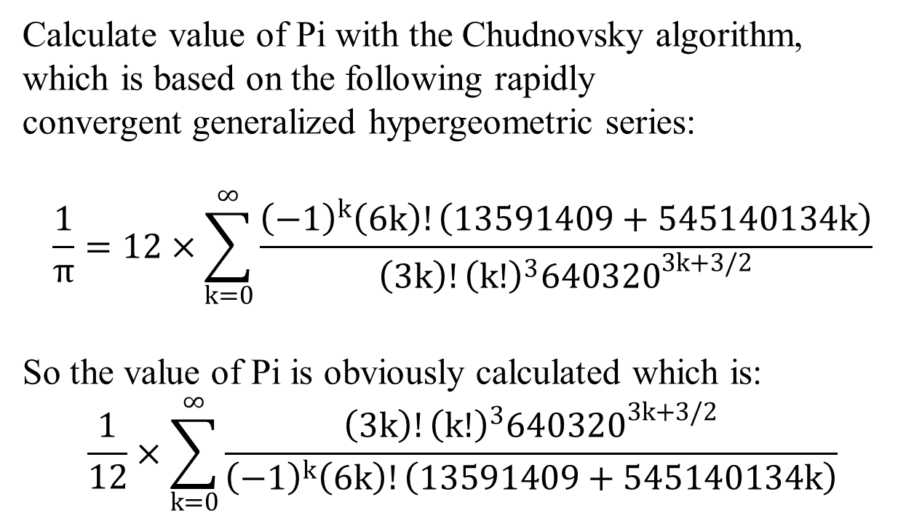
Calculate value of Pi
Calculate value of Pi with the Chudnovsky algorithm, which is based on the following rapidly convergent generalized hypergeometric series:
$$\frac{1}{π}=12×\sum_{k=0}^{∞}{\frac{{\left(−1\right)}^{k}\left(6k\right)!\left(13591409+545140134k\right)}{\left(3k\right)!{\left(k!\right)}^{3}{640320}^{3k+3/2}}}$$
So the value of Pi is obviously calculated which is:
$$\frac{1}{12}×\sum_{k=0}^{∞}{\frac{\left(3k\right)!{\left(k!\right)}^{3}{640320}^{3k+3/2}}{{\left(−1\right)}^{k}\left(6k\right)!\left(13591409+545140134k\right)}}$$

Slide 13
Calculate value of Pi
 | Execution Time (Second) | Minimum number of Iterations
Chudnovsky Algorithm | 0.0001 | 1
Liu Hui Algorithm | 0.078 | 25
Leibniz formula | 5.452 | 100000000
Gregory–Leibniz series | 0.001 | 8
Riemann zeta function | 17.491 | 1000000000

Slide 14
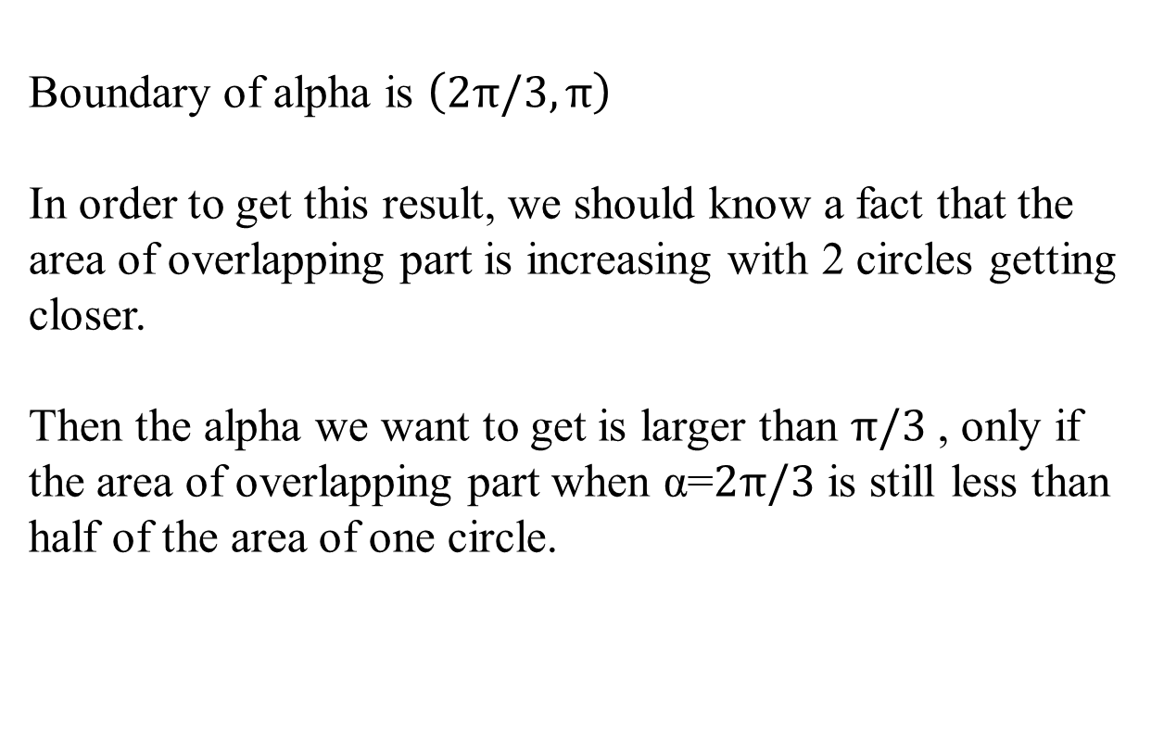
Boundary of alpha
Boundary of alpha is $\left(2π/3,π\right)$
In order to get this result, we should know a fact that the area of overlapping part is increasing with 2 circles getting closer.
Then the alpha we want to get is larger than $π/3$ , only if the area of overlapping part when $\text{α}\text{=}2π/3$ is still less than half of the area of one circle.

Slide 15
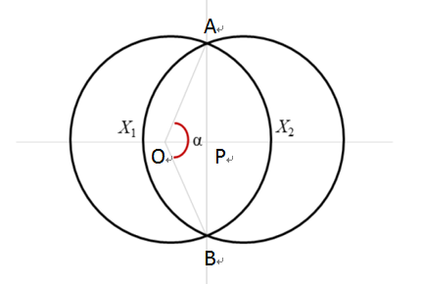
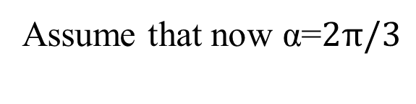
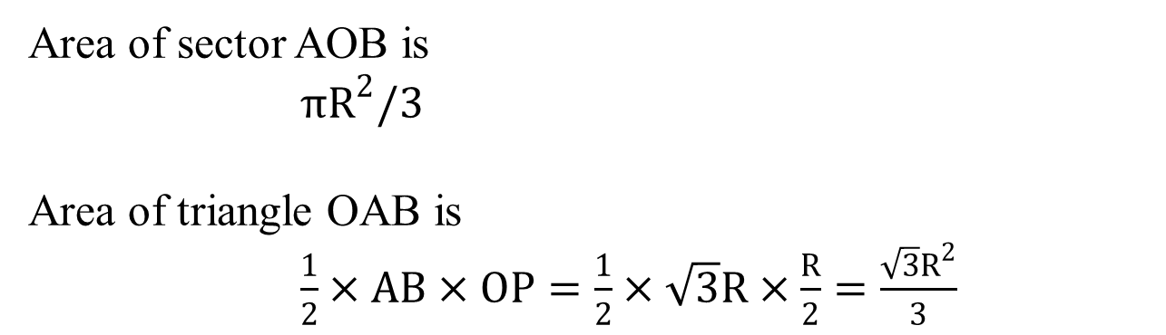

Boundary of alpha
Assume that now $\text{α}\text{=}2π/3$
$$OA=OB=R$$
$$AB=2PA=\sqrt{3}R$$
$$OP=R/2$$
Area of sector AOB is
${πR}^{2}/3$
Area of triangle OAB is
$\frac{1}{2}×AB×OP=\frac{1}{2}×\sqrt{3}R×\frac{R}{2}=\frac{\sqrt{3}R^{2}}{3}$

Slide 16
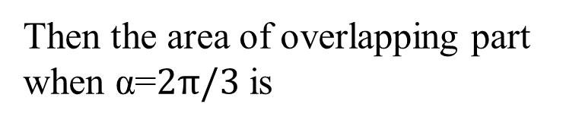
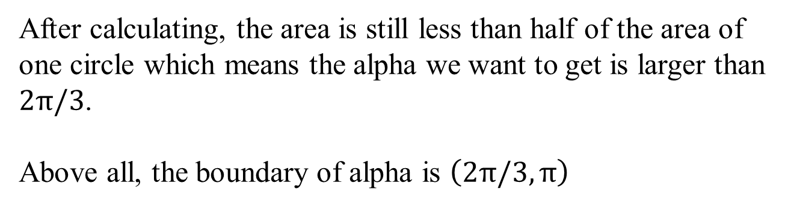
Boundary of alpha
Then the area of overlapping part when $\text{α}\text{=}2π/3$ is
2 $×$ Area of sector AOB - Area of triangle OAB
After calculating, the area is still less than half of the area of one circle which means the alpha we want to get is larger than $2π/3$.
Above all, the boundary of alpha is $\left(2π/3,π\right)$

Slide 17
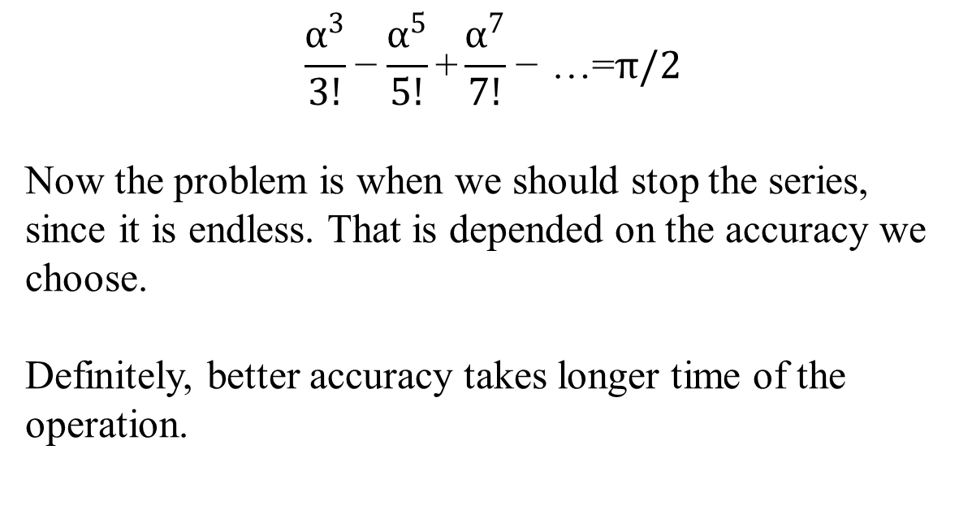
Determine Series End Position
$$\frac{α^{3}}{3!}\text{−}\frac{α^{5}}{5!}\text{+}\frac{α^{7}}{7!}\text{−}\text{ …=}π/2$$
Now the problem is when we should stop the series, since it is endless. That is depended on the accuracy we choose.
Definitely, better accuracy takes longer time of the operation.

Slide 18
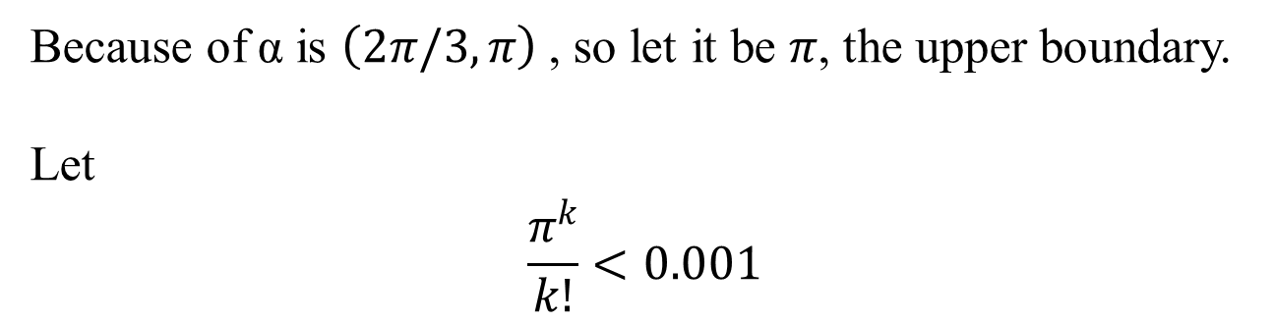
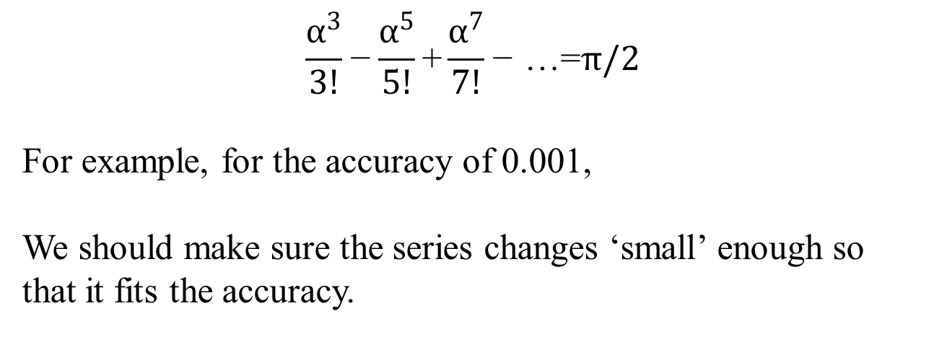
Determine Series End Position
$$\frac{α^{3}}{3!}\text{−}\frac{α^{5}}{5!}\text{+}\frac{α^{7}}{7!}\text{−}\text{ …=}π/2$$
For example, for the accuracy of 0.001,
We should make sure the series changes ‘small’ enough so that it fits the accuracy.
Because of$\text{α}$ is $\left(2π/3,π\right)$ , so let it be $π$, the upper boundary.
Let
$$\frac{π^{k}}{k!}<0.001$$

Slide 19
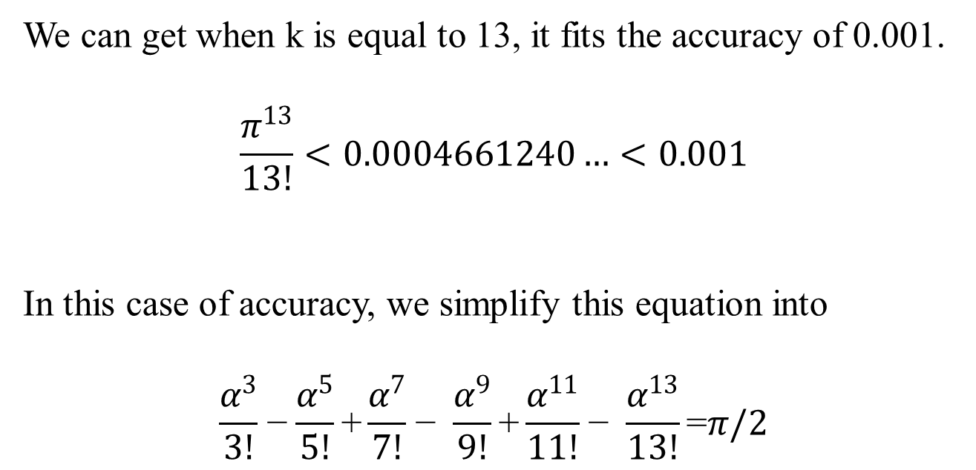
Determine Series End Position
We can get when k is equal to 13, it fits the accuracy of 0.001.
$$\frac{π^{13}}{13!}<0.0004661240…<0.001$$
In this case of accuracy, we simplify this equation into
$$\frac{α^{3}}{3!}\text{−}\frac{α^{5}}{5!}\text{+}\frac{α^{7}}{7!}\text{−} \frac{α^{9}}{9!}\text{+}\frac{α^{11}}{11!}\text{−} \frac{α^{13}}{13!}\text{=}π/2$$

Slide 20
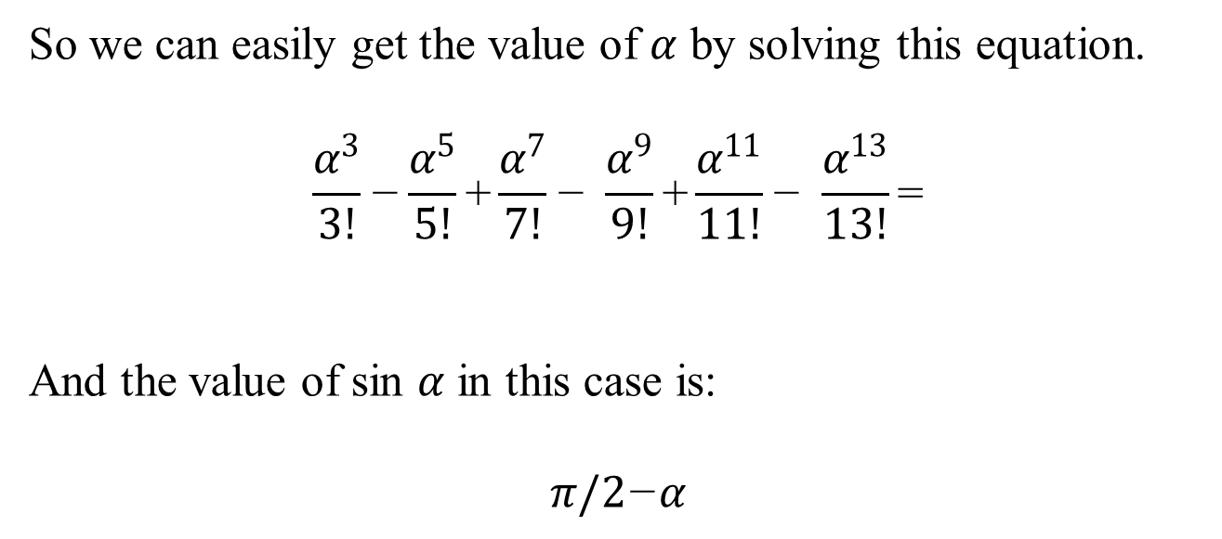

Get the value of $α$
So we can easily get the value of $α$ by solving this equation.
$$\frac{α^{3}}{3!}\text{−}\frac{α^{5}}{5!}\text{+}\frac{α^{7}}{7!}\text{−} \frac{α^{9}}{9!}\text{+}\frac{α^{11}}{11!}\text{−} \frac{α^{13}}{13!}\text{=}$$
And the value of sin $α$ in this case is:
$$π/2\text{−}α$$

Slide 21

Calculate the Value of L
From the 1st equation
$$l=2R\left(1−\cos{α/2}\right)$$
We need to calculate the value of $\cos{α/2}$.

Slide 22
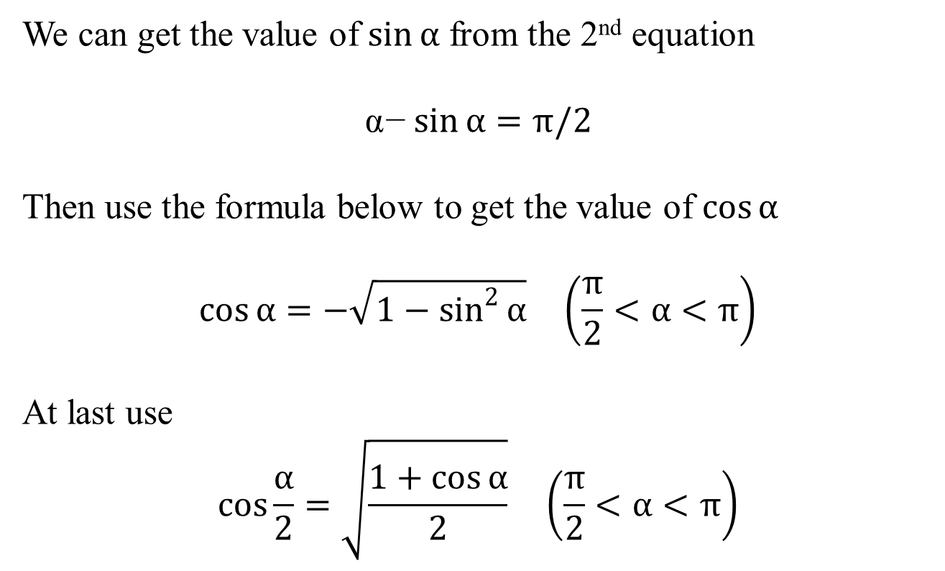
Calculate the Value of L
We can get the value of $\sin{α}$ from the 2nd equation
$$\text{α}\text{−}\sin{α}=π/2$$
Then use the formula below to get the value of $\cos{α}$
$$\cos{α}=−\sqrt{1−\sin^{2}{α}} \left(\frac{π}{2}<α<π\right)$$
At last use
$$\cos{\frac{α}{2}}=\sqrt{\frac{1+\cos{α}}{2}} \left(\frac{π}{2}<α<π\right)$$

Slide 23

Calculate the Value of L
Now we have the value of $\cos{\frac{α}{2}}$
Finally,
$$l=2R\left(1−\cos{α/2}\right)$$

Slide 24
IMPLEMENTATION OUTPUTS OVER DIFFERENT LANGUAGES

Slide 25
Matlab
Presenter: Lin Zhu

Slide 26
Introduction of Matlab
MATLAB is a high-level for numerical computation, visualization, and programming.
Using MATLAB, you can analyze data, develop algorithms, and create models and applications. The language, tools, and built-in math functions enable you to explore multiple approaches and reach a solution faster traditional programming languages, such as C/C++ or Java.

Slide 27
Evaluation of Matlab
Advantages:
Matlab is a language for numerical computation.
Matlab allows its users to accurately solve problems, produce graphics easily and produce code efficiently.
It's very easy for a beginner in computer programming.

Slide 28
Evaluation of Matlab
Disadvantages:
Matlab is an interpreted language.
The main disadvantage of interpreted languages is execution speed.
When a language is compiled, all of the code is analyzed and processed efficiently, before the programmer distributes the application.

Slide 29
Exception Handling
When the MATLAB software throws an exception, it captures information about what caused the error in a data structure called a MException object.
You can obtain access to the MException object by catching the exception before your program aborts and accessing the object constructed for this particular error via the catch command.

Slide 30
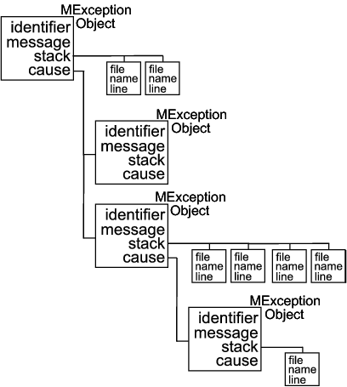
Exception Handling

Slide 31
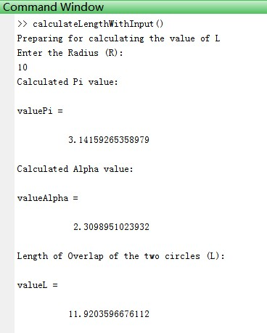
Final Output

Slide 32
Final Output

Slide 33
Final Output

Slide 34
Final Output
Variable name | Variable value
Radius (R) | 1 | 5 | 10 | 20 | 50 | 100 | 200 | 500 | 1000
Length (L) | 1.1920 | 5.9601 | 11.9203 | 23.8407 | 59.6017 | 119.2035 | 238.4071 | 596.0179 | 1192.0359

Slide 35
Experience
Code Reviews
Mattias Karlsson
YOU SHOULD DO CODE REViEWS.
Why? Because they increase code quality
and reduce defect rate .
But not necessarily for the reasons you might think.

Slide 36
Experience
Instead of simply correcting mistakes in code, the purpose of code reviews should be to share knowledge and establish common coding guidelines. Sharing your code with other programmers enables collective code ownership.
Let a random team member walk through the code with the rest of the team.
Instead of looking for errors, you should review the code by trying to learn and understand it.

Slide 38
C++
Presenter: Shivangi Rathore

Slide 40
JavaScript
Presenter: Aravindan Balasubramanian

Slide 42
PHP
Presenter: Romil Bandi

Slide 44
Ruby
Presenter: Qing Sun

Slide 46
Python
Presenter: Safan Maredia

Slide 48
CONCLUSION
Presenter: ?????

