Slide 1
RRRR3 Intro to Rstudio + Knitr
BSR Reproducible Research Journal Club
Jessica Minnier
August 10, 2016

Slide 2
RRRR3. Getting Started with R, Rstudio, and knitr
3.1 – Using R: the Basics (questions?)
3.2 – Using Rstudio
Install Rstudio and R

Slide 3
Panes in Rstudio
Console
Run code, see output, interact with R
environment/history
Objects in workspace
History of code
files/plots/packages/help
File directory
Plots (helpful to zoom)
Packages installed and loaded
Help
Viewer – interactive graphics
Source pane (when you open a file)
Tabs of script or markdown files i.e. .R, .Rmd, .txt, View(dataset)
Tutorial: http://stat545.com/block002_hello-r-workspace-wd-project.html

Slide 4
Rstudio projects
https://support.rstudio.com/hc/en-us/articles/200526207-Using-Projects
Create a project, make a file, exit, reopen
File management system, saves workspace
Add version control (git), create R package, templates for R Markdown documents, R presentations, etc
Tools → project options

Slide 5
Other Rstudio Tips (It’s the little things!)
see intro-rstudio.Rmd
Cmd-enter each line (automatically moves to next line!)
Run → entire document
Code auto completion
Code help (tab)
File path auto completion
Code snippets
Addins

Slide 6
Following slides are from: Reproducible Research
And
Version Control
http://sisbid.github.io/Module1/
https://docs.google.com/presentation/d/1F2tyP9nsHcY9DT5B6rSS95sIA9DEreDNt7s_HmbrINw/edit

Slide 7
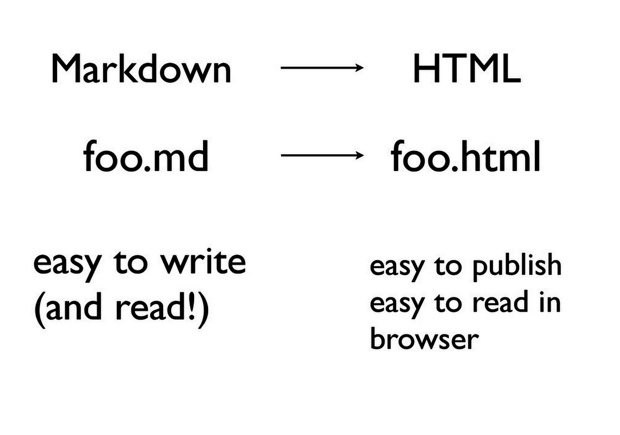
https://speakerdeck.com/jennybc/new-tools-and-workflows-for-data-analysis
http://sisbid.github.io/Module1/

Slide 8
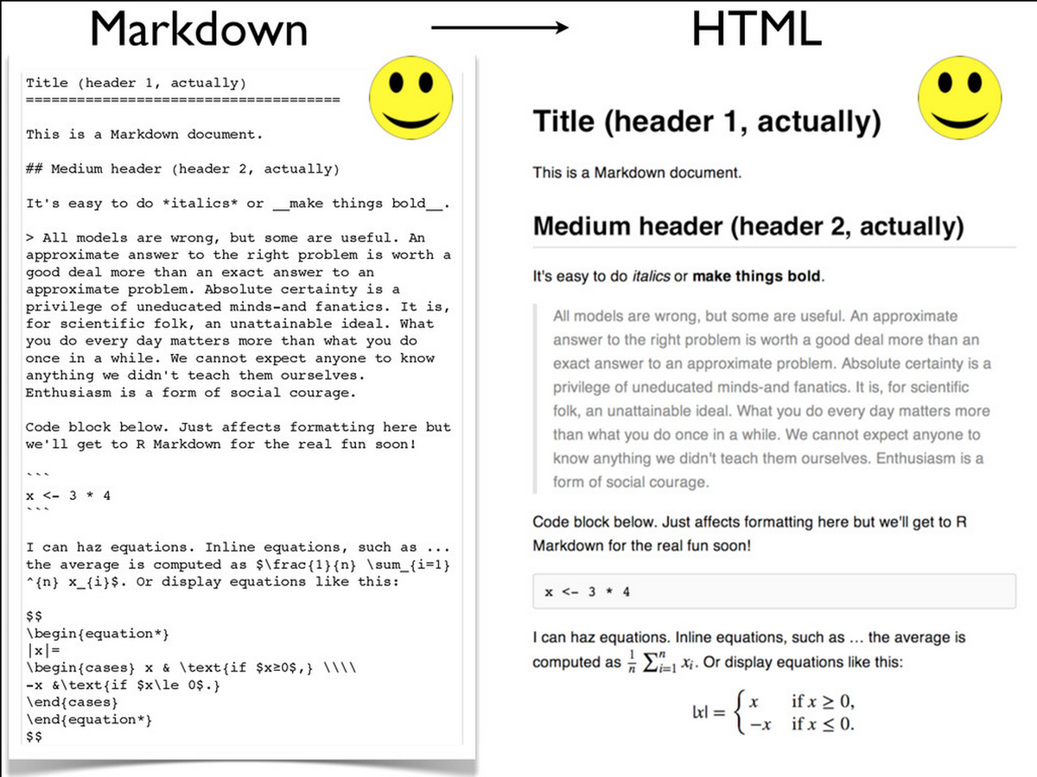
http://sisbid.github.io/Module1/
https://speakerdeck.com/jennybc/new-tools-and-workflows-for-data-analysis

Slide 9
Markdown
Go to intro-markdown.md
Best thing about html = no page breaks!

Slide 10
R Markdown
R Markdown = Markdown + R code
Developed by Rstudio
Use knitr to compile R Markdown code to Markdown which is rendered to html or pdf or doc

Slide 11
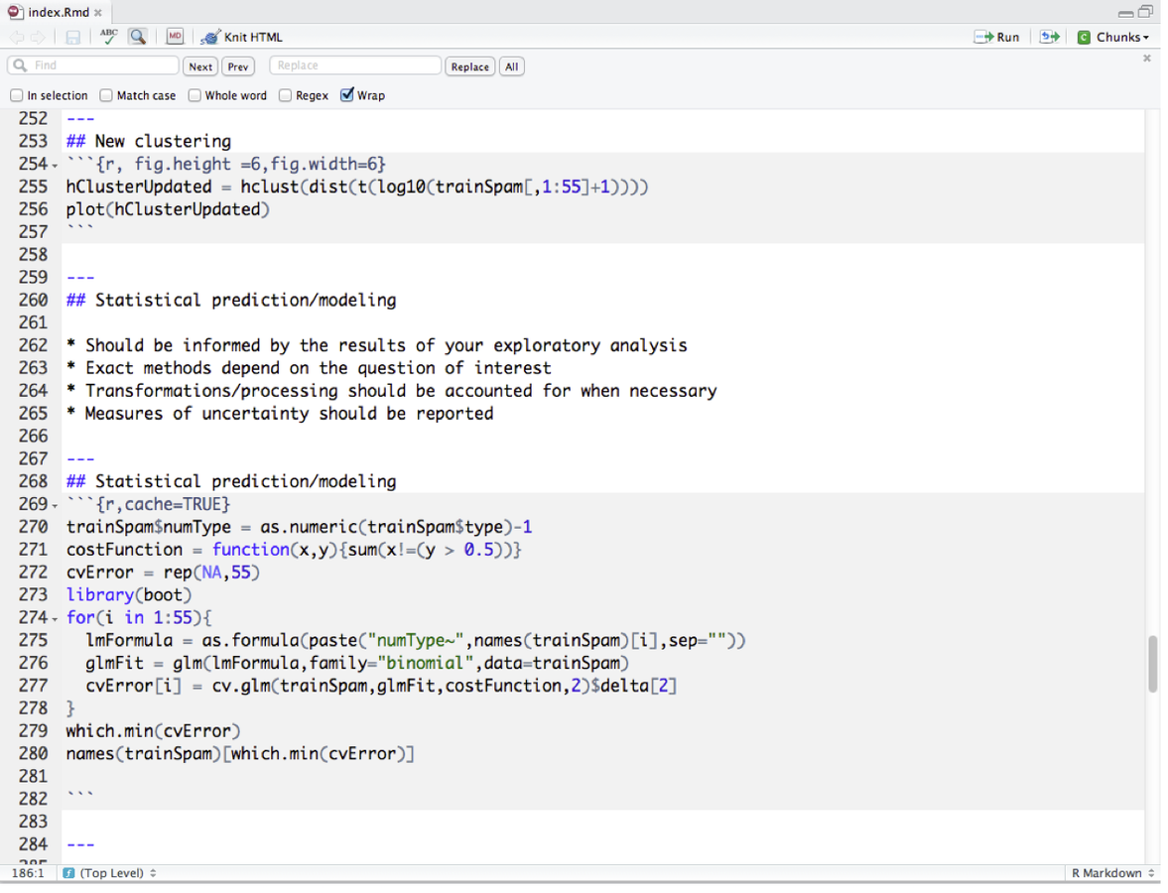
http://sisbid.github.io/Module1/
http://www.rstudio.com/ide/docs/authoring/using_markdown

Slide 12
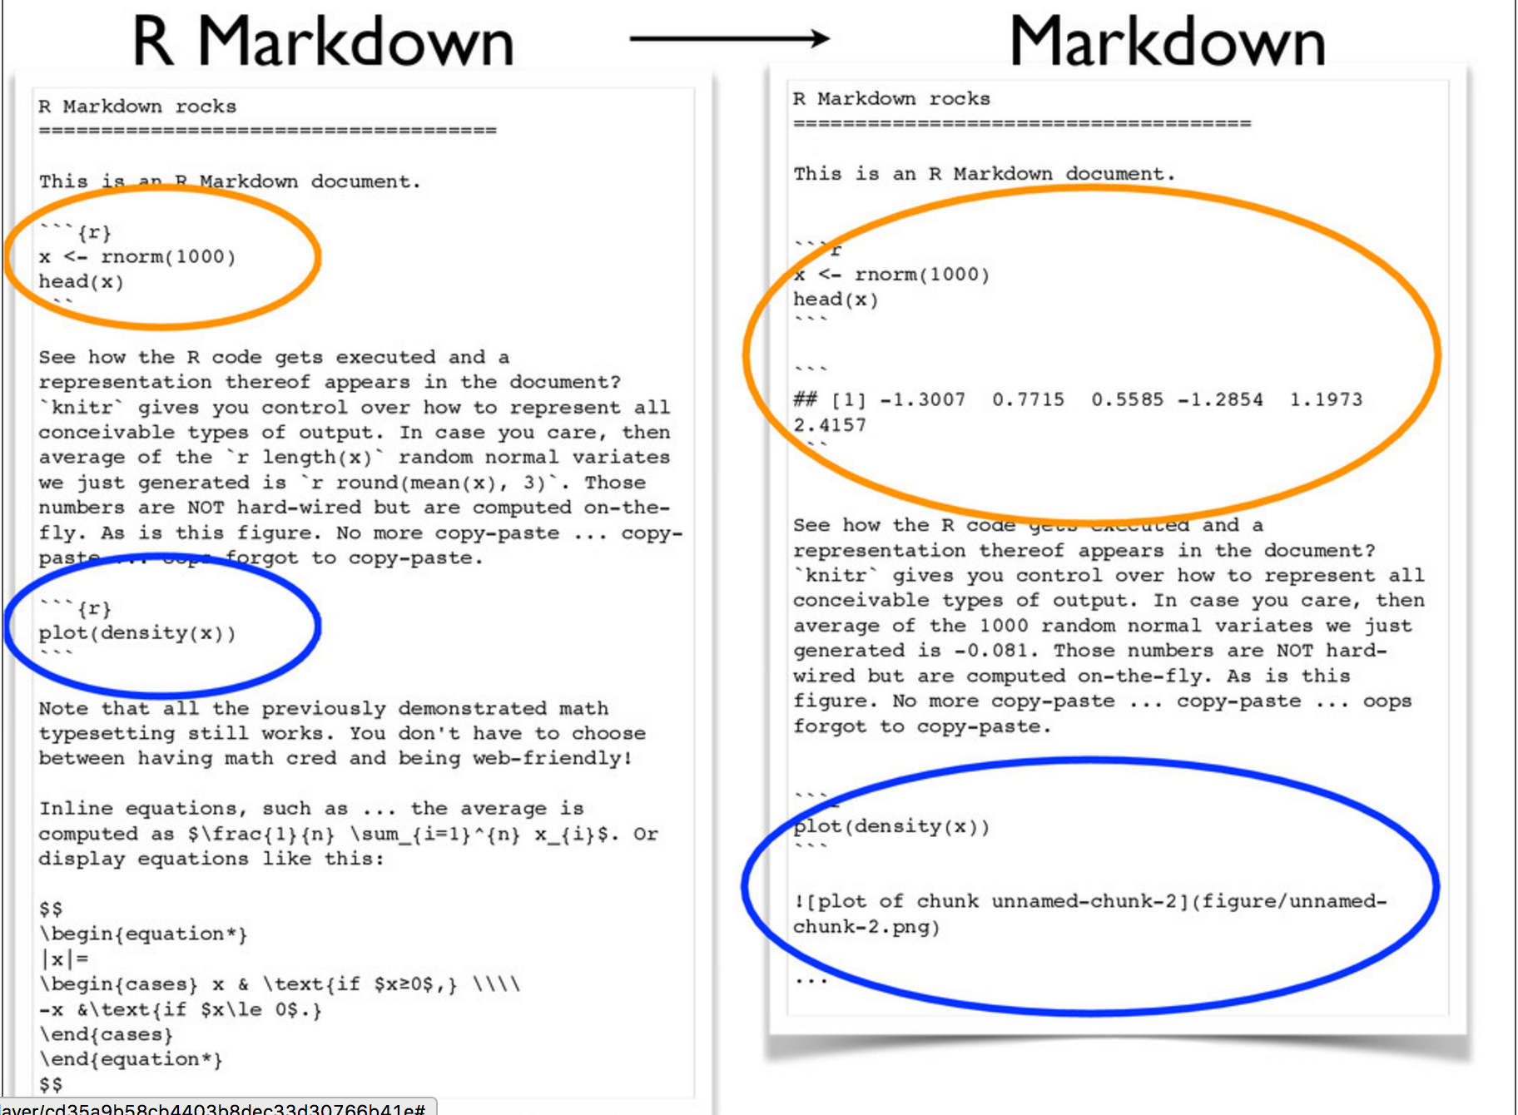
http://sisbid.github.io/Module1/
https://speakerdeck.com/jennybc/ubc-stat545-2015-cm001-intro-to-course

Slide 13
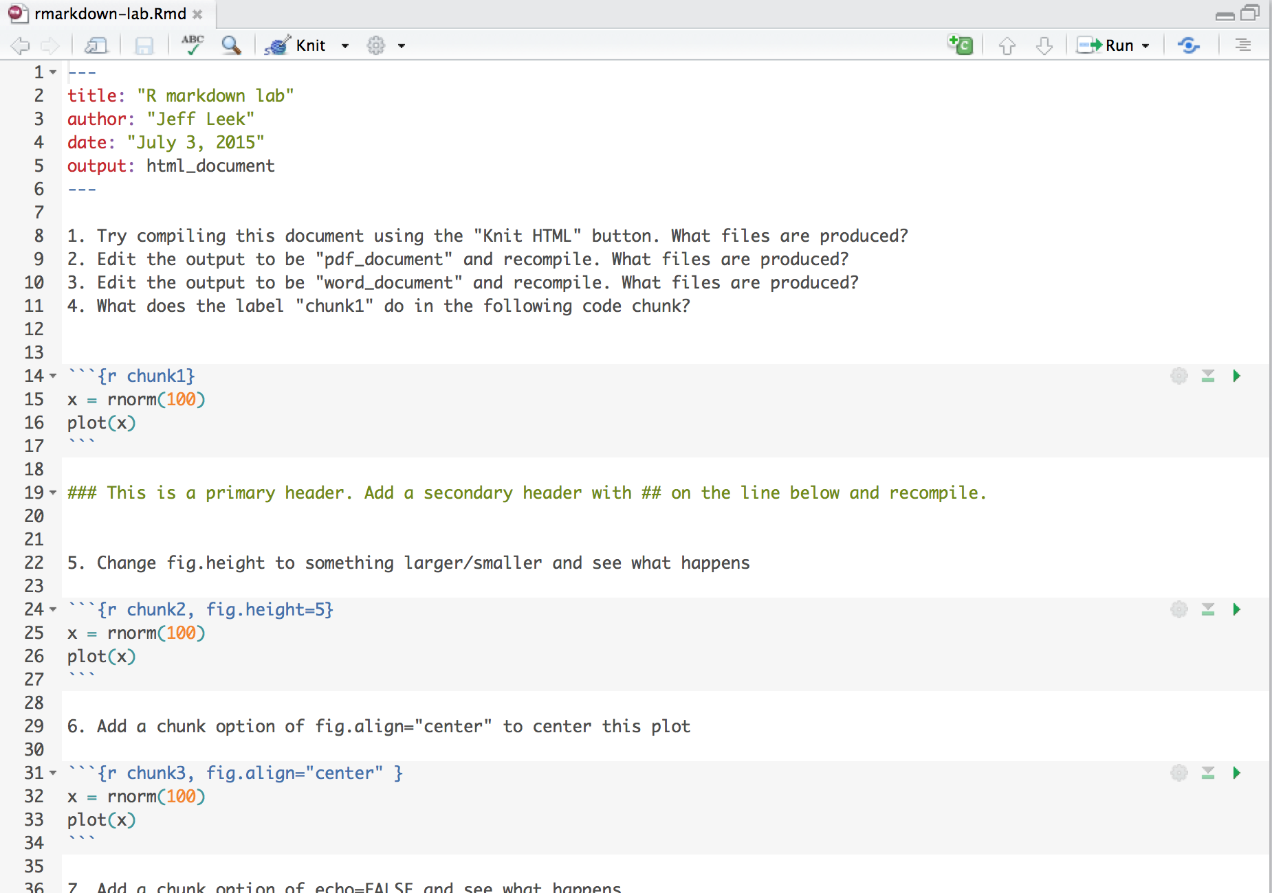
YAML
http://sisbid.github.io/Module1/

Slide 14
Code chunk
http://sisbid.github.io/Module1/

Slide 15
Chunk label
http://sisbid.github.io/Module1/

Slide 16
Other parameters
http://sisbid.github.io/Module1/

Slide 17
R Markdown
Go to intro-rmarkdown.Rmd
Also show kbroman-Rmarkdown.md
But what about Sweave?
http://yihui.name/knitr/demo/sweave/
Sweave used R + latex → pdf
Knitr uses R markdown → html, pdf, doc

Slide 18
R Markdown Reference Guide
http://www.rstudio.com/wp-content/uploads/2015/03/rmarkdown-reference.pdf
Cheatsheet
http://www.rstudio.com/wp-content/uploads/2016/03/rmarkdown-cheatsheet-2.0.pdf

Slide 19
Next Time
More knitr examples
YAML examples
Code chunk options
Knitr notebooks

