Slide 1
Term Deposit Subscription Prediction
By Lina Abdullahi

Slide 2
The Problem
A Portuguese bank is aiming to improve its customer acquisition marketing strategies for term deposits.
The bank needs to identify potential subscribers, to tailor its marketing efforts to increase subscription rates at lower cost/effort.
Notes:
As you know, a term deposit is a type of savings account offered by banks and financial institutions. The bank wants to efficiently increase term deposit subscription rates with minimum effort.

Slide 3
The solution
A classification model trained on existing data can assist the financial institution in optimizing its marketing efforts by targeting potential customers who are more likely to subscribe to term deposits, thereby increasing the efficiency of their campaigns and ultimately improving the conversion rate and subscription.
Notes:
The insights gained from the model can be used to drive targeted campaigns for reaching out to clients most likely to subscribe, optimizing marketing expenses and improving overall customer satisfaction.
The model will be able to predict how likely it is for a customer to subscribe to a term deposit.
This classification task also identifies the biggest predictors of term deposit subscription for the bank.

Slide 4
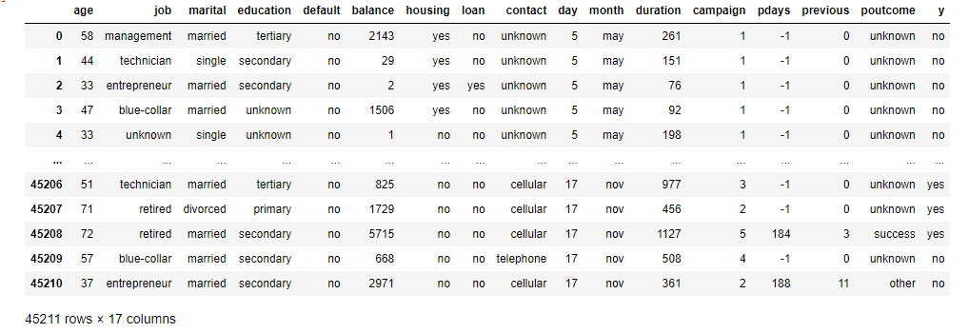
The Data
The raw dataset contains 45,211 records and 17 attributes.
Key Data source:
Moro,S., Rita,P., and Cortez,P.. (2012). Bank Marketing. UCI Machine Learning Repository. https://doi.org/10.24432/C5K306.
Link: (https://archive.ics.uci.edu/dataset/222/bank+marketing)
Notes:
The data contains: - Bank client data: age (numeric), job, marital status , education level, whether the client has credit in default, average yearly balance in euros, whether the client has housing loan, or other loans.
Data related to the last contact of the current campaign: contact communication type , last contact day of the month, last contact month of year and last contact duration in seconds.
other attributes: such as the number of contacts performed during this campaign, number of days that passed by after the client was last contacted from a previous campaign, number of contacts performed for the client before this campaign and outcome of the previous marketing campaign
Output variable (desired target) is subscription.

Slide 5
Data Wrangling
The dataset didn’t require much cleaning and initial observations were:
out-of-range data or outliers were identified in several variables.
Category imbalance was also observed in a few of the categorical variables.
Skewness and low variability - the distribution of some numerical variables is highly skewed and have clustered values towards the lower end.
Notes:
The raw data is more or less clean and doesn't have any duplicate values, however some features like ‘previous outcome’ have a high number of ‘unknown’ values which are essentially missing values.

Slide 6
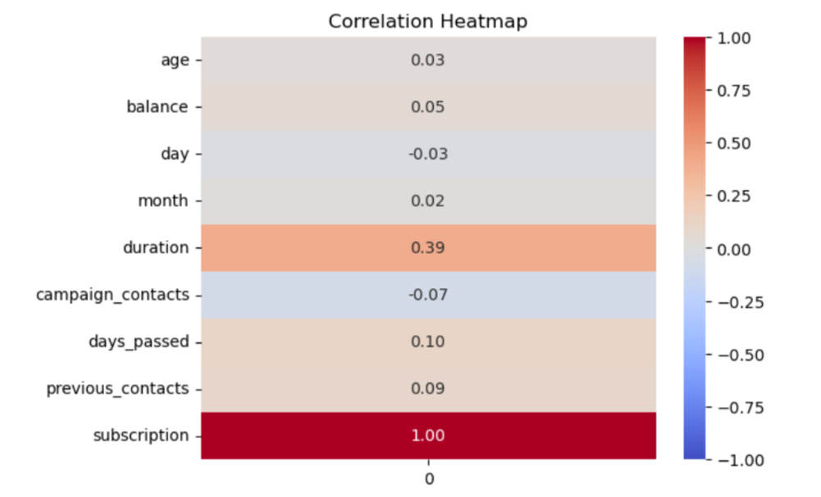
The Analysis
The initial data exploration revealed that there is no direct correlation among the independent variables.
‘Duration’ is the only numerical variable that shows a direct correlation with subscription.
Notes:
There is no linear relationship among the independent variables and the heatmap only revealed a link between ‘duration and subscription.
Further analysis showed more relationships between subscription and independent variables.

Slide 7
The Analysis
The variables that showed some connection with the subscription were:
Duration
Loans
Job
Balance
Age
Notes:
Longer call durations and a moderate number of contacts appear to be linked with a higher number of subscription rates.
Customers without existing loans (both housing or other) show a higher rate of subscription, aligning with intuitive expectations.
Those in management as well as retirees and students are associated with a higher number of subscriptions.
Generally, moderately high balances (lower positives) are associated with higher numbers of subscriptions.
It also appears that higher number of contacts made to clients results in adverse effects on subscription.
And age of the customer has a nonlinear relationship with subscription i.e. customers above the age of 60 and those below 30, are likely to be associated with a higher number of subscriptions.

Slide 8
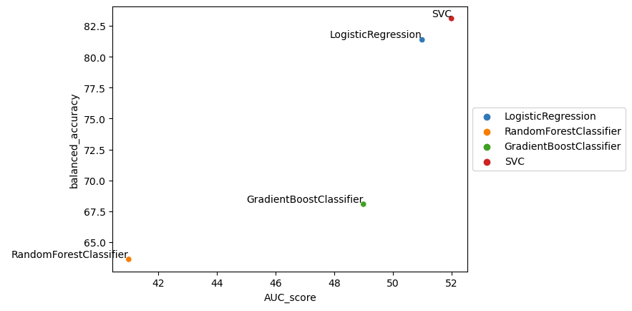
Machine Learning
Support Vector Classifier
Logistic Regression
Gradient Boosting Classifier
Random Forest Classifier
A model was trained using each one of the classifiers.
Model selection step resulted in Logistic Regression being selected due to its interpretable coefficients, faster performance and reasonable performance metrics.
Notes:
After fitting the 4 models, initially, the accuracy metric indicated that Gradient Boosting and Random Forest models performed better than others.
However, other evaluation metrics like balanced accuracy, confusion matrix, F1 score, and AUC and the high number of False Negatives in these models suggested otherwise.
The Logistic Regression and Support Vector Classifier (SVC) were identified as the better options for the imbalanced dataset due to their performance in handling the imbalance.

Slide 9
Model Training
Randomized Grid Search was used for hyperparameter tuning.
The best parameters for the Logistic regression model was:
class_weight set to 'balanced'
'warm_start' set to True,
'lbfgs' set as the 'solver',
100 maximum iterations and ,
'C' set to 1.0.
Notes:
Hyperparameter tuning did not significantly improve the model performance, the biggest improvement was achieved by setting class_weight to 'balanced'.

Slide 10
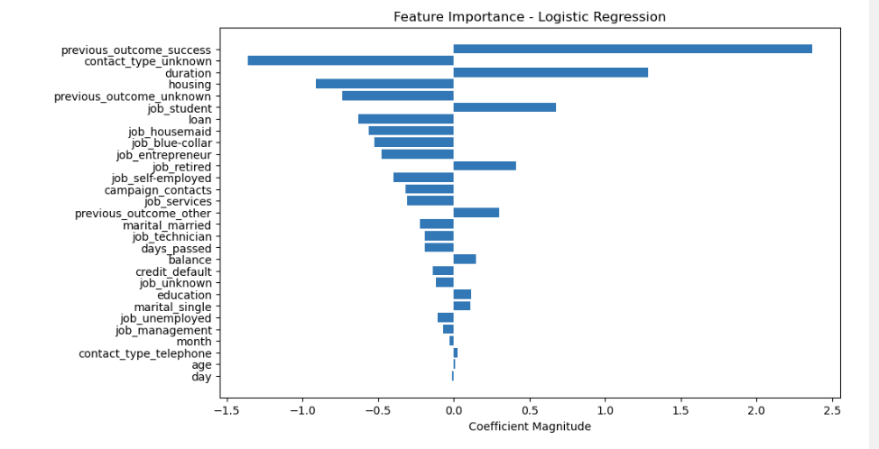
Results
Previous_outcome_success - had the biggest impact on subscription. - Those with 'previous_outcome success' have 10.67 times the odds of subscribing than those who had a different outcome
.
'duration' - An increase of 1 second in the phone call duration in the campaign calls multiplies the odds of subscribing to term deposits by 3.62.
'housing loan' - Those with 'housing loans' have 0.4 times the odds of subscribing than those who don’t.
Notes:
'contact_type_unknown' - was shown to have a significant negative impact on subscription - recalling that a very significant portion of the feature contact_type had the value 'unknown', this association could be considered incorrect.
The model might have incorrectly associated this feature's dominance with the target variable, and assume a strong relationship between them only due to the model's bias towards the majority class within this highly imbalanced feature.

Slide 11
Conclusion
In conclusion, previous campaign’s success is the biggest predictor of term deposit subscription followed by duration of campaign calls and housing loans.
Other features such as job types and balance also had an impact on subscription. Different job types had varied effects on subscription, aligning with the exploratory data analysis results, specifically being a student or retired increased subscription tendency, while being a housemaid, blue-collar worker, or entrepreneur decreased it.
Month and Day of contact, had minimal impact on subscription according to the model.

Slide 12
Future improvements
Further analysis or feature engineering may enhance the model's performance, especially in handling the imbalanced nature of the data and improving predictive capabilities.
To mitigate the issue of having incorrect coefficients of contact_type_unknown, we could consider removing this feature from the training set before fitting the model.
The threshold for prediction can be adjusted to allow the model to capture more of or less of the positive instances
Notes:
The decision to adjust this threshold depends on the bank's Subscription goals for future campaigns.
Lowering the threshold allow to have more positive instances, potentially reducing missed positive cases which could enable the bank to maximize efforts in targeting more customers leading to a higher potential subscription. Similarly,increasing it can make the model more conservative in classifying instances as positive, allowing the bank to use less resources in the campaign and focus on a smaller number of customers that are highly likely to subscribe.

Slide 13
Questions?

