Slide 1
Handwritten Digit Recognition
A Comparative Study of Machine Learning Algorithms
Prepared by:
Rawaa Hammad, Lina Abu Farha, Khalid Omari.
Instructor:
Dr. Adnan Yahya
01

Slide 2
Handwritten Digit Recognition
A Comparative Study of Machine Learning Algorithms
Abstract
This project focuses on building a Handwritten Digit Recognition System capable of recognizing numbers written in both Arabic and English. The system uses three machine learning models: Decision Tree, K-Nearest Neighbors (KNN), and Convolutional Neural Networks (CNN). A graphical user interface (GUI) was implemented to provide a user-friendly way to upload images and get predictions.
01

Slide 3
Datasets
Arabic Digits Dataset
The dataset was obtained from Kaggle. consists of 88,000 images, divided as follows:
Training set: 60,000 images
Test set: 28,000 images
English Digits Dataset
The dataset was preloaded in Python using TensorFlow/Keras.
Training set: 60,000 images
Test set: 10,000 images
01

Slide 4

Implementation Details
We used Python to implement the algorithms.
- Python is ideal for AI due to its simplicity and vast libraries, such as TensorFlow.
- It allows the creation of a user-friendly interface.
01

Slide 5
Algorithms Used
z
Algorithms Used
1
K-Nearest Neighbors (KNN)
Convolutional Neural
Network (CNN)
Decision Tree
2
Classifies digits based on pixel values, splitting the dataset into branches.
Classifies a digit based on the majority class of its nearest neighbors.
deep learning algorithm designed to recognize patterns in images.
3
01

Slide 6
Model Training and Evaluation
We evaluated and compared the performance of the models, and the following metrics were used:
- Accuracy: measures the percentage of correct predictions out of the total predictions.
- Training Time: the time required to train each model.
01

Slide 7
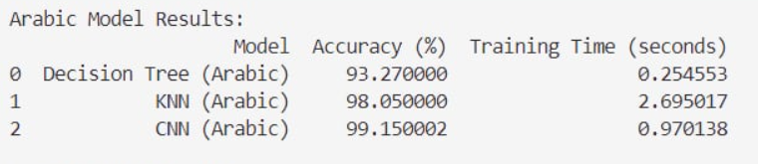
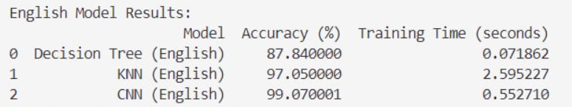
Model Training and Evaluation
- Arabic model results:
- English model results:
01

Slide 8
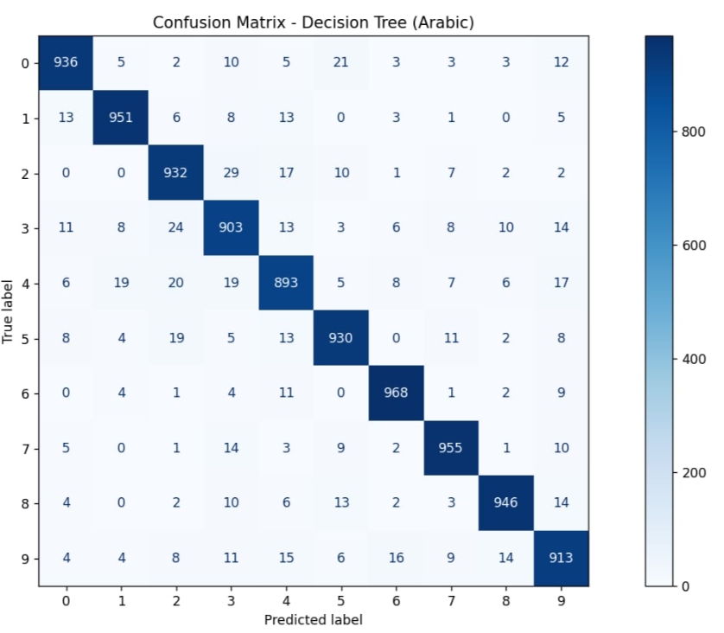
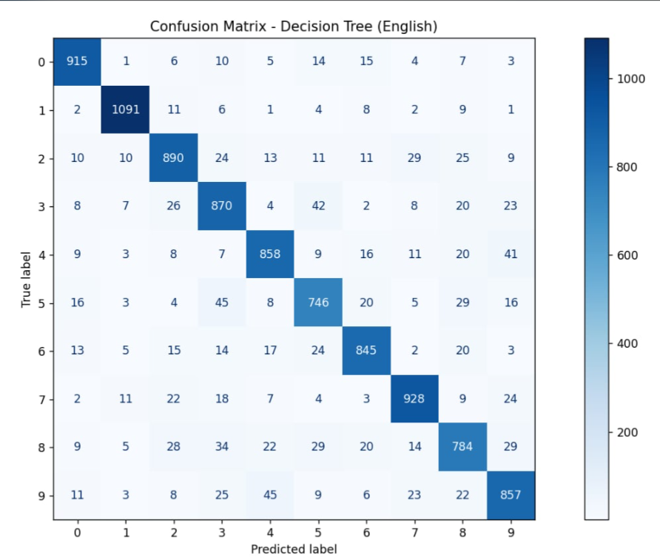
Model Training and Evaluation
Decision Tree
01

Slide 9
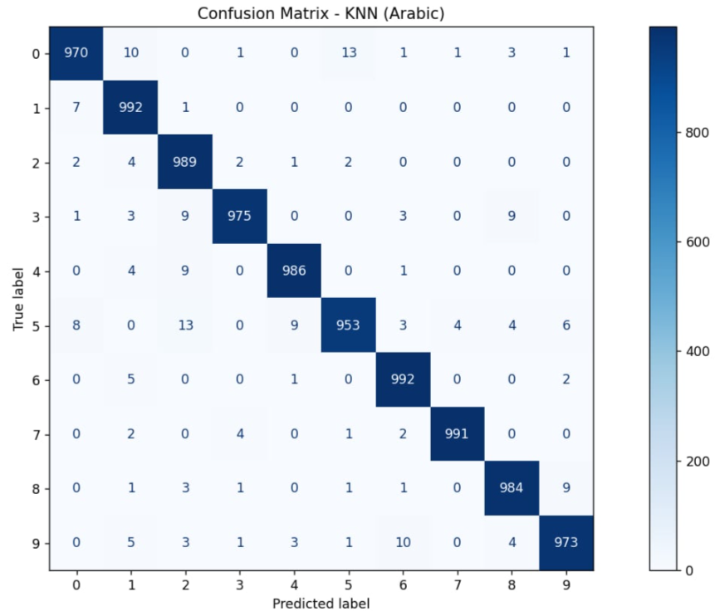
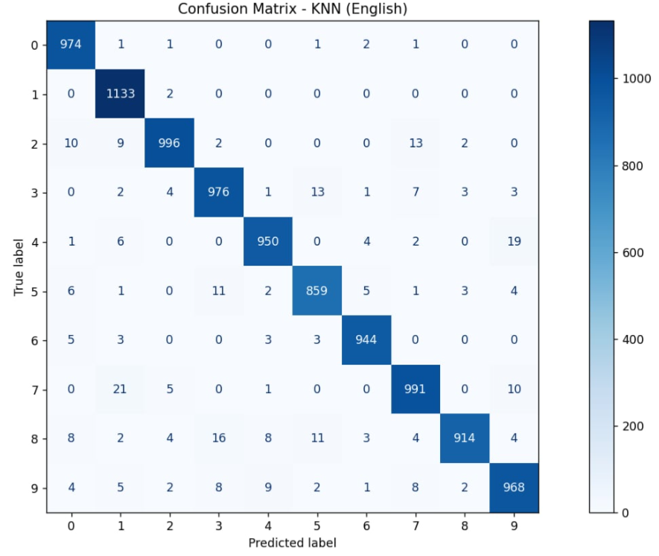
Model Training and Evaluation
K-Nearest Neighbors (KNN)
01

Slide 10
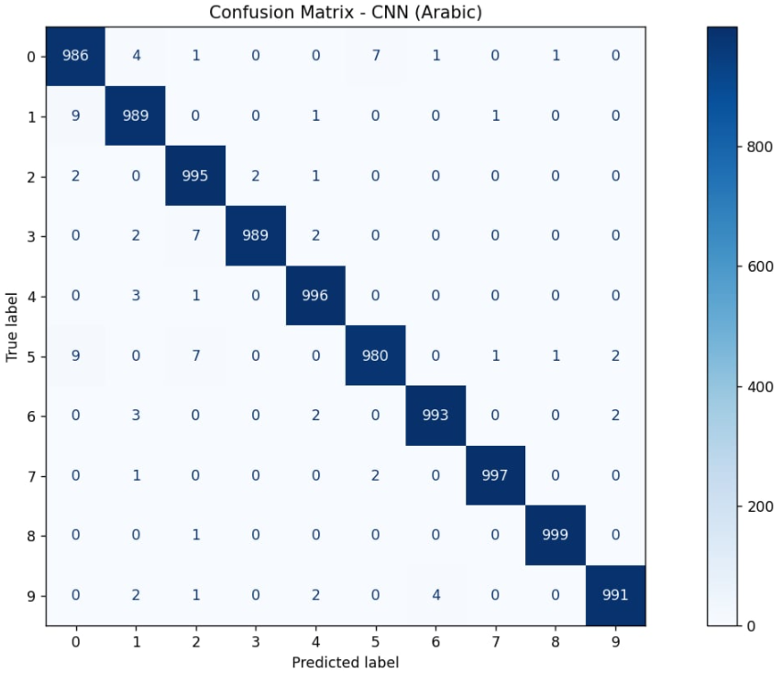
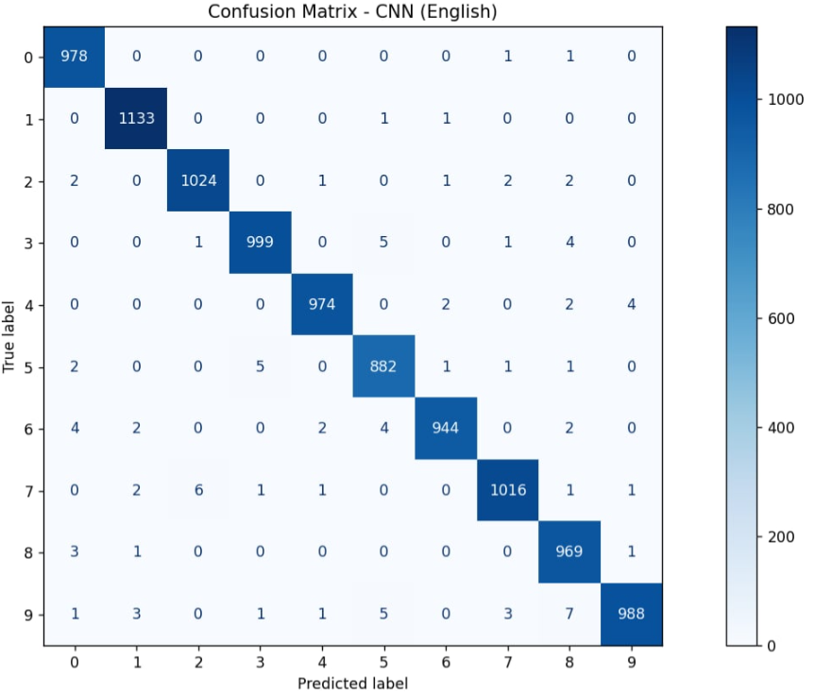
Model Training and Evaluation
Convolutional Neural Network (CNN)
01

Slide 11
Model Training and Evaluation
Analysis and Comparison
Best Performing Algorithm
Second Best
Third
Convolutional Neural Networks (CNN)
Achieved the highest accuracy, precision.
Demonstrated superior ability to learn intricate patterns in handwritten digits.
Robust performance across both Arabic and English datasets.
K-Nearest Neighbors (KNN)
Showed competitive results, especially in the Arabic dataset.
Slightly lagged behind CNN in all metrics.
Decision Tree
Efficient but demonstrated the lowest performance overall.
Struggled particularly with the English dataset.
01

Slide 12
The Final Results
The Final Results
Best choice: Convolutional Neural Networks (CNN)
Worst choice: Decision Tree
01

Slide 13
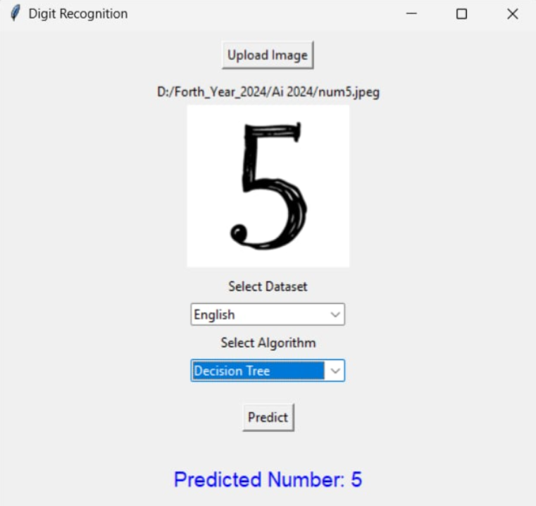
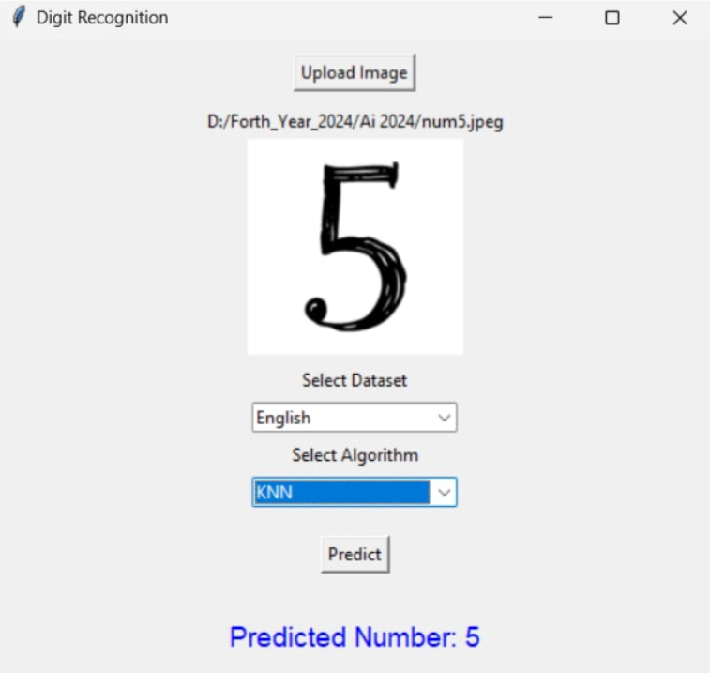
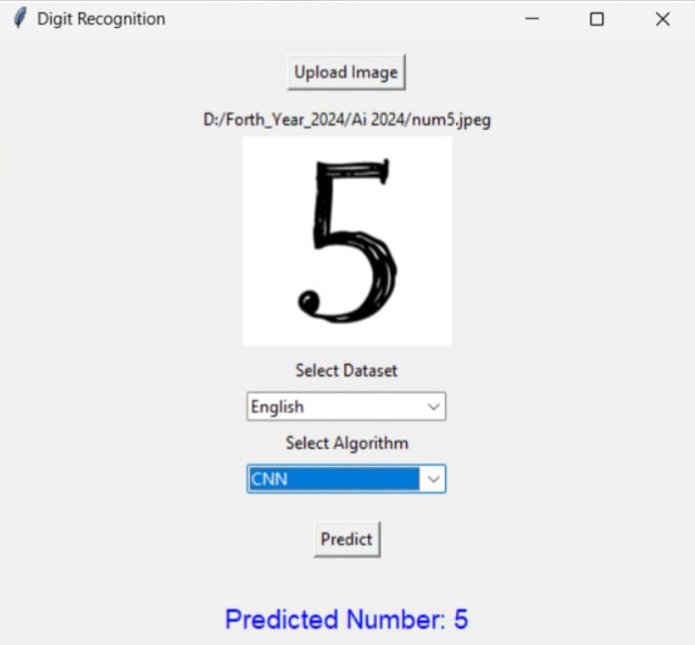
01

Slide 14
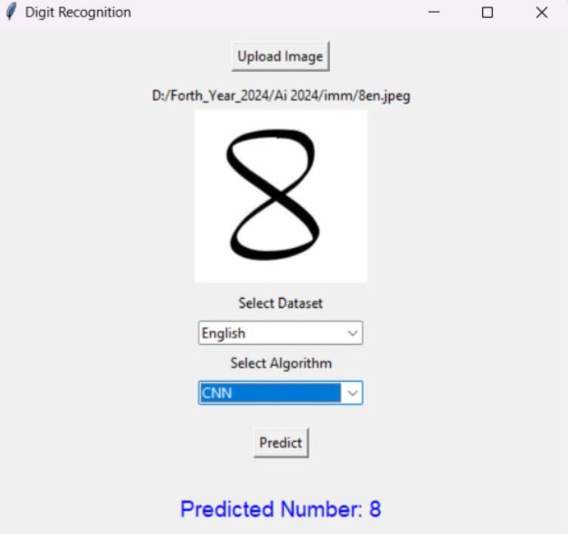
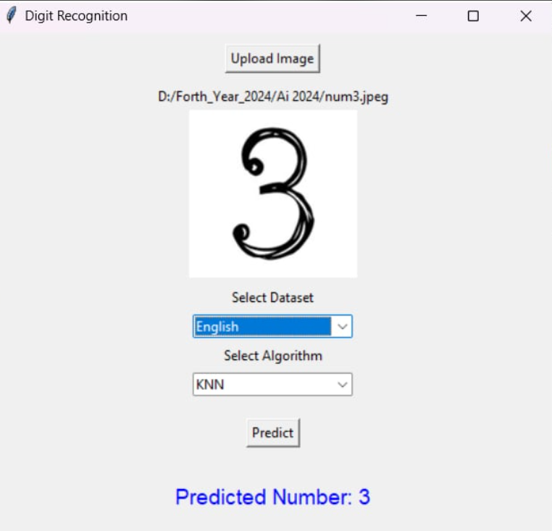
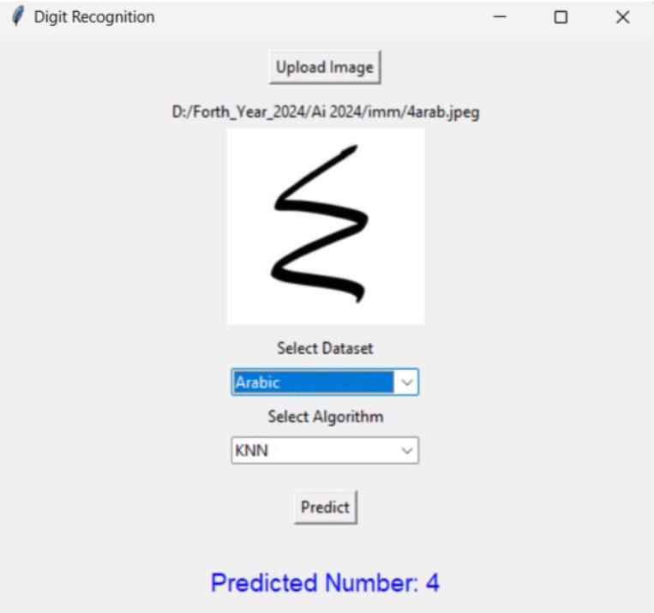
01

Slide 15
The Conclusion:
Conclusion:
The project successfully demonstrated the effectiveness of machine learning algorithms for handwritten digit recognition in both Arabic and English languages.
The CNN model consistently achieved the highest accuracy, showcasing its ability to learn complex patterns in images.
The user-friendly GUI enables real-time predictions, making the system practical for various applications.
01

