Slide 1

Interpretable Asymmetry Modeling for Post-Stroke Hemiparesis:
Robust Laterality Prediction using Minimal Kinematic Features
Lina Falek
Dr Wanxin CHEN
Pr Samer MOHAMMED
Pr Reda BELAICHE
LISSI Laboratory, UPEC, Vitry-sur-Seine
March 5th, 2026
Notes:
today I will present my work on Interpretable Asymmetry Modeling for Post-Stroke Hemiparesis: Laterality Prediction using Minimal Kinematic Features. The goal is to automatically detect and quantify the asymmetric walking patterns caused by hemiparesis, and to identify the affected side — using only body-worn inertial sensors

Slide 2

Table of contents
Context and Motivation
Data Collection
Signal Preprocessing & Swing Detection
Subject Calibration & Feature Extraction
Classification
Conclusion
Notes:
Here is the plan for this presentation. I will begin with the clinical context
and motivation, then walk you through our complete processing pipeline: data
collection, signal preprocessing, swing phase detection, and subject-specific
calibration. I will then cover feature extraction and the AI-LR representation
we designed, followed by the classification framework and results. I will close
with a discussion and perspectives for future work.

Slide 3

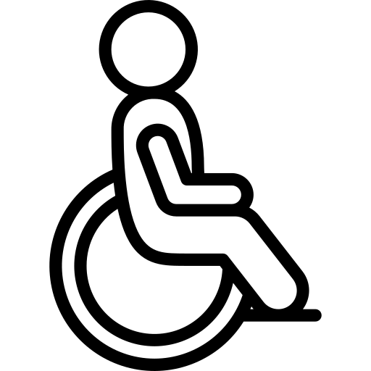


Context & Motivation
Stroke is the Leading Cause of Lifelong Disability
15 Million
Suffer a stroke annually worldwide
5Million
Are left permanently disabled each year
>1Million
Individuals in France living with a history of stroke
49.1%
Of hospitalized patients are affected bg hemiplegia
Notes:
Stroke is the leading cause of lifelong disability worldwide. Every year,
15 million people suffer a stroke globally, and of those, 5 million are left
with permanent disability. In France alone, more than 1 million individuals live
with a history of stroke. A key consequence is hemiparesis — a one-sided motor
impairment — which affects nearly half of all hospitalized stroke patients:
49.1%.
Hemiparesis severely disrupts walking. It creates asymmetric gait patterns where
the affected leg moves very differently from the non-paretic leg — and these
asymmetries are clinically meaningful markers of both severity and recovery.
Our work proposes an end-to-end pipeline using low-cost wearable
.inertial sensors to automatically characterize these asymmetries and predict
which side of the body is affected.

Slide 4
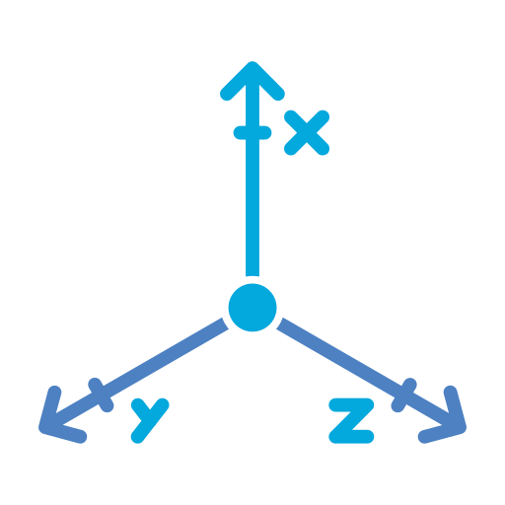

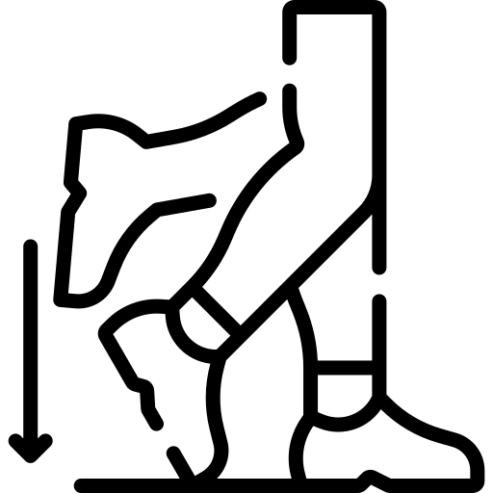

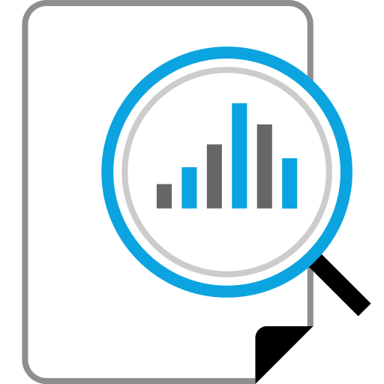

End-to-End Pipeline
From raw IMU signals to hemiparetic-side prediction
Data Collection
Signal Processing
SwingDetection
Subject Calibration
Feature Extraction
Classification
Notes:
Before diving into each component, let me give you an overview of the full
pipeline — from raw IMU signals all the way to predicting the hemiparetic side.
[BEAT 1 — "Data Collection" box highlighted]
The first step is Data Collection. equipped patients with wearable IMU sensors
and had them walk through standardized trials.
[BEAT 2 — "Signal Processing" box highlighted]
The raw signals then go through Signal Processing: we apply low-pass filtering
to remove noise, and a frame calibration to align every sensor to a common
anatomical reference.
[BEAT 3 — "Swing Detection" box highlighted]
Next, Swing Detection. We need to automatically segment the continuous signal
into individual strides.
[BEAT 4 — "Subject Calibration" box highlighted]
Because hemiparetic gait is highly individual, the swing detector requires
subject-specific parameters. The Subject Calibration step performs
optimization to tune those parameters for each patient.
[BEAT 5 — "Feature Extraction" box highlighted]
From the segmented strides, we perform Feature Extraction. We compute joint
angles and spatiotemporal metrics, and encode left-right asymmetry
[BEAT 6 — "Classification" box highlighted]
Finally, Classification. Those 18 features are fed into a machine learning
classifier to predict which side is affected.
Each of these steps will now be explained in detail.

Slide 5
Data Collection
Demographic
30
26
18
8
hemiparetic patients
Patients successfully processed
Left paretic (69%)
Right paretic (31%)
Variable | Total (n=26) | Left (n=18) | Right (n=8)
Age | 54.7 (12.6) | 55.9 (11.6) | 55.9 (11.6)
Gender (M/F) | 17/9 | 13/5 | 4/4
Weight (kg) | 80.0 (13.2) | 83.0 (12.0) | 73.3 (14.1)
Height (cm) | 165.8 (6.6) | 166.7 (7.0) | 163.9 (5.7)
MoCA score | 26.7 (2.3) | 26.7 (2.3) | 26.6 (2.4)
Stroke type (ischemic/hemorrhagic) | 17/9 | 13/5 | 4/4
Notes:
Our dataset includes 30 post-stroke hemiparetic patients. Of these, 26 were
successfully processed by the pipeline — 4 had to be excluded due to missing
sensor index files. Among the 26, 18 have left-side paresis and 8 have
right-side paresis.
The demographic table shows that the two groups are well matched: average age
around 55 years, similar weight, height, and cognitive score as measured by the
MoCA — around 26.7 out of 30. The distribution of ischemic versus hemorrhagic
stroke is also comparable. The class imbalance — 18 left versus 8 right — is
handled explicitly in the classification step through balanced class weighting.

Slide 6
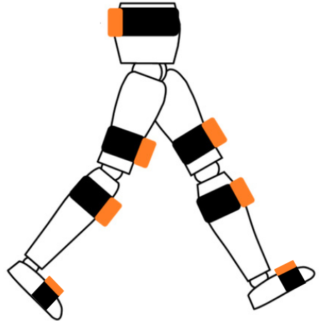
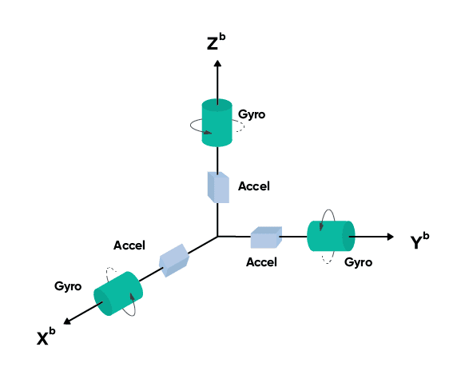
Data Collection
Setup and Protocol
Barefoot Fast
Barefoot Pref
Shoe Fast
Shoe Pref
Sensor Setup
7 IMU sensors (Xsens-type)
Sensors record
Acceleration
gyroscope
magnetometer
Euler angles
Protocol
4 walking trials per patient
Notes:
Each patient was equipped with 7 IMU sensors of the Xsens type, placed on the
waist, both thighs, both shanks, and both feet. Each sensor simultaneously
records 3-axis acceleration, gyroscope, magnetometer, and Euler angles.
The protocol consisted of 4 walking trials per patient: barefoot at fast pace,
barefoot at preferred pace, with shoes at fast pace, and with shoes at preferred
pace.

Slide 7
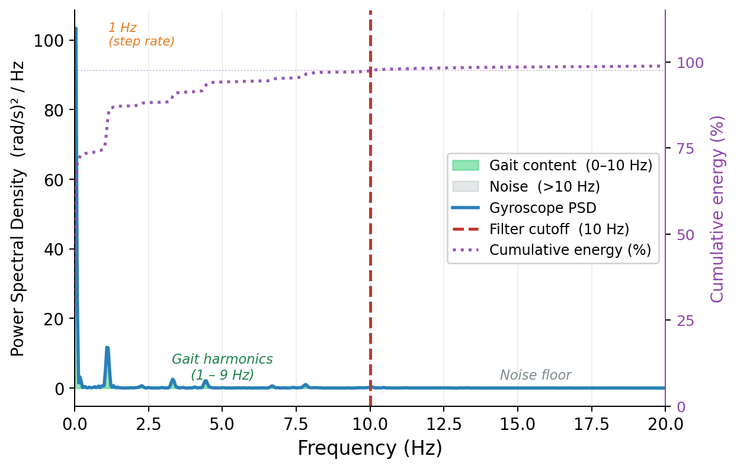
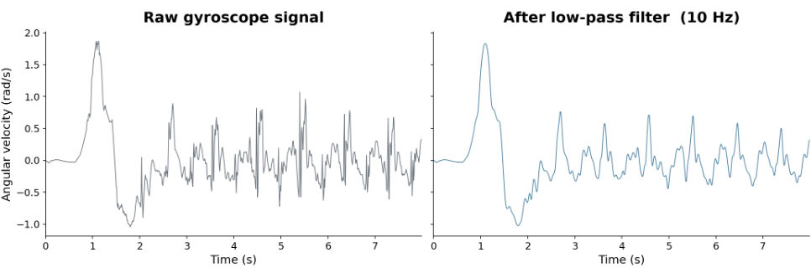
Signal Preprocessing
Low-pass filtering
Power Spectral Density of knee gyroscope
Filtered angular velocity signal (10 Hz low-pass)
Notes:
Before any analysis, the raw signals must be cleaned. The figure on the left
shows the power spectral density of the knee gyroscope signal. You can clearly
see that all gait-relevant content — the step rate and its harmonics — falls
between 1 and 9 Hz. Everything above 10 Hz is noise floor.
We therefore apply a 10 Hz low-pass Butterworth filter. The result is shown on
the right: a clean, smooth angular velocity signal that faithfully captures the
rhythmic pattern of gait cycles while removing measurement noise entirely.

Slide 8
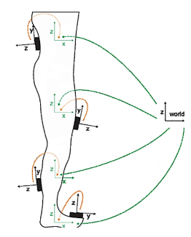
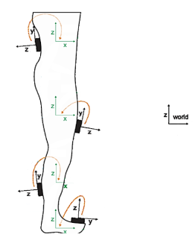
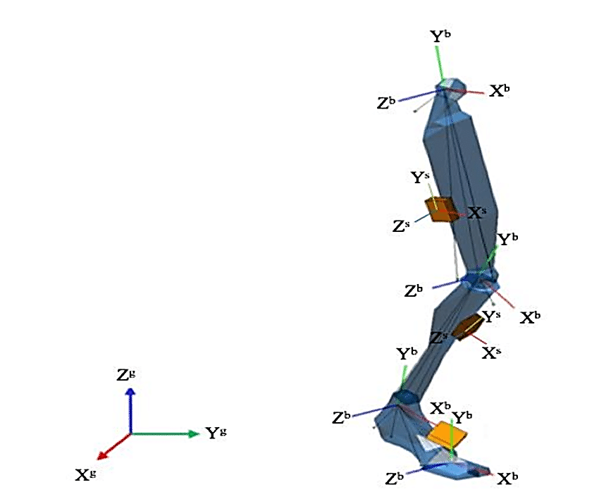
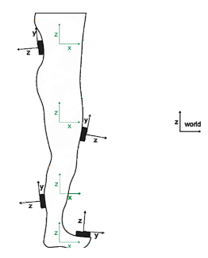
Signal Preprocessing
Calibration
Sensor → body
frame
Sensor Frame
Body Frame
Global Frame
Body → global
frame
Notes:
After filtering, we address a second issue: each sensor has its own arbitrary
local coordinate frame — the sensor frame — which depends on how it was
physically attached to the patient. For any meaningful cross-patient or
cross-segment comparison, all sensors must speak the same anatomical language.
We perform a two-step calibration. First, we transform each sensor's output from
its local sensor frame into the body segment frame it belongs to. Then, we
further align that body frame to the global anatomical frame. This ensures that,
for example, the knee flexion angle has a consistent meaning across all patients,
regardless of how the sensor was physically mounted.

Slide 9
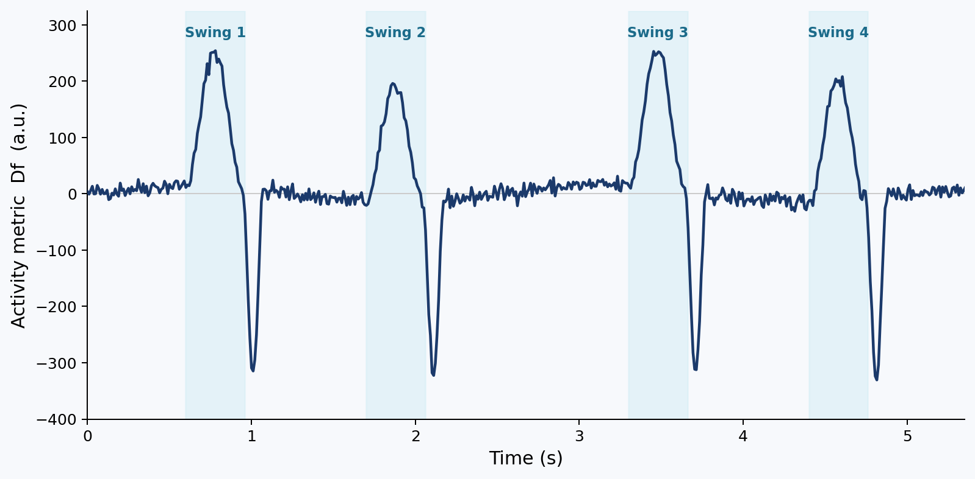
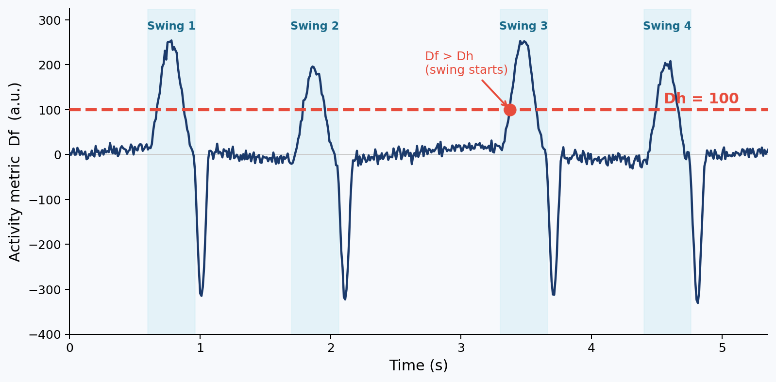
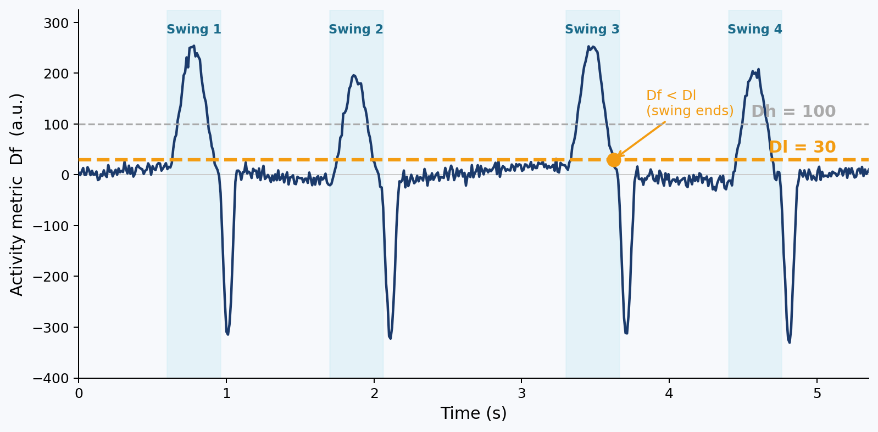
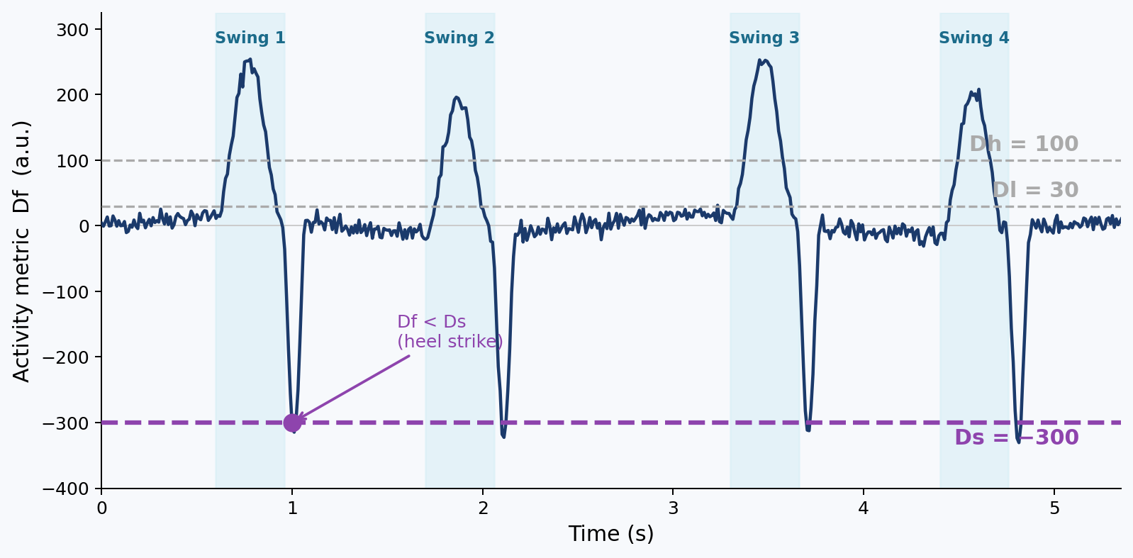
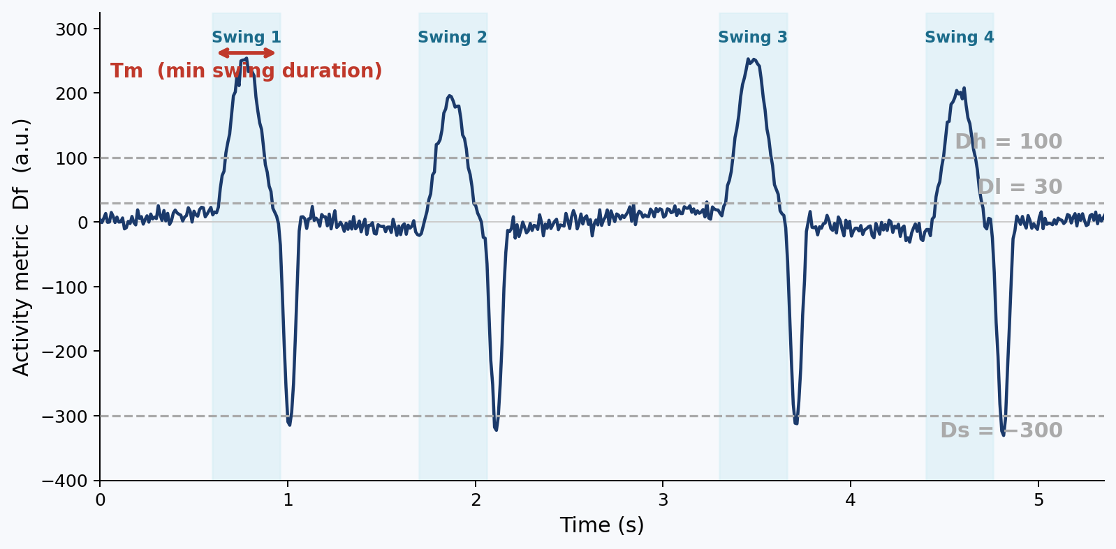
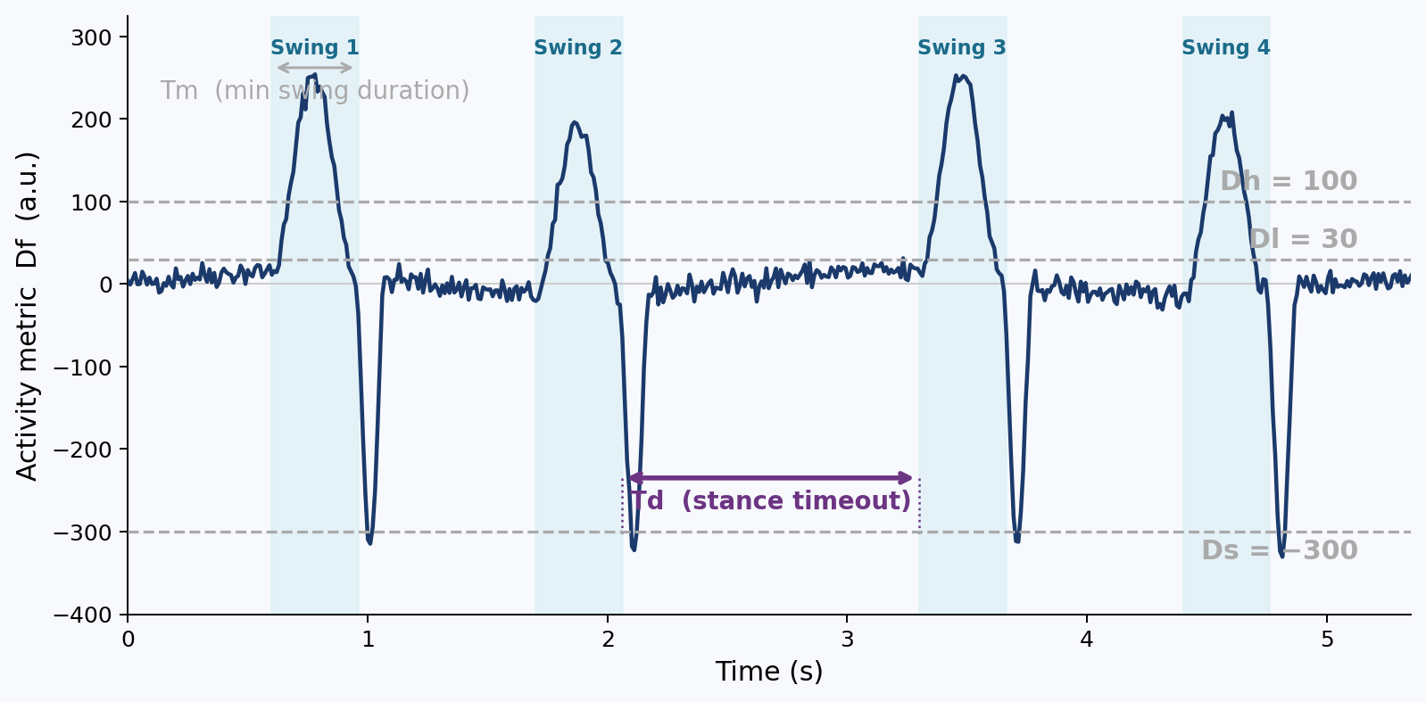
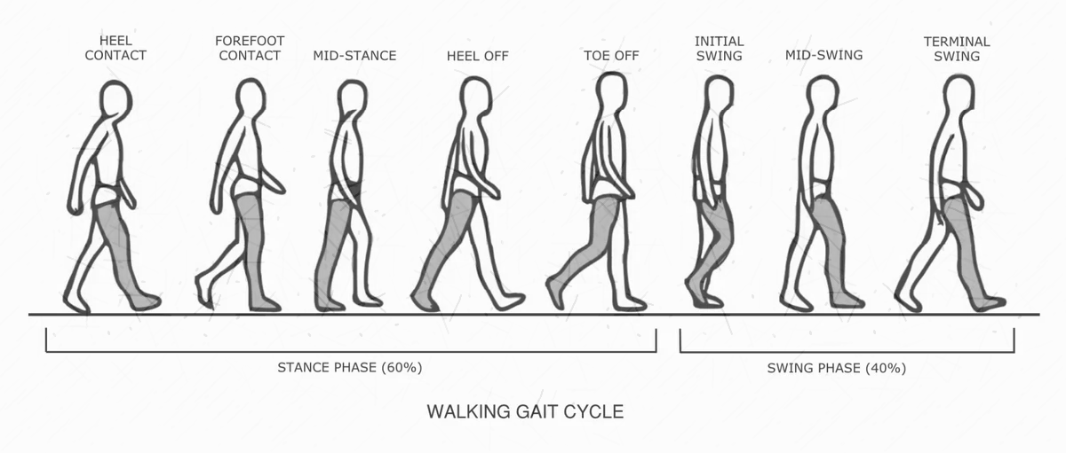
Swing Phase Detection
Finite state machine on gravity-compensated foot acceleration
Dh : high threshold: D must exceed this to start a swing
Dl : low threshold: D must drop below this to end a swing
Ds : negative threshold: D must also dip below Ds
Tm : minimum pulse duration (samples) to count as a swing
Td : minimum gap between consecutive swing events
Notes:
Gait analysis requires segmenting the continuous signal into individual strides.
To do this, we designed a finite state machine — FSM — that operates on the
gravity-compensated foot acceleration, which we call the activity metric Df.
The FSM is controlled by 5 parameters:
- Dh, the high threshold: the signal must exceed Dh to trigger the start of a
swing phase.
- Dl, the low threshold: it must then drop below Dl to confirm the swing has
ended.
- Ds, a negative threshold: the signal must also dip below Ds to confirm the
push-off phase of the previous step.
- Tm, the minimum swing duration in samples, to reject short spurious peaks.
- And Td, the minimum gap between two consecutive swings.

Slide 10
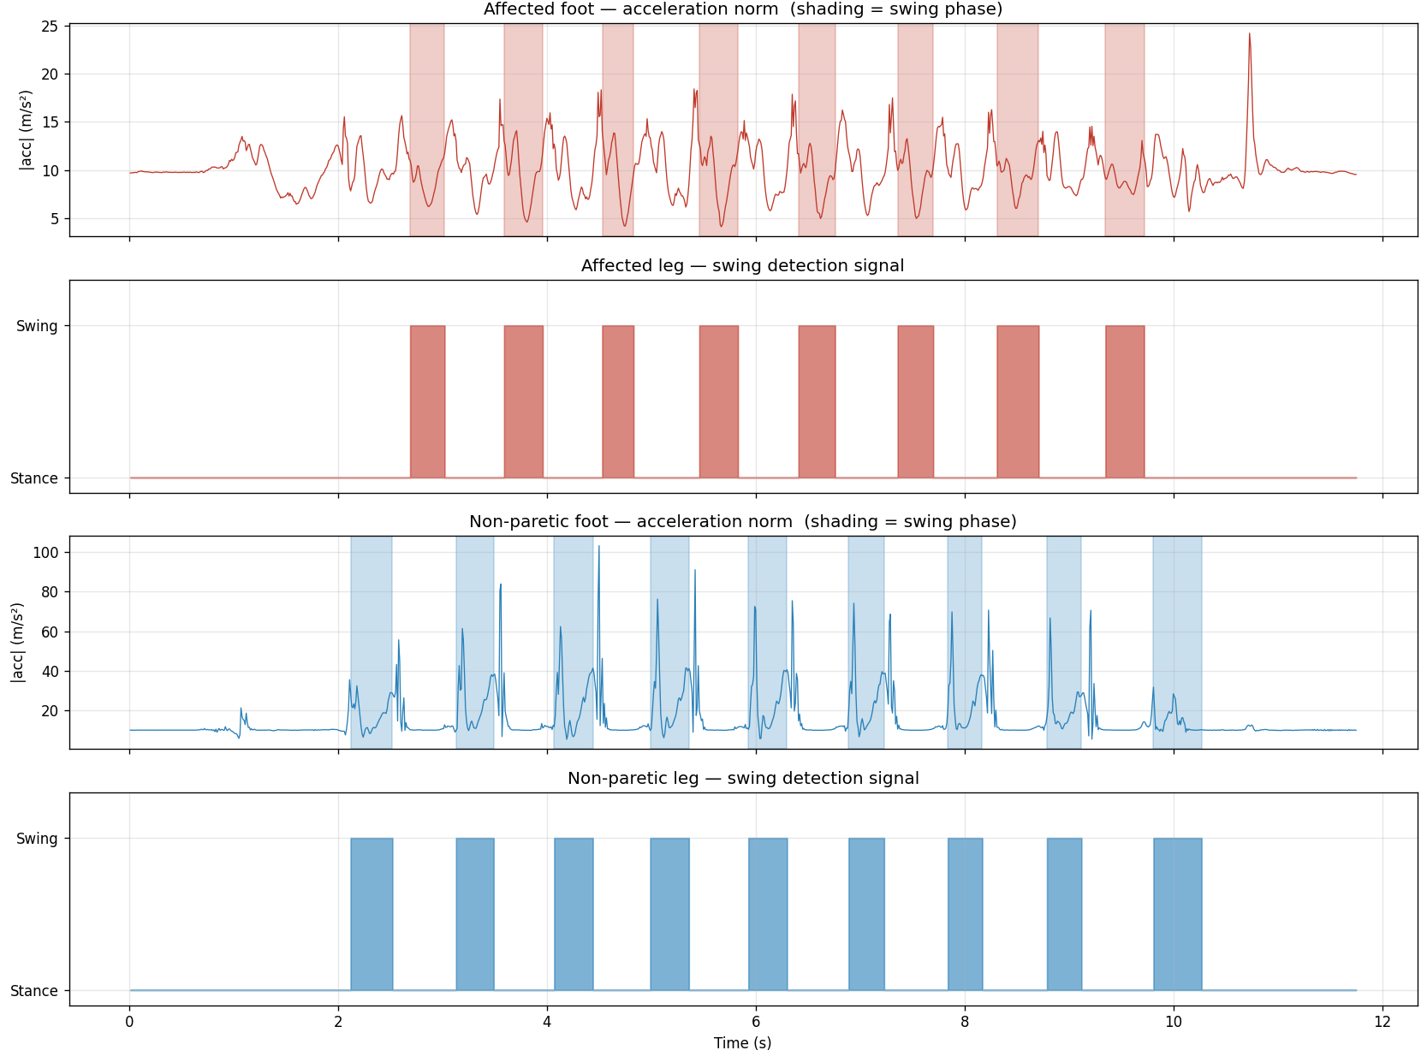
Swing Phase Detection
Finite state machine on gravity-compensated foot acceleration
Patient 17-MA - Barefoot preferred walk:
affected (left, red) vs. non-paretic (right, blue)
Notes:
Here you can see the FSM applied to real data — patient 17-MA, during a barefoot
preferred-speed walk.
On the left in red: the affected foot acceleration norm, with shaded regions
marking the detected swing phases. On the right in blue: the non-paretic foot.
Even visually, the asymmetry is striking. The affected foot shows lower, more
irregular peaks — consistent with drop foot and reduced clearance, which are
hallmarks of hemiparesis. The binary swing/stance signal below each plot
confirms that the FSM correctly detects and segments both legs independently.

Slide 11
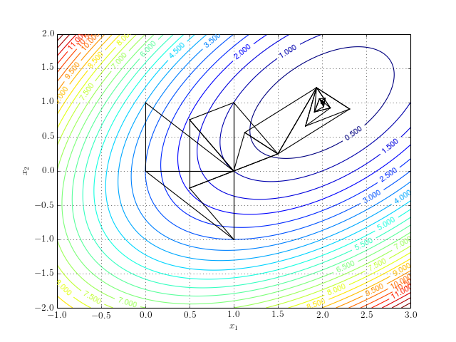
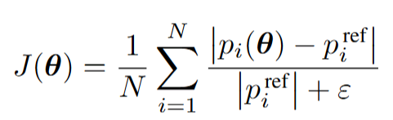
Subject-Specific Parameter Calibration
Nelder-Mead optimization against reference gait system
Default parameters fail:
• Default θ₀ = [100, 30, -300, 30, 10] works for healthy gait
• Hemiparetic patients: attenuated peaks, prolonged ground contact
• Each patient has a unique pathological gait profile
Optimization algorithm:
• Nelder-Mead simplex (gradient-free → handles FSM discontinuities)
• Physiological bounds: Dh∈[50,200], Dl∈[10,80], Ds∈[-500,-100], Tm∈[15,80], Td∈[5,30]
Objective Function:
average normalized absolute error
Notes:
The default FSM parameters — θ₀ = [100, 30, -300, 30, 10] — work well for
healthy gait, but fail on hemiparetic patients. Hemiparetic gait features
attenuated acceleration peaks, prolonged ground contact, and highly individual
movement patterns. A single fixed parameter set simply cannot generalize.
Our solution is a subject-specific calibration. We use the Nelder-Mead
simplex algorithm — a gradient-free optimizer — to tune the 5 FSM parameters
for each patient. Nelder-Mead is appropriate here precisely because the FSM
contains discrete threshold comparisons that create discontinuities in the
objective function landscape where gradient-based methods would fail.
The objective function J(θ) minimizes the average normalized absolute error
between our FSM-detected gait parameters and those of a validated reference
system, over all N strides.

Slide 12
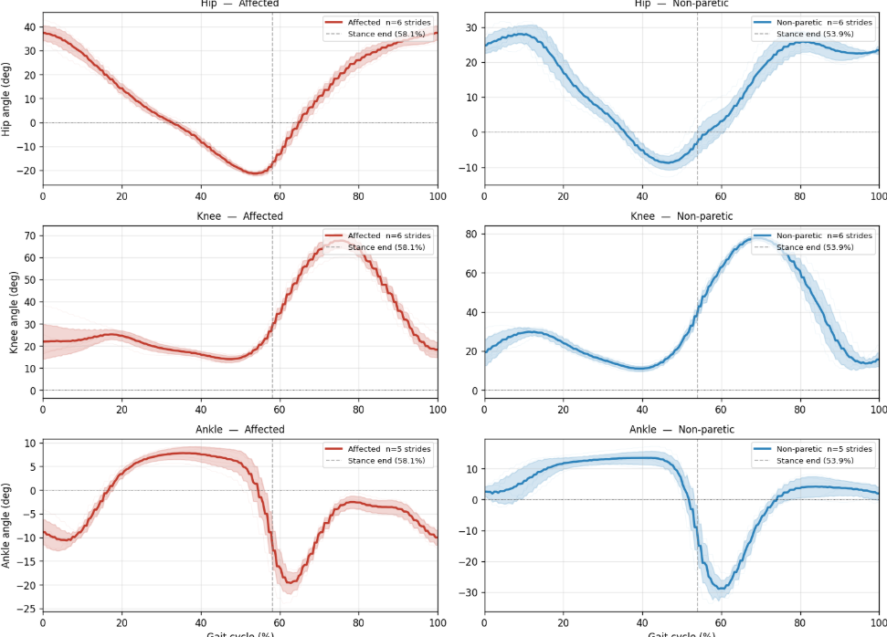

Feature Extraction & AI-LR Representation
Features and asymmetry index
From gait cycles to features:
• From segmented gait cycles: hip, knee, ankle angles
• Spatiotemporal: stride length/time, swing%, stance%
5 spatiotemporal features × 2 sides → 5 AI-LR
3 joints × 4 angle metrics × 2 sides → 12 AI-LR
walkingSpeed
18 features total fed to classifier
Notes:
Once strides are segmented, we extract features. From the joint angle profiles
— hip, knee, and ankle on both sides — we compute 4 metrics per joint: mean,
maximum, minimum, and range, separately for the swing and stance phases. We also
extract 5 spatiotemporal features per side: stride length, stride time, swing
percentage, stance percentage, and walking speed.
The key innovation in our approach is the AI-LR representation — the
Asymmetry Index, Lateralized. Instead of feeding raw left and right values
separately to the classifier, we encode the left-right asymmetry directly:
AI = (f_left - f_right) / (f_left + f_right)
This gives a signed, normalized index. A positive value means the left side
dominates; a negative value means the right side dominates. The sign directly
encodes which side is more impaired — making the feature space inherently
lateralized and physically interpretable.
The final count: 5 spatiotemporal features give 5 AI-LR values, 3 joints times
4 metrics times 2 sides give 12 AI-LR values, plus walking speed — 18 features
total fed to the classifier.

Slide 13
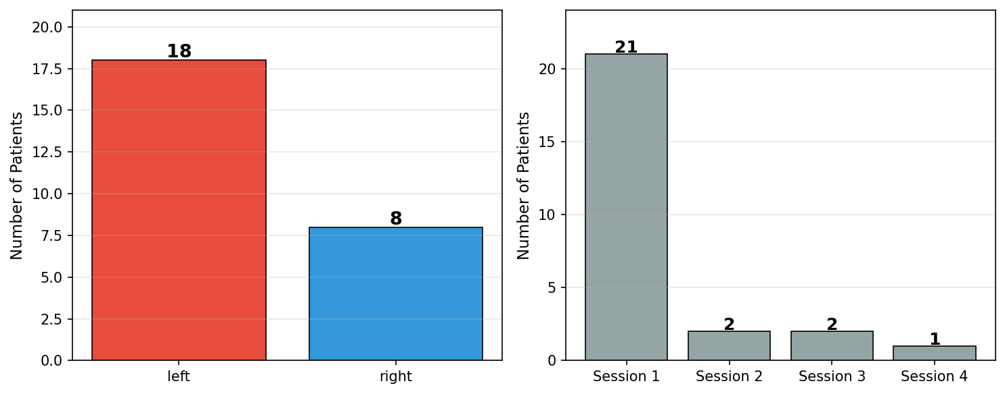
Classification Framework
LOSO-CV with within-fold Mann-Whitney feature selection
Dataset & metrics:
• N = 26 patients (18 left-paretic, 8 right-paretic)
• Balanced class weighting to mitigate imbalance
• Metrics: balanced accuracy, MCC, AUC
Leave-One-Subject-Out CV (LOSO-CV)
Hold out 1 patient as test set
Rank 18 AI-LR features by Mann-Whitney U (training only)
Select top k = 2 features
Train classifier on 25 patients (k=2 features)
Predict held-out patient
Repeat 26× → aggregate metrics
Classifiers evaluated:
• Logistic Regression (linear)
• SVM Linear (linear)
• Random Forest (non-linear ensemble)
• Gaussian Naive Bayes (probabilistic)
★ No data leakage: feature selection is performed inside the fold
Notes:
Now for the classification framework. We have 26 patients — 18 left-paretic and
8 right-paretic. We use balanced class weighting in all classifiers to mitigate
this imbalance. We evaluate four classifiers: Logistic Regression and SVM Linear
— both linear — Random Forest as a non-linear ensemble, and Gaussian Naive Bayes
as a probabilistic baseline. Our metrics are balanced accuracy, MCC, and AUC.
The validation scheme is Leave-One-Subject-Out Cross-Validation — LOSO-CV —
which is the appropriate choice for small clinical datasets. The procedure:
Step 1: hold out one patient as the test set.
Step 2: on the remaining 25 patients, rank the 18 AI-LR features by Mann-Whitney
U statistic — using only training data.
Step 3: select the top k features — here, k=2.
Step 4: train the classifier on 25 patients with those 2 features.
Step 5: predict the held-out patient.
Step 6: repeat 26 times — once per patient — and aggregate all metrics.
A critical design point: feature selection is performed inside the fold, on
training data only. The held-out patient never influences which features are
selected. There is no data leakage.

Slide 14
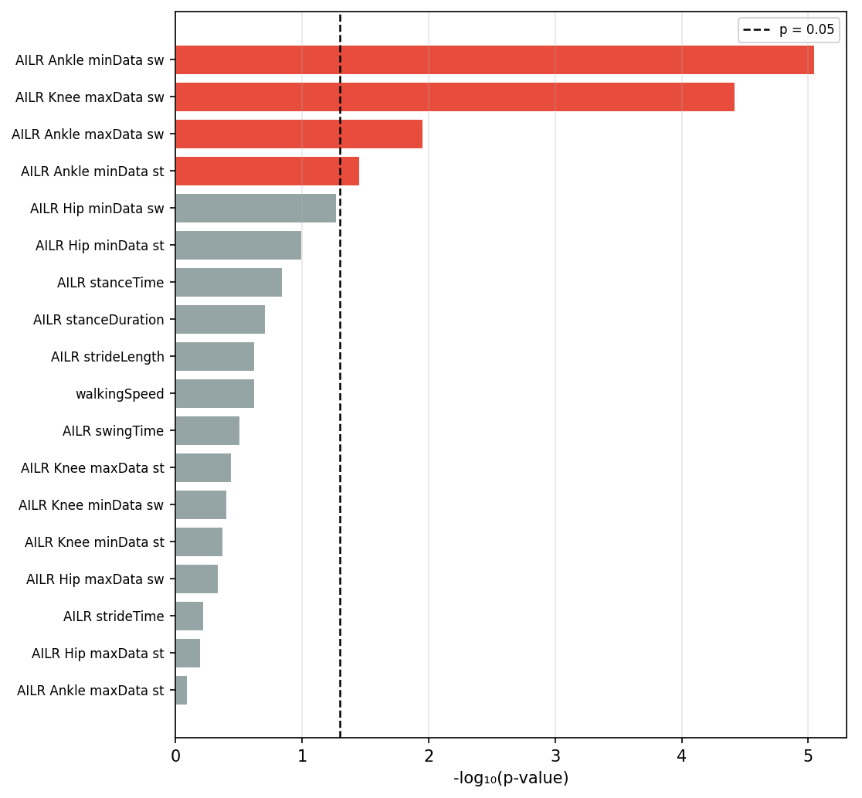
Feature Statistics
Discriminant power of AI-LR indices — Mann-Whitney U test, N=26
Top 4 features are kinematic (ankle/knee swing angles)
all statistically significant (p < 0.05).
Spatiotemporal features are weaker discriminators.
Notes:
To evaluate discriminant power, we ran a Mann-Whitney U test on all 18 AI-LR
features across the 26 patients. The bar chart shows -log10 of the p-value —
a higher bar means a more statistically significant feature.
The top 4 features are all kinematic: ankle minimum during swing, knee maximum
during swing, ankle maximum during swing, and ankle minimum during stance. All
18 features cross the significance threshold — the dashed line at p=0.05.
An important observation: spatiotemporal features such as stride length, swing
time, and stance time rank consistently lower than kinematic features. This
suggests that in this population, kinematic asymmetries — how the joints move —
are more informative than timing asymmetries alone.

Slide 15
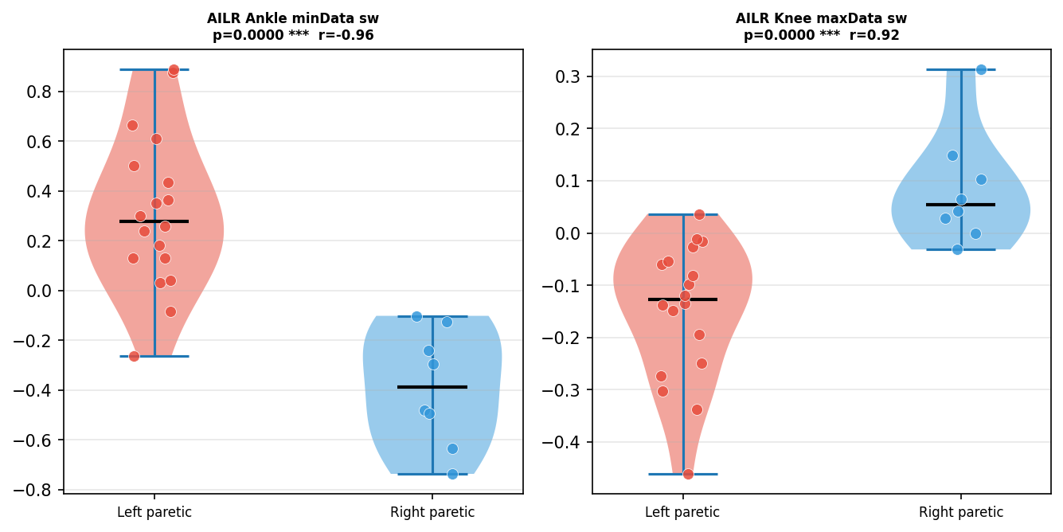
Two Features — Near-Perfect Separation
AI-LR distributions for left-paretic vs. right-paretic groups
Notes:
The two top-ranked features already show near-perfect visual separation between
left-paretic and right-paretic patients.
On the left violin plot: the ankle AI-LR minimum during swing is clearly
positive for left-paretic patients and clearly negative for right-paretic ones,
with a Spearman correlation of r = -0.96 and p < 0.0001. On the right: the
knee AI-LR maximum during swing shows the mirror behavior, with r = 0.92.
This makes physiological sense. Drop foot — reduced ankle clearance on the
affected side — maps directly to the ankle feature. Stiff-knee gait — reduced
knee flexion on the affected side — maps to the knee feature. Our data-driven
analysis independently recovered the two primary clinical hallmarks of
hemiparesis.

Slide 16
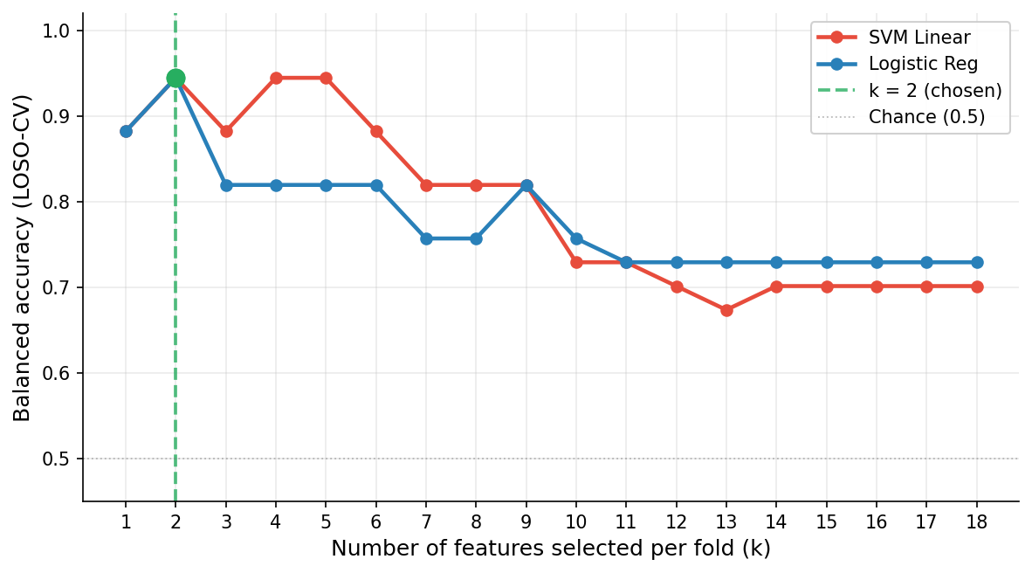
Feature Count Sweep — Why k = 2?
Balanced accuracy vs. number of features selected per fold (k = 1..18)
Models peak at k = 2 and degrade monotonically → laterality signal concentrated in 2 features
Notes:
How did we choose k=2? We ran the full LOSO-CV for every value of k from 1 to
18 and measured balanced accuracy.
The result is unambiguous. Both SVM Linear and Logistic Regression peak exactly
at k=2, reaching 94.4%. Beyond k=2, performance degrades monotonically as more
features are added. This tells us that the laterality signal is concentrated in
just 2 features — adding more introduces noise rather than information,
especially given a dataset of only 26 patients.
k=2 is therefore not an arbitrary choice — it is empirically validated as the
optimal operating point.

Slide 17
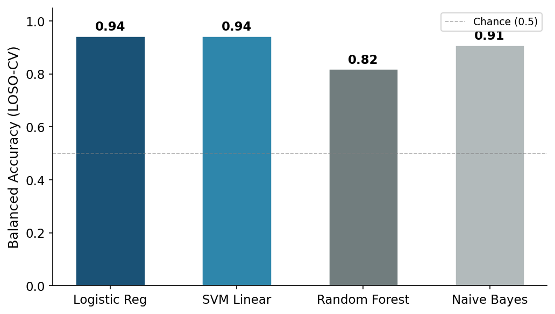
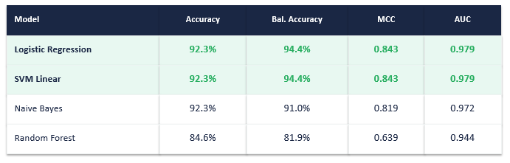
Classification Results
LOSO-CV performance — N=26 patients, k=2 features (Mann-Whitney within fold)
AI-LR space is highly linearly separable
94.4%
Balanced Accuracy
Notes:
Here are the final results at k=2. Both Logistic Regression and SVM Linear
achieve 92.3% raw accuracy and 94.4% balanced accuracy, with MCC of 0.843 and
AUC of 0.979. Naive Bayes reaches 91.0% balanced accuracy, and Random Forest
81.9%.
The fact that linear models outperform the non-linear Random Forest is not
surprising given what we saw in the violin plots: the AI-LR space is highly
linearly separable. Complex non-linear decision boundaries are not needed and
would likely overfit on a 26-patient dataset.
The headline result: 94.4% balanced accuracy, well above chance, using only
2 features extracted from 7 wearable sensors.

Slide 18
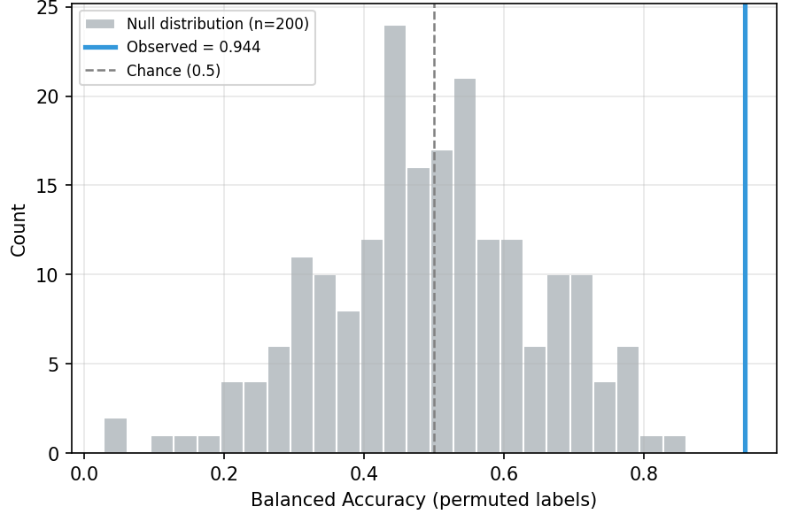
Permutation Test — Statistical Significance
n = 200 label shuffles under identical LOSO-CV loop
k = 2 (top features): p < 0.0001 ✓
Notes:
To confirm this result is not due to chance, we performed a permutation test.
We randomly shuffled the patient labels 200 times and ran the full LOSO-CV
pipeline each time, producing a null distribution of balanced accuracies.
The null distribution is centered around 0.5 — chance level — as expected. Our
observed accuracy of 94.4%, shown by the blue vertical line, falls entirely
outside this null distribution. The p-value is less than 0.0001. The result is
statistically significant beyond any reasonable threshold.

Slide 19
Discussion
Clinical interpretation and engineering implications
Clinical Alignment:
Drop foot + stiff-knee gait: the 2 primary marks of hemiparesis
Data-driven analysis identified known clinical markers automatically.
AI-LR maps complex deficits onto a simple 2-feature linear model.
Engineering Implications:
Linear, 2-feature decision → embeddable on wearable microcontrollers
Potential perception front-end for exoskeleton assist-as-needed control
Notes:
From a clinical perspective: the two most discriminant features — the ankle
swing AI-LR minimum and the knee swing AI-LR maximum — correspond exactly to
drop foot and stiff-knee gait, the two primary hallmarks of hemiparesis that
clinicians observe manually. Our data-driven pipeline independently rediscovered
these markers. This validates both the AI-LR representation and the processing
pipeline. The AI-LR framework successfully maps complex multi-joint asymmetric
deficits onto a simple, physically interpretable 2-feature linear space.
From an engineering perspective, the implications are concrete:
- A linear, 2-feature decision boundary is embeddable on wearable
microcontrollers — no GPU, no cloud infrastructure required.
- - This pipeline could serve as a perception front-end for exoskeleton
assist-as-needed control, providing real-time detection of which leg is paretic
and how asymmetric the current gait is.

Slide 20
Conclusion & Future Work
Contributions
✓ FSM swing detector — handles foot drag and stiff-knee patterns
✓ Subject-specific calibration via Nelder-Mead optimization
✓ AI-LR feature space — laterally signed and physically interpretable
✓ 94.4% balanced accuracy with only 2 features
Future Work
Longitudinal tracking: monitor gait recovery across all session
Notes:
To summarize, this work delivers four concrete contributions.
First: a robust finite state machine swing detector specifically designed to
handle the challenges of hemiparetic gait — foot drag and stiff-knee patterns
that defeat standard detectors.
Second: a subject-specific calibration via Nelder-Mead optimization,
which adapts the swing detector to each patient's unique pathological gait
profile.
Third: the AI-LR feature space — a laterally signed, normalized, and physically
interpretable representation of gait asymmetry that maps directly to clinical
markers.
And fourth: 94.4% balanced accuracy in a rigorous 26-patient LOSO cross-
validation using only 2 features — demonstrating that robust and interpretable
hemiparetic side identification is achievable with minimal, wearable hardware.
As future work, we plan to extend this to longitudinal tracking — monitoring how
gait asymmetry evolves across multiple rehabilitation sessions per patient — to
move from identification toward quantitative recovery monitoring.
Thank you. I am happy to take your questions.

