Slide 1
Build it: skeletal excitation–contraction coupling
Wrap-up session · work in pairs · you will draw the mechanism, not read it
HOW THIS WORKS
WHY WE'RE DOING THIS
1. Open the PARTS slides (3 and 4).
2. Click an object, Ctrl+C. Go to your CANVAS slide, Ctrl+V.
3. Drag it where it belongs.
4. Ctrl+D duplicates whatever is selected — use it for the ions.
5. Don't resize anything. The parts are already to scale with each
other, the same scale as the animation.
6. Add arrows and label pills from slide 4. Type your own if one
is missing.
7. Build first, then check. The answer is not on any slide here.
You can already recognise this pathway. Recognition is not what the exam asks of you.
Rebuilding a mechanism out of loose parts forces you to commit to an order, a direction and a source — the three things people get wrong under pressure, and the three things a finished slide has already decided for you.
It is also a study tool you keep: any pathway, any drawing program. Build it once from parts and you stop needing to re-read the slide.
Objects taken from Video 3 · Shehadeh Lab Foundational Science Library · videos.shehadehlab.com

Slide 2
The finished thing should teach itself
Before you start: what a complete Canvas 1 build has to make obvious
1
What physically connects the T-tubule to the store
name both proteins, and show that they touch
2
Whether any Ca²⁺ has to cross the sarcolemma first
this is the whole difference from the heart — commit to an answer on the page
3
Which membrane each channel sits in
one is in the T-tubule, one is in the SR; they are not interchangeable
4
What the released Ca²⁺ actually binds
the switch is on the thin filament here
5
How the store gets refilled
and what that step costs the cell
If a classmate can read the order of events off your drawing without you talking, it is finished.

Slide 3
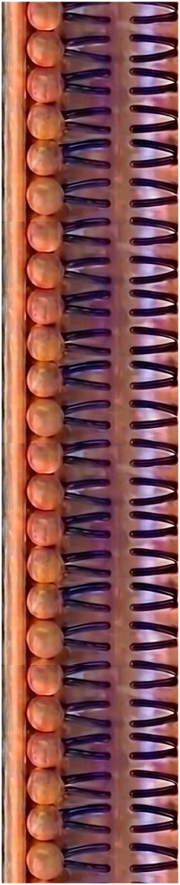
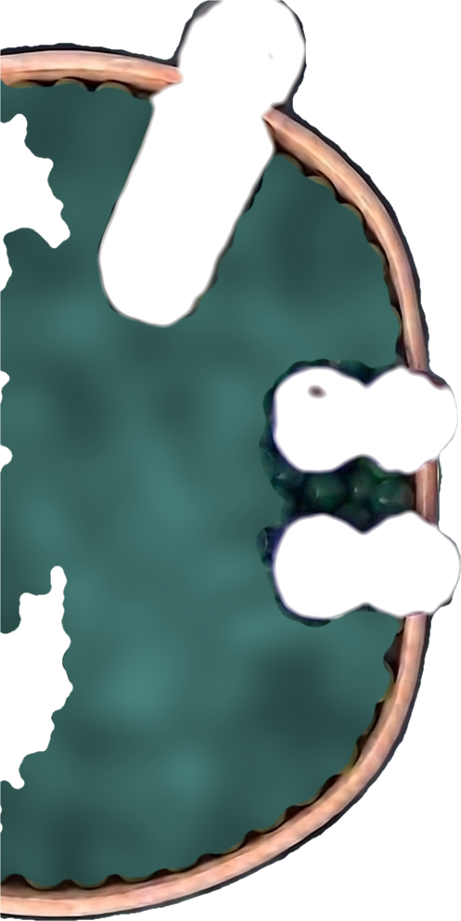
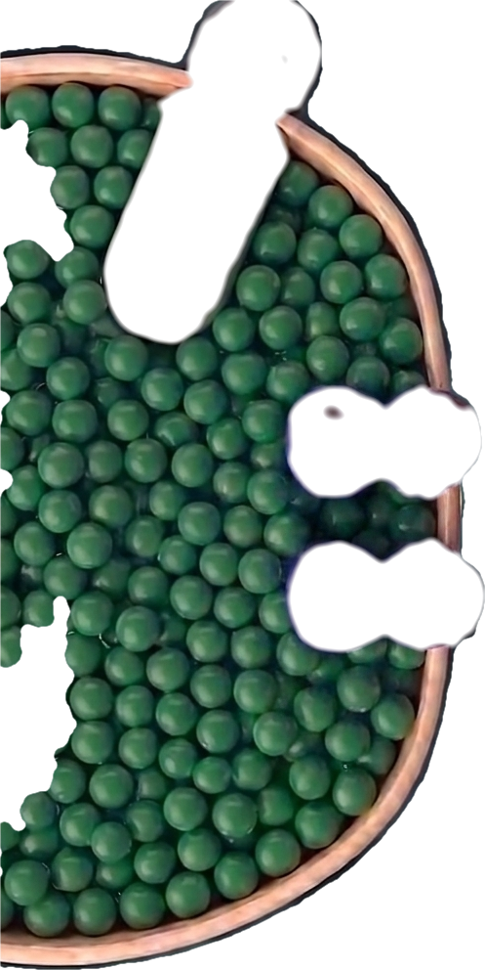
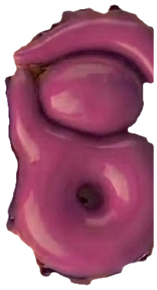
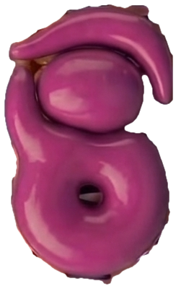
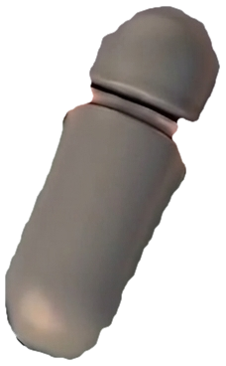
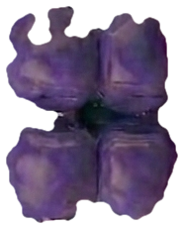
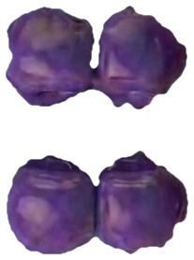
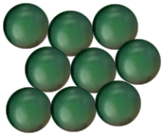

PARTS · structures
Copy from here. Every part is at the same scale as the others.
Left out on purpose: the myofilaments, troponin C, and the foot process that holds the two channels together. Draw those yourself — deciding where they go is half the point.
T-tubule membrane
SR — empty
SR — full
RyR1 shut
RyR1 open
DHPR at rest
DHPR — shape changed
SERCA
Ca²⁺ by the handful
single Ca²⁺ — Ctrl+D
Objects taken from Video 3 · Shehadeh Lab Foundational Science Library · videos.shehadehlab.com

Slide 4
PARTS · arrows and labels
Rotate an arrow by its top handle. Edit any pill by double-clicking the text.
ARROWS — a direction is a claim; make it deliberately
STRUCTURES
MOLECULES
WHAT IS HAPPENING
T-tubule
Ca²⁺
Mechanical coupling
Sarcolemma
ATP
No outside Ca²⁺ needed
SR (store)
Troponin C
Contraction
DHPR (Ca_v1.1)
Volatile anaesthetic
Relaxation
signal arrives
blocked here
RyR1
Succinylcholine
Stuck open
SERCA
Dantrolene
Malignant hyperthermia
more / less
Triad
Rising end-tidal CO₂
BLANK PILL — copy it and type whatever you need
Myofilaments
Rigidity
…
Heat
Colour key matches the video: Ca²⁺ green · DHPR magenta · RyR1 violet · SERCA grey · SR wall salmon

Slide 5
Canvas 1 · From voltage to contraction
12 min
A signal sweeps down the T-tubule. Build everything between that and a relaxed fibre again.
MUST SHOW: what physically links the two membranes · whether outside Ca²⁺ is needed · how the store refills
SR / STORE
CYTOPLASM
T-TUBULE LUMEN
The two channels touch. If your drawing has a gap between them with Ca²⁺ crossing it, you have drawn the heart by mistake.

Slide 6
Canvas 2 · Where anaesthesia hijacks it
10 min
Same drawing. Now give this patient a RyR1 mutation and a volatile anaesthetic.
MUST SHOW: which channel jams · why the temperature and the CO₂ climb · exactly where dantrolene acts
SR / STORE
CYTOPLASM
T-TUBULE LUMEN
Heat and CO₂ are not the primary event — they are what a cell looks like when it cannot stop spending ATP. Your arrows should make that order obvious.

Slide 7
Canvas 3 · Stretch — the same figure, one muscle over
if you finish early
Draw the cardiac version beside this one and change only what actually differs.
MUST SHOW: the one structural difference · what it does to the Ca²⁺ requirement · which drug class it opens the door to
SR / STORE
CYTOPLASM
T-TUBULE LUMEN
Two drawings, one difference. If you find yourself changing more than one thing, you have changed something that does not really differ.

