Slide 1
Build it: cardiac excitation–contraction coupling
Wrap-up session · work in pairs · you will draw the mechanism, not read it
HOW THIS WORKS
WHY WE'RE DOING THIS
1. Open the PARTS slides (3 and 4).
2. Click an object, Ctrl+C. Go to your CANVAS slide, Ctrl+V.
3. Drag it where it belongs.
4. Ctrl+D duplicates whatever is selected — use it for the Ca²⁺ ions.
5. Don't resize anything. The parts are already to scale with each
other, the same scale as the animation.
6. Add arrows and label pills from slide 4. Type your own if one
is missing.
7. 12 minutes on Canvas 1. Then three builds go on the screen and
we argue about them.
You can already recognise this pathway. Recognition is not what the exam asks of you.
Rebuilding a mechanism out of loose parts forces you to commit to an order, a direction and a source — the three things people get wrong under pressure, and the three things a finished slide has already decided for you.
It is also a study tool you keep: any pathway, any drawing program. Build it once from parts and you stop needing to re-read the slide.
Objects taken from Video 5 · Shehadeh Lab Foundational Science Library · videos.shehadehlab.com

Slide 2
The finished thing should teach itself
Before you start: what a complete Canvas 1 build has to make obvious
1
Where the first Ca²⁺ comes from
and how much of it
2
Why a small trigger makes a large release
the amplifier step, named
3
Which channel sits in which membrane
sarcolemma vs SR — they are not interchangeable
4
Both routes that clear Ca²⁺ again
and what each one costs the cell
5
The direction of every arrow
in, out, or into the store
If a classmate can read the order of events off your drawing without you talking, it is finished.

Slide 3
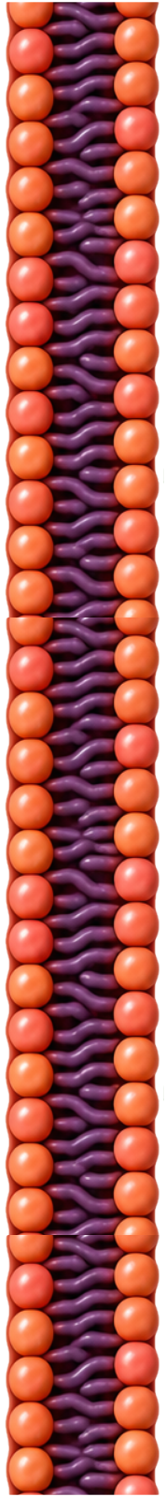
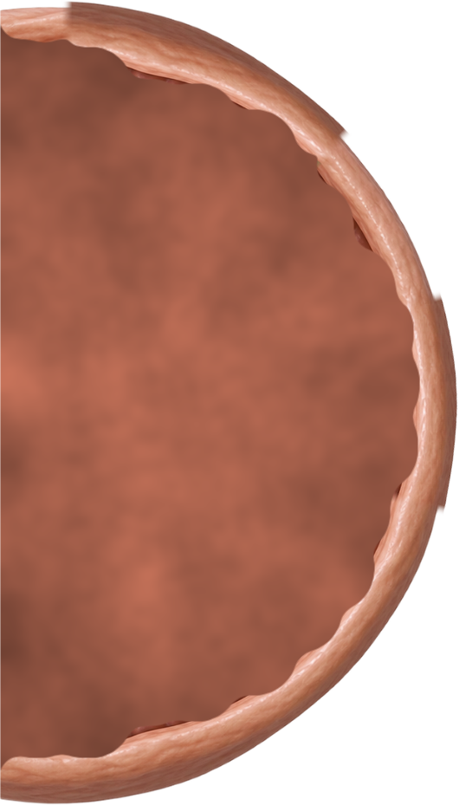
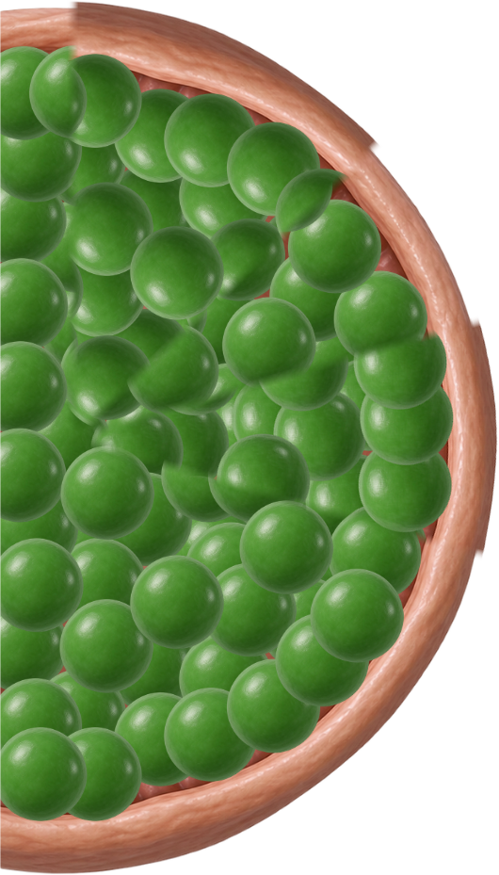
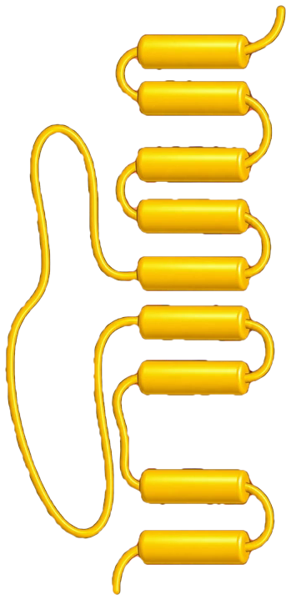
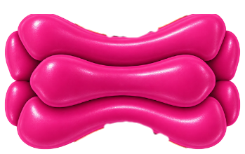
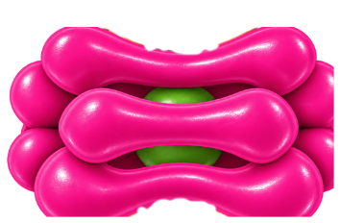
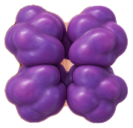
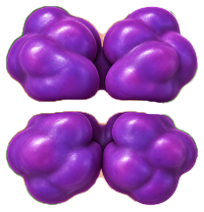
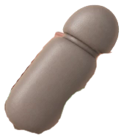

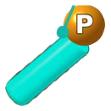
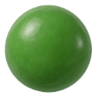
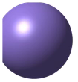

PARTS · structures
Copy from here. Every part is at the same scale as the others.
Sarcolemma
SR — empty
SR — full
NCX
Ca_v1.2 shut
Ca_v1.2 open
RyR2 shut
RyR2 open
SERCA
PLB
PLB–P
IONS — click one, then Ctrl+D as many times as you need
Left out on purpose: the T-tubule, the myofilaments, the β₁ receptor and cAMP. Draw those yourself — deciding where they go is half the point.
Ca²⁺
Na⁺
phosphate (PKA)
Objects taken from Video 5 · Shehadeh Lab Foundational Science Library · videos.shehadehlab.com

Slide 4
PARTS · arrows and labels
Rotate an arrow by its top handle. Edit any pill by double-clicking the text.
ARROWS — a direction is a claim; make it deliberately
STRUCTURES
MOLECULES
WHAT IS HAPPENING
Sarcolemma
Ca²⁺
CICR
T-tubule
Na⁺
3 Na⁺ : 1 Ca²⁺
SR (store)
ATP
Contraction
Ca_v1.2 (L-type)
Adrenaline
Relaxation
action potential
blocked here
RyR2
β₁ receptor
Lusitropy
SERCA
cAMP
① RATE
more / less
NCX
PKA
② FORCE
BLANK PILL — copy it and type whatever you need
Phospholamban
Pi
③ RELAXATION
…
Troponin C
Verapamil
Myofilaments
Diltiazem
Colour key matches the videos: Ca²⁺ green · Na⁺ lavender · Ca_v1.2 magenta · RyR2 violet · NCX yellow · SERCA grey · PLB teal · phosphate amber

Slide 5
Canvas 1 · One beat
12 min
One action potential arrives. Build what happens next, all the way back to a relaxed cell.
MUST SHOW: where the first Ca²⁺ comes from · why a small trigger makes a big release · both routes that clear it again
SR / STORE
CYTOSOL
EXTRACELLULAR
Paste your parts anywhere, then arrange. Nothing here is fixed — move the zone words if they are in your way.

Slide 6
Canvas 2 · Turn the sympathetic drive on
10 min
Copy your Canvas 1 build onto this slide first (select all on slide 5, Ctrl+C, Ctrl+V here), then add adrenaline.
MUST SHOW: β₁ → cAMP → PKA · the three targets, each on the molecule it acts on · which arm fails in HFpEF
SR / STORE
CYTOSOL
EXTRACELLULAR
Rate is cAMP binding HCN directly. Force and relaxation are PKA phosphorylation. Do not draw all three the same way.

Slide 7
Canvas 3 · Stretch — narrow the door
if you finish early
Same drawing. Now put verapamil and diltiazem where they act, and follow the consequence in two directions.
MUST SHOW: why the ventricular rate falls in AF with RVR · why the same block is dangerous in HFrEF and in pre-excited AF
SR / STORE
CYTOSOL
EXTRACELLULAR
Rate control is not rhythm control. Your drawing should make that obvious without a sentence.

