Slide 1
Build it: the resting membrane potential
Wrap-up session · work in pairs · you will draw the mechanism, not read it
HOW THIS WORKS
WHY WE'RE DOING THIS
1. Open the PARTS slides (3 and 4).
2. Click an object, Ctrl+C. Go to your CANVAS slide, Ctrl+V.
3. Drag it where it belongs.
4. Ctrl+D duplicates whatever is selected — use it for the ions.
5. Don't resize anything. The parts are already to scale with each
other, the same scale as the animation.
6. Add arrows and label pills from slide 4. Type your own if one
is missing.
7. Build first, then check. The answer is not on any slide here.
You can already recognise this pathway. Recognition is not what the exam asks of you.
Rebuilding a mechanism out of loose parts forces you to commit to an order, a direction and a source — the three things people get wrong under pressure, and the three things a finished slide has already decided for you.
It is also a study tool you keep: any pathway, any drawing program. Build it once from parts and you stop needing to re-read the slide.
Objects taken from Video 1 · Shehadeh Lab Foundational Science Library · videos.shehadehlab.com

Slide 2
The finished thing should teach itself
Before you start: what a complete Canvas 1 build has to make obvious
1
Which ion the resting membrane actually lets through
and through which protein — a leak is not a gate
2
Where the negative charge that cannot leave is sitting
this is the half of the answer people forget
3
Which way each ion would move if the membrane let it
chemical gradient and electrical gradient are two different arrows
4
What the pump contributes, in two separate ways
one of them is worth only a few millivolts — say which
5
Why the voltage settles instead of running away
show the point where the two arrows on your chosen ion cancel
If a classmate can read the reasoning off your drawing without you talking, it is finished.

Slide 3
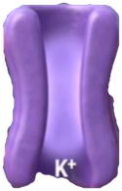
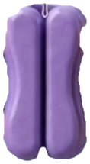
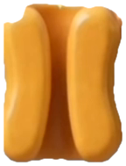
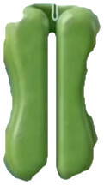
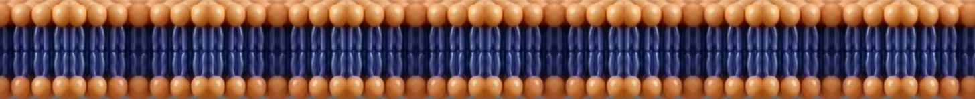
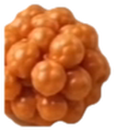





PARTS · structures
Copy from here. Every part is at the same scale as the others.
Every part here is cut from the film itself, so the ions carry their own labels. ATP and Pi are the exception — the animation renders them as a burst of light, which does not cut cleanly, so those two are drawn.
lipid bilayer
K⁺ leak · open
K⁺ gated · shut
Na⁺/K⁺ ATPase
Na⁺ gated · shut
trapped anions A⁻
K⁺
Na⁺
Cl⁻
ATP
Pi
Objects taken from Video 1 · Shehadeh Lab Foundational Science Library · videos.shehadehlab.com

Slide 4
PARTS · arrows and labels
Rotate an arrow by its top handle. Edit any pill by double-clicking the text.
ARROWS — a direction is a claim; make it deliberately
STRUCTURES
MOLECULES
WHAT IS HAPPENING
Lipid bilayer
Na⁺
−70 mV
Na⁺/K⁺ ATPase
K⁺
3 Na⁺ out : 2 K⁺ in
K⁺ leak channel
Cl⁻
Chemical gradient
Voltage-gated K⁺
A⁻ (impermeant)
Electrical gradient
signal arrives
blocked here
Voltage-gated Na⁺
ATP
Equilibrium potential
Extracellular fluid
ADP + Pi
Most permeable at rest
more / less
Cytosol
Net loss of positive charge
BLANK PILL — copy it and type whatever you need
Depolarisation
…
Hyperpolarisation
Colours follow the film: K⁺ gold · Na⁺ violet · Cl⁻ red · trapped anions brown · pump amber · K⁺ channels purple · Na⁺ channels green

Slide 5
Canvas 1 · Why the inside is negative
12 min
Build a cell at rest. Put every charge where it actually is, not where it would like to be.
MUST SHOW: which ion leaks and through what · where the trapped negative charge sits · what the pump adds
EXTRACELLULAR FLUID
CYTOSOL
Two arrows on potassium — one chemical, one electrical. The resting potential is where they stop arguing.

Slide 6
Canvas 2 · Change one thing
10 min
Copy your build here twice. On the first, raise extracellular K⁺. On the second, stop the pump.
MUST SHOW: which way the membrane potential moves in each · how fast · which of the two is the emergency
EXTRACELLULAR FLUID
CYTOSOL
One of these moves the voltage in seconds and the other over hours. Your drawing should say which, and why.

Slide 7
Canvas 3 · Stretch — how much is the pump worth?
if you finish early
Separate the two things the pump does, and mark how many millivolts each is worth.
MUST SHOW: the gradient it maintains · the charge it moves directly · which one dominates the resting voltage
EXTRACELLULAR FLUID
CYTOSOL
If you take out the pump's direct electrogenic contribution, the resting potential barely moves. Say why it still matters.

