Slide 1
Build it: the neuromuscular junction
Wrap-up session · work in pairs · you will draw the mechanism, not read it
HOW THIS WORKS
WHY WE'RE DOING THIS
1. Open the PARTS slides (3 and 4).
2. Click an object, Ctrl+C. Go to your CANVAS slide, Ctrl+V.
3. Drag it where it belongs.
4. Ctrl+D duplicates whatever is selected — use it for the ions.
5. Don't resize anything. The parts are already to scale with each
other, the same scale as the animation.
6. Add arrows and label pills from slide 4. Type your own if one
is missing.
7. Build first, then check. The answer is not on any slide here.
You can already recognise this pathway. Recognition is not what the exam asks of you.
Rebuilding a mechanism out of loose parts forces you to commit to an order, a direction and a source — the three things people get wrong under pressure, and the three things a finished slide has already decided for you.
It is also a study tool you keep: any pathway, any drawing program. Build it once from parts and you stop needing to re-read the slide.
Objects taken from Video 4 · Shehadeh Lab Foundational Science Library · videos.shehadehlab.com

Slide 2
The finished thing should teach itself
Before you start: what a complete Canvas 1 build has to make obvious
1
Which channel lets Ca²⁺ in, and which membrane it sits in
there are two kinds of channel on this terminal and they do opposite jobs
2
What the Ca²⁺ actually does once it is inside
it does not cross the cleft; show what it acts on
3
Which side of the cleft the receptor is on
and what kind of receptor it is
4
How the signal is switched off again
one enzyme, and where it lives
5
Where a single antibody could break this
leave a mark at every point you think is attackable — you will use it on Canvas 2
If a classmate can read the order of events off your drawing without you talking, it is finished.

Slide 3
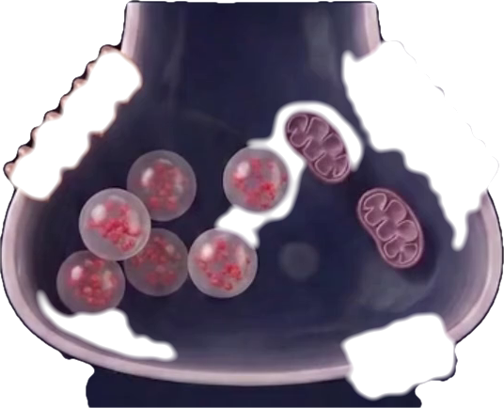
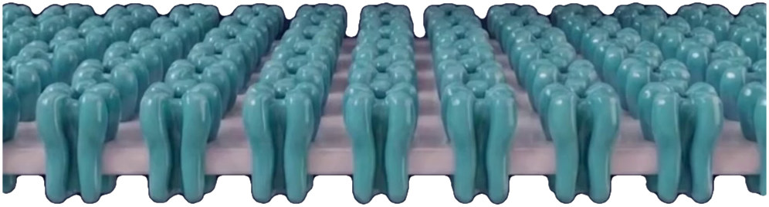
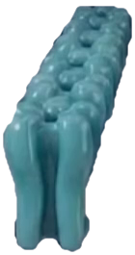
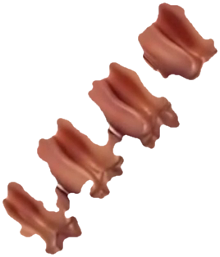
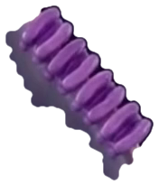
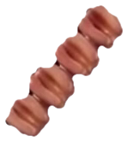
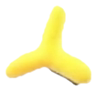
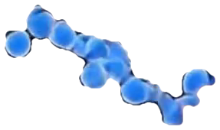

PARTS · structures
Copy from here. Every part is at the same scale as the others.
Left out on purpose: the action potential, acetylcholinesterase, and the vesicle-fusion machinery. Draw those yourself — deciding where they go is half the point.
presynaptic terminal
P/Q-type Ca²⁺ channel
K⁺ channel
muscle endplate
nicotinic AChR
ACh
Ca²⁺
autoantibody
Firdapse (3,4-DAP)
Objects taken from Video 4 · Shehadeh Lab Foundational Science Library · videos.shehadehlab.com

Slide 4
PARTS · arrows and labels
Rotate an arrow by its top handle. Edit any pill by double-clicking the text.
ARROWS — a direction is a claim; make it deliberately
STRUCTURES
MOLECULES
WHAT IS HAPPENING
Presynaptic terminal
Ca²⁺
Vesicle fusion
Active zone
ACh
Endplate potential
Synaptic vesicle
Acetylcholinesterase
↓ ACh release
Ca_v2.1 (P/Q-type)
Autoantibody
Improves with use
signal arrives
blocked here
K⁺ channel
Firdapse (3,4-DAP)
Worsens with use
Synaptic cleft
LEMS
more / less
Nicotinic AChR
Myasthenia gravis
BLANK PILL — copy it and type whatever you need
Muscle endplate
Small-cell lung cancer
…
Mitochondrion
Longer action potential
Colour key matches the video: Ca²⁺ green · ACh salmon · P/Q channel purple · K⁺ channel orange · AChR teal · antibody yellow · Firdapse blue

Slide 5
Canvas 1 · One impulse, one twitch
12 min
An action potential reaches the terminal. Build everything between that and a muscle fibre that fires.
MUST SHOW: which channel lets Ca²⁺ in · what Ca²⁺ acts on inside the terminal · which side the receptor is on
NERVE TERMINAL
SYNAPTIC CLEFT
MUSCLE
Ca²⁺ never crosses the cleft. If your drawing has it landing on the muscle, something has gone wrong two steps earlier.

Slide 6
Canvas 2 · Put the antibody where it belongs
10 min
Build the junction twice, side by side. Give one LEMS and the other myasthenia gravis.
MUST SHOW: the two different targets · why one improves with repeated use and the other worsens · which one hunts for a tumour
NERVE TERMINAL
SYNAPTIC CLEFT
MUSCLE
The clinical difference falls straight out of the anatomy. If your two drawings differ only in a label, you have not found it yet.

Slide 7
Canvas 3 · Stretch — the drug that treats the wrong channel
if you finish early
Add Firdapse to your LEMS drawing. It does not touch the channel the antibodies attacked.
MUST SHOW: which channel it blocks · what that does to the action potential · how that ends in more ACh
NERVE TERMINAL
SYNAPTIC CLEFT
MUSCLE
Three steps between blocking a potassium channel and releasing more transmitter. Draw all three, in order, or the drug looks like magic.

