Slide 1
Build it: the cross-bridge cycle
Wrap-up session · work in pairs · you will draw the mechanism, not read it
HOW THIS WORKS
WHY WE'RE DOING THIS
1. Open the PARTS slides (3 and 4).
2. Click an object, Ctrl+C. Go to your CANVAS slide, Ctrl+V.
3. Drag it where it belongs.
4. Ctrl+D duplicates whatever is selected — use it for the ions.
5. Don't resize anything. The parts are already to scale with each
other, the same scale as the animation.
6. Add arrows and label pills from slide 4. Type your own if one
is missing.
7. Build first, then check. The answer is not on any slide here.
You can already recognise this pathway. Recognition is not what the exam asks of you.
Rebuilding a mechanism out of loose parts forces you to commit to an order, a direction and a source — the three things people get wrong under pressure, and the three things a finished slide has already decided for you.
It is also a study tool you keep: any pathway, any drawing program. Build it once from parts and you stop needing to re-read the slide.
Parts drawn to match Video 2 · Shehadeh Lab Foundational Science Library · videos.shehadehlab.com

Slide 2
The finished thing should teach itself
Before you start: what a complete Canvas 1 build has to make obvious
1
What is sitting in the nucleotide pocket at every step
ATP, ADP + Pi, ADP alone, or nothing — the cycle is defined by this, not by the pictures
2
Which step is the power stroke
and which way the thin filament moves when it happens
3
Which step spends ATP, and which step is released by it
these are two different steps; most people merge them
4
Where the cycle stops if ATP runs out
name the state, and say what the muscle feels like
5
That the cycle is a loop
your last step has to hand over to your first
If a classmate can read the order of events off your drawing without you talking, it is finished.

Slide 3
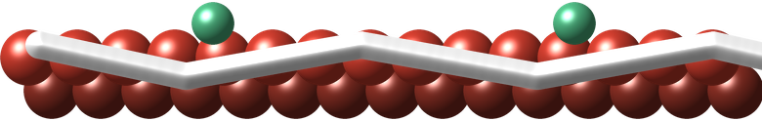
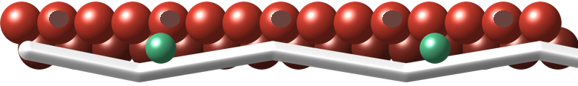


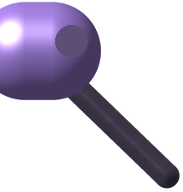
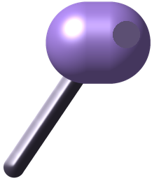




PARTS · structures
Copy from here. Every part is at the same scale as the others.
These parts are drawn rather than lifted from the film: Video 2's animation is too small on screen to cut clean pieces from. The colours are the ones the closing card uses.
thin filament — sites covered
thin filament — sites exposed
thick filament
head — lever cocked
head — lever swung
Z disc
ATP
ADP
Pi
Ca²⁺
Parts drawn to match Video 2 · Shehadeh Lab Foundational Science Library · videos.shehadehlab.com

Slide 4
PARTS · arrows and labels
Rotate an arrow by its top handle. Edit any pill by double-clicking the text.
ARROWS — a direction is a claim; make it deliberately
STRUCTURES
MOLECULES
THE SIX STATES
Actin
ATP
① Cocked / primed
Tropomyosin
ADP
② Attached
Troponin
Pi
③ Power stroke
Myosin head
Ca²⁺
④ Rigor (locked)
signal arrives
blocked here
Lever arm
Troponin C
⑤ Detachment
Thick filament
⑥ Re-cocking
more / less
Z disc
Binding site exposed
BLANK PILL — copy it and type whatever you need
M line
Filaments slide
…
Sarcomere
Sarcomere shortens
Colours follow the closing card: actin red · tropomyosin white · troponin green · myosin purple · ATP/ADP gold · Pi orange · Ca²⁺ green

Slide 5
Canvas 1 · One head, one full cycle
12 min
Lay the six states out as a ring. Put the right nucleotide in the pocket at every step.
MUST SHOW: what is bound at each step · which step is the power stroke · which step ATP is spent on and which it releases
M LINE ←
→ Z DISC
The pocket on each head is empty on purpose. What you drop into it is the answer.

Slide 6
Canvas 2 · What calcium actually does
10 min
Build the thin filament twice — relaxed and activated — and show exactly what Ca²⁺ changes.
MUST SHOW: what Ca²⁺ binds · what physically moves · why a myosin head with ATP still does nothing without it
M LINE ←
→ Z DISC
Calcium does not touch the myosin head in this muscle. If your arrow goes there, follow it back one protein.

Slide 7
Canvas 3 · Stretch — where the cycle stops
if you finish early
Take the ATP away. Mark the state the cycle halts in, and say what the body feels like.
MUST SHOW: the halted state, named · why that state and not another · what finally releases it
M LINE ←
→ Z DISC
Rigor is not the muscle contracting. It is the muscle unable to let go. Your drawing should show the difference.

