Slide 1
Build it: smooth muscle tone
Wrap-up session · work in pairs · you will draw the mechanism, not read it
HOW THIS WORKS
WHY WE'RE DOING THIS
1. Open the PARTS slides (3 and 4).
2. Click an object, Ctrl+C. Go to your CANVAS slide, Ctrl+V.
3. Drag it where it belongs.
4. Ctrl+D duplicates whatever is selected — use it for the ions.
5. Don't resize anything. The parts are already to scale with each
other, the same scale as the animation.
6. Add arrows and label pills from slide 4. Type your own if one
is missing.
7. Build first, then check. The answer is not on any slide here.
You can already recognise this pathway. Recognition is not what the exam asks of you.
Rebuilding a mechanism out of loose parts forces you to commit to an order, a direction and a source — the three things people get wrong under pressure, and the three things a finished slide has already decided for you.
It is also a study tool you keep: any pathway, any drawing program. Build it once from parts and you stop needing to re-read the slide.
Objects taken from Video 6 · Shehadeh Lab Foundational Science Library · videos.shehadehlab.com

Slide 2
The finished thing should teach itself
Before you start: what a complete Canvas 1 build has to make obvious
1
The two places Ca²⁺ comes from
one outside the cell, one inside it — and which drug closes which
2
What Ca²⁺ actually binds
there is no troponin in this cell; name the protein that takes its place
3
Which molecule carries the phosphate
the switch is on the myosin here, not on the thin filament
4
Why an unphosphorylated head is useless
show a head that cannot pull, next to one that can
5
Both enzymes running at the same time
tone is a balance, not an on/off switch
If a classmate can read the order of events off your drawing without you talking, it is finished.

Slide 3
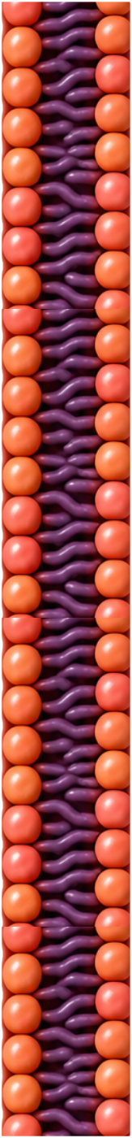
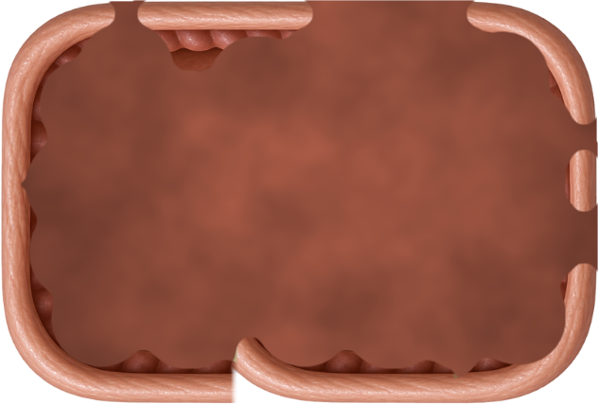
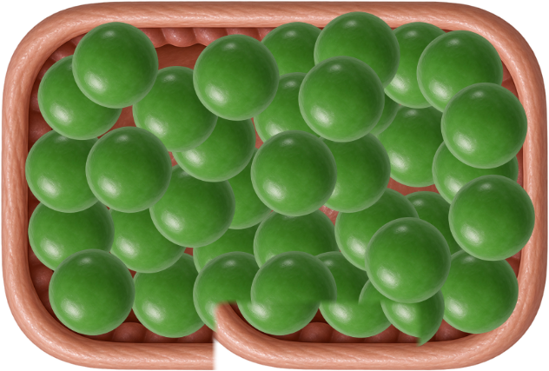
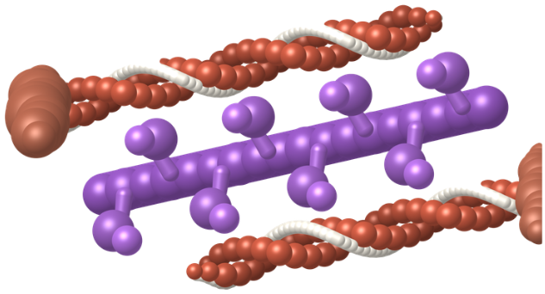
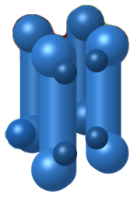
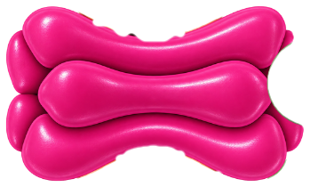
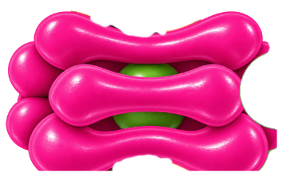
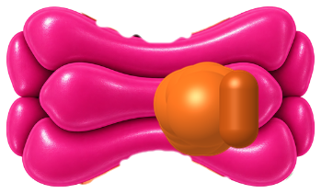
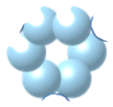
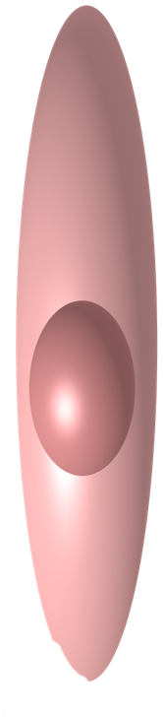
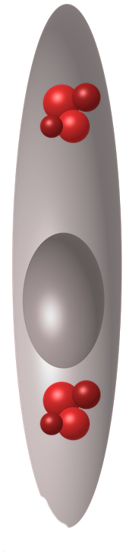


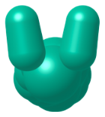
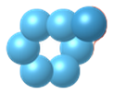
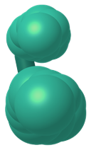

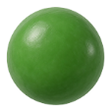
PARTS · structures
Copy from here. Every part is at the same scale as the others.
Left out on purpose: guanylyl cyclase, PKG, and the pumps that clear Ca²⁺ again. Draw those yourself — deciding where they go is half the point.
Sarcolemma
SR — empty
SR — full
IP₃ receptor
IP₃
L-type shut
L-type open
L-type plugged
contractile unit
calmodulin
MLCK
MLCP
cAMP
NO
endothelial cell
nitroprusside
phosphate
Ca²⁺ — click one, then Ctrl+D
Objects taken from Video 6 · Shehadeh Lab Foundational Science Library · videos.shehadehlab.com

Slide 4
PARTS · arrows and labels
Rotate an arrow by its top handle. Edit any pill by double-clicking the text.
ARROWS — a direction is a claim; make it deliberately
STRUCTURES
MOLECULES
WHAT IS HAPPENING
Sarcolemma
Ca²⁺
No troponin here
L-type (DHP receptor)
IP₃
Myosin–P
SR (store)
Calmodulin
Power stroke
IP₃ receptor
MLCK
LATCH
signal arrives
blocked here
Actin
MLCP
Tone
Myosin
ATP
Relaxation
more / less
Dense body
Pi
Vasodilation
BLANK PILL — copy it and type whatever you need
Endothelial cell
cAMP
Amlodipine
…
cGMP
Nitroprusside
NO
Nitroglycerin
ACh
Colour key matches the video: Ca²⁺ green · L-type magenta · IP₃ receptor blue · MLCK amber · MLCP teal · calmodulin cream · NO teal

Slide 5
Canvas 1 · Switch the muscle on
12 min
Calcium arrives. Build everything between that and a head that pulls.
MUST SHOW: the two Ca²⁺ sources · what Ca²⁺ binds instead of troponin · which filament carries the phosphate
SR / STORE
CYTOSOL
OUTSIDE / LUMEN
The cover of the video asked: this muscle has no troponin, so what does calcium switch on? Your drawing is the answer.

Slide 6
Canvas 2 · Tone is a tug of war
10 min
Copy your Canvas 1 build here, then add the other enzyme and let both run at once.
MUST SHOW: MLCK and MLCP working simultaneously · where latch sits · what cAMP does — and what it does not do
SR / STORE
CYTOSOL
OUTSIDE / LUMEN
cAMP does not strengthen the phosphatase. It blocks the kinase, and the phosphatase wins by default. Your arrows should say which.

Slide 7
Canvas 3 · Three ways to open a vessel
10 min
Same drawing. Add acetylcholine, nitroprusside and amlodipine, each acting where it really acts.
MUST SHOW: which one fails when the endothelium is dead · which enzyme each route ends on · where amlodipine acts
SR / STORE
CYTOSOL
OUTSIDE / LUMEN
Two of these end on the phosphatase and one never gets that far. Mark the endothelial cell dead and see which arrows survive.

