Slide 1
Build it: all three muscle types, side by side
The capstone · work in pairs · one canvas, three columns, no table to copy from
HOW THIS WORKS
WHY WE'RE DOING THIS
1. Open the PARTS slides (3, 4 and 5).
2. Click an object, Ctrl+C. Go to your CANVAS slide, Ctrl+V.
3. The parts are NOT sorted by muscle type. Working out which column
each one belongs in is the first half of the exercise.
4. Ctrl+D duplicates whatever is selected.
5. Don't resize anything. The three families have already been rescaled
to a common yardstick so they can be compared honestly.
6. Build all three columns before you start filling in the table.
You have the comparison table in your slides. Reading a filled-in table is not the same skill as producing one.
Sorting loose parts into three columns forces you to know which protein belongs to which cell, and building each column forces you to know what it does there. A table lets you recognise both without ever committing.
The last row of the table is the one that separates the three cells in a single sentence. Find it yourself before you look it up.
Objects taken from Videos 3, 5 and 6 · rescaled to a common yardstick · videos.shehadehlab.com

Slide 2
The finished thing should teach itself
Before you start: what a complete Canvas 1 build has to make obvious
1
Every part in the column it belongs to
some parts appear in more than one column — say so rather than choosing
2
What triggers release in each cell
one is mechanical, one is chemical, one is a second messenger
3
Where the Ca²⁺ comes from in each cell
and which of the three cannot manage without the extracellular pool
4
What the Ca²⁺ binds in each cell
two share a target; one does not
5
Which filament carries the regulatory switch
this is the single row that separates smooth muscle from the other two
If a classmate can read all three mechanisms off your columns without you talking, it is finished.

Slide 3
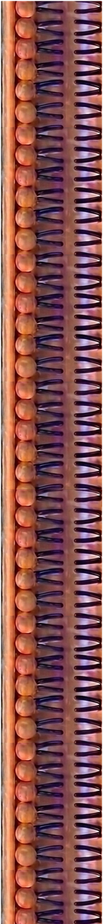
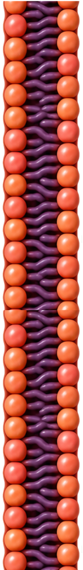
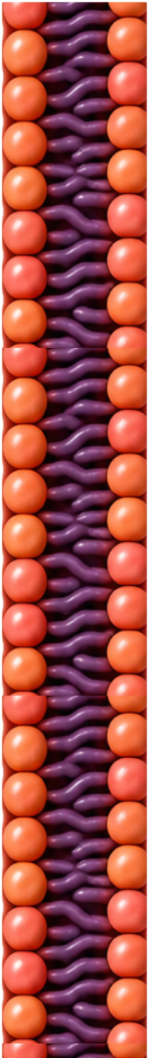
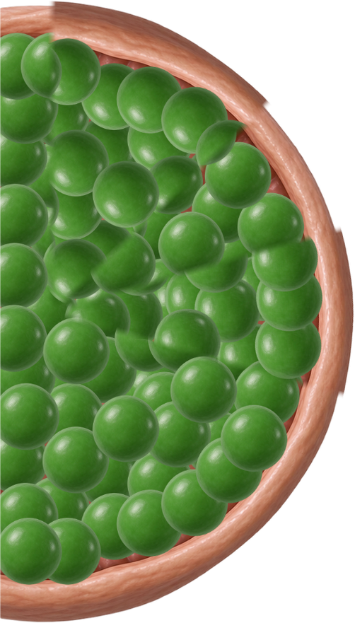
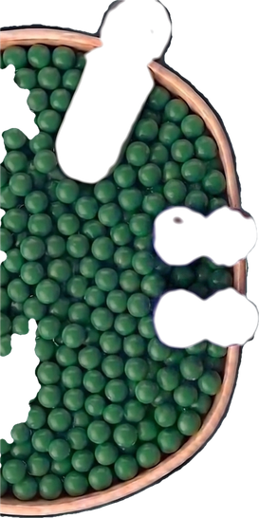
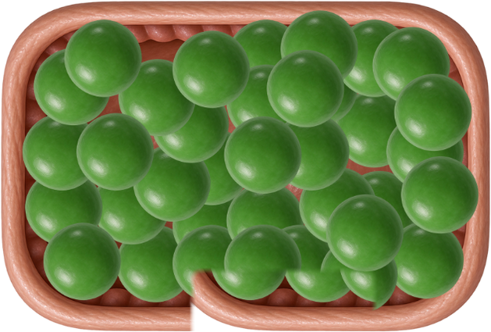
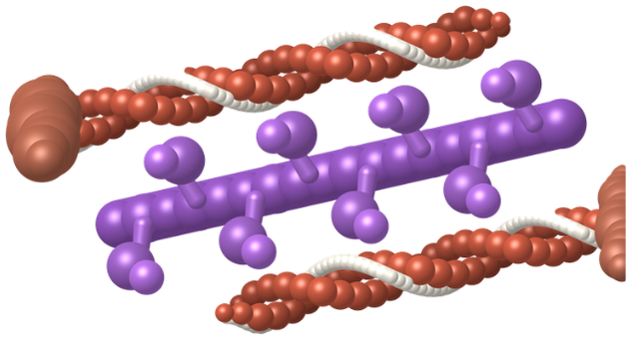
PARTS · the stores, the membranes and the machinery
Not sorted by muscle type. Working that out is the first half of the exercise.
Three membranes, three stores, one contractile unit. Two of the three cells draw their filaments a different way — decide whether that difference is real or just a drawing style.
membrane A
membrane B
membrane C
store A
store B
store C
contractile unit
Objects taken from Videos 3, 5 and 6 · rescaled to a common yardstick · videos.shehadehlab.com

Slide 4
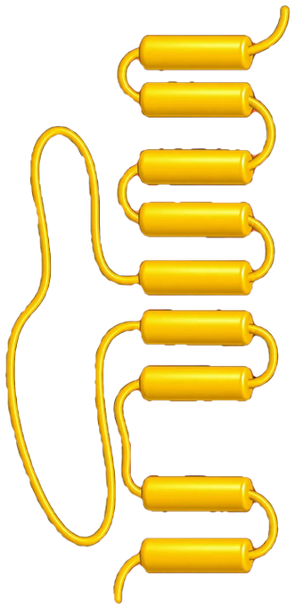
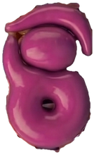
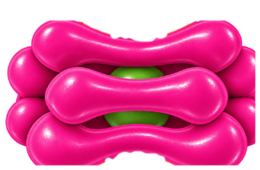
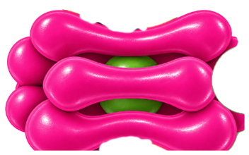
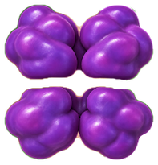
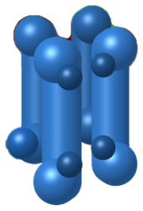
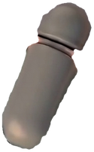
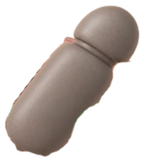
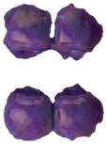



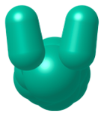

PARTS · the channels, pumps and switches
Same rule: nothing here is labelled by muscle type.
The three channels at the left are the same protein family drawn by three different films. They are the same size here on purpose — decide for yourself whether they do the same job.
channel 1
channel 2
channel 3
release 1
release 2
release 3
pump A
pump B
exchanger
brake
sensor
kinase
phosphatase
Ca²⁺ — the same ion everywhere
Objects taken from Videos 3, 5 and 6 · rescaled to a common yardstick · videos.shehadehlab.com

Slide 5
PARTS · answers to drop into the table
Use these on Canvas 2. If the pill you want is missing, copy a blank one and type it.
THE TRIGGER
THE Ca²⁺ SOURCE
SENSOR, SWITCH, RESET
Action potential
SR only
Troponin C
Mechanical coupling
SR + extracellular
Calmodulin
Ca²⁺-induced Ca²⁺ release
Extracellular + SR
Thin filament
IP₃ from a GPCR
Needs outside Ca²⁺
Thick filament
Depolarisation
Does not need outside Ca²⁺
SERCA
Stretch
L-type channel
NCX
RyR1
MLCP
RyR2
MLCK
IP₃ receptor
Latch
No troponin
Skeletal · Cardiac · Smooth are the deck's own key colours: rust, wine, blue

Slide 6
Canvas 1 · Sort the parts, then build all three
15 min
Three columns. Put every part where it belongs, then build each mechanism in its own column.
MUST SHOW: every part in the right column · the trigger for each · the Ca²⁺ source for each
SKELETAL
CARDIAC
SMOOTH
Some parts belong in more than one column. Duplicate them and say so — that is a finding, not a problem.

Slide 7
Canvas 2 · Fill the table from your own drawing
10 min
Drag the pills from slide 6 into the cells. Answer from your columns, not from memory.
SKELETAL
CARDIAC
SMOOTH
What triggers release?
Where does the Ca²⁺ come from?
What does Ca²⁺ bind?
Which filament carries the switch?
How does it relax?
The bottom row is the one that separates smooth muscle from the other two in a single sentence.

Slide 8
Canvas 3 · Stretch — one drug, three answers
if you finish early
Put dantrolene, verapamil and amlodipine on your columns. Each acts in one column and matters in another.
MUST SHOW: where each drug binds · which column feels it · why two of them share a target family and not an indication
SKELETAL
CARDIAC
SMOOTH
The same channel family appears in all three columns. What changes is what the cell does with it.

