Slide 1

DATA-DRIVEN PROCESS IMPROVEMENT PROJECT
Amusement Park Scenario

Slide 2
What data are necessary to include? Why?
Number of customers visiting per day
To measure the daily visits which would help with the estimation of food court customers.
The amount customers spend on a trip level
It would help measuring the best pricing of food in the park to make more affordable, thus, more appealing.
The duration of each trip
Knowing the average duration of customers trips would assist in knowing if customers stayed long enough to grab a meant from the food courts and the time customers spend on traveling to the courts and the games.
What food vendors customers frequent
This would help to measure the types of food customers like it, what strategies/ policies are better, what are the best vendors distribution in the park, what are the prices that are affordable to the costumers.

Slide 3
What data to set aside (NOT include)? Why?
How many visits annual customers make per year
This would not help with the decision since it would measure the frequency of visits an annual customer makes but won’t add up in the scenario of food sales dropping.
How much customers spend annually
Measuring the amount that customers spend annually is not a good factor in this decision-making process; it is better to measure the amount that customers spend on a trip level.
What rides customers frequent
Measuring the rides that customers frequent is irrelevant to the situation we are dealing with; thus, it is better to ignore it.

Slide 4
How to go about collecting the data, and what new data collection strategies or tools are needed to do so?
It is helpful to use Transactional Tracking method to collect data about the types of food, costs, frequency of purchases and the amount customers spend on their trips. It also would be helpful to ask customers about their preferences and their experiences in the amusement park to measure their satisfaction and their tendencies for the food experiences in it; this would be applicable via Surveys (digital questionnaires or simply asking customers that are waiting in lines).For the best way to collect data about the number of customer visiting and the duration of time they spend in the amusement park is by Observations and tracking the entrance records. These data collection strategies and tools are needed to implement the analysis in the best manner.

Slide 5
Which should be conducted first? and why?
The data about the what food vendors that customers frequent the most is a prior to be conducted first; as it would tell what food types are more favorable, what strategies/ policies are better, what are the best vendors distribution in the park, what are the prices that are affordable to the costumers.
This would be a great start for the analysis and would lead the investigation to a better data-driven decision-making process.

Slide 6
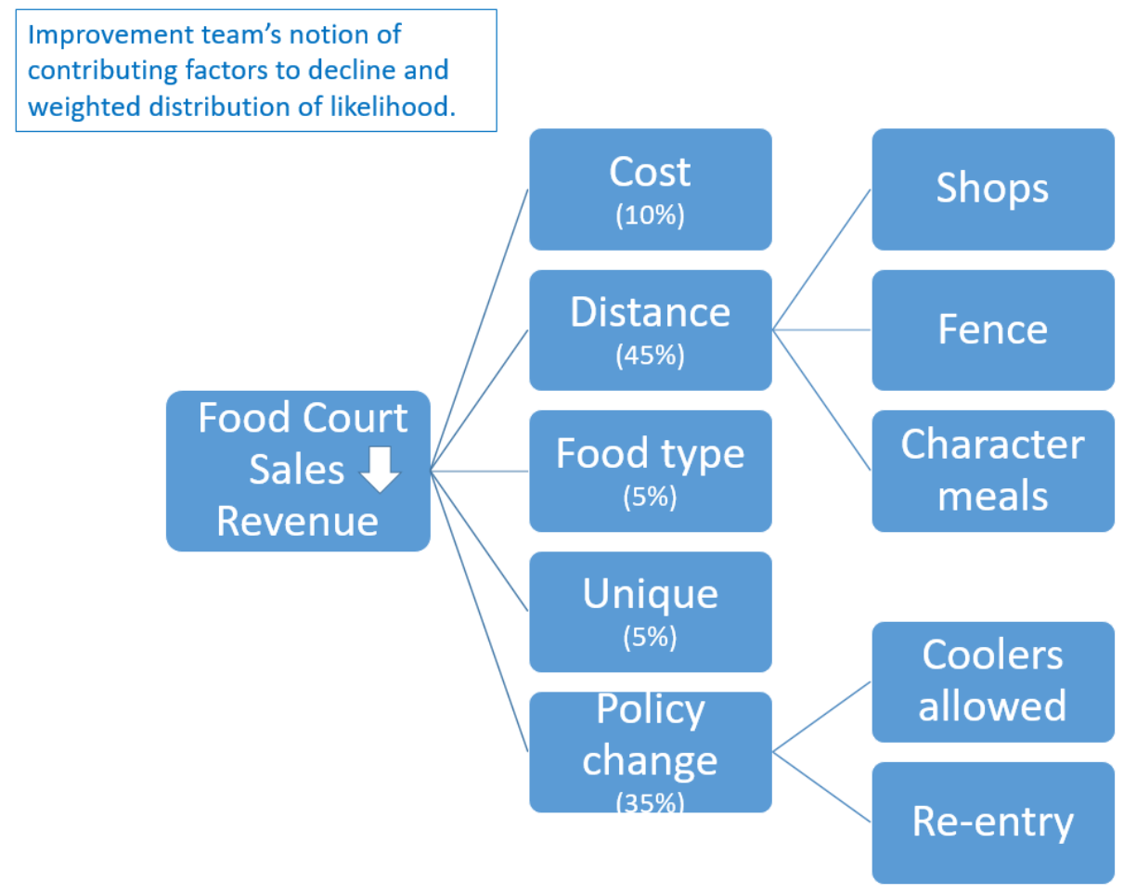

Slide 7
Thank you!
DDDM-Amusement Park Scenario

