Slide 1
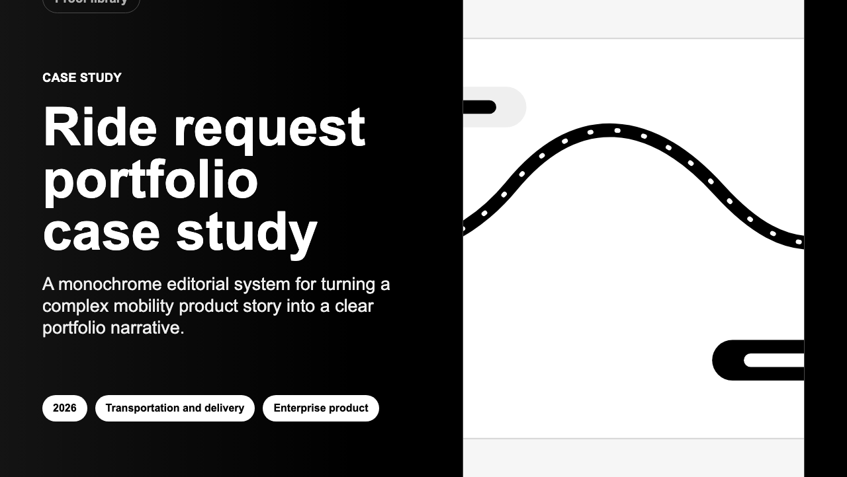
3-SLIDE PITCH
Turn project work into proof people can send.
The app helps teams turn messy project details into clear case studies, sales documents, reports and visuals.
PDF
Word
Report
Spreadsheet
Banner
One story. Many useful things to share.
01

Slide 2
HOW IT WORKS
Write the story once. Make every file from there.
Instead of rebuilding the same story again and again, the app keeps the important pieces together and turns them into the files people need.
2. Shape the story
1. Add the work
3. Share it
Guided fields help the user explain what happened, why it mattered and what changed.
Project notes, images, outcomes and key numbers live in one place.
Create the polished files without rewriting the story from scratch.
No copy-paste maze.
02

Slide 3
DEVELOPMENT COST
A strong first version will likely cost $180k-$320k.
This is a planning range, not a quote. It assumes the current working app is the starting point and excludes ongoing hosting, support, legal review and sales work.
RECOMMENDED
Full first version
Pilot polish
Hosted app
$180k-$320k
$60k-$100k
$350k-$650k+
12-16 weeks
6-8 weeks
Recommended path: accounts, imports, exports, reports, backups, testing and launch docs.
5-7 months
Make setup easier, improve templates, polish the user experience and run focused QA.
Adds multi-user hosting, monitoring, billing/onboarding and deeper security review.
Estimate basis: 2026 US agency rates around $100-$149/hr, plus custom software benchmark ranges for MVP and medium-complexity builds.
03

