Slide 1
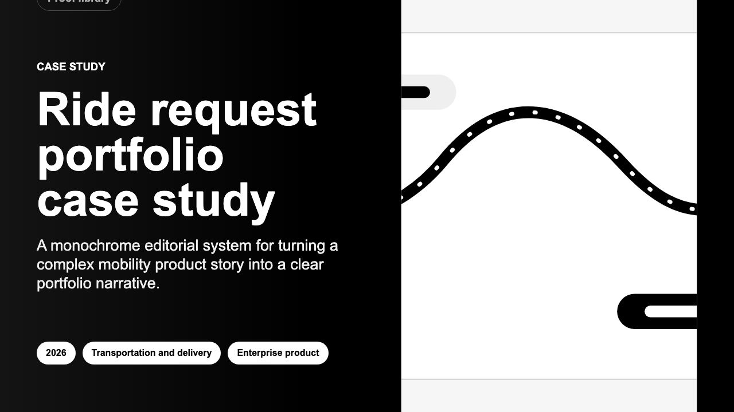
PITCH DECK | MAY 2026
Local-first
case-study builder
Turns one structured source into client-ready stories,
engineering reports, business-development documents and
sales assets without sending sensitive proof into a cloud
workflow.
03
05
16:9
CI
working surfaces
export formats
sales banners
release gates
case studies, BD docs, engineering reports
PDF, DOCX, Markdown, XLSX, PNG
1600 x 900 generated artwork
checks, tests, export and smoke flows
Sources: README.md; exports/visual-snapshots/case-study-banner.png
01

Slide 2
BOTTLENECK
The expensive work is not writing once; it is rewriting safely everywhere.
Portfolio, BD and engineering proof tends to fragment across docs, decks, PDFs and
screenshots. The app attacks the rewrite loop rather than adding another publishing
surface.
Manual proof loop
Structured proof loop
Draft in docs
context slips
JSON source
single source
Paste into deck
format drift
Builder workspace
editable draft
Rebuild PDF
asset risk
Preview route
visual QA
Rewrite outreach
stale proof
Export family
same story
The pitch
Turn proof work into a repeatable system, not a set of one-off documents.
Sources: README.md; data/bd-documents/enterprise-build-support.json
02

Slide 3
PRODUCT SYSTEM
A JSON core makes every artifact an output, not a rewrite.
The platform is already structured as source data, dedicated authoring
surfaces, export workers, and production controls.
Source layer
Workspace layer
Output layer
Project JSON
Case-study builder
Client artifacts
case-study story, metrics,
assets
draft, preview, asset
visibility
A4 PDF, DOCX, Markdown
BD JSON
BD builder
Data assets
buyer problems, process,
proof
sales-facing proof and offers
XLSX impact workbook
Report source
Engineering reports
Sales media
outline, sections, uploaded
images
sections, subsections,
compiled PDF
1600 x 900 banner PNG
Governance rail
role-based access | backup snapshots | file-signature checks | HTTPS enforcement | queued render workers
Sources: README.md; docs/production.md; src/server.js
03

Slide 4
OPERATOR JOURNEY
The user moves from draft to deliverable without surrendering local control.
Import, edit, preview and export happen through local routes and files. For
internal deployment, access roles, backups and render queues preserve the same
control model.
01
02
03
04
05
06
Import
Structure
Preview
Render
Package
Backup
PDF or Word content
becomes editable draft
fields
source JSON captures
story, metrics and
asset visibility
HTML routes expose the
exact artifact before
export
Playwright workers
generate PDF and
banner files
PDF, DOCX, Markdown,
XLSX or PNG leaves the
app
production saves copy
timestamped snapshots
Local-control contract
data on disk | role-gated write paths | signature-checked uploads | serialized render jobs | restore from BACKUP_DIR
Sources: README.md; docs/production.md
04

Slide 5
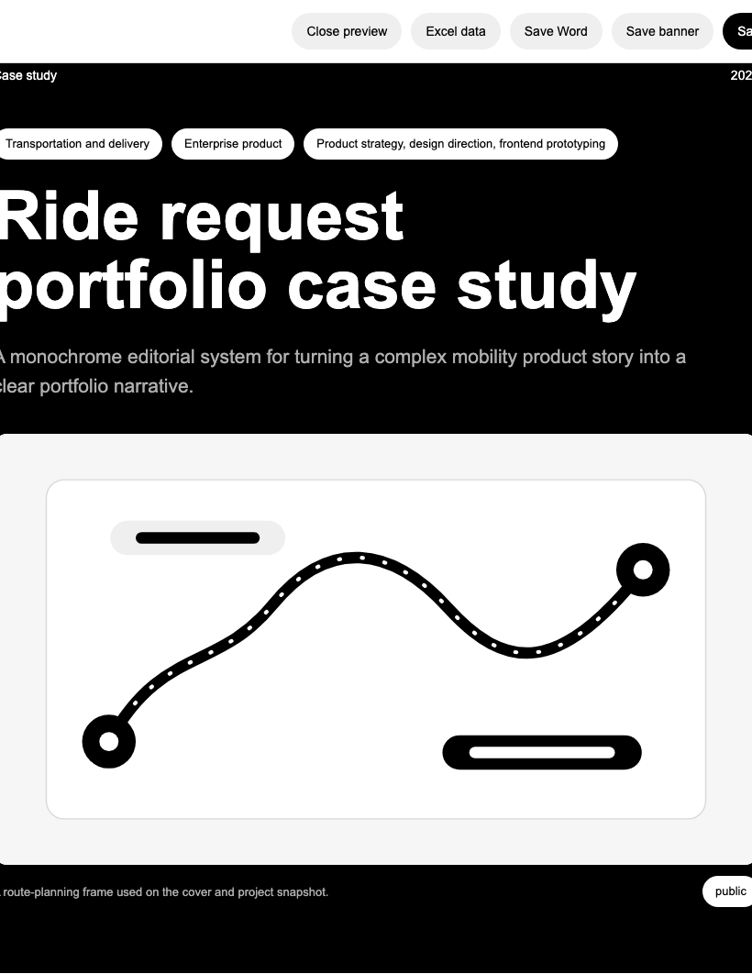
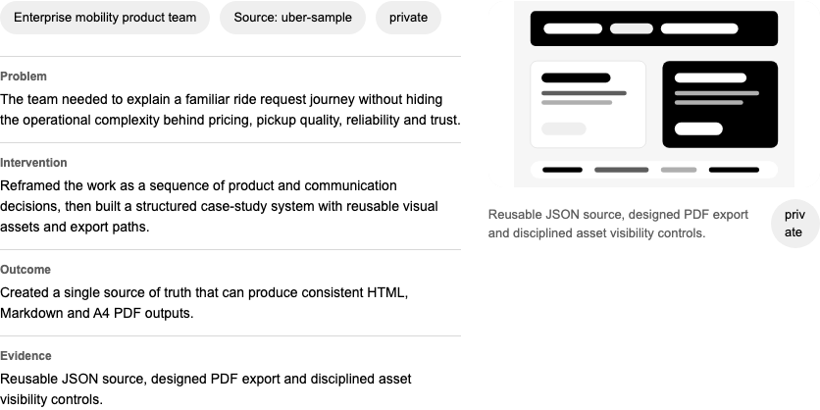
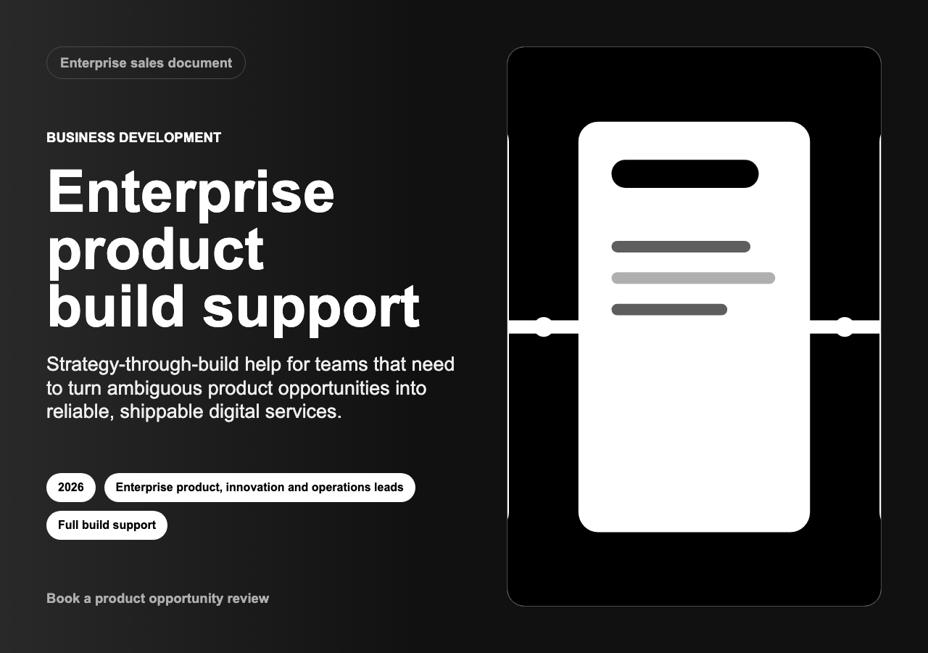
OUTPUT PROOF
The app already produces the formats buyers ask to see.
BD proof section
PDF
designed A4 outputs
Marketing banner
Case-study PDF
DOCX
editable client handoff
MD
versionable content
XLSX
impact data
PNG
sales/banner media
The pitch is tangible: the repo contains real generated PDFs, banners, Markdown and an XLSX workbook, plus
visual smoke snapshots for quality checks.
Sources: exports/visual-snapshots/*.png; README.md export section
05

Slide 6
RELEASE DISCIPLINE
The release path tests artifacts, experience, and production controls.
This matters because the product promise is an artifact promise. A broken PDF,
banner, keyboard path or backup flow would break the buyer story.
Syntax checks
server, builders, templates, workers and export scripts
Node tests
auth, backups, projects, BD documents, reports, assets
Current proof
Render preflight
Chromium availability before PDF or banner jobs
8+
Export generation
Markdown, XLSX, PDF, engineering PDF, BD PDF, banners
scripted gates
package.json and README
Experience smoke
dashboard, routes, responsive surfaces and export links
QA
Quality smoke
keyboard paths, semantic labels, long-copy stress, snapshots
visual snapshots
Production smoke
hashed users, BACKUP_DIR and TLS proxy enforcement
saved under exports/
Sources: package.json; README.md; docs/production.md
06

Slide 7
DIFFERENTIATION
Local-first is the wedge: confidentiality plus polished proof.
The product does not compete by being another shared writing canvas. It competes where
sensitive work still has to become sharp commercial evidence.
Cloud sales rooms
This app
local proof engine
Confidential control
Generic docs
Deck templates
Artifact quality
Structured source, editorial outputs and deployment controls meet in one local proof engine.
Sources: docs/production.md; README.md; strategic framing from current feature set
07

Slide 8
BUYER WEDGE
The first buyers sell expertise through proof.
The strongest wedge is not all content teams. It is teams whose credibility
depends on turning confidential work into specific, reusable evidence.
Senior independents
Product consultancies
Internal product teams
Design/innovation teams
portfolio refresh
BD proof
exec updates
safe storytelling
case-study PDF + banner
offer doc + proof
sections
engineering report +
appendix
visibility-gated assets
Land
Expand
Embed
Defend
GTM motion
start with hands-on proof creation, package repeatable templates, then sell internal deployment where confidentiality matters
Sources: data/bd-documents/enterprise-build-support.json; README route groups
08

Slide 9
ROADMAP
The product can expand from builder to proof operating system.
The current repo is already past concept: the next work is packaging, repeatability and
pilot evidence rather than proving whether the export engine can exist.
Current build
Productization sprint
Pilot system
local app, JSON sources,
builders, previews, exports,
auth, backups, CI
packaged setup, template
library, polished empty states,
pilot-ready docs
team workflows, review states,
evidence library and optional
hosted deployment path
Case-study builder
Onboarding path
Permissioned proof library
BD document builder
Template governance
Review workflow
Engineering report workspace
Export QA polish
Hosted-service gap closure
No invented traction: pilot metrics should be gathered in the sprint, then added to this story.
Sources: docs/production.md remaining gaps; README.md current capabilities
09

Slide 10
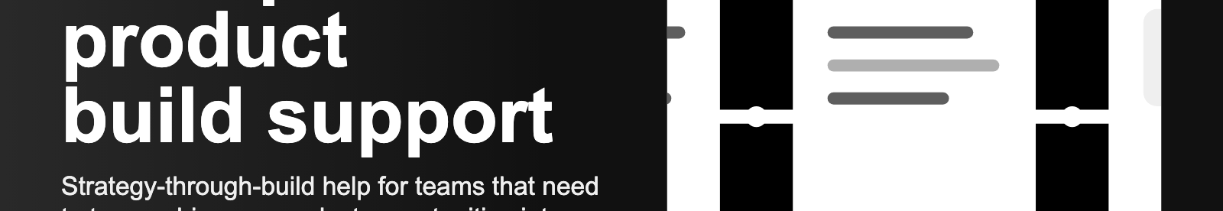
THE ASK
Fund the sprint that turns a working local app into a repeatable proof engine.
The credible next bet is focused: package the product, sharpen the default
templates, and run pilots that generate real usage and conversion evidence.
Sprint success gates
Package
Polish
Pilot
pilot setup under 30 minutes
one-command setup,
production checklist,
sample data reset
empty states, import
guidance, export QA,
template library
3-5 proof-heavy teams,
measured artifact cycle
and reuse
exports pass visual QA
users reuse one source in 3+ outputs
production controls documented
Working artifact engine today; pilot evidence next.
Sources: current repo capabilities; README.md; docs/production.md
10

