Slide 1
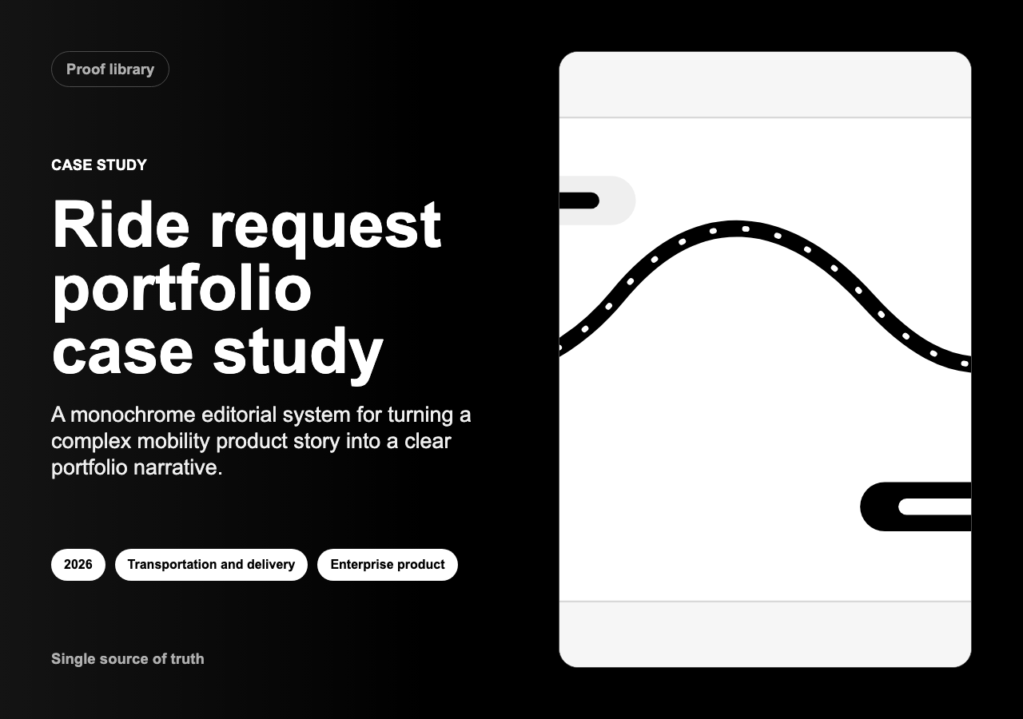
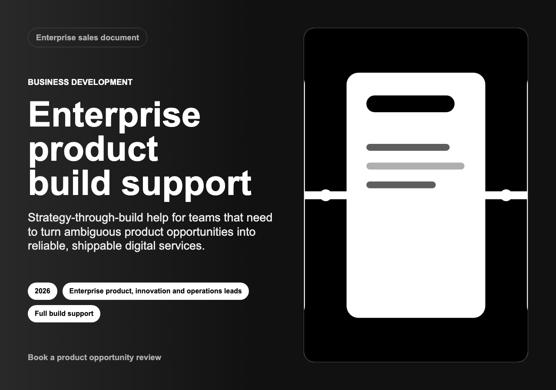
PITCH DECK
Build the app with a product design process, not a handoff chain.
The playbook gives us a simple path: learn what people need, test the experience, build the right version, then improve it after launch.
Current prototype
Fully functional app
Clear build decision
Decision needed: internal separate teams or one external agency team.
10-slide pitch deck | June 2026
01

Slide 2
WHY THE PLAYBOOK MATTERS
The biggest risk is building the wrong thing well.
The app already has useful pieces. The next step is turning those pieces into a product people trust and use.
Without a shared process
With the playbook
What improves
Teams can work hard and still miss each other. Research sits apart from design. Design sits apart from build. Launch arrives with unanswered questions.
Each phase ends with a clear decision. Everyone can see what we learned, what we chose, what is ready to build, and what still needs work.
Better product choices
Less rework
Clearer launch quality
Proof after launch
Product Design Digital Playbook pitch
02

Slide 3
PROCESS MAP
Nine gates take the work from idea to learning.
Each gate is a plain checkpoint. We only move on when the evidence is good enough for the next spend.
00
01
02
03
04
05
06
07
08
Fit
Discover
Define
Concept
Prototype
Validate
Delivery
Launch
Learn
Frame the right problem
Shape the right experience
Build and keep learning
Opportunity fit, discovery, and problem clarity.
Concepts, prototypes, tests, and design decisions.
Handoff, QA, launch, measurement, and improvement.
Product Design Digital Playbook pitch
03

Slide 4
PLAYBOOK PROCESS
Part 1 of 3
Prove the problem before designing the solution.
This first section makes sure the team agrees what is worth solving, who it is for, and what success will mean.
00
01
02
03
04
05
06
07
08
Fit
Discover
Define
Concept
Prototype
Validate
Delivery
Launch
Learn
00
Opportunity fit
01
Discover
02
Define
Decide whether this is worth exploring.
Output: brief, owner, early measures, assumptions.
Understand people, context, and pain points.
Output: research notes, journey map, open questions.
Choose the problem and success criteria.
Output: problem statement, user scenario, design principles.
Plain meaning: name the user, the need, and the measure before spending build money.
Product Design Digital Playbook pitch
04

Slide 5
PLAYBOOK PROCESS
Part 2 of 3
Test the experience before committing the build.
This middle section turns the idea into something people can react to before it becomes production software.
00
01
02
03
04
05
06
07
08
Fit
Discover
Define
Concept
Prototype
Validate
Delivery
Launch
Learn
03
Develop concepts
04
Prototype
05
Validate
Try several solution directions before choosing.
Output: selected idea, risks, prototype plan.
Make the experience tangible with flows, content, and wireframes.
Output: clickable prototype.
Test with users and evidence.
Output: usability, accessibility, and content improvements.
Plain meaning: learn cheaply while the product is still easy to change.
Product Design Digital Playbook pitch
05

Slide 6
PLAYBOOK PROCESS
Part 3 of 3
Build the whole product system, not just screens.
This final section prepares the app for real use, safe launch, and practical learning after it ships.
00
01
02
03
04
05
06
07
08
Fit
Discover
Define
Concept
Prototype
Validate
Delivery
Launch
Learn
06
Delivery design
07
Build and launch
08
Learn and improve
Prepare the product for build.
Output: specs, backlog slices, acceptance criteria.
Ship the right thing safely.
Output: design QA, accessibility checks, launch checklist.
Measure what happened after launch.
Output: outcome review, debt triage, roadmap updates.
Plain meaning: the product is finished only when it can be used, measured, and improved.
Product Design Digital Playbook pitch
06

Slide 7
BUILD OPTION A
Internal separate teams know the business, but coordination becomes the work.
This can work, but only if one person owns decisions and the teams reserve real time together.
Product
Design
Engineering
Risk
sets priorities
maps the experience
builds and tests
handoff drag
Works best when
Main challenge
Cost shape
Named people are assigned, calendars are protected, and there is one product owner who can make tradeoffs fast.
Separate team goals can slow decisions. The product may look finished before the workflow, quality checks, and launch support are truly ready.
Lower visible cash cost, but higher hidden cost in meetings, waiting, rework, and stretched timelines.
Product Design Digital Playbook pitch
07

Slide 8
BUILD OPTION B
An external agency gives one accountable delivery team.
The tradeoff is simple: more upfront cash, less internal coordination, and faster access to product, design, engineering, and QA specialists.
One shared team
product
design
Playbook gates
Launchable app
evidence before spend
with support
engineering
QA
One backlog. One sprint rhythm. One build plan.
Works best when
Main challenge
Cost shape
An internal owner is available every week. Subject experts join research, reviews, and launch decisions.
Knowledge transfer must be planned from day one so the product does not leave with the agency.
Higher cash cost, clearer scope, stronger delivery rhythm, and easier accountability.
Product Design Digital Playbook pitch
08

Slide 9
COST AND MODEL CHOICE
The decision is not just cost. It is where the risk sits.
The same product can cost less in cash but more in delay, or more in cash but less in coordination.
Sources: Clutch 2026 pricing guide; Keyhole Software 2026 cost benchmarks.
Internal separate teams
External agency
Visible cost
Lower cash spend because people already work here.
$180k-$320k planning range for a full first version.
Time
Often 5-8 months when people are part-time.
Often 12-16 weeks with a dedicated team.
Main risk
Waiting, handoffs, and rework between teams.
Vendor dependency and knowledge transfer.
Control
High control, but decisions can spread out.
Clearer delivery owner, with internal product owner still needed.
Best fit
When teams can truly reserve time together.
When speed, quality, and accountability matter most.
A larger hosted or enterprise path can move beyond $350k-$650k+ if multi-tenancy, billing, compliance, or deep integrations are added.
Planning ranges based on current public cost guides; not a quote
09

Slide 10
RECOMMENDED PATH
Use the playbook with one accountable build team.
Approve a playbook-led productization sprint.
Best option: external agency team, led by an internal product owner. If the work stays internal, form one dedicated product pod instead of keeping teams separate.
Decision
Choose build model and budget range.
30
60
90
Days 1-30
Days 31-60
Days 61-90
Frame the opportunity. Run discovery. Agree the problem, users, and success measures.
Create concepts. Prototype the strongest path. Test it with real users and improve it.
Prepare build-ready scope, budget, roadmap, QA plan, and launch decision.
Recommendation
10

