Slide 1
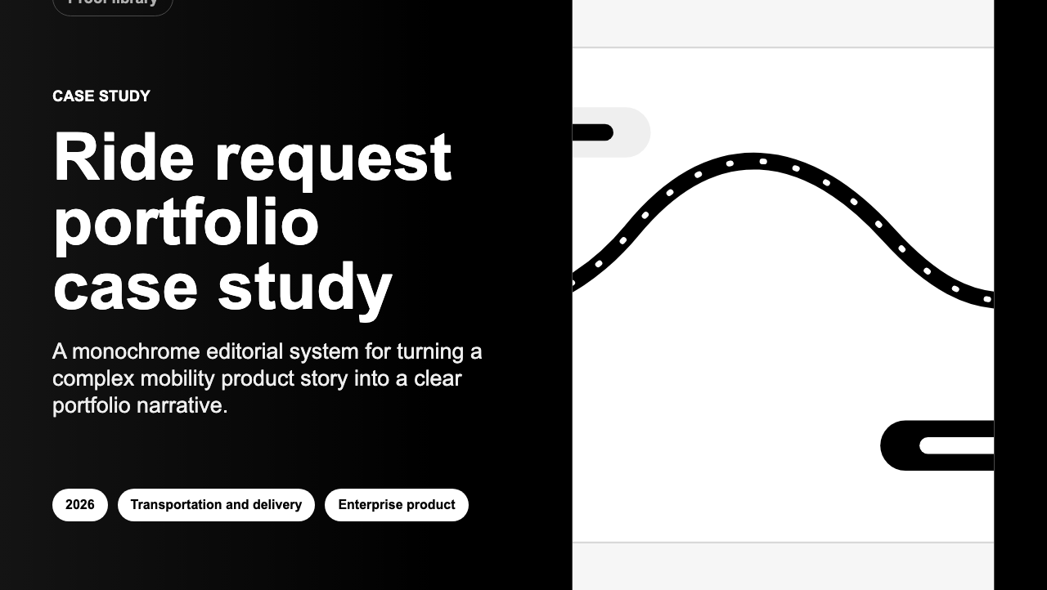
3-SLIDE PITCH
Turn project work into proof people can send.
The app helps teams turn messy project details into clear case studies, sales documents, reports and visuals.
PDF
Word
Report
Spreadsheet
Banner
One story. Many useful things to share.
01

Slide 2
HOW IT WORKS
Write the story once. Make every file from there.
Instead of rebuilding the same story again and again, the app keeps the important pieces together and turns them into the files people need.
2. Shape the story
1. Add the work
3. Share it
Guided fields help the user explain what happened, why it mattered and what changed.
Project notes, images, outcomes and key numbers live in one place.
Create the polished files without rewriting the story from scratch.
No copy-paste maze.
02

Slide 3
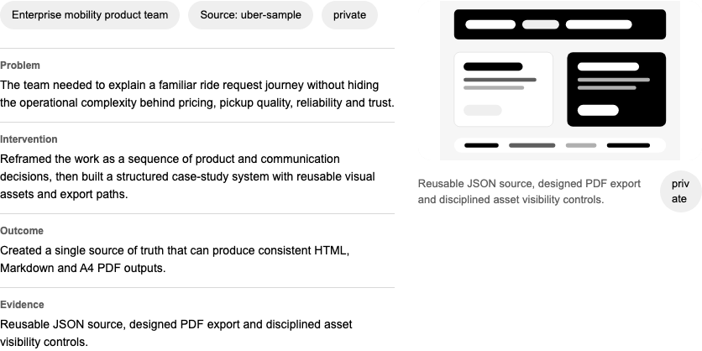
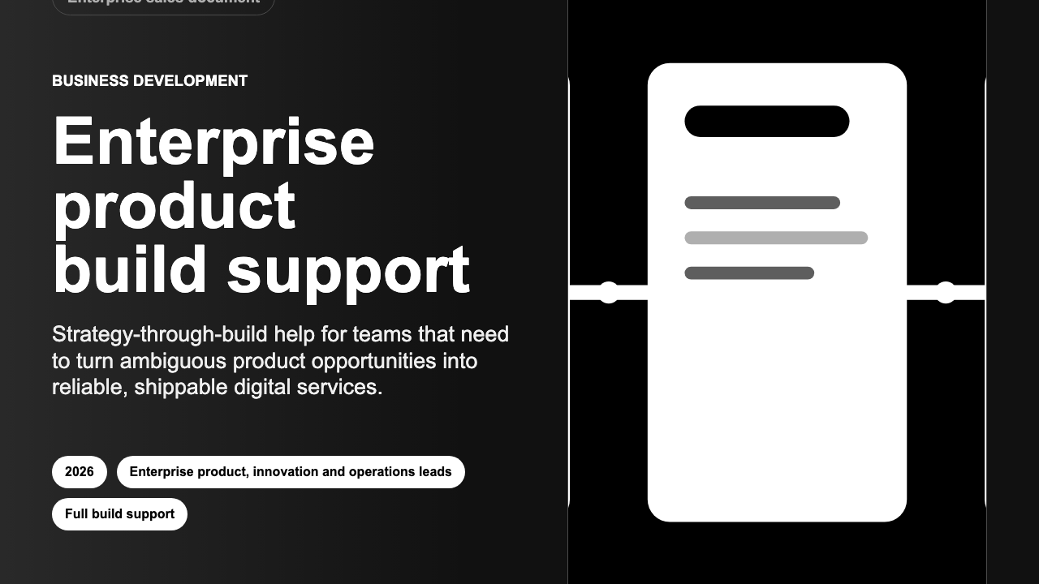
NEXT STEP
A working product is ready for a small pilot.
The next move is simple: package it clearly, test it with a few proof-heavy teams, and learn what they actually use.
Who to test with
What to learn
Consultants, product teams and independent experts who need better proof.
Can they make useful materials faster, with less rewriting and less risk?
Goal: make strong work easier to explain.
03

