Slide 1
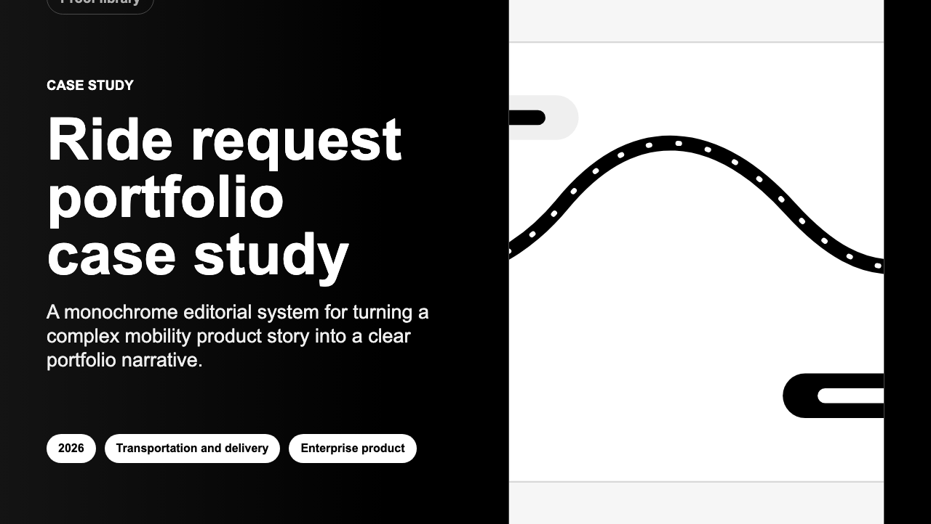
PLAIN-LANGUAGE PITCH
This app turns project work into polished proof.
Write the story once. Then turn it into a case study, a sales document, a report, a spreadsheet, or a banner.
PDF
Word
Spreadsheet
Web preview
Banner image
One place to manage the story. Many useful things to share.
01

Slide 2
THE PROBLEM
Good work is hard to explain when the proof is scattered.
A project story often ends up split across notes, screenshots, PDFs, spreadsheets and old slides. Every update creates another version to fix.
Notes
PDFs
Spreadsheets
Screenshots
Slides
the thinking
the polished version
the numbers
the evidence
the sales story
The real cost is not writing. It is keeping every version clear, current and safe to share.
02

Slide 3
THE IDEA
Keep the story in one place. Make every file from there.
The app keeps project details, images, numbers and notes together. When the story changes, the next PDF or sales document starts from the same source.
2. Shape the story
1. Add the project
3. Share the result
Use guided fields instead of starting from a blank page. The app keeps the important pieces together.
Name the project, describe the work, add useful images and key numbers.
Create a polished PDF, Word file, report, spreadsheet or banner from the same work.
No copy-paste maze.
03

Slide 4
HOW IT FEELS
The path is simple: draft, check, export.
A non-technical user should understand the whole flow without knowing how the app is built.
1
2
3
4
5
Start a project
Bring in source material
Preview it
Export it
Reuse it
Add the story and key details.
Use PDF or Word content when helpful.
See the page before sharing it.
Save the finished file.
Make the next version from the same work.
Simple promise
The app helps people finish the proof, not manage more software.
04

Slide 5
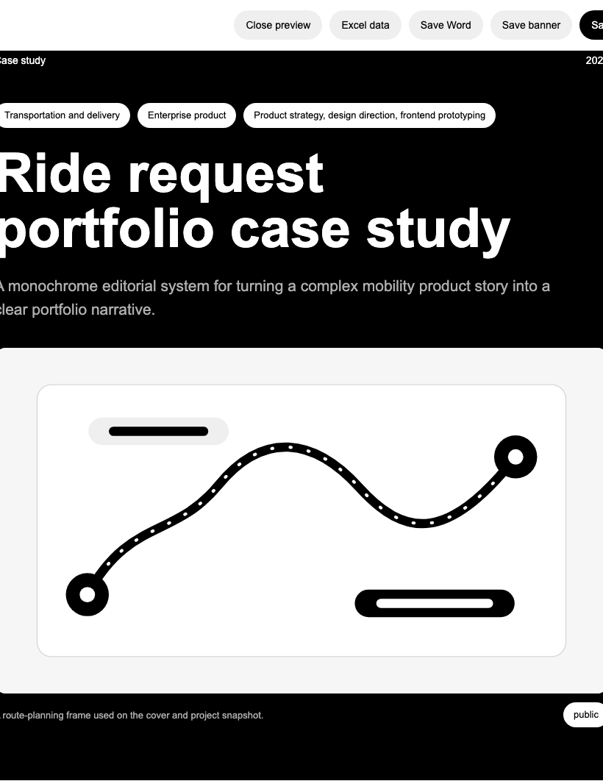
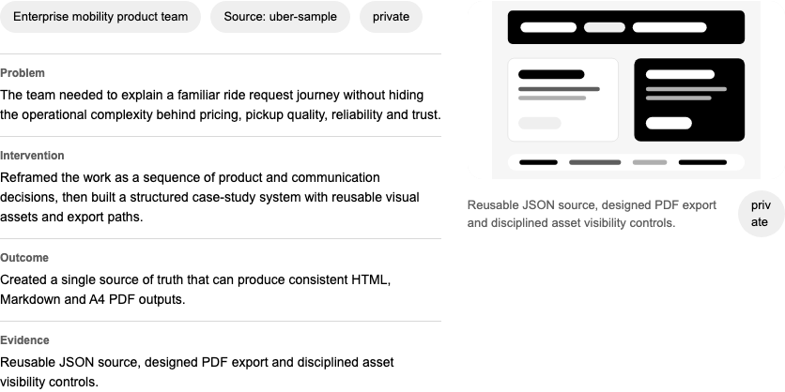
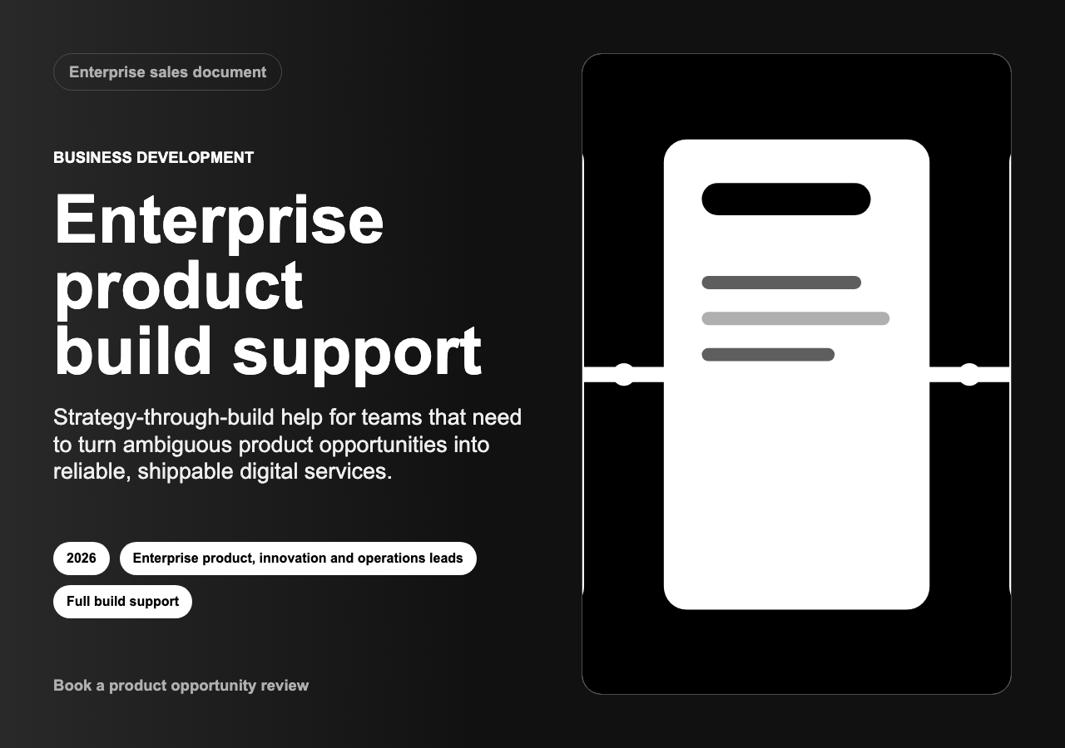
WHAT IT MAKES
These are real outputs from the app today.
Sales document
Case study
Marketing banner
The important point: this is not only a writing tool. It makes finished materials someone can actually send.
05

Slide 6
WHY PRIVACY MATTERS
Some of the best project proof is also the hardest to share.
Client names, internal numbers, product screenshots and unfinished work often need care. This app is designed so sensitive material can stay controlled.
Private by default
Access can be limited
Backups are built in
Work can stay on your own computer or an internal server.
Viewers, editors and admins can have different permissions.
Saved work can be copied to a backup folder for recovery.
The goal is simple: help people show the work without overexposing the work.
06

Slide 7
WHO IT HELPS
The first users are people who sell trust through examples.
They do not just need prettier documents. They need a faster, safer way to explain why their work mattered.
Independent experts
Consulting teams
Product teams
Design teams
need better case studies for their portfolio
need proof for sales conversations
need clear internal reports
need safe ways to show sensitive work
useful fit
strong first market
useful fit
useful fit
The wedge is narrow on purpose: start where clear proof has direct business value.
07

Slide 8
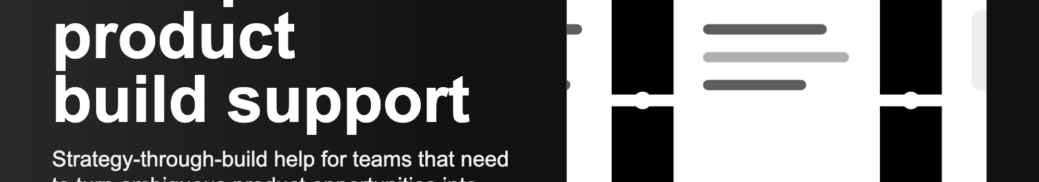
NEXT STEP
Package the working app, then test it with real users.
The next phase should not add noise. It should make the product easier to try, easier to trust, and easier to judge.
Make it easier to start
Polish the default templates
Run a small pilot
clean setup, sample projects and simple help text
better empty states and stronger examples
learn from teams who create proof-heavy work
A working product exists. Now it needs simpler packaging and real-world feedback.
08

