Slide 1
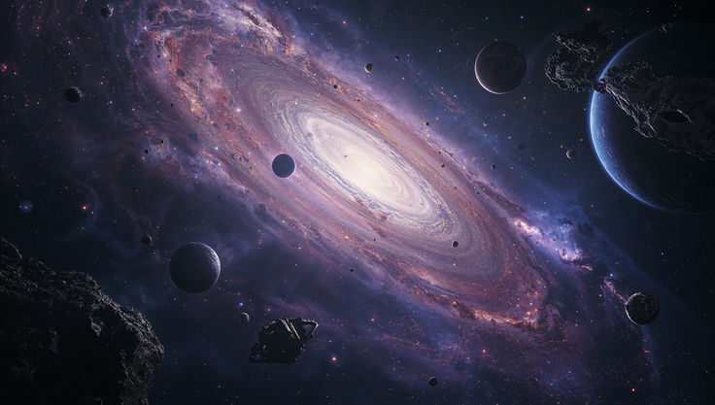
A Science Fiction Journey:
Learning the Secrets of the Stars.
Project Title:
Using AI to Find the Stars That Could Be Home.

Slide 2
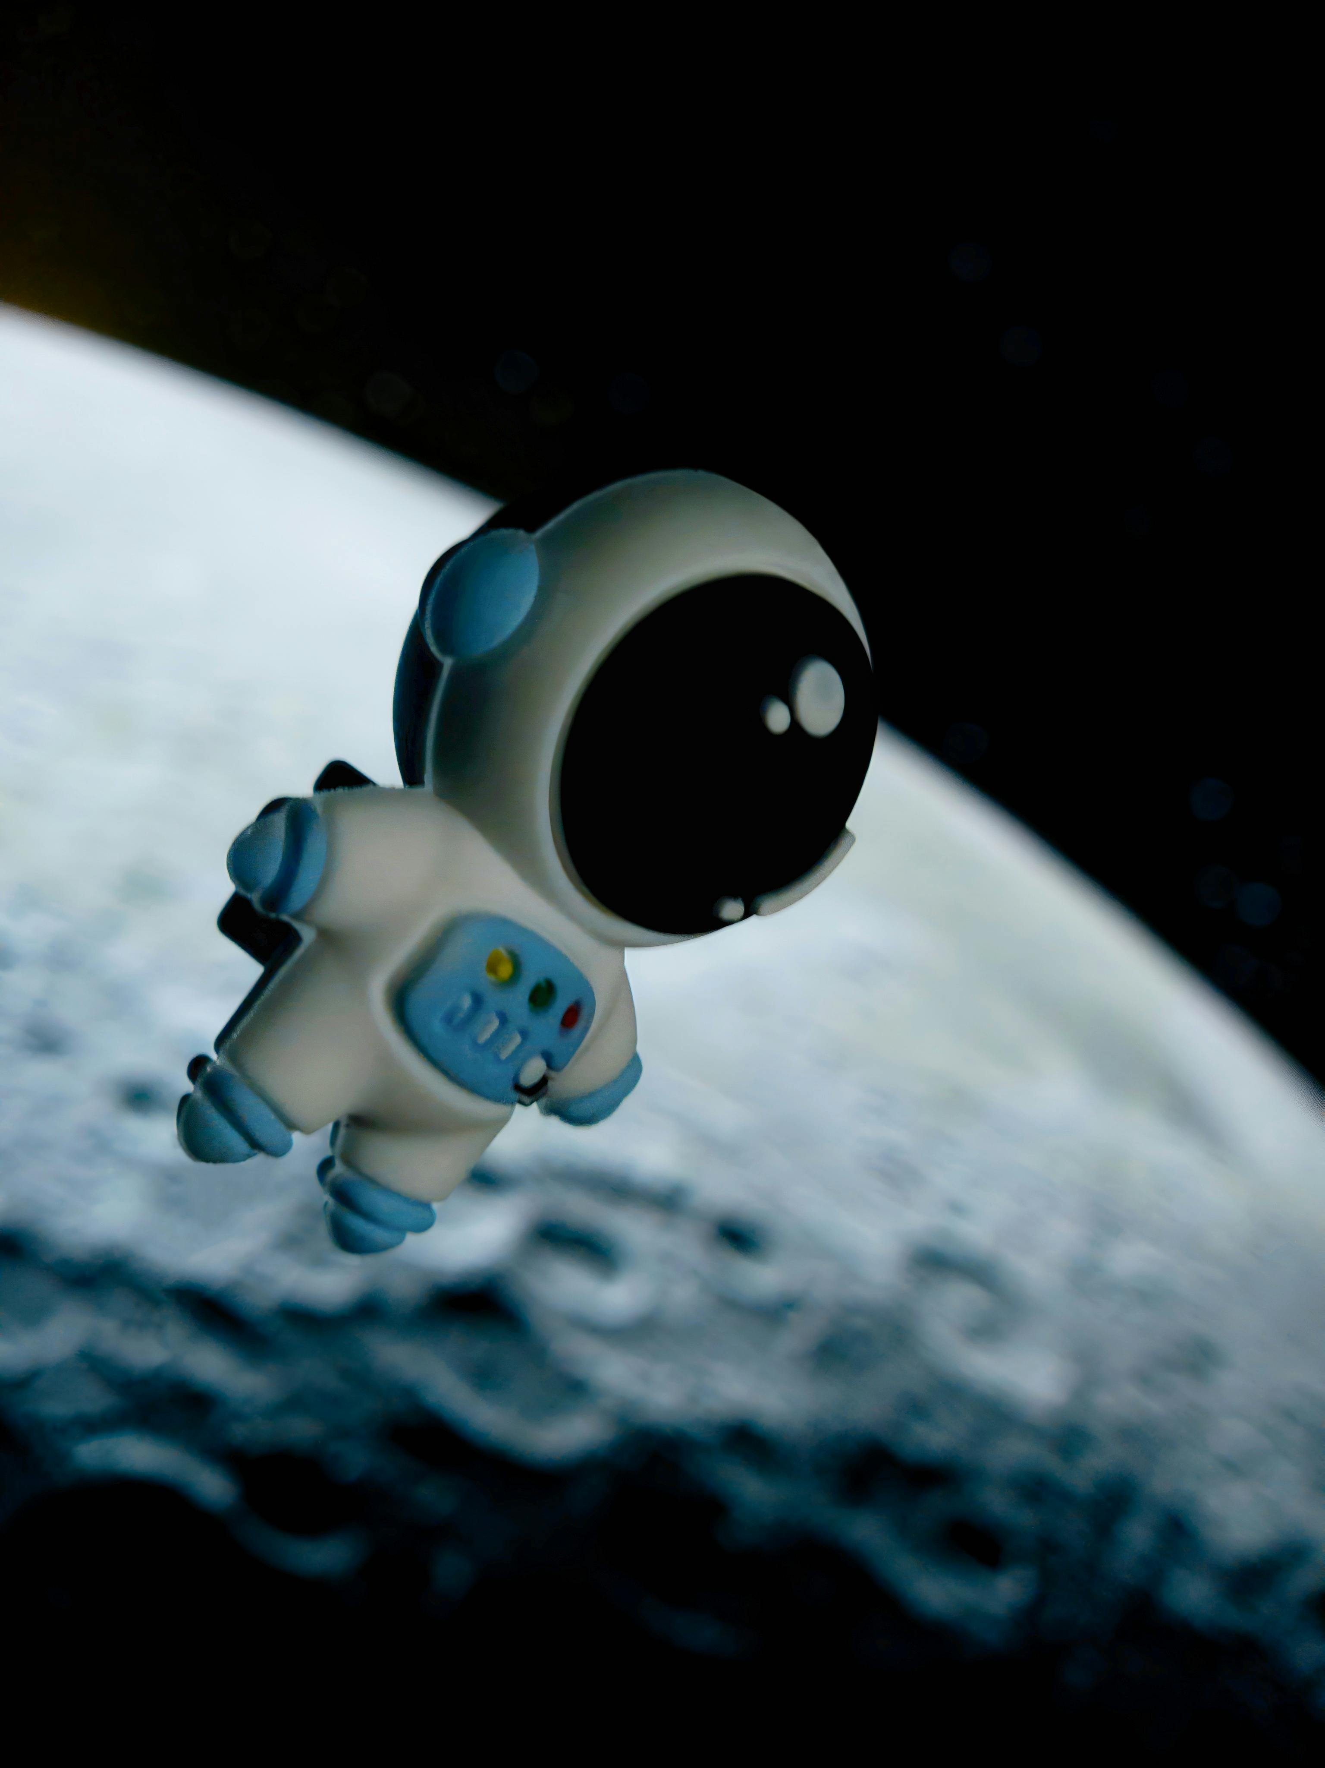
Presented by:
Aleena Khan
(Roll no# ULBSITM23-65)
Incharge:
Sir. Faisal Hafeez

Slide 3
INTRODUCTION:
A smart "Planet Hunter" tool that uses Artificial Intelligence to identify stars in our galaxy.
It scans thousands of stars and find "Sun-like" stars that could host a second home for humans.
Space is too big for humans to study every star manually. This AI does the hard work for us in seconds.

Slide 4
How this project work??

Slide 5
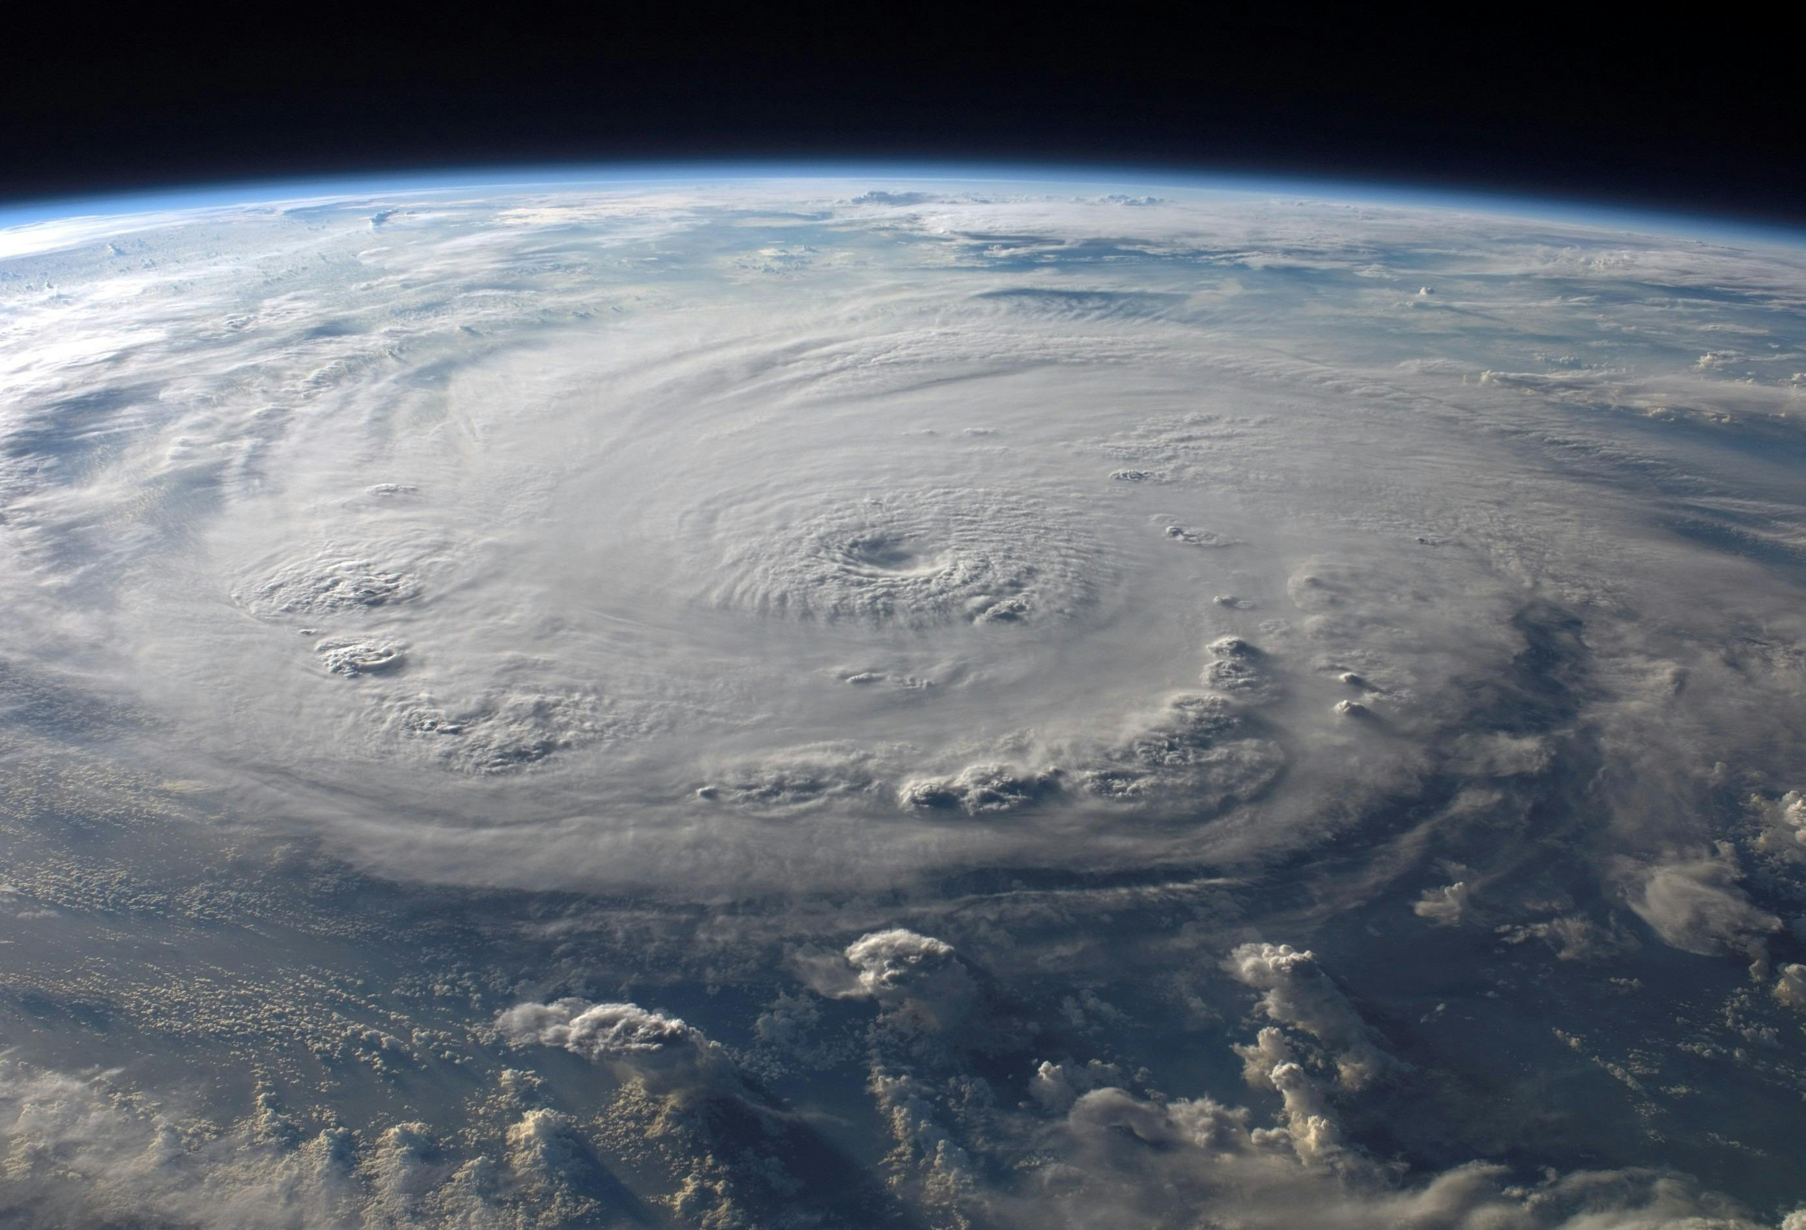
Decision Tree algorithm
DATASET
BRAIN
Star Dataset
sourced Kaggle
Scikit-Learn: The toolkit used to build the Decision Tree
Pandas: Used to load and read the CSV dataset.
Flask
A Python web framework
The Bridge
Libraries

Slide 6
what is
the use of Inputs??
(The Search Terms)

Slide 7
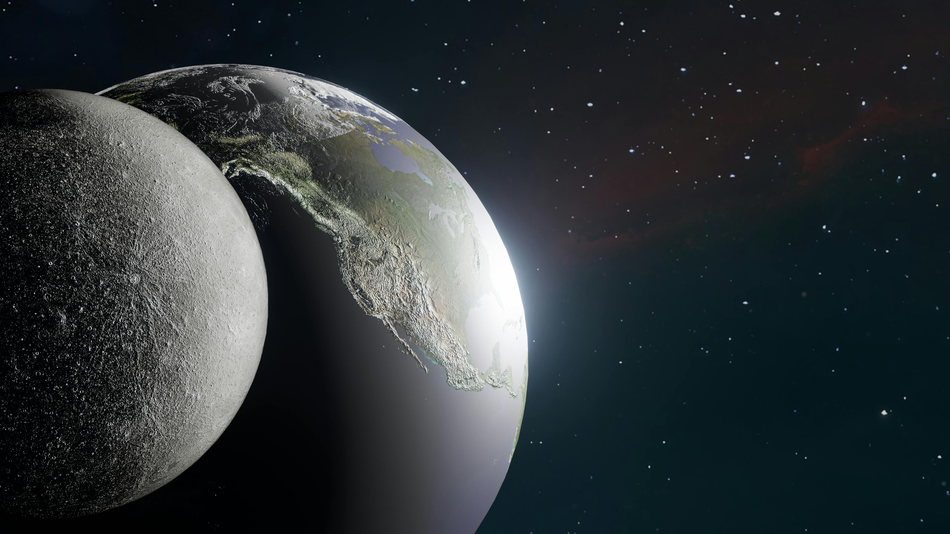
Temperature:
Tells us the color (Blue = Hot,
Red = Cool).
Temperature

Slide 8
Luminosity:
Tells us the total power/brightness of the star.
Luminosity

Slide 9
Radius:
Tells us the physical size (Giant vs. Dwarf).
Radius

Slide 10
Absolute Magnitude:
Tells us the star's true brightness regardless of distance.
Absolute Magnitude

Slide 11
The Story
Title: Operation Nova Terra

Slide 12
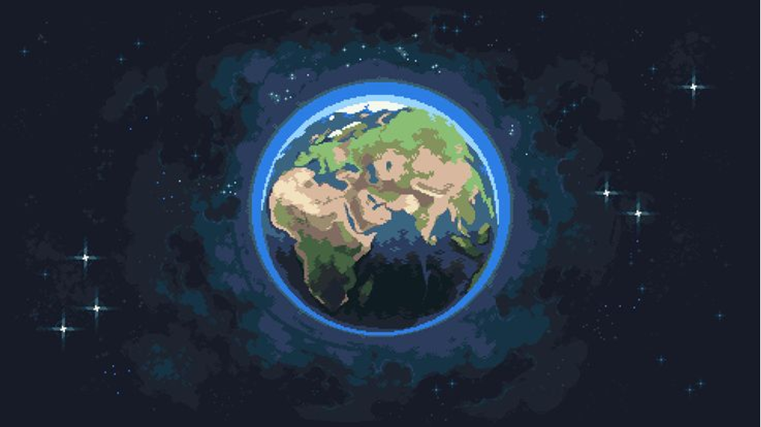
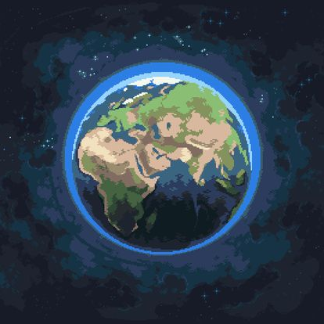
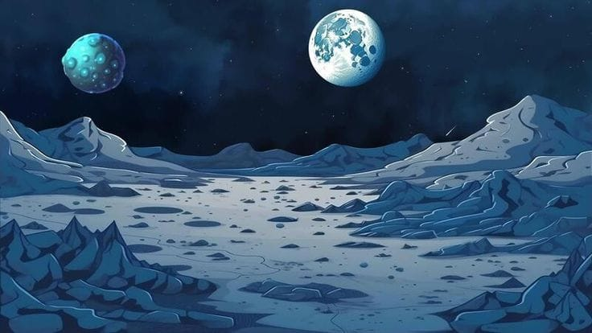
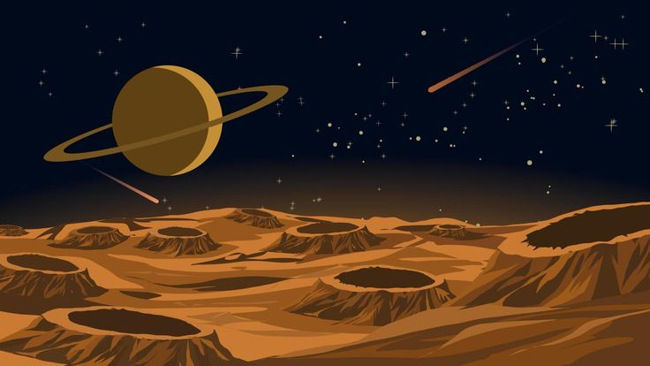
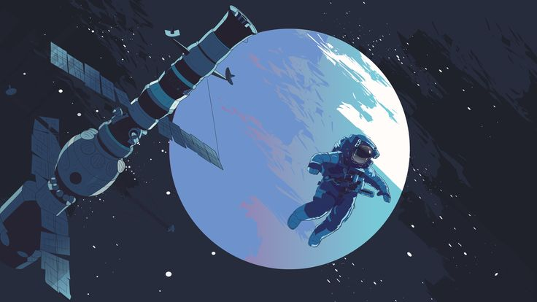
The Start:
Earth is crowded,
and we need a new home.
Player is the Commander of a scouting mission.

Slide 13
The Mission:
Use the AI to analyze mystery stars and find one that matches our Sun’s parameters.

Slide 14
The system checks the unknown star's location through our inputs
and ignores stars that are too small or too large.
We are looking for a star that is just like our Sun

Slide 15
The Ending:
Once the AI identifies a Sun-like star, the ship sets a course for the new system, giving humanity a chance to survive on a "New Earth.

Slide 16
Classification
Red Giant
Blue Giant
White Dwarf
Red Dwarf
Sun-like

Slide 17
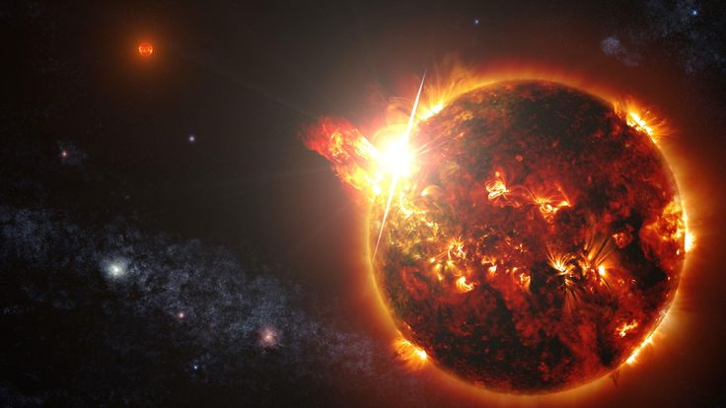
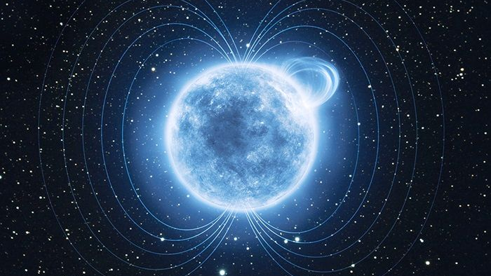
A dying, bloated star. Very big and bright, but too unstable for life.

Slide 18
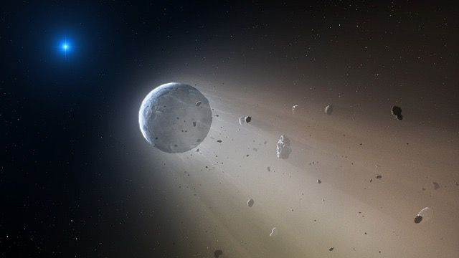
A massive, super-hot star. They burn fast and die young.

Slide 19
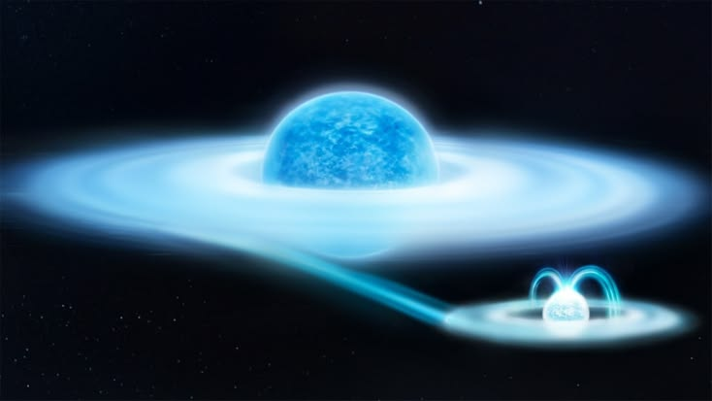
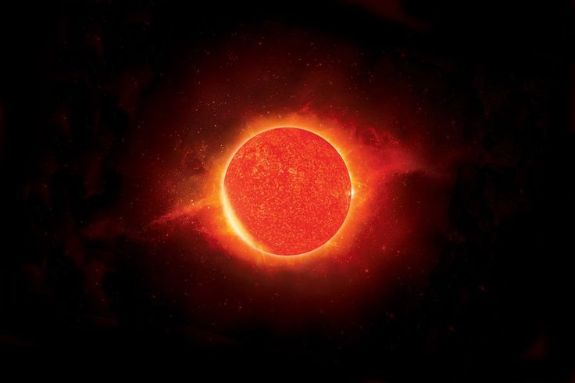
A tiny, Earth-sized "ghost" of a dead star. Very hot but very small.

Slide 20
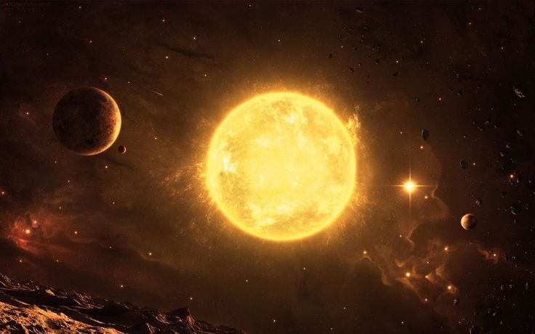
Small, cool, and long-lived. The most common "hybrid" stars in space

Slide 21
Our "Nova Terra" target. Perfect heat and size for life.

Slide 22
Thank You!
for listening......

