Slide 1
hcqc - HPC compiler quality checker
Masaki Arai masaki.arai@linaro.org
LEG HPC-SIG

Slide 2
Background and Purpose
The quality of the kernel part is important in HPC applications(number crunch on supercomputer).
Make it easy to check the quality of compiler optimizations and acquire data to improve them
Check changes due to compiler version updates
My task in HPC-SIG
Improve optimizations in Clang/LLVM for HPC applications
Need some tools for acquiring and summarizing data
→ hcqc：HPC compiler quality checker

Slide 3
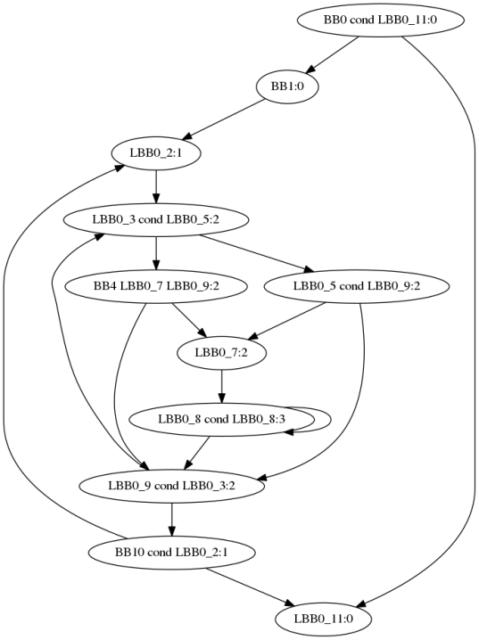
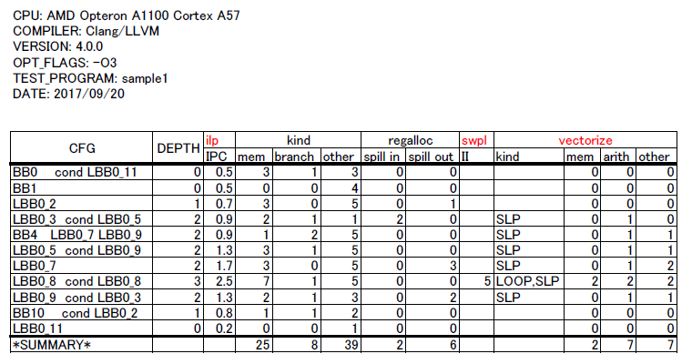
Goal of hcqc

Slide 4
Example of execution
See HimenoBMT-static.xlsx (regalloc)
GCC is better than Clang/LLVM.
See hpcg-3.0.xlsx (op)
GCC generates `fmadd’ and `fmsub’ but Clang/LLVM dosesn’t. (Need `-ffp-contract=fast’)

Slide 5
Workflow of hcqc
Compile and run one test program
Verify results by comparing output and answer data
Generate the assembly code and make control flow graph of the kernel part
Get data from:
Assembly codes
Debug information generated by compilers
Extend compilers if necessary
DWARF info, Runtime info, etc.（Future work）

Slide 6
Overview of `hcqc'
{
“DISTRIBUTION" : "OpenSUSE Tumbleweed",
"ARCH" : “aarch64",
"CPU" : "AMD Opteron A1100 Cortex A57",
"LANGUAGE" : "C",
"COMPILER" : “GCC",
"COMMAND" : "/usr/bin/gcc",
"VERSION" : “7.1.1",
"OPT_FLAGS" : ["-O2"],
"ASM_FLAGS" : ["-S“, “-fverbose-asm”],
“FLAG_DB” : [[“?DEBUG_FLAG", “-g”],
[“?C99_STANDARD", “-std=c99”]]
}
Configuration info
Target description
Test program info
Information for build
{
"LANGUAGE" : "C",
"MAIN_FLAGS" : [“?DEBUG_FLAG", “?C99_STANDARD"],
"KERNEL_FLAGS" : ["-DFAST", “?C99_STANDARD "],
"LINK_FLAGS" : [“?C99_STANDARD "],
"LIB_LIST" : ["-lm"],
"MAIN_FILENAME" : "main.c",
"KERNEL_FILENAME" : "kernel.c“,
"KERNEL_FUNCTION_NAME" : "kernel“,
“INPUT" : [“STDIN", "in.data"],
“OUTPUT" : [“STDOUT", “out.data"]
}
All info by JSON format

Slide 7
Metric programs in hcqc
Collect data for specific categories:
op: mnemonics in kernel code
kind: kinds of mnemonics in kernel code
regalloc: # of spill in/out in kernel code
Methods for collecting information depends on compilers
For example in regalloc: hcqc/command/metirc/regalloc
GCC: compile with `–fverbose-asm’ and select memory access mnemonics with comments including `%sfp’
hcqc/command/metirc/regalloc/regalloc001.py
Clang/LLVM: spill codes with comments including `Spill’ or `Reload’
hcqc/command/metirc/regalloc/regalloc001.py
hcqc automatically chooses methods using config info

Slide 8
Implementation of hcqc
Commands by Python3 scripts: ~2000 LOC
Information files by JSON format
Result data files by JSON format
Result report files by CSV format
Control flow graphs by Graphviz`s dot
[
[ "TITLE", ["CFG", "DEPTH", "memory", "branch", "other"]],
[ "kernel ", [ "0", "0", "0", "0"]],
[ ".LFB0 ", [ "0", "0", "0", "17"]],
[ ".L3 ", [ "0", "0", "0", "3"]],
[ ".L5 ", [ "0", "0", "0", "4"]],
[ ".L4 ", [ "0", "0", "0", "21"]],
[ ".L12 ", [ "0", "0", "0", "0"]],
[ ".LFE0 ", [ "0", "0", "0", "0"]],
[ "*SUMMARY*", [ "-", "0", "0", "45"]]]

Slide 9
Test Programs for hcqc
Generate from programs that were problematic in Fujitsu's production compilers in the past
108 programs(104 Fortran and 4 C programs)
Extract kernel parts and modify them to release in public
Extract hot spots
Convert them from Fortran to C(for comparison between GCC and Clang/LLVM)
Prepare the data to run and check those kernel parts
under confirmation process for public release

Slide 10
Future Work
Add supports for SVE(if available in GCC or Clang/LLVM)
Implement metric programs:
vectorization(metric/vectorize)
software pipelining(metric/swpl)
instruction level parallelism(metric/ilp)
Add features for comparing with x86_64(SVE vs. AVX)

Slide 11
demo
Checkout hcqc
URL https://github.com/Linaro/hcqc
Run demo(on AArch64)
`hcqc/RUN.md’ shows how to execute.

