Slide 1
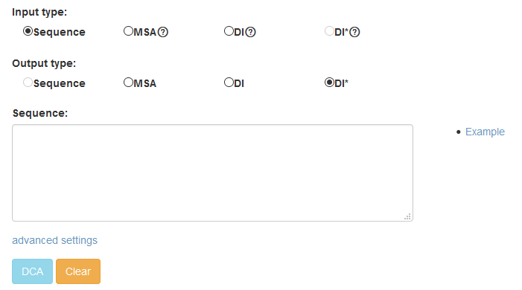
DIs after being ranked to pick out the top L/2 DIs and then processed by removing the isolated points to reduce the false positives
Multiple sequence alignment
Direct informations
Step 1: Select an input type
Step 2: Select an output type
Step 3: Fill in the necessary
input
Click to show the example
Step 4: Submit

Slide 2
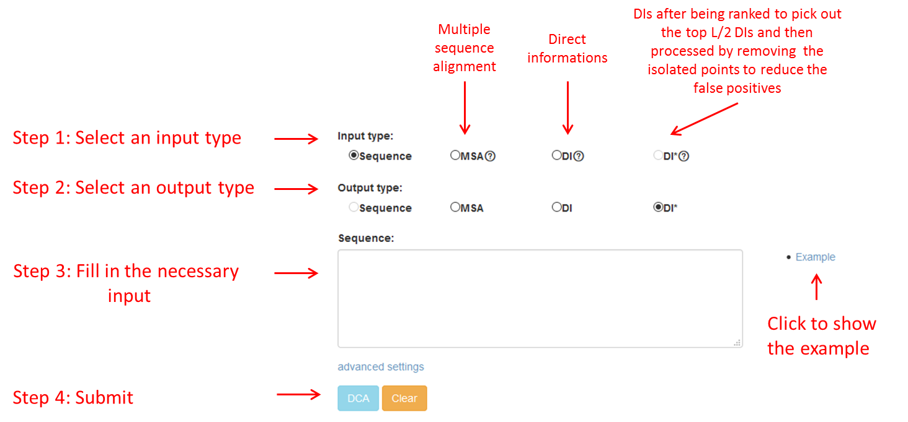

Slide 3
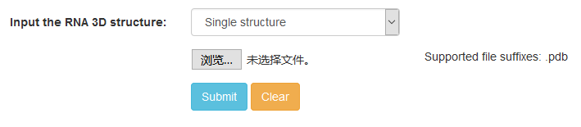
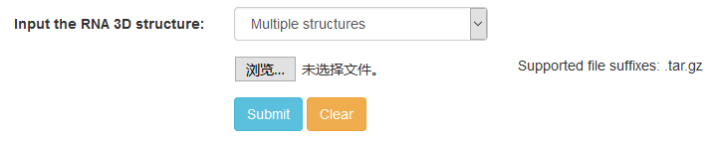
Supported file suffixes
Step 1: Upload a single structure
Step 2: Submit
Step 1: Upload multiple structures
Step 2: Submit

Slide 4
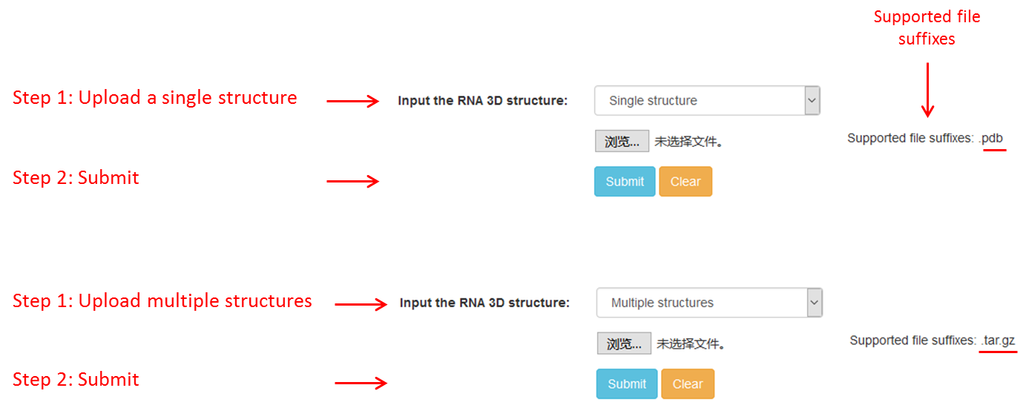

Slide 5
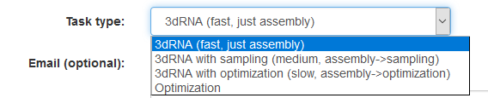

Slide 6
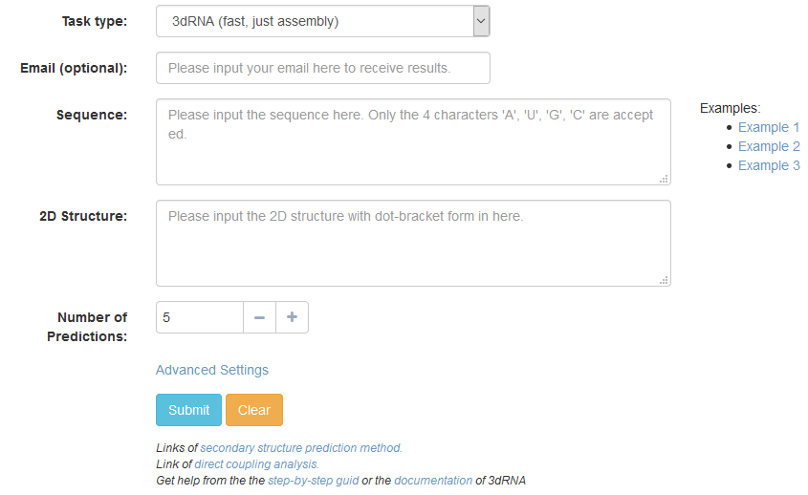

Slide 7
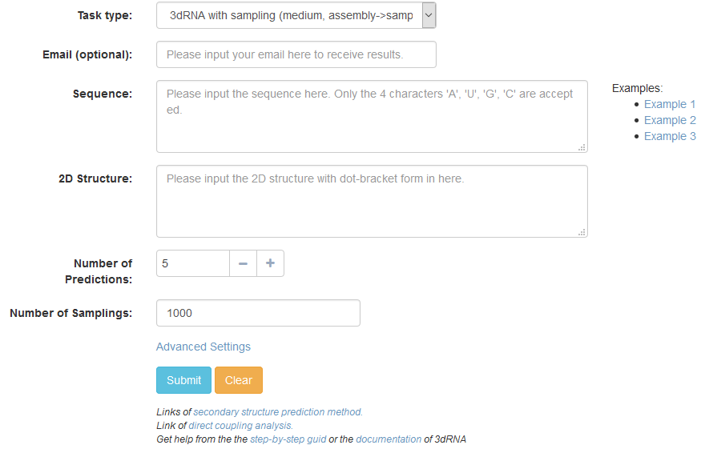

Slide 8
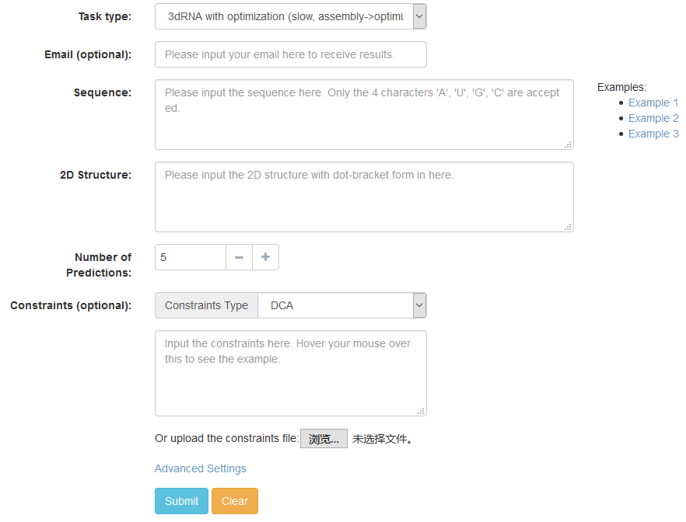

Slide 9
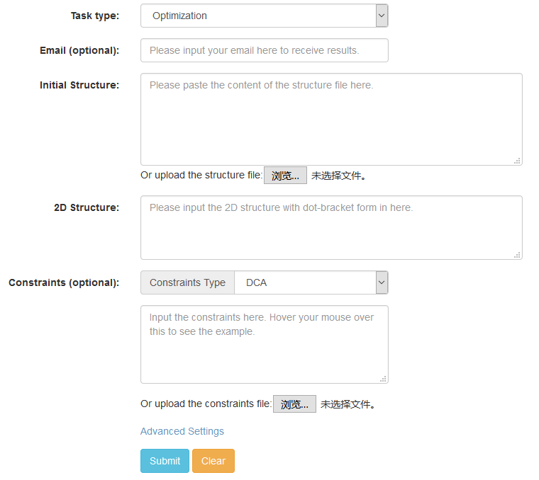

Slide 10
