Slide 1
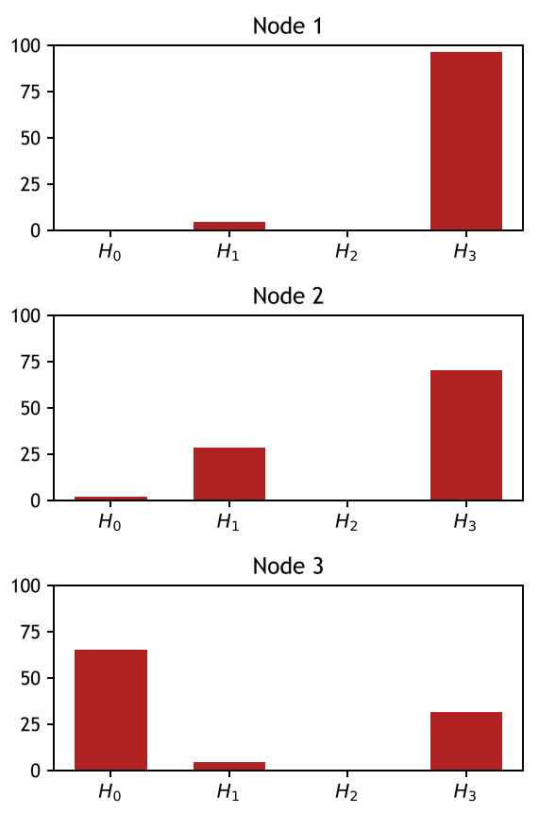
96
0
4
0
70
28
2
0
65
31
4
0

