Slide 1

Assignment 1.2 DSC640-T302
Lincoln Brown
Professor Williams

Slide 2
Dataset
I used the hotdog_contest_winners dataset to complete this assignment.
I created my visualizations with Tableau, R, and Python.
I attempted to make the visualizations as consistent as possible across the different visualization tools. I wanted to challenge myself to not just make the graphs but make the graphs as similar as possible using the different tools so that I could understand the intricacies of color and graph layout.

Slide 3
Tableau Visualizations: Bar Graph
For the first Tableau Visualization, we have a bar graph showing the sum of hot dogs eaten by each country.

Slide 4
Tableau Visualizations: Stacked Bar Graph
Next, we have a stacked bar graph that shows the number of total hot dogs eaten by each contest winner. The number of hot dogs eaten by the winner in each year are segmented in the bar representing the total sum of hot dogs eaten.

Slide 5
Tableau Visualizations: Pie Chart
The pie chart represents the number of dogs eaten by each country.

Slide 6
Tableau Visualizations: Donut Chart
For the donut chart, we are looking at the number of new records set by a winner from each country. Two of the countries (Mexico and Germany) failed to set any new records.

Slide 7
Tableau Visualizations: Line Graph
The line graph shows the number of hot dogs eaten that won the contest each year.

Slide 8
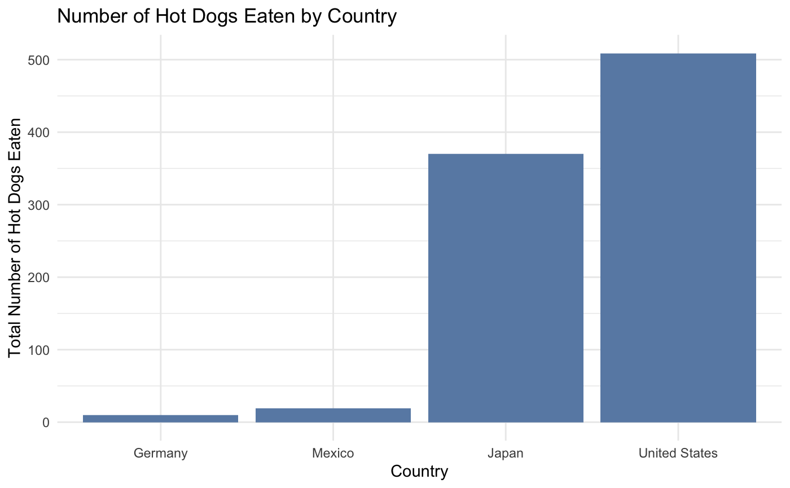
R Visualizations: Bar Graph
The bar graph shows the number of hot dogs eaten by each country.

Slide 9
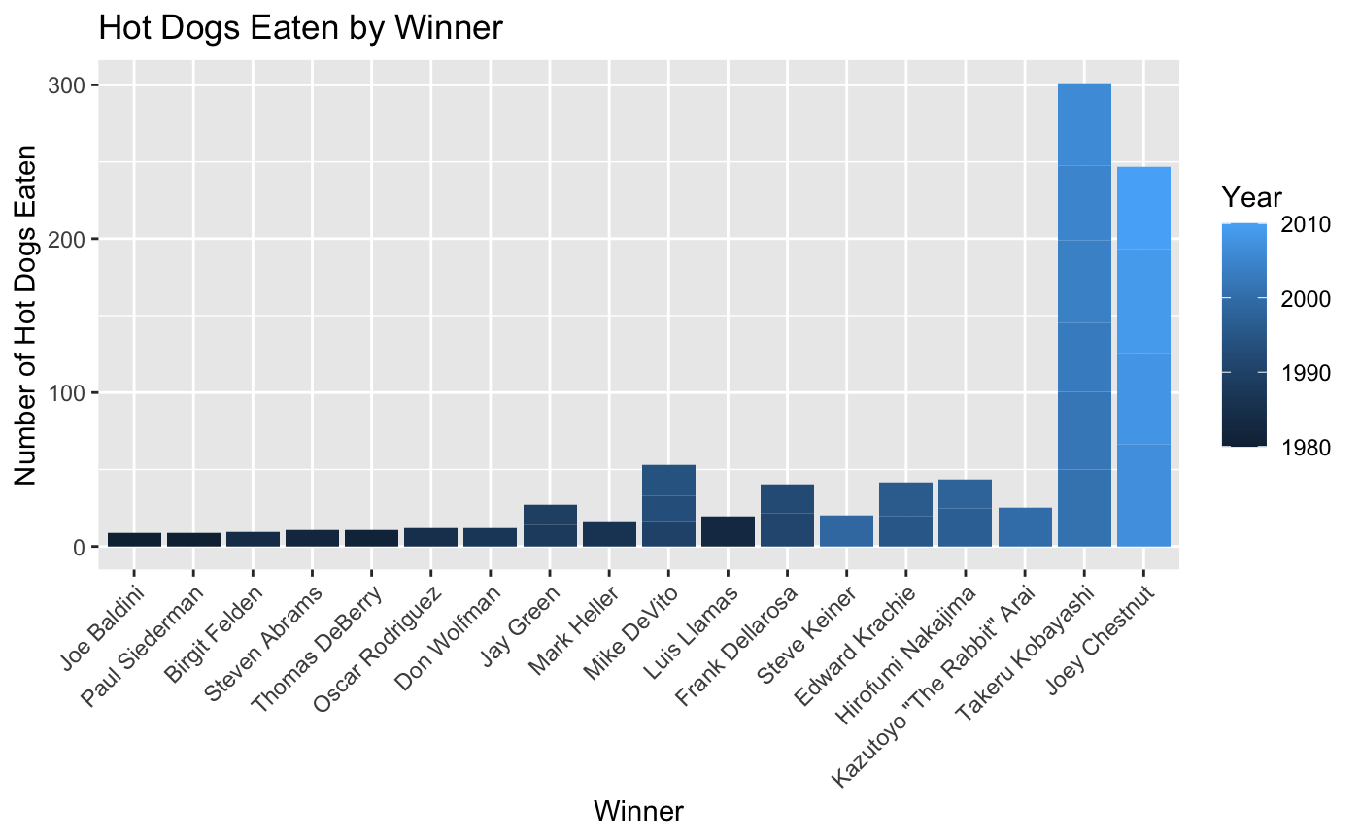
R Visualizations: Stacked Bar Graph
This stacked bar graph shows the number of total hot dogs eaten by each contest winner. The number of hot dogs eaten by the winner in each year are segmented in the bar representing the total sum of hot dogs eaten.

Slide 10
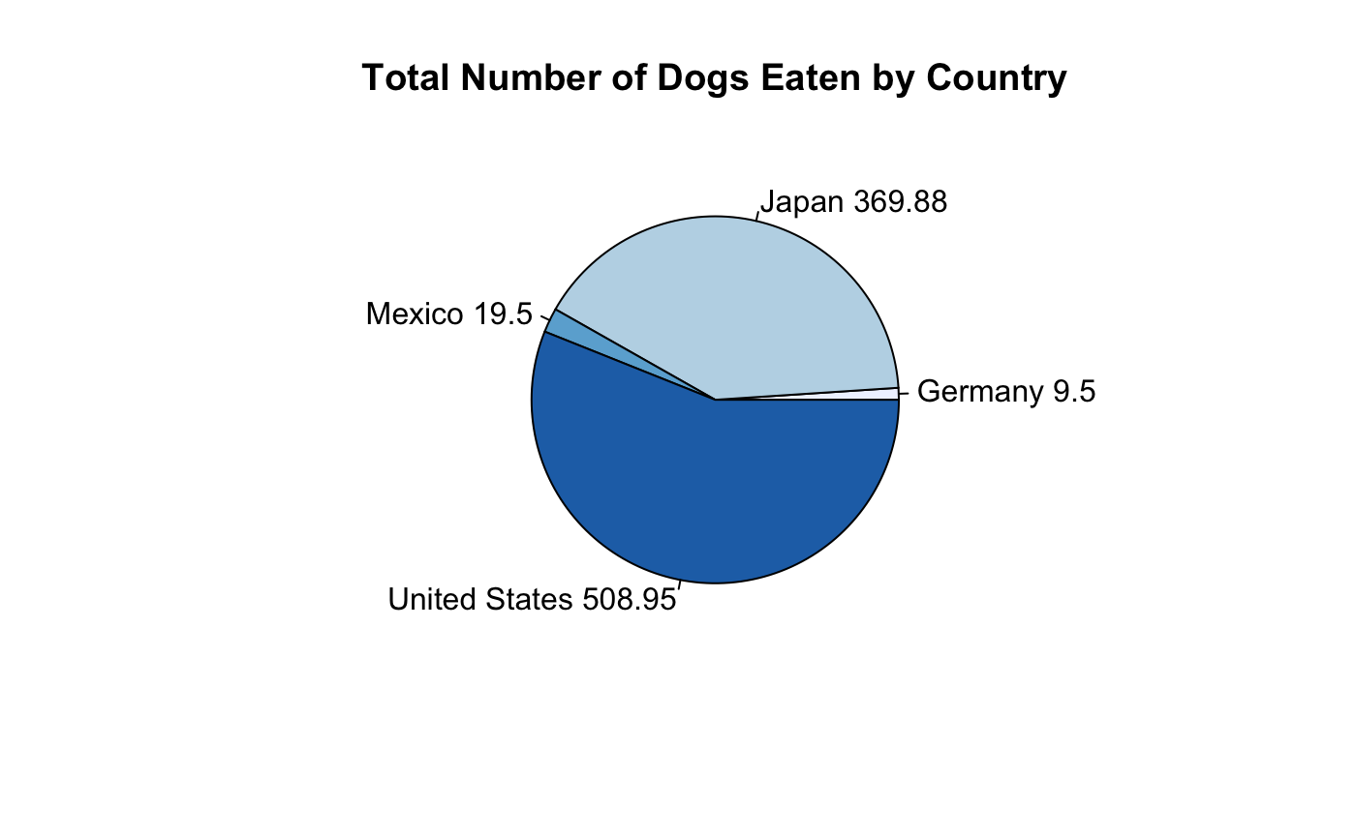
R Visualizations: Pie Chart
The pie chart shows the number of hot dogs eaten by each country.

Slide 11
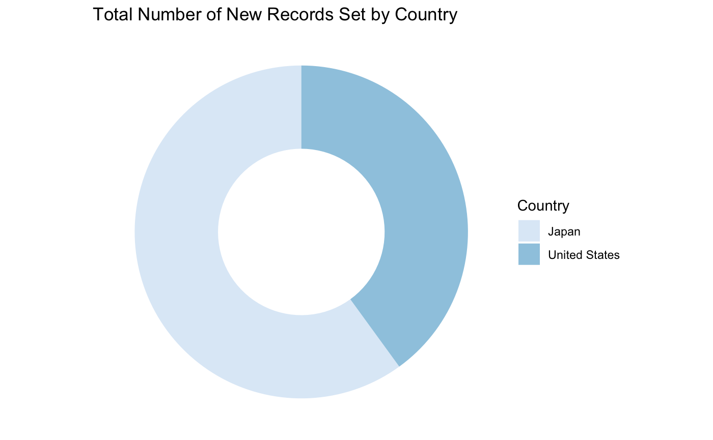
R Visualizations: Donut Chart
The donut chart shows the number of new records set by a winner from each country. Germany and Mexico did not have any winners set new records.

Slide 12
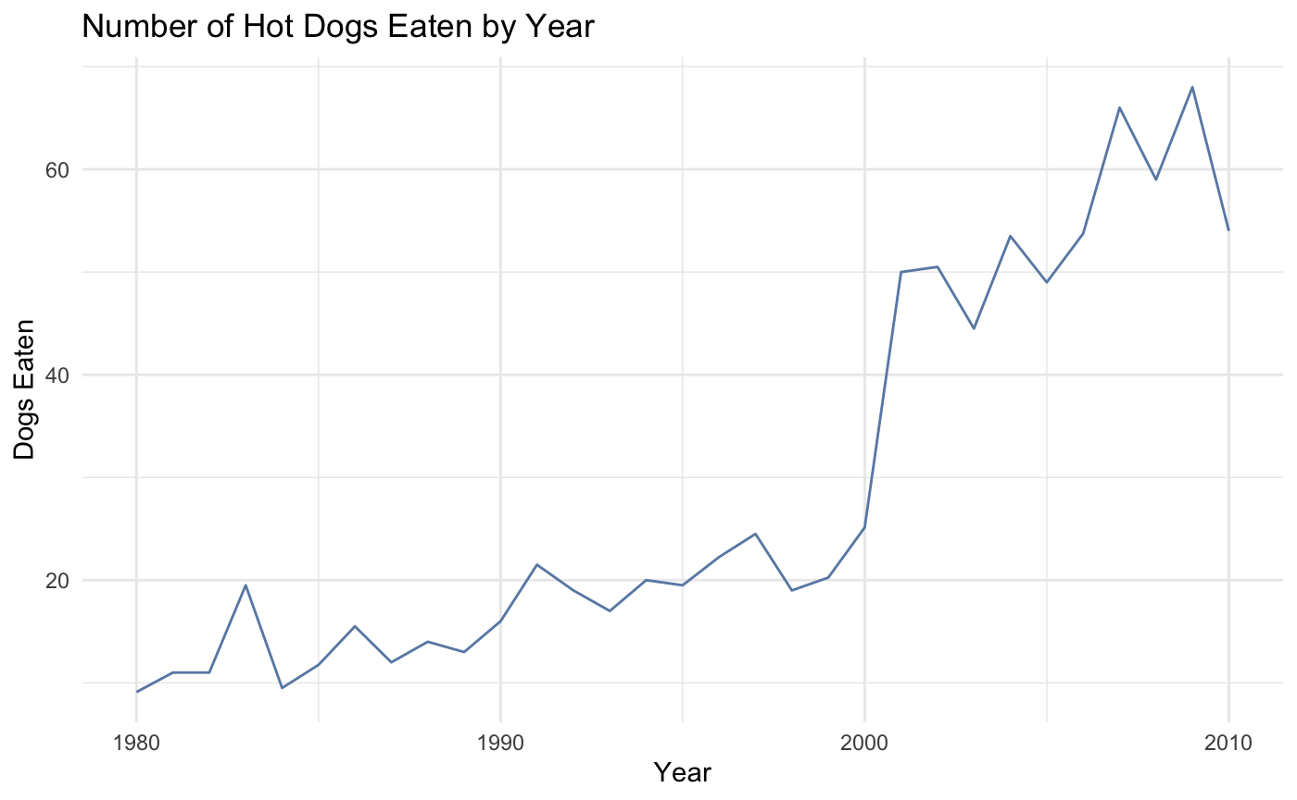
R Visualizations: Line Graph
The line graph shows the number of hot dogs eaten to win the contest each year.

Slide 13
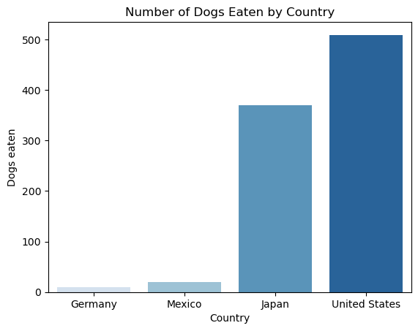
Python Visualizations: Bar Graph
The bar graph shows the number of hot dogs eaten by each country.

Slide 14
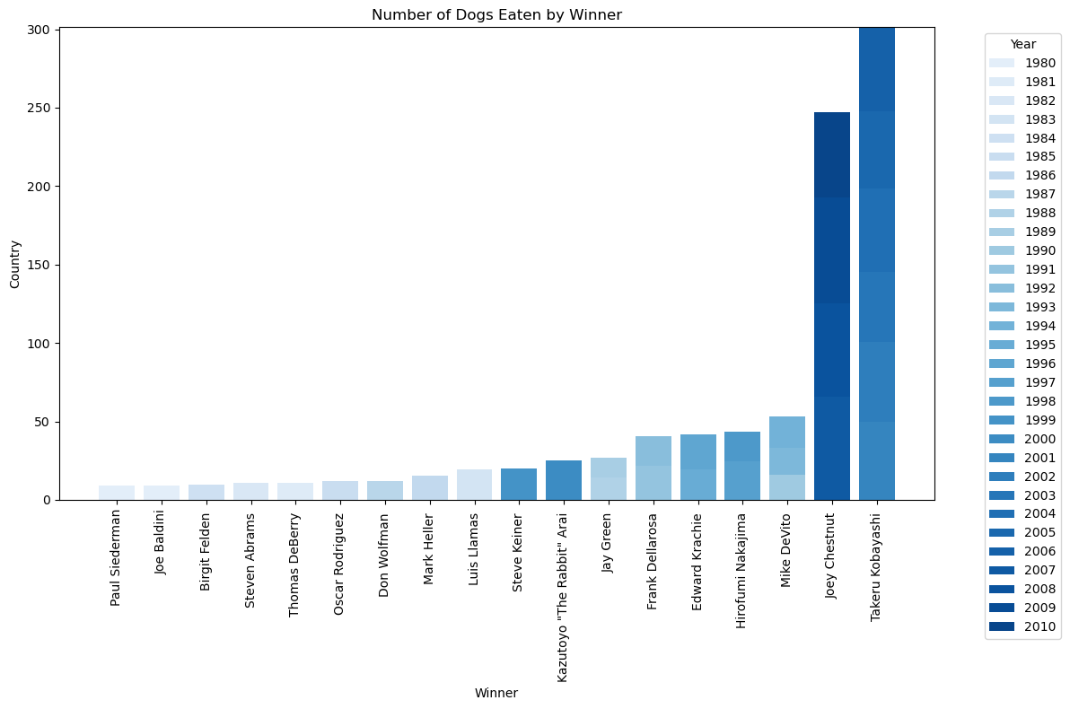
Python Visualizations: Stacked Bar Graph
This stacked bar graph shows the number of total hot dogs eaten by each contest winner. The number of hot dogs eaten by the winner in each year are segmented in the bar representing the total sum of hot dogs eaten.

Slide 15
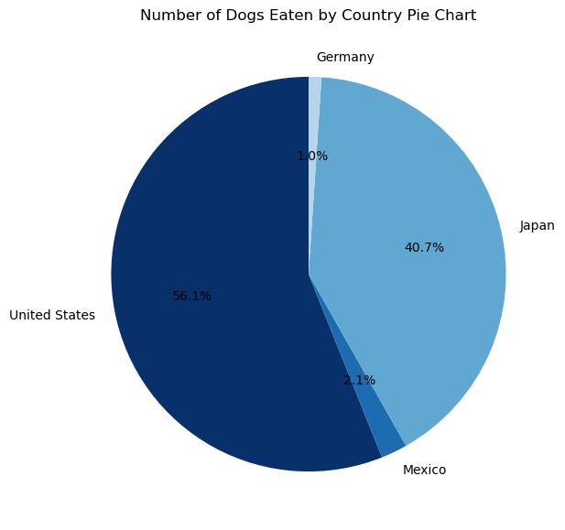
Python Visualizations: Pie Chart
The pie chart shows the number of hot dogs eaten by each country.

Slide 16
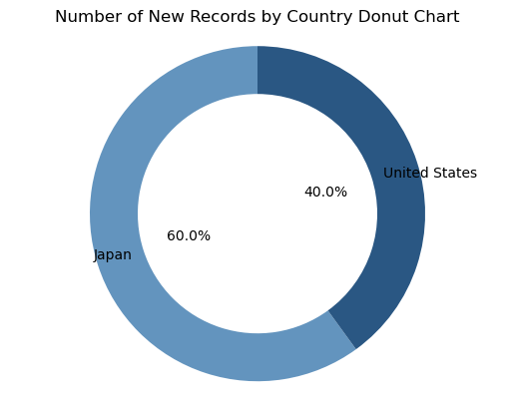
Python Visualizations: Donut Chart
The donut chart shows the number of new records set by a winner from each country. Germany and Mexico did not have any winners set new records.

Slide 17
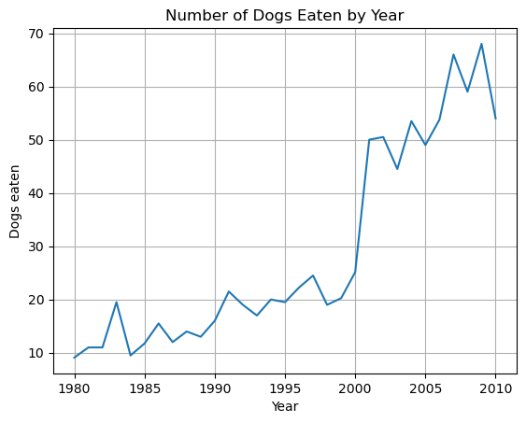
Python Visualizations: Line Chart
The line chart shows the number of hot dogs eaten by the winner for each year of the contest.

