Slide 1
Assignment 4.2
DSC640-T302
Lincoln Brown
Professor Williams

Slide 2

Tableau Visualizations: Heat Map
Here we have a heat map showing 6 statistics for the top 25 players who scored the most points per game.

Slide 3
Tableau Visualizations: Spatial Map
This map shows all of the Costco locations in the United States

Slide 4
Tableau Visualizations: Lollipop Chart
This lollipop chart shows the top 10 basketball players who scored the most points per game

Slide 5
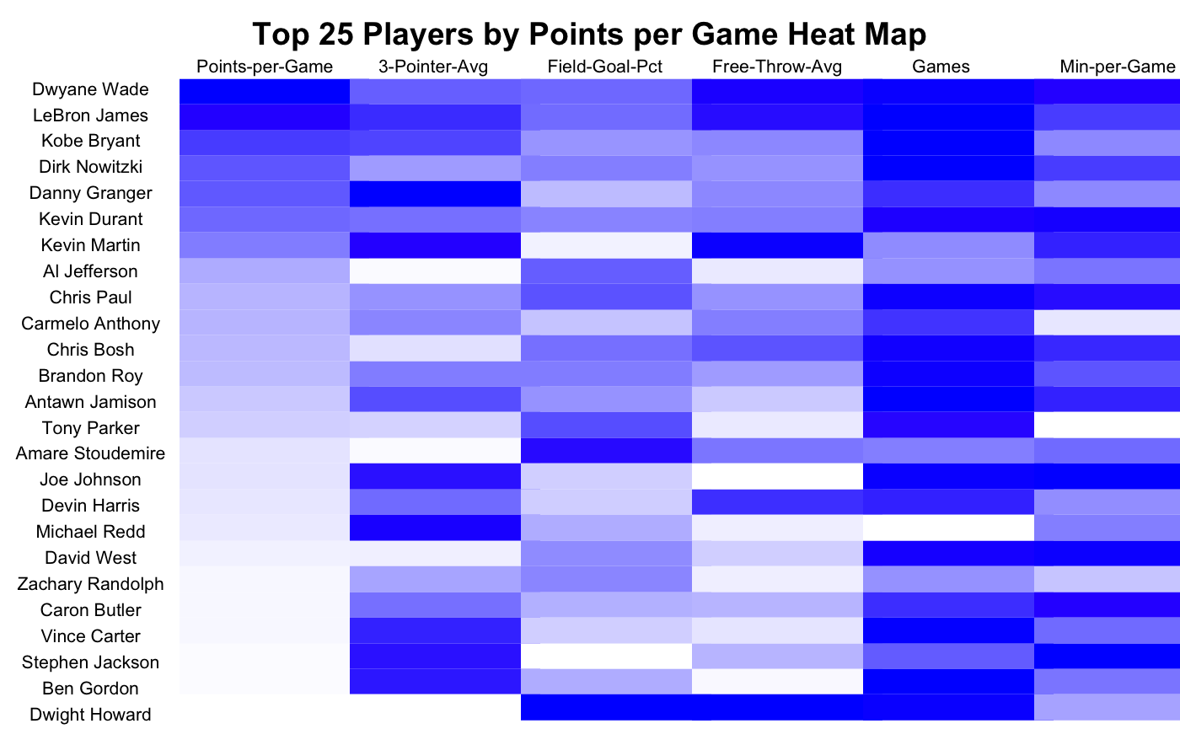
R Visualizations: Heat Map
This heat map shows 6 statistics for the top 25 players who scored the most points per game

Slide 6
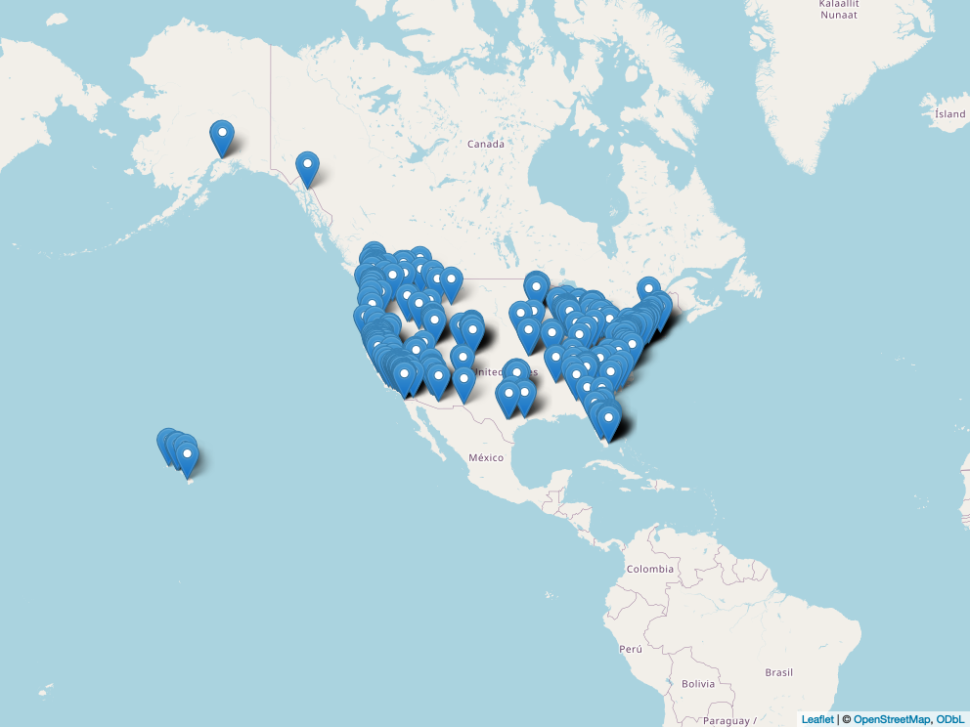
R Visualizations: Spatial Map
This map shows the United States Costco locations

Slide 7
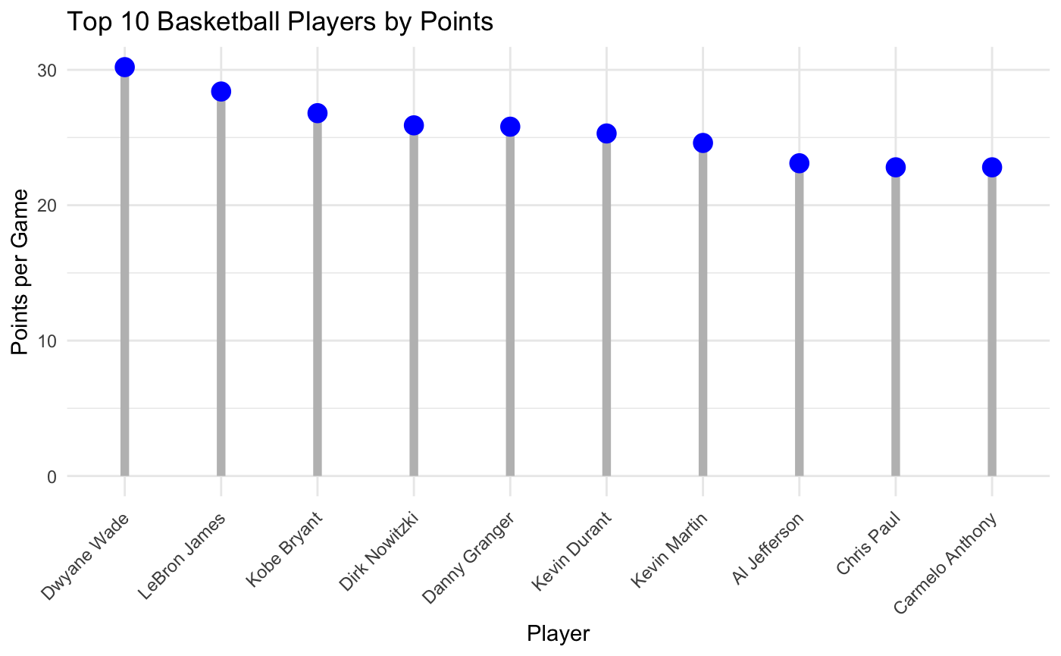
R Visualizations: Lollipop Chart
This lollipop chart shows the top 10 basketball players who scored the most points per game

Slide 8
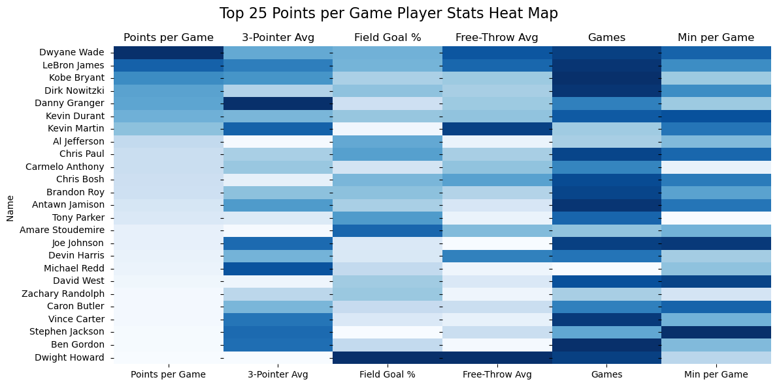
Python Visualizations: Heat Map
This heat map shows 6 statistics for the top 25 basketball players who scored the most points per game.

Slide 9

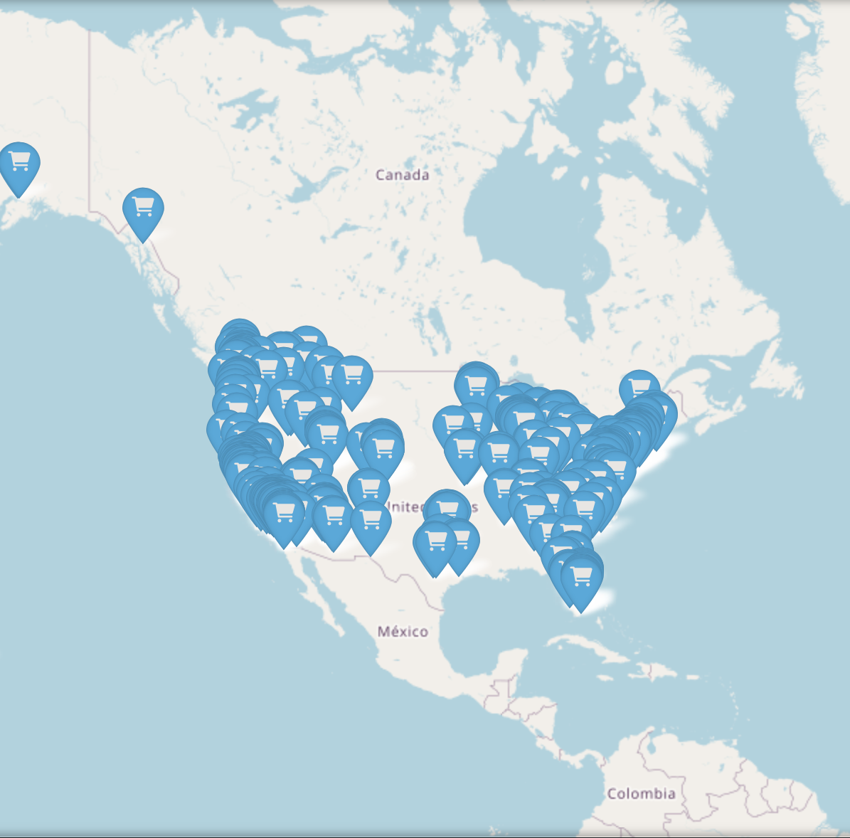
Python Visualizations: Spatial Map
This spatial map shows the Costco locations in the United States.

Slide 10
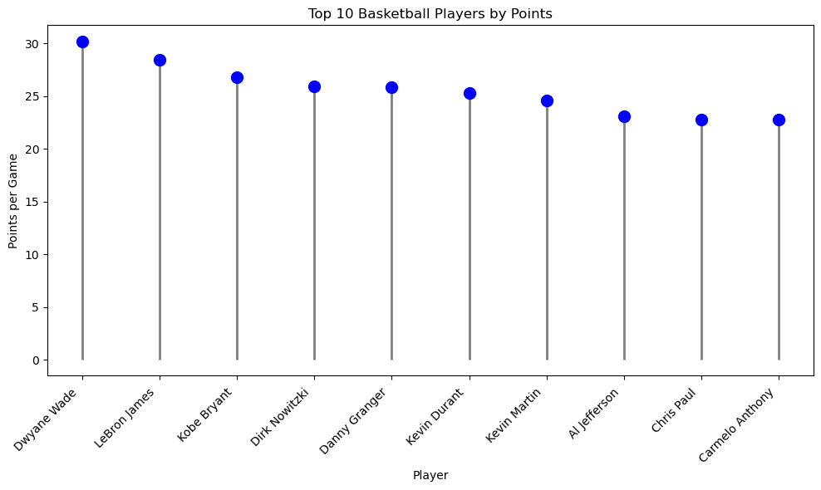
Python Visualizations: Lollipop Chart
This lollipop chart shows the top 10 basketball players who scored the most points per game.

