Slide 1

Assignment 3.2
DSC640-T302
Lincoln Brown
Professor Williams

Slide 2
Tableau Visualizations: Scatterplot
In this visualization, we are looking at the top ten murder rates by population in the US.
From the graph, we can see that District of Columbia has the highest murder rate. Coincidentally, it also has the lowest population.

Slide 3
Tableau Visualizations: Bubble Chart
In this chart, we are looking at top ten states with the highest forcible rape rate by population. Additionally, we can see the murder rate by the size of the circle.
In this graph, we can see that New Mexico has the highest forcible rape rate

Slide 4
Tableau Visualizations: Density Map
This density map shows the burglary rate across the United States.

Slide 5
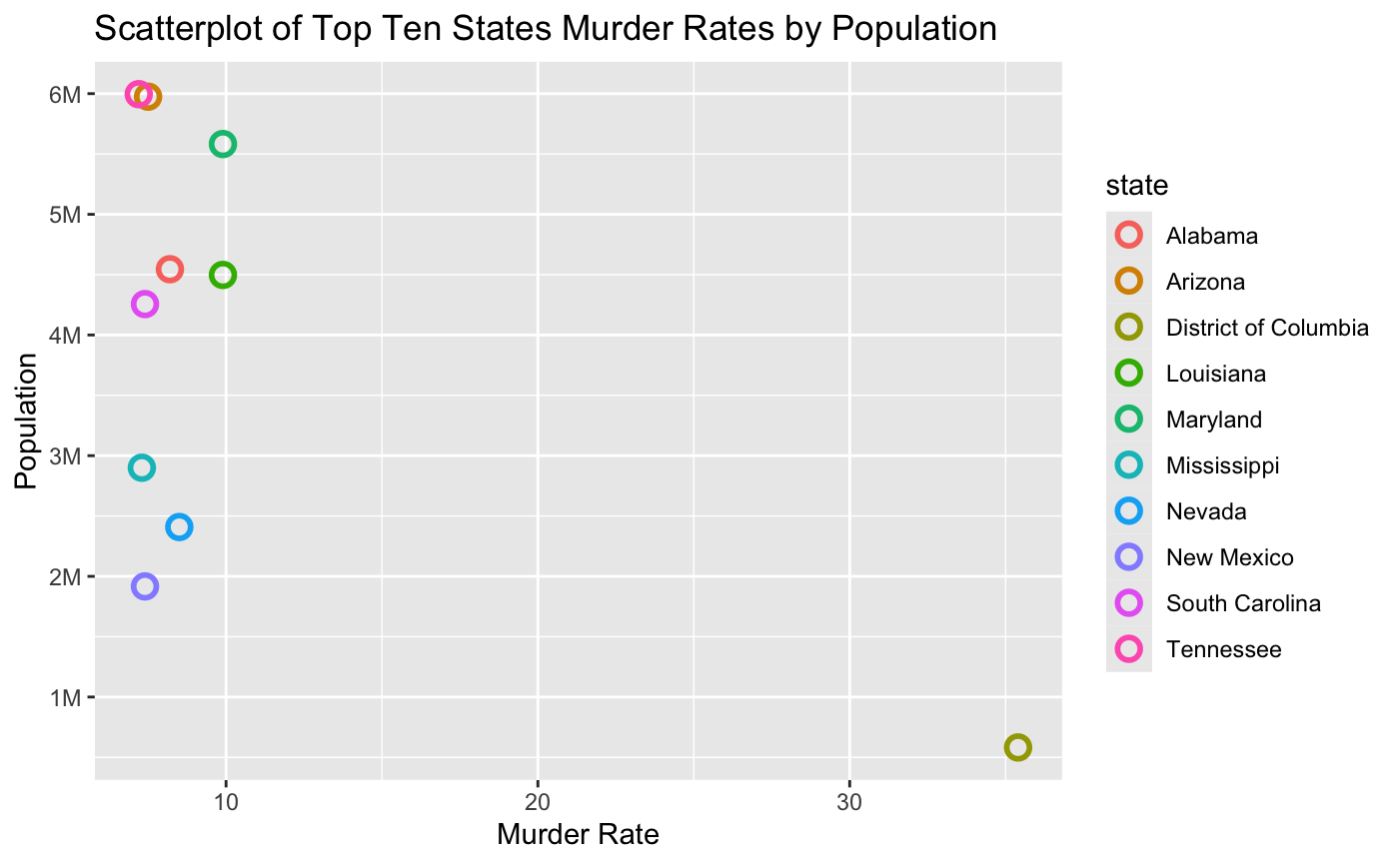
R Visualizations: Scatterplot
In this scatterplot, like before, we are looking at the top ten states with the highest murder rates.

Slide 6
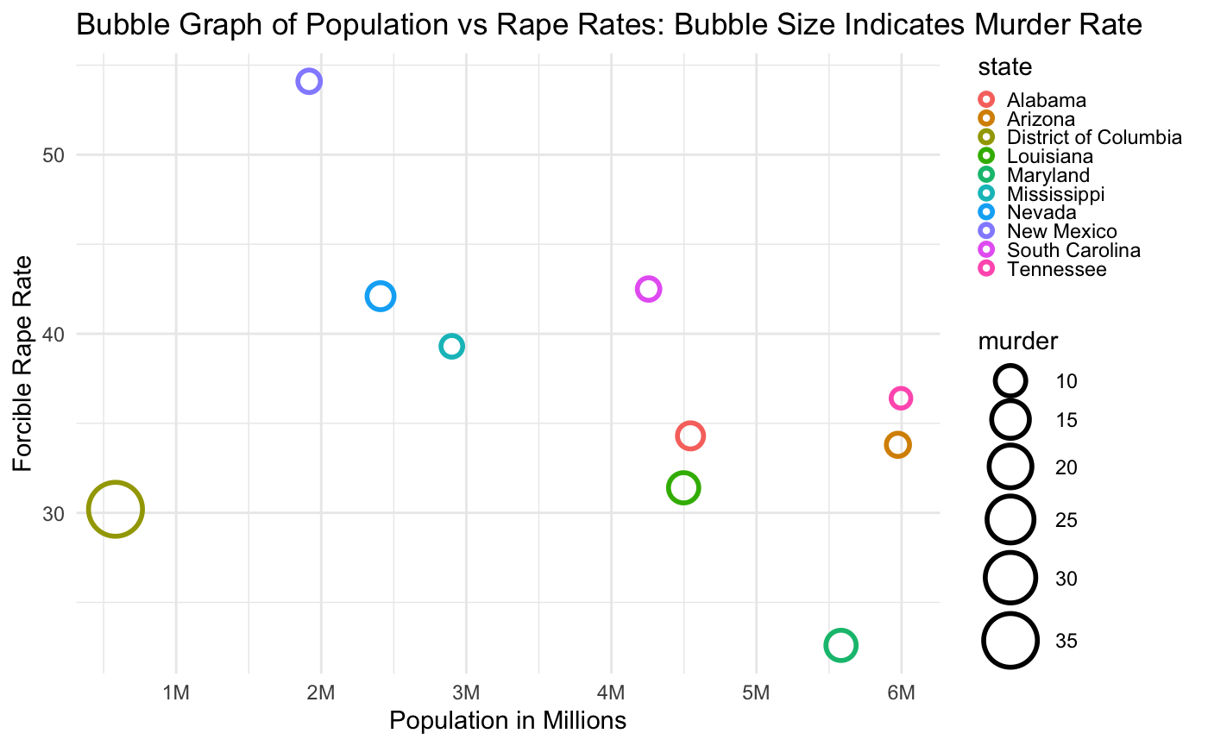
R Visualizations: Bubble Chart
In this chart, we are looking at top ten states with the highest forcible rape rate by population. Additionally, we can see the murder rate by the size of the circle.
I had some trouble getting the legends to show up appropriately. They were too large and were getting cut off.

Slide 7
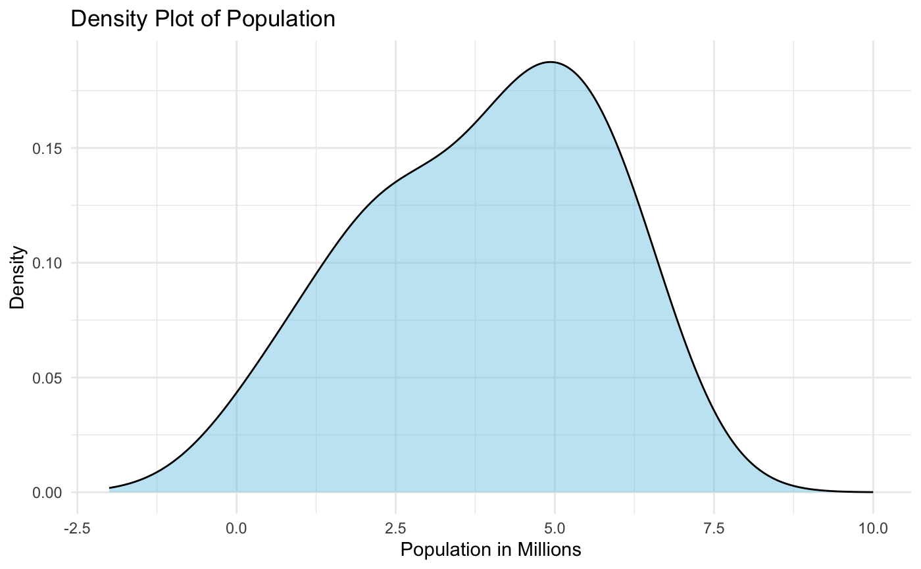
R Visualizations: Density Plot
This is a density plot of the population.
It shows a kernel density estimate of the distribution of the population.

Slide 8
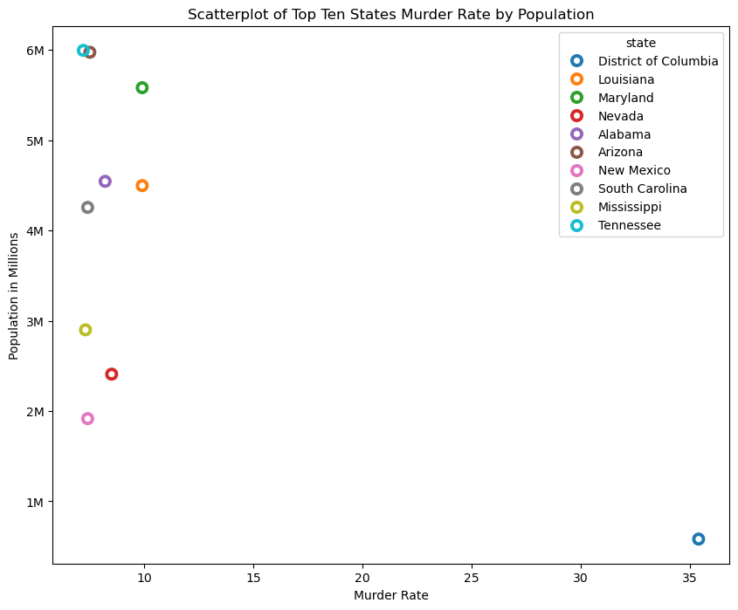
Python Visualizations: Scatterplot
Like before, we are looking at the states with the top ten murder rates by population.

Slide 9
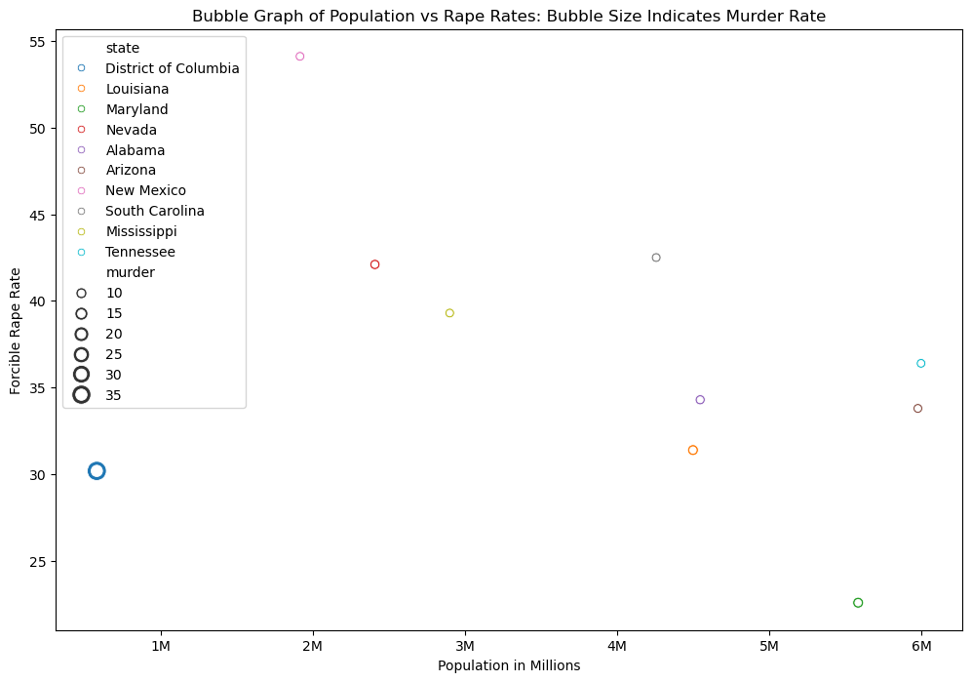
Python Visualizations: Bubble Chart
Like before, we are looking at the top ten states with the highest forcible rape rates by population. We can see the murder rate by the size of the circle.

Slide 10
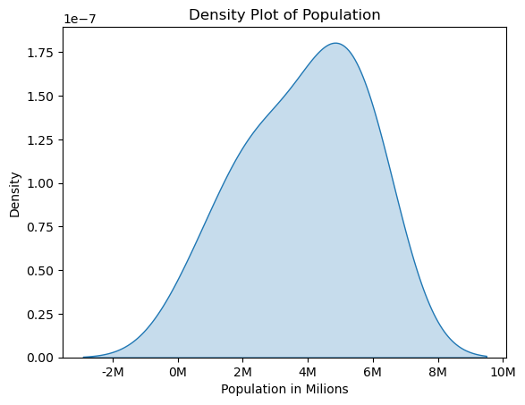
Python Visualizations: Density Plot
Here we are looking at the density plot of population again.
There is a discrepancy between this plot and the R plot that I’m not sure how to address. The scale on this is in 1e-7, but in R it was 0.00 to 0.20.

