Slide 1
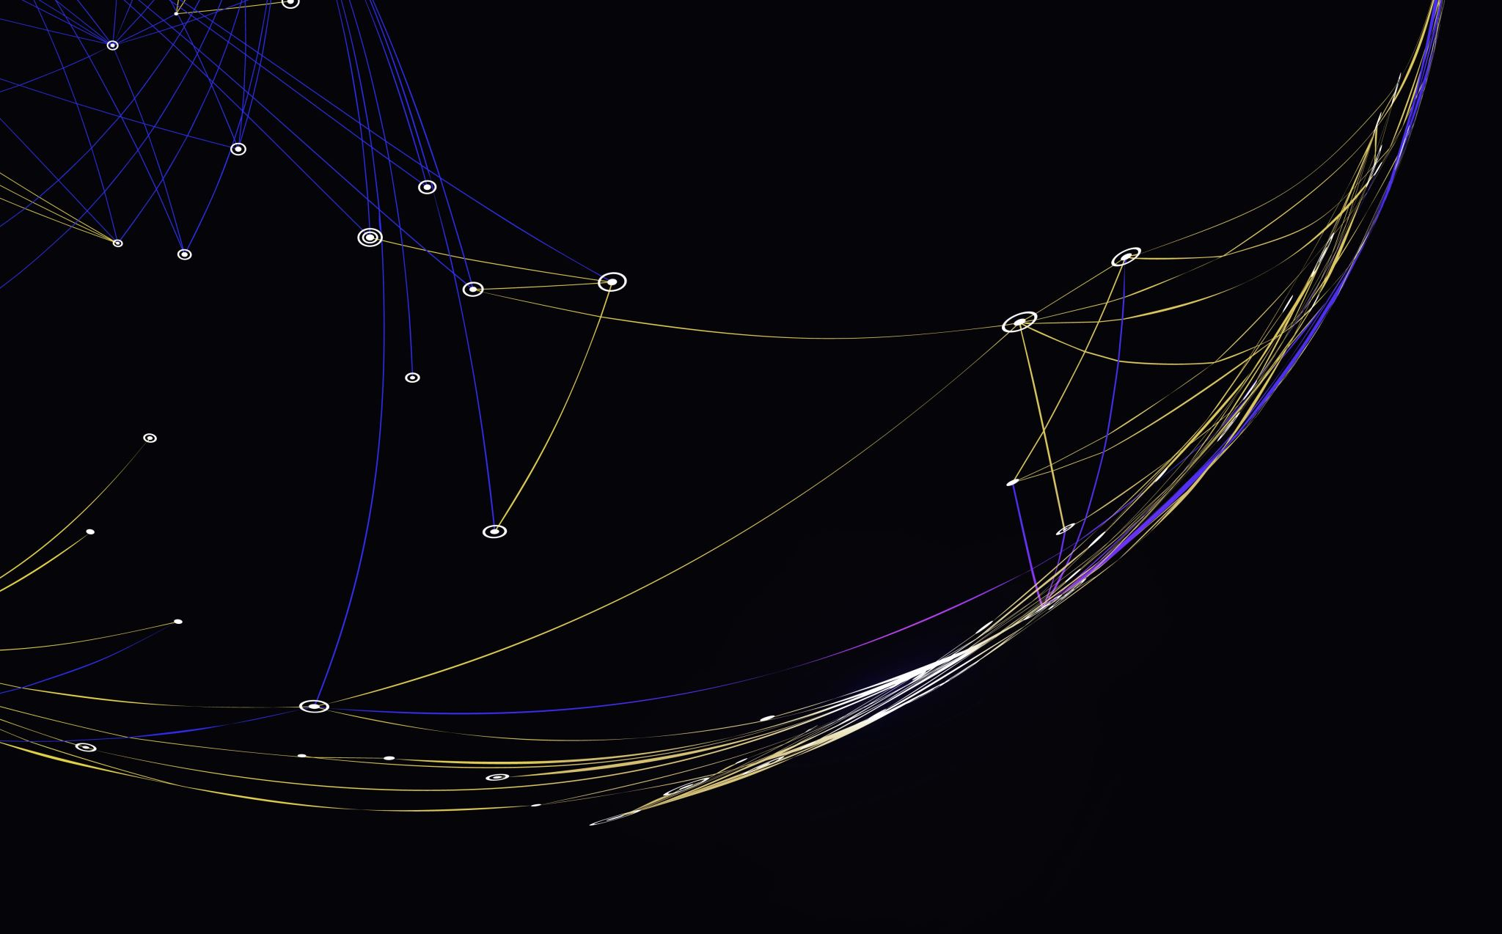
Exercise 2.2
DSC640-T302
Lincoln Brown
Professor Williams

Slide 2
Tableau Visualizations: Tree Map
For the tree map, I chose to look at the top 3 expenditure categories for 1984-2008.

Slide 3
Tableau Visualizations: Area Chart
This area chart shows the growth of the world population from 1960 to 2009.

Slide 4
Tableau Visualizations: Stacked Area Chart
The Stacked Area Chart shows the top 3 expenditures for 1984-2008.

Slide 5
Tableau Visualizations: Step Chart
This step chart shows the US unemployment rate from 1948-2010

Slide 6
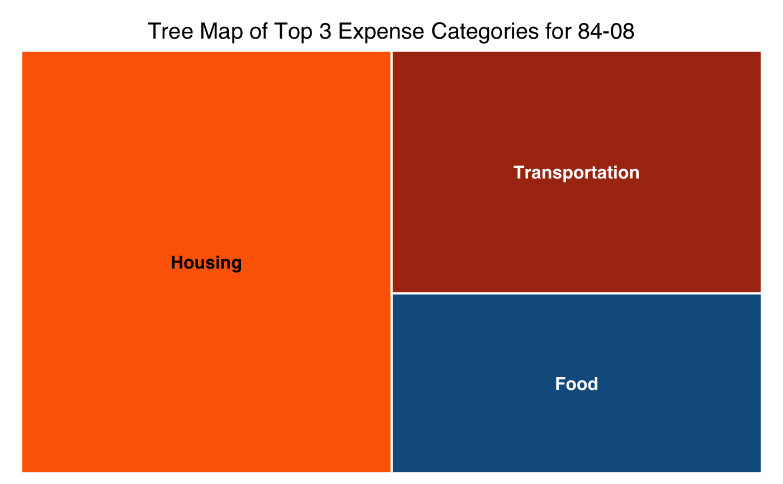
R Visualizations: Tree Map
The tree map shows the top 3 expenditure categories for 1984-2008

Slide 7
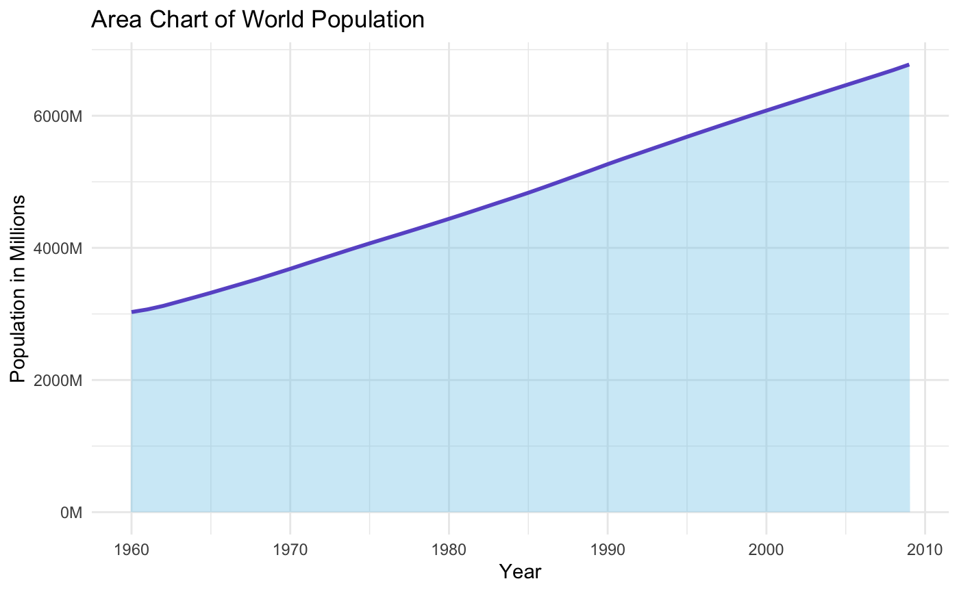
R Visualizations: Area Chart
This area chart shows the growth of the world population from 1960 to 2009.

Slide 8
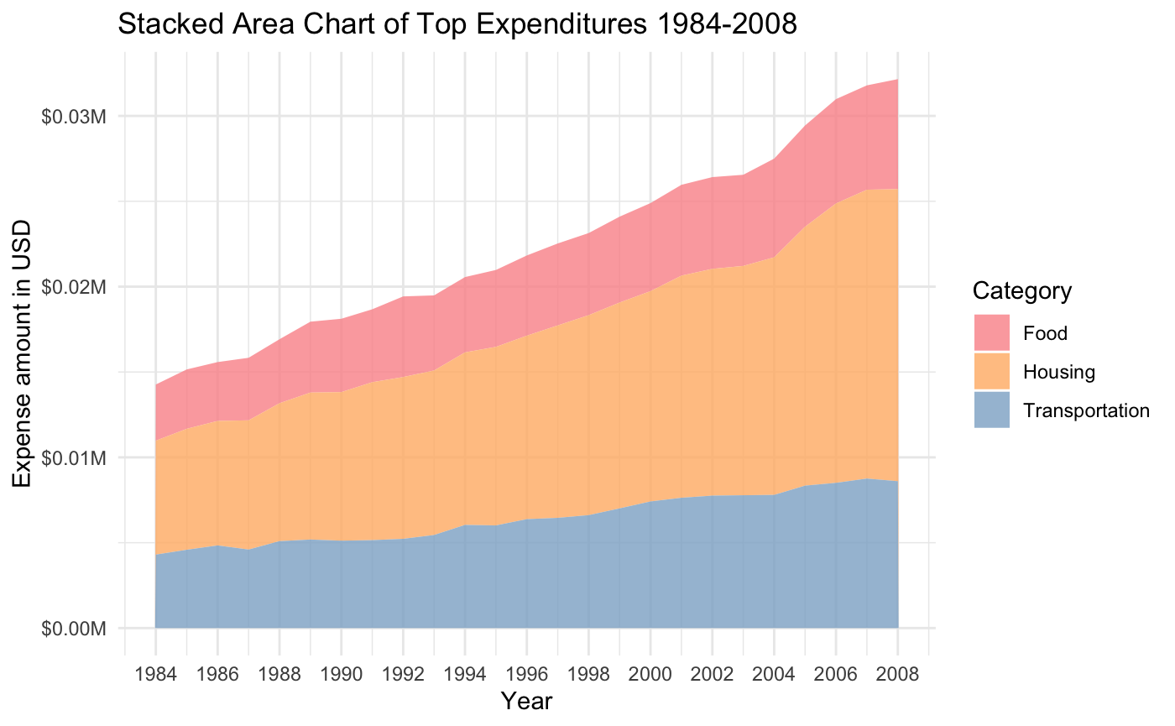
R Visualizations: Stacked Area Chart
The Stacked Area Chart shows the top 3 expenditures for 1984-2008.

Slide 9
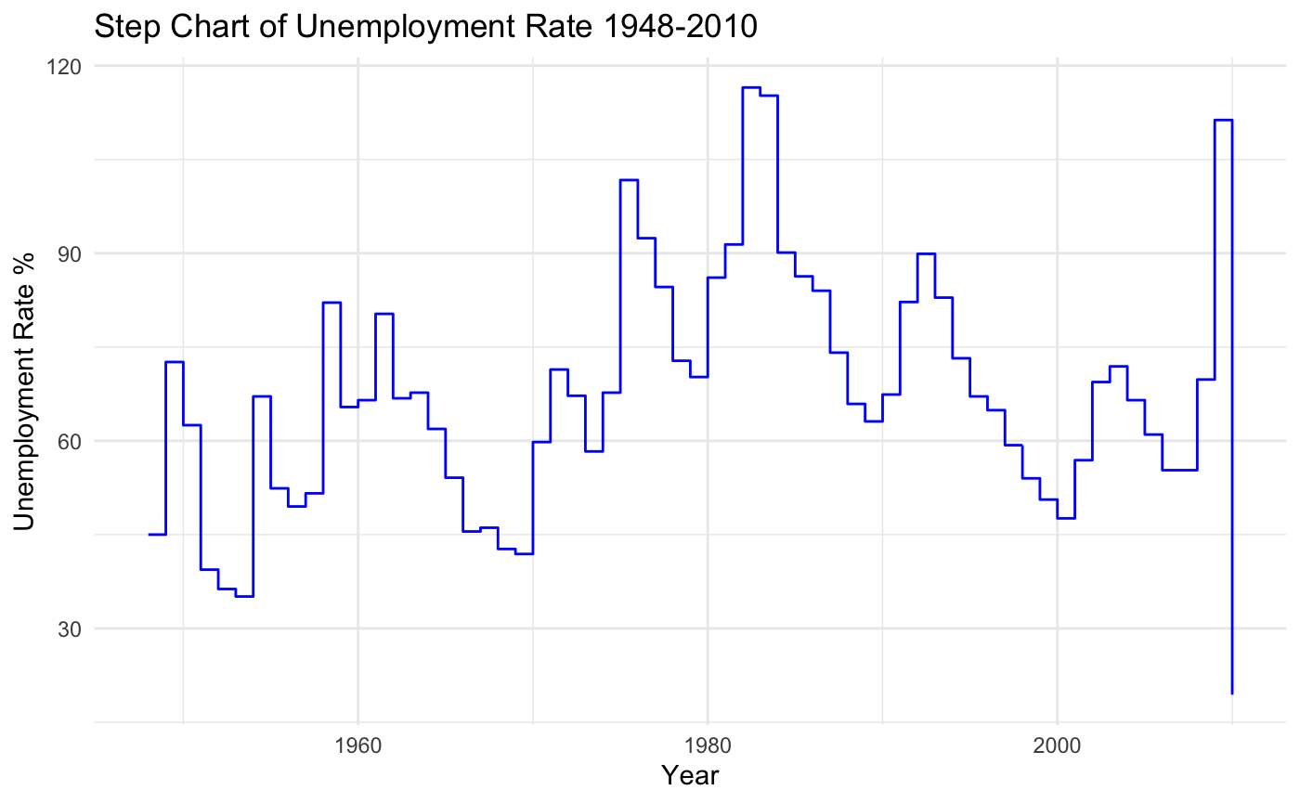
R Visualizations: Step Chart
This step chart shows the US unemployment rate from 1948-2010

Slide 10
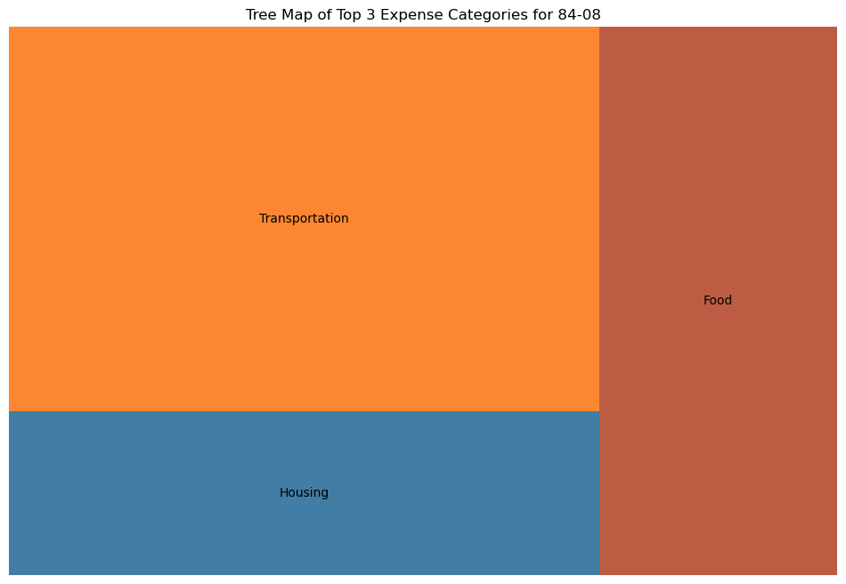
Python Visualizations Tree Map
For the tree map, I chose to look at the top 3 expenditure categories for 1984-2008.

Slide 11
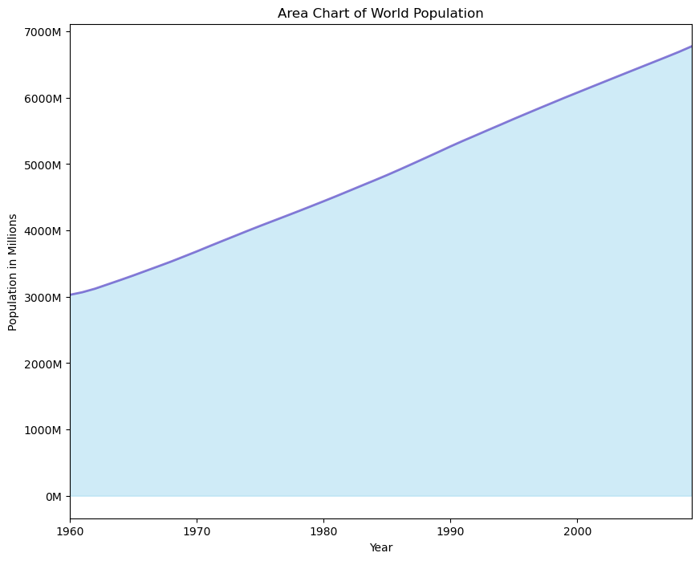
Python Visualizations: Area Chart
This area chart shows the growth of the world population from 1960 to 2009.

Slide 12
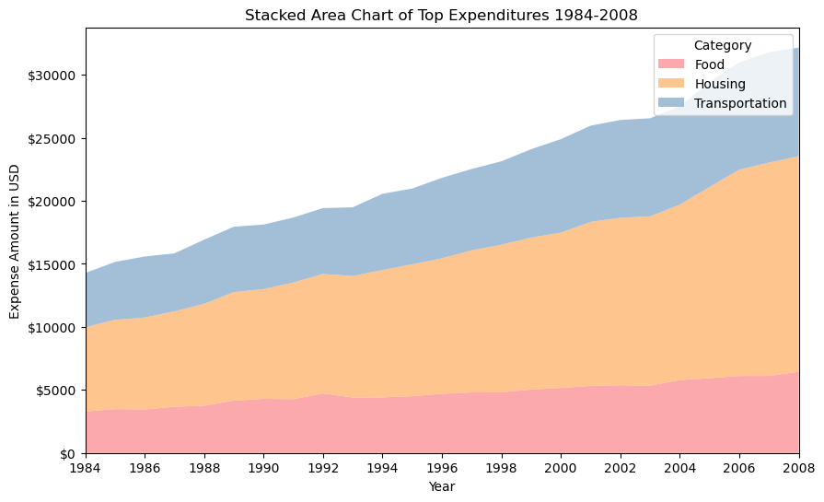
Python Visualizations: Stacked Area Chart
The Stacked Area Chart shows the top 3 expenditures for 1984-2008.

Slide 13
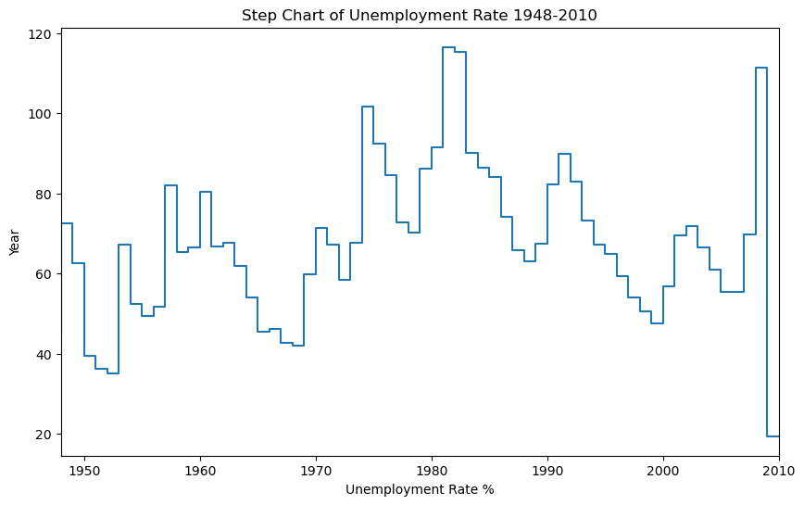
Python Visualizations: Step Chart
This step chart shows the US unemployment rate from 1948-2010

Slide 14
Summary
Overall, I enjoyed this assignment. It was a great learning opportunity because I had never created these graphs before. Creating them in the different applications was fairly straightforward, the only thing I wondered about was how to go about reorganizing the display of the Tree Map in R and Python.

