Slide 1
COVID-19
VAERS DATA
By Lincoln Brown
DSC530-T301
Dr. Parajulee

Slide 2
What is VAERS?
The Vaccine Adverse Event Reporting System (VAERS) is a national early warning system to detect possible safety problems in U.S. licensed vaccines. VAERS is co-managed by the Centers for Disease Control and Prevention (CDC) and the U.S. Food and Drug Administration (FDA). VAERS accepts and analyzes reports of adverse events (possible side effects) following vaccination.
VAERS is not designed to detect if a vaccine caused an adverse event, but it can identify unusual or unexpected patterns of reporting that might indicate possible safety problems requiring a closer look.
(HHS, n.d.)

Slide 3
Variables
The analysis will consist primarily of the five following variables:
State
Age
Sex
Vaccine Type
Vaccine Manufacturer

Slide 4
Describe what the variables mean
State - This is the state that the adverse event was recorded in
Age - The age of the person at the time of the adverse event
Sex - The sex of the person
Vaccine Type - The type of vaccine treatment that was related to an adverse event, types include COVID19, Flu, TDAP, etc.
Vaccine Manufacturer - The manufacturer of the vaccine related to an adverse event.

Slide 5
Descriptive Characteristics
Characteristic | Year | 2020 | 2021
Total # of Unique Cases | 48,901 | 406,001
Average Age | 44 | 49
Age Standard Deviation | 24.05 | 18.33
Min Age | 0 | 0
Max Age | 115 | 119

Slide 6
Characteristics of Age related to cases where death was reported
Characteristic | Year | 2020 | 2021
Number of Deaths | 172 | 5518
Number of Deaths where Age < 1 | 98 | 32
Mean Age that Died | 24.15 | 72.83
Median Age | 0.5 | 75.0
* The number of deaths reported are reduced in these tabulations because I removed cases where the age was NA.

Slide 7
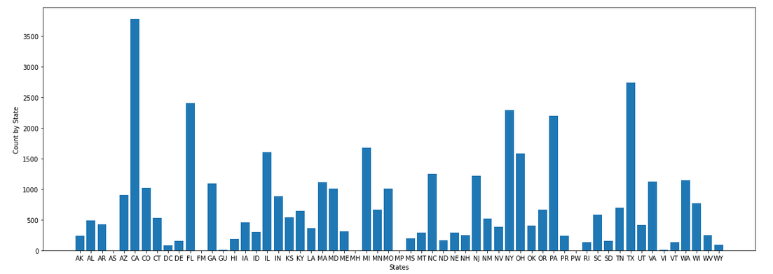
Histograms
Number of Adverse Events reported by State in 2020

Slide 8
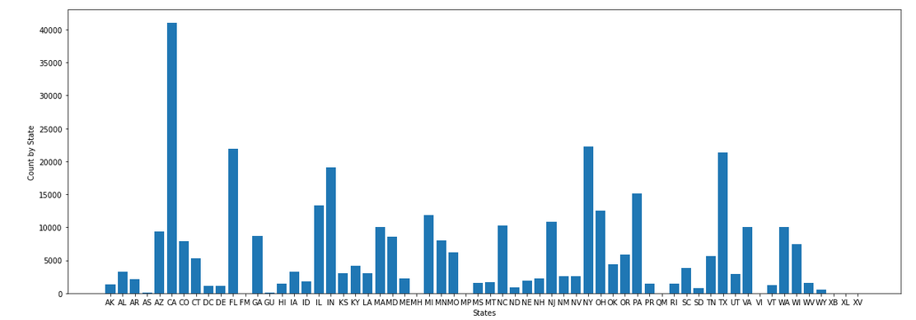
Histograms
Number of Adverse Events reported by State in 2021

Slide 9
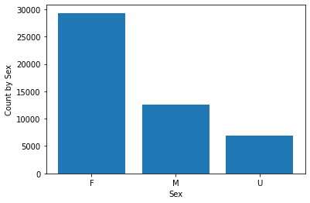
Histograms
Number of Adverse Events
by Sex for 2020

Slide 10
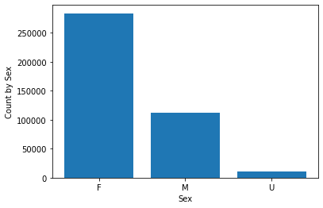
Histograms
Number of Adverse Events
by Sex for 2021

Slide 11
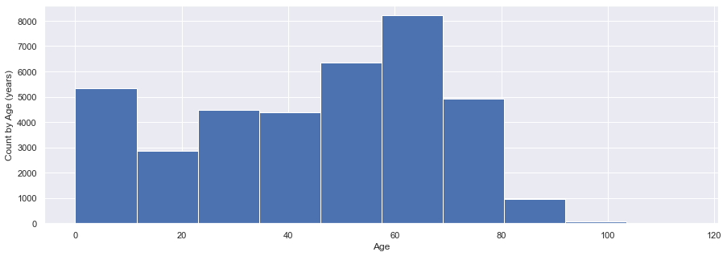
Histograms
Number of Adverse Events
by Age for 2020

Slide 12
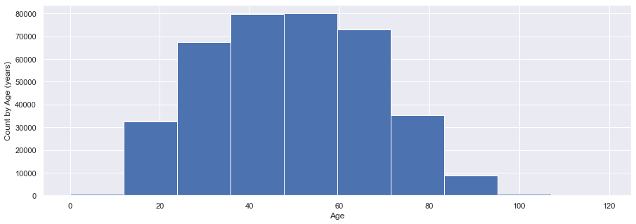
Histograms
Number of Adverse Events
by Age for 2021

Slide 13
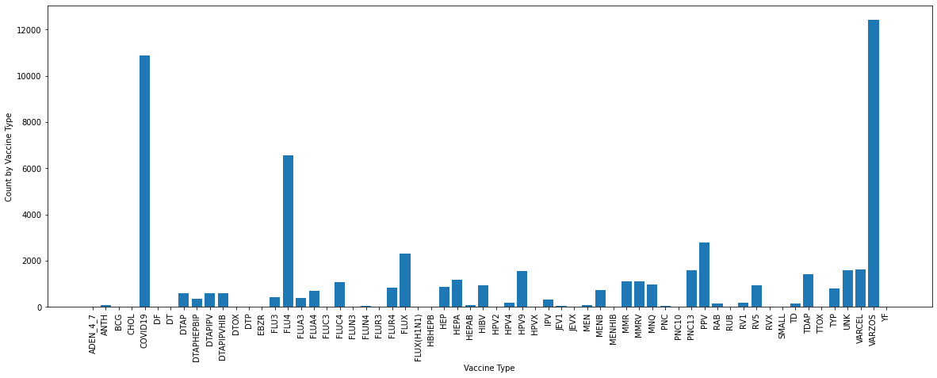
Histograms
Number of Adverse Events
by Vaccine Type for 2020. The number of events reported for COVID-19 type vaccines is outweighed only by VARZOS type vaccines.

Slide 14
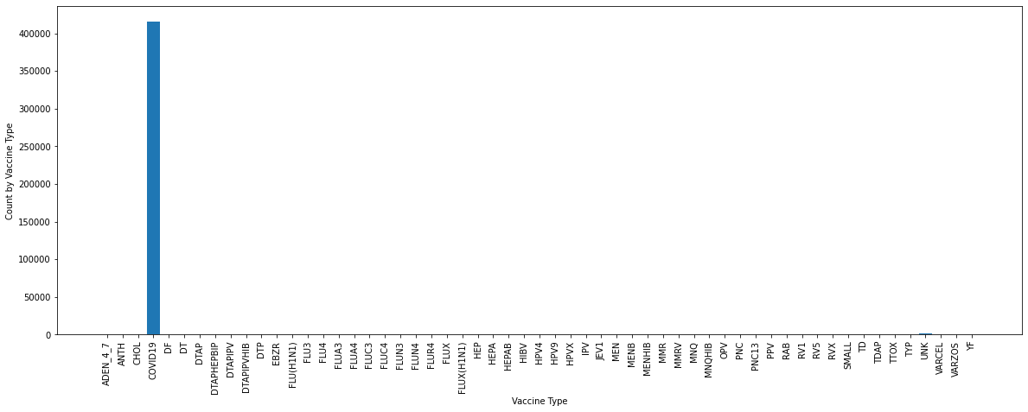
Histograms
Number of Adverse Events
by Vaccine Type for 2021.
The vast majority of reported events were from the COVID19 type vaccines.

Slide 15
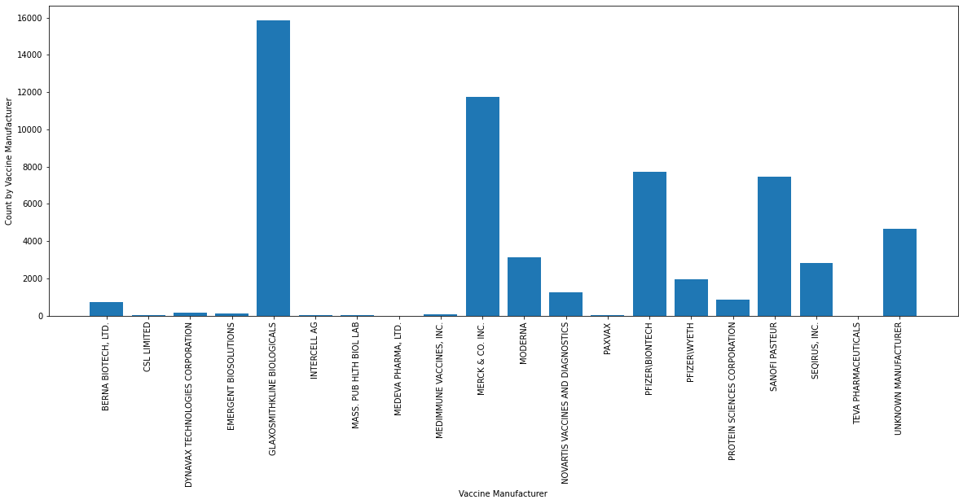
Histograms
Number of Adverse Events
by Vaccine Manufacturer for 2020. GlaxoSmithKline has the most events, with Merck a close second.
These manufacturers are not associated with COVID-19 vaccinations.

Slide 16
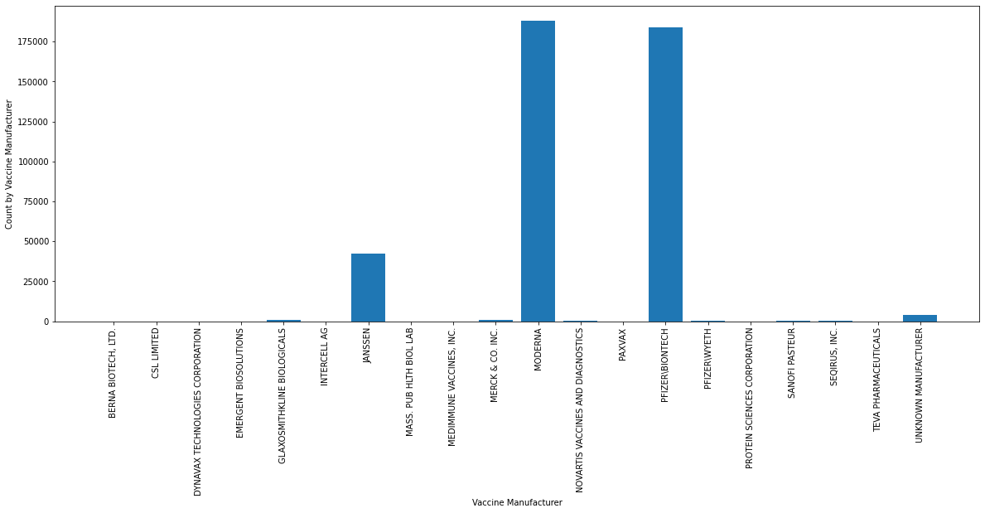
Histograms
Number of Adverse Events
by Vaccine Manufacturer for 2021.
Moderna and Pfizer have very similar total events, with Moderna having slightly more than Pfizer. Moderna, Pfizer, and Janssen are the producers of the COVID-19 vaccinations.

Slide 17
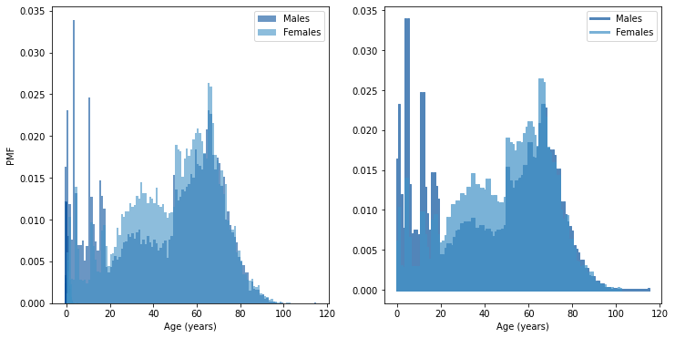
PMF
Probability Mass Function comparing the average age for males and females in 2020.
We can see what almost appears to be a bimodal distribution of the ages in 2020. There is a high probability of deaths associated with those under 20, and a spike near infancy. The other age associated with high probability is around 70.

Slide 18
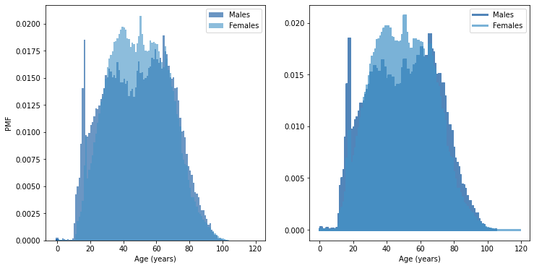
PMF
Probability Mass Function comparing the average age for males and females in 2021.
This distribution looks much closer to the normal distribution, with a spike just under 20, but strong density between 30 and 80.

Slide 19
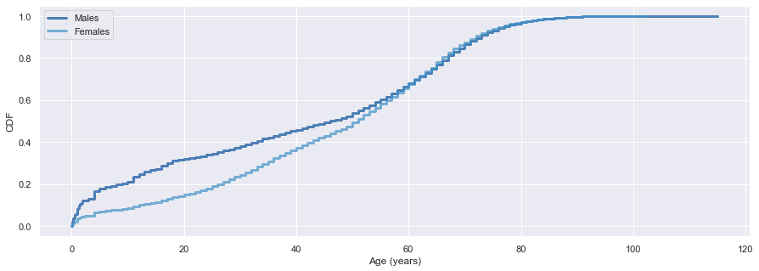
CDF
In this continuous distribution function for data from 2020, we can see how adverse events are associated differently between the sexes by age. Males appear to have a higher probability of being affected at an earlier age, with the effect tapering off by age 60.

Slide 20
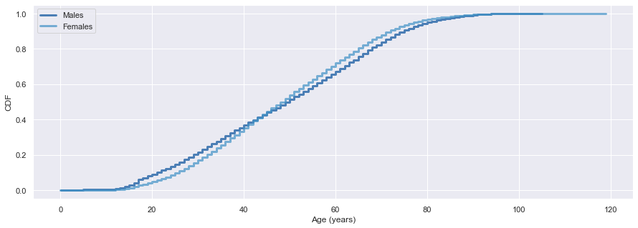
CDF
In this continuous distribution function for data from 2021, we can see that males are slightly more affected under 40, with the trend reversing and women being more affected after 40.

Slide 21
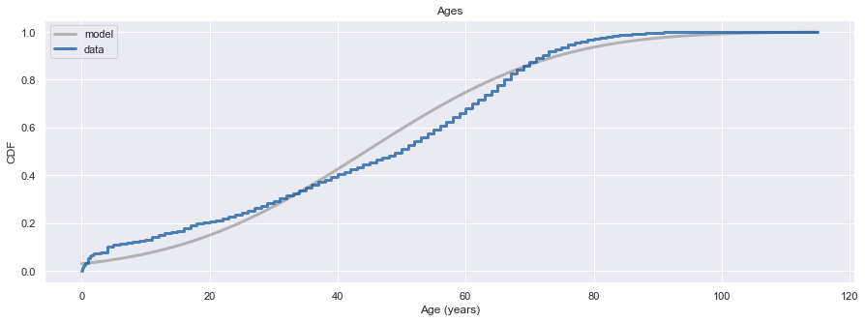
Analytical Distribution
I wanted to compare the distribution of ages for 2020 and 2021 to the normal distribution. The plot below illustrates how approximately normal the 2020 (blue line) distribution is compared to the normal model (gray line). It is relatively close, but still deviates from the normal model.

Slide 22
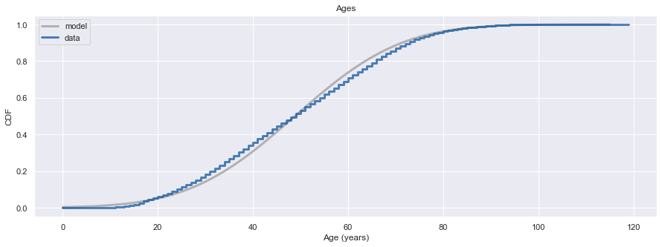
Analytical Distribution
The plot below illustrates how approximately normal the 2021 (blue line) distribution is compared to the normal model (gray line). As we can see, it is very close to the normal distribution, which is to be expected given that there are much more data points in the data set for 2021 than 2020.

Slide 23
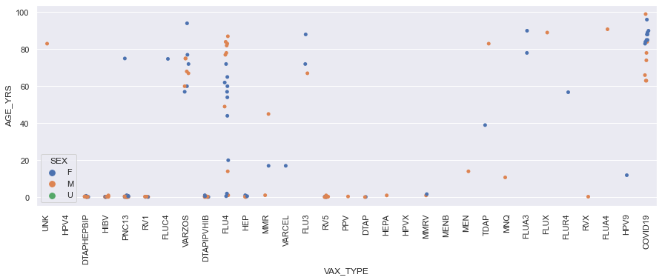
Scatter Plots
In this scatter plot for the data from 2020, we can see that there is a spread of points for several vaccines around infancy, and incidents between ages 40 and 80 for the FLU4 type vaccines and above 60 for COVID-19 type vaccines.

Slide 24
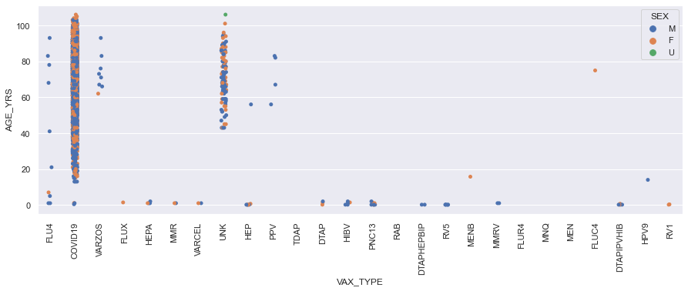
Scatter Plots
In this scatter plot for the data from 2020, we can see that the COVID19 vaccinations have a distribution across all ages. There are still adverse events reported for infancy across several of the other types of vaccines. The unknown vaccine type has points distributed between 40 and 80, similar to the FLU4 vaccine from 2020’s data.

Slide 25
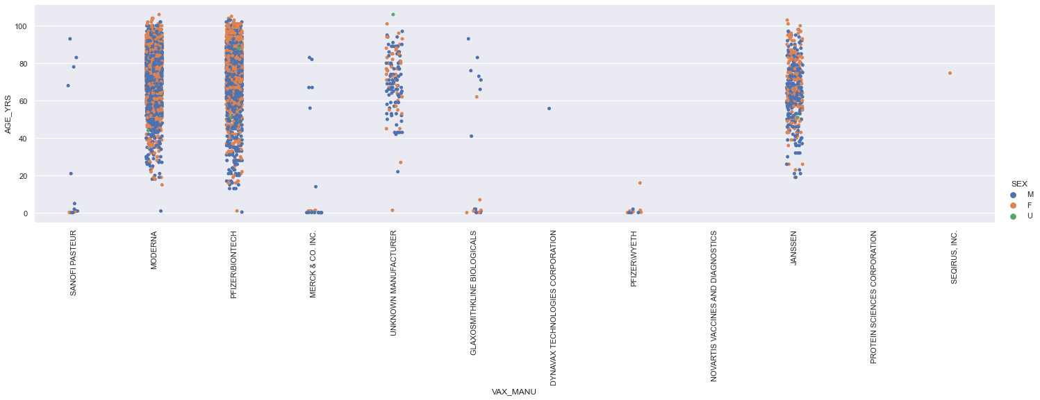
Scatter Plots
In this scatter plot for the data from 2021, we see the distribution of adverse events by age, according to the Vaccine Manufacturer. Moderna and Pfizer have high density between 40 and 100, but still have some cases between 20 and 40. Janssen has less cases between 20 and 40, with a higher concentration around 60. Although, this could be due to the fact that Janssen has less total cases to represent.

Slide 26
Hypothesis Test
Looking at the PMF graphs, I noticed that the ages for 2020 did not have a normal distribution and thought it looked like the distribution was bimodal. I want to compare the mean age between 2020 and 2021.
Null Hypothesis:
H0 = mean age 2020 == mean age 2021
Alternative Hypothesis:
HA = mean age 2020 != mean age 2021

Slide 27
Hypothesis Test
Using a two-tailed hypothesis at the 99% confidence level yields:
t-value: -3.4745983634709336
p-value: 0.0005116763119314343
With a significant p-value of .0005, with 99% confidence we can reject the null hypothesis in favor of the alternative hypothesis that the difference in mean age between men and women in 2021 is not due to chance.

Slide 28
Regression Analysis
My regression analysis is limited due to the categorical nature of the data and my limits as an inexperienced data scientist. I was disappointed that I was not able to create a model using the DIED variable as an outcome variable. All of my attempts to use this resulted in a Perfect Separation detected error.
I ended up using AGE_YRS as an endog variable, with SEX and DIED as the exog variables.
Yielding the results found on the next slide.

Slide 29
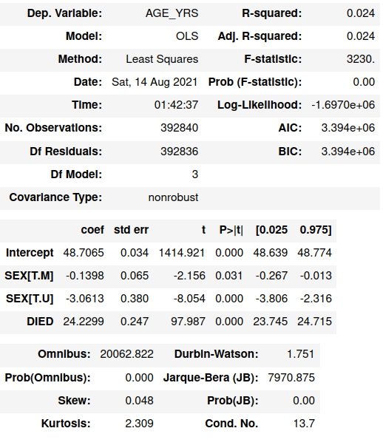
Regression Analysis Results
The p-values for each variable are significant, but the DIED variable has the highest t statistic, indicating that the age of a person has a high correlation with an adverse event that results in death.
This is logical because older people have a greater likelihood of dying of natural causes. Therefore, it makes sense to see a higher association of death in adverse events reported in older people.

Slide 30
References:
HHS. (n.d.). VAERS home. VAERS. https://vaers.hhs.gov/faq.html#collapse1.

