Slide 1

FINAL YEAR PROJECT PRESENTATION ON Health Monitoring System to Detect Early Symptoms of Heart Attack Using AI and ML
ELECTRONICS AND COMMUNICATION ENGINEERING
NATIONAL INSTITUTE OF TECHNOLOGY
AGARTALA-799046, INDIA

Slide 2
Presented by
Shraddha Majumdar (21UEC077)
Bipriti Deb Sarma (21UEC026)
Lincoln Saha (21UEC092)
Aryan Chakma (21UEC047)
Supervisor:
Dr. Atanu Chowdhury
HOD & Associate Professor
ECE Department

Slide 3

Heart Disease remains a leading cause of death worldwide, affecting millions of people annually.
Factors such as lifestyle, genetics, and underlying conditions can contribute to the development of heart disease.
The healthcare costs associated with heart disease place a significant strain on healthcare systems globally.
So, timely identification of heart disease can enable proactive treatment and management, improving patient outcomes.

Slide 4

AI and ML models can analyze vast amounts of patient data to identify patterns and risk factors.
These techniques can build predictive models to forecast the likelihood of heart disease development.
AI-based screening tools can enable early detection of heart disease, leading to timely interventions.

Slide 5


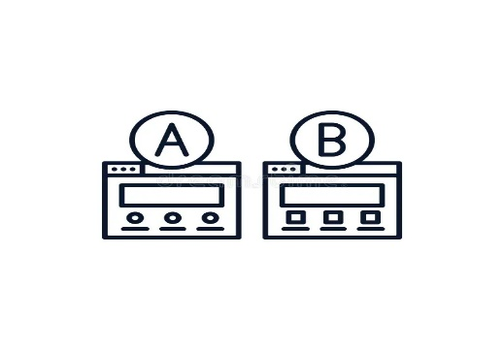

WORK
Logistic Regression Model
Heart Rate
FLOW
Train Test Split
Data Pre Processing

Slide 6
CONVERSION
STORED VALUES => DATA SETS
DATA PRE-PROCESSING
TRAINING SET
TEST SET
ML MODEL
PREDICTED OUTCOME

Slide 7
WORK
FLOW
Data set
Logistic Regression Model
Data Pre Processing
Train Test Split

Slide 8
Why logistic regression model?
Logistic Regression Model is a Machine Learning model used when the goal is to predict one of two possible outcomes like
“ True ” or “ False ”. In this project this model is used for predicting outcomes that belong to one of two categories, like "disease present" or "disease absent." It works by finding a relationship between the input data (like age, blood pressure, cholesterol levels, etc.) and the probability of having heart disease. This model is easy to interpret, handles binary classification well, and is often accurate for problems like this when the input data has a clear pattern.

Slide 9

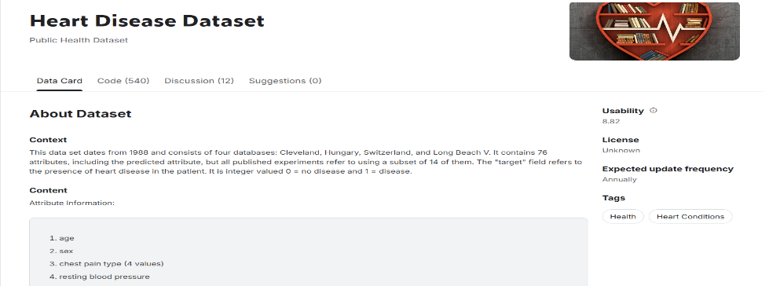
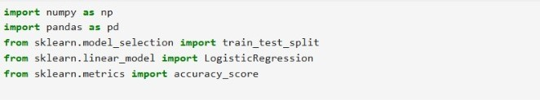



Data set
Libraries

Slide 10

Data pre processing
Data preprocessing is a crucial step in any machine learning project to ensure the data is clean, structured, and suitable for analysis.
The dataset is imported in CSV format, into a pandas DataFrame. This helps organize data in a structured tabular format.

Slide 11
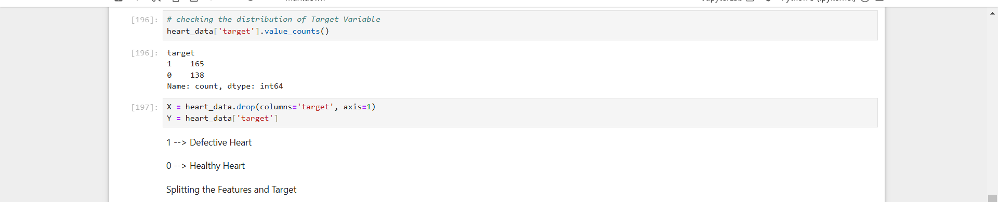
Distribution of Target variable
Analysed the target variable to check the balance of classes (e.g., presence vs. absence of heart disease).
Features (X): Extracted all columns except target.
Target (Y): Isolated the target column for prediction tasks.

Slide 12
Train test split
The dataset is split into training and testing sets. The training set will be used to train the model and the testing set will be used to evaluate its performance.
We will use 80% of the data for training and 20% for testing.

Slide 13
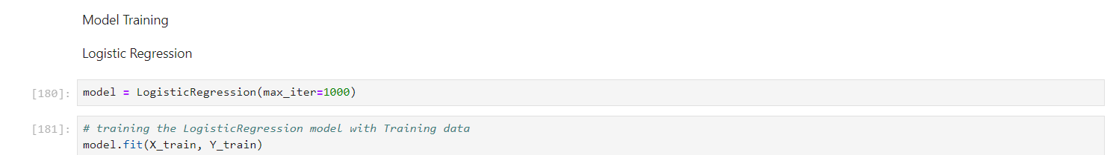
Model training
We will train our Logistic Regression model using the training data.
The fit method trains the model on the training data. After training, the model will have learned the relationships between the features and the target variable.

Slide 14
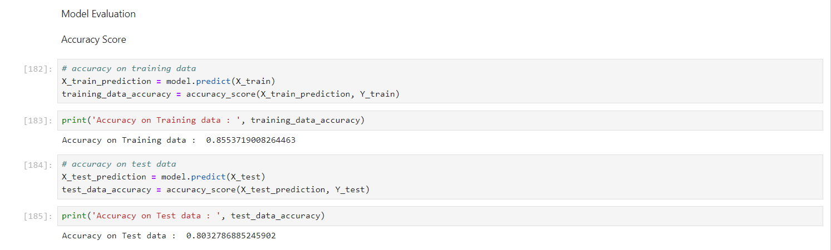
MODEL EVALUATION
After training the model, we evaluate its performance on both the training data and the test data. We use the accuracy score as the evaluation metric, which tells us how many predictions were correct out of the total predictions.
This gives us the accuracy on the training data. For example, the model achieves an accuracy of 85% on the training data, which means it correctly predicted the target variable for 85% of the training samples.
For the test data, the model achieves an accuracy of 80%, indicating its performance on data it has not seen before. The training and test accuracy values are quite close, suggesting that the model is not overfitting and is performing well on new, unseen data.

Slide 15
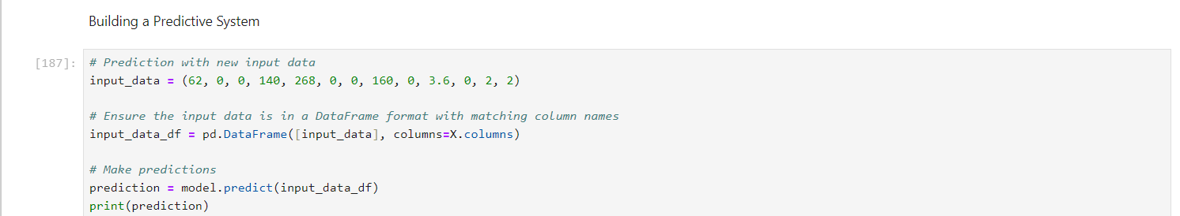
MODEL EVALUATION
Finally, we build a predictive system where we can input feature values (e.g., age, sex, chest pain, etc.), and the model will predict whether the person has heart disease or not.
The input data consists of 13 feature values. The data reshaped to ensure it’s in the correct format for the model. After reshaping, we use the model to make a prediction.

Slide 16
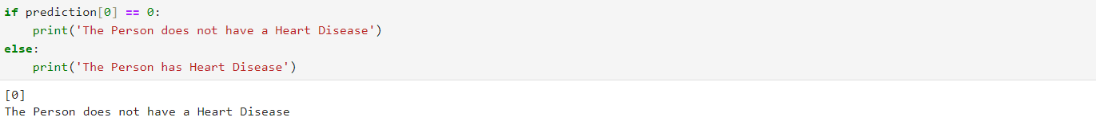
output
The model outputs either 0 (healthy heart) or 1 (diseased heart). In our case, it predicts 0, meaning the person does not have heart disease.
This condition checks the prediction and outputs a clear message: whether the person has heart disease or not.

Slide 17
Hardware Implementation Flowchart
Pulse Modulator
Heart ECG
Monitoring
Blood Glucose Level Sensor
ML
Data Set
Pulse Transit Time
Photoplethysmography
Blood
Cholesterol
Level
Blood Pressure
Arduino UNO
ML Algorithm
Required Output

Slide 18
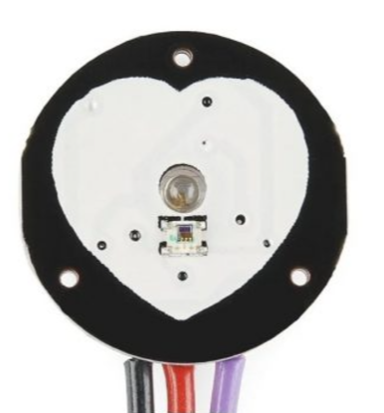
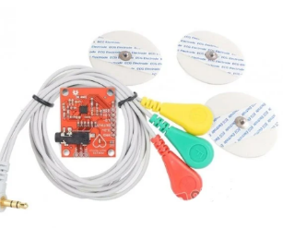
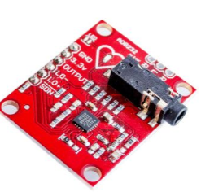
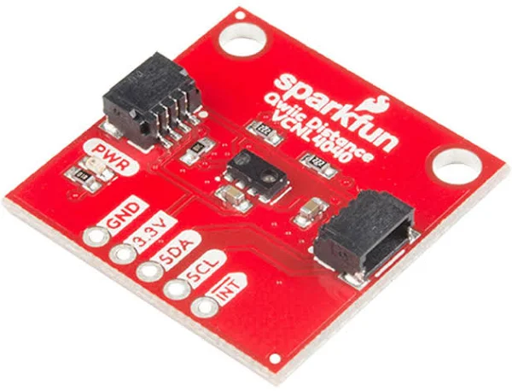
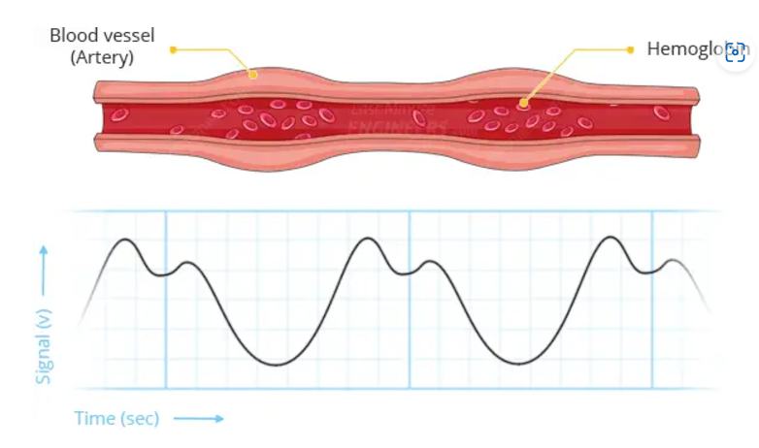
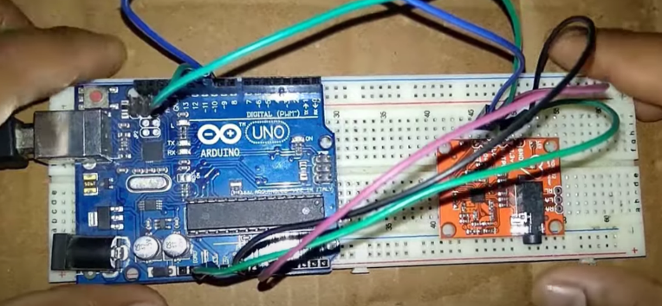
Pulse Sensor
Heart Rate Monitor
AD8232 ECG sensor
Glucose Level Monitoring Sensor

Slide 19
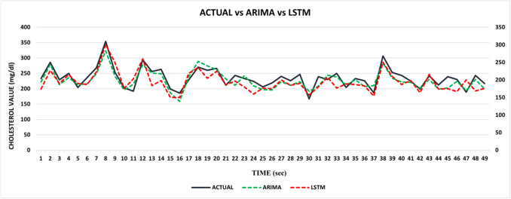

, , , , ,
, , , , ,
Autoregressive integrated moving average (ARIMA) model
:
ARIMA is a statistical method that models time series data based on its own past values and error terms. It makes forecasts based solely on the historical patterns in the data
Long short-term memory networks (LSTM) model
:
LSTM is a type of recurrent neural network that uses deep learning to model sequence data.
Ref : Umapathi Krishnamoorthy, Vijay Kumar S Jatti,… Learned prediction of cholesterol and glucose using ARIMA and LSTM models – A comparison. https://www.sciencedirect.com/science/article/pii/S2666720723001649

Slide 20
conclusion
In conclusion, the logistic regression model performed well in predicting heart disease, achieving an accuracy of 85% on the training dataset and 80% on the testing dataset. The close alignment between these two accuracy scores indicates that the model is not overfitting and has strong generalization capabilities. This is crucial in ensuring that the model performs reliably when faced with unseen data. The results suggest that logistic regression is an effective tool for binary classification tasks, especially in domains like healthcare, where early and accurate predictions are vital.

Slide 21
Thank you

