Slide 1
Manual ML vs AutoML
10-year heart disease risk prediction (Framingham)
AutoML - IA-3 project
Team members: [add names and register numbers]

Slide 2
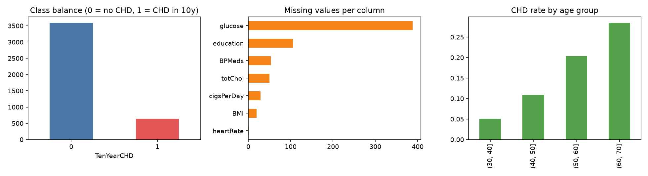
Problem and data
• Predict CHD within 10 years from routine clinical data
• Framingham extract: 4,240 rows, 15 features, 15.2% positive (imbalanced)
• 645 missing cells (glucose 9%)
• One stratified 80/20 split, seed 42; test set touched once
• Metric: ROC-AUC (accuracy is misleading at 85% majority)

Slide 3
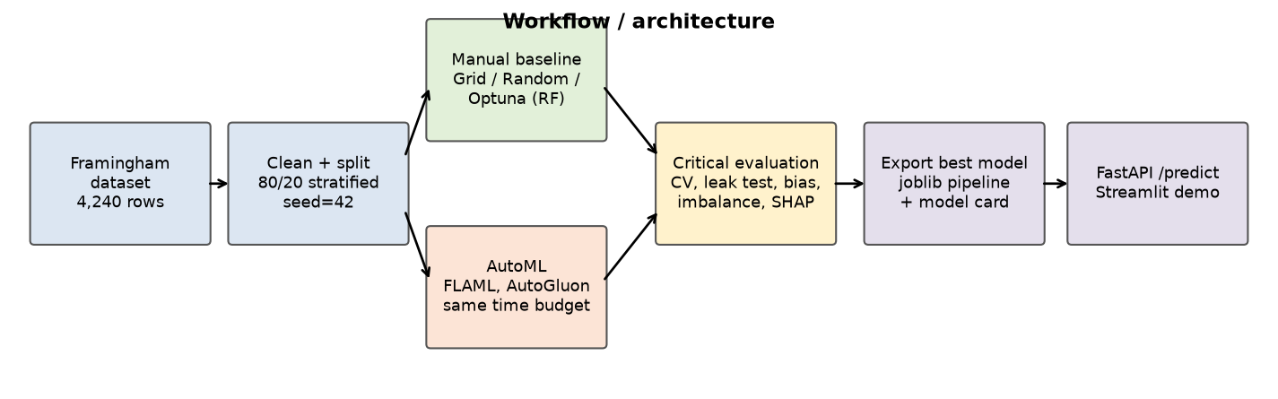
Workflow: same split, same data, same budget

Slide 4
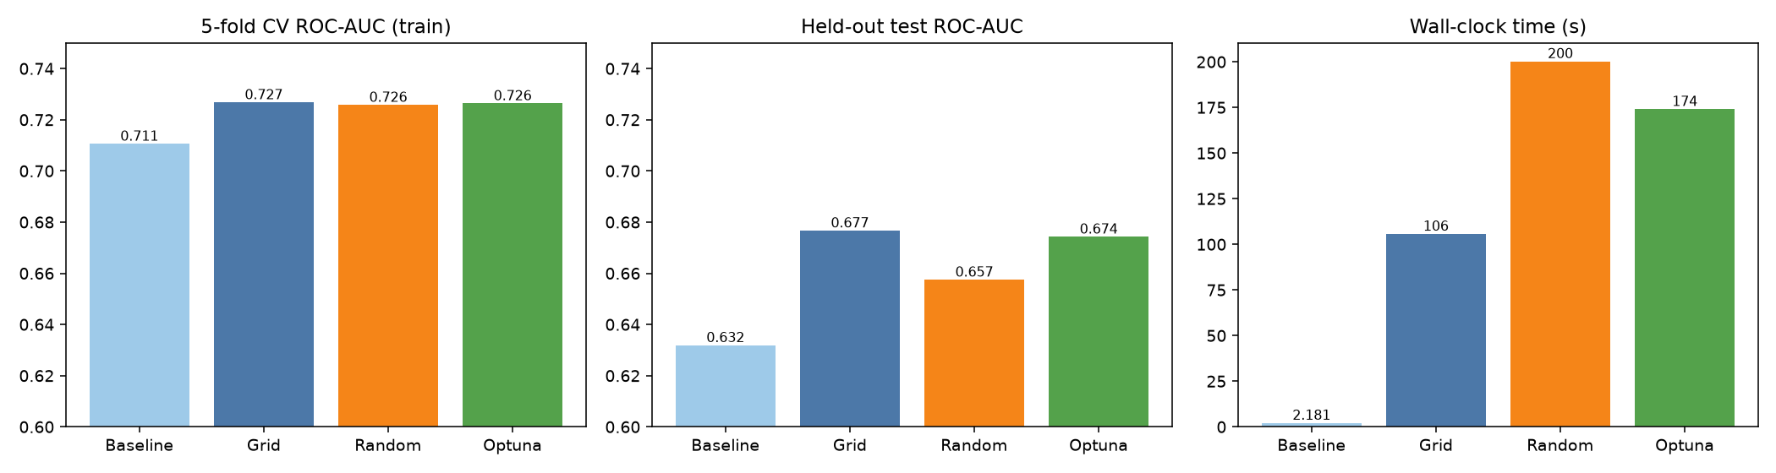
Step 2: Baseline and tuning (same RF, 36 evaluations each)
• Baseline CV AUC 0.711, train AUC 1.00 -> overfits
• Grid / Random / Optuna CV AUC: 0.727 / 0.726 / 0.726
• Differences are below CV noise (std 0.03)
• Time: 106s / 200s / 174s
• Logistic regression is competitive (test 0.702)

Slide 5
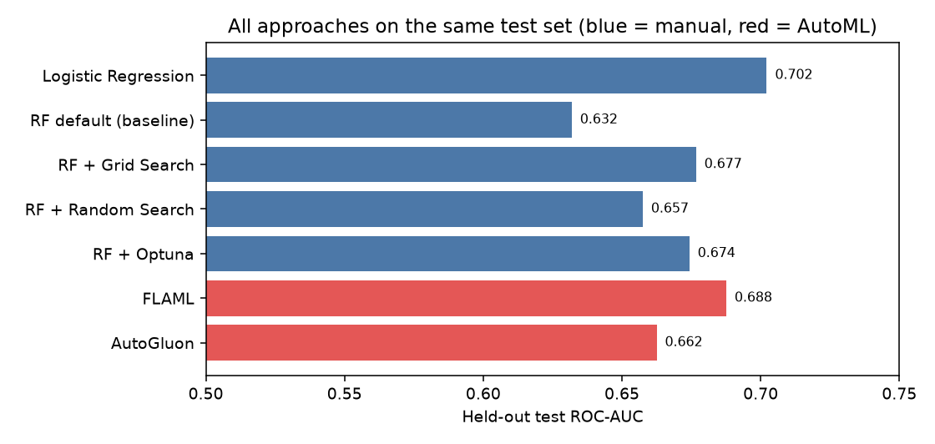
Step 3: AutoML leaderboards
• FLAML winner: extra_tree (CV AUC 0.728)
• AutoGluon: 49 models, winner WeightedEnsemble_L3
• Tools used the same 15 features; no new features created
• Top families: FLAML extra_tree, AutoGluon ExtraTrees; linear models weakest
• Some AutoGluon families skipped (failed imports, see log)

Slide 6
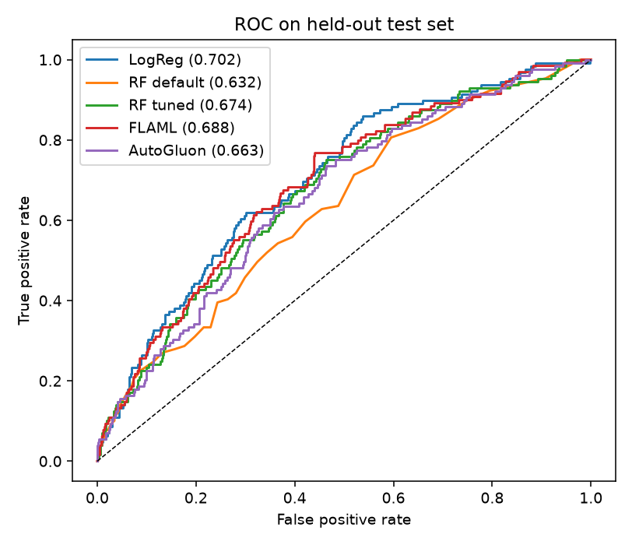
Manual vs AutoML: honest result
• Test AUC: LogReg 0.702, FLAML 0.688, AutoGluon 0.662, tuned RF 0.674
• 95% CIs overlap: no significant winner
• AutoML = speed and robustness, not a higher ceiling
• Interpretability: LogReg > RF+SHAP > FLAML > AutoGluon ensemble
• Time: manual tuning 2-4 min, AutoML = whole budget

Slide 7
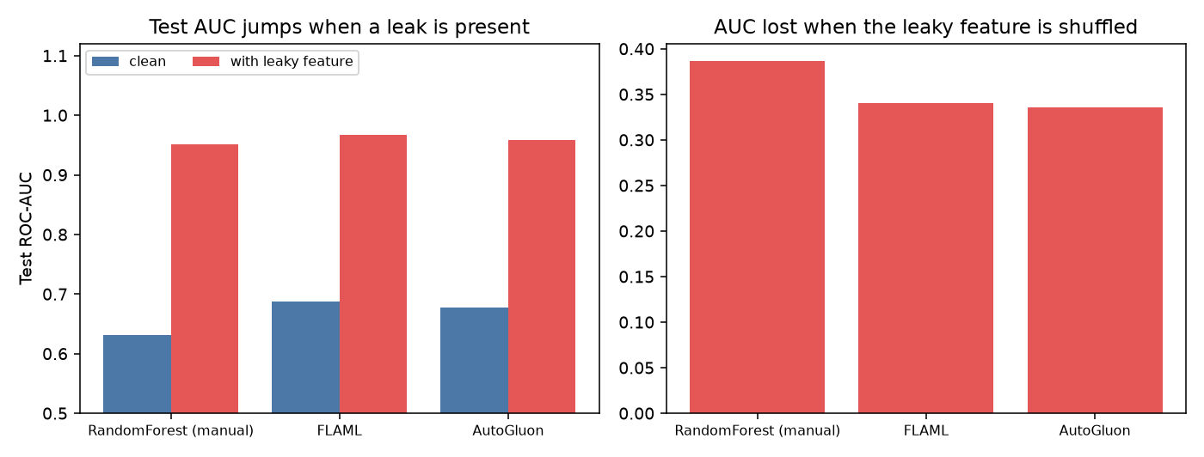
Step 4: Leakage experiment
• Added a post-outcome feature (outcome with 5% noise)
• Test AUC: ~0.63-0.69 -> 0.95-0.97
• Both AutoML tools exploit it at once (AutoGluon ranks it #1)
• No warning from the tools
• Single-feature AUC screen catches it: 0.94 vs 0.69 for age

Slide 8
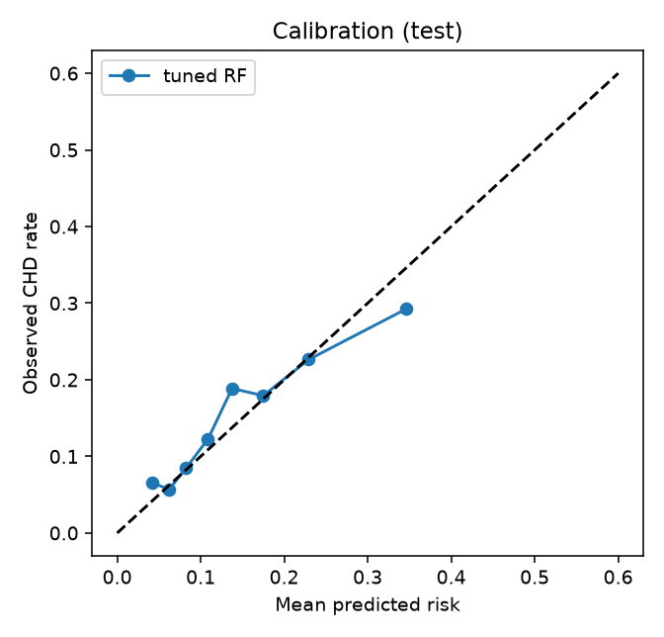
Imbalance, bias and overfitting
• At 0.5 threshold recall is only 1.6%; weighting -> 51% with same AUC
• Threshold 0.18 from train CV: recall 0.48, precision 0.25
• Men flagged 37% vs women 24%
• Under-45s almost never flagged (recall 0.11); age-driven model
• CV to test AUC drop 0.05 is within test-set noise

Slide 9
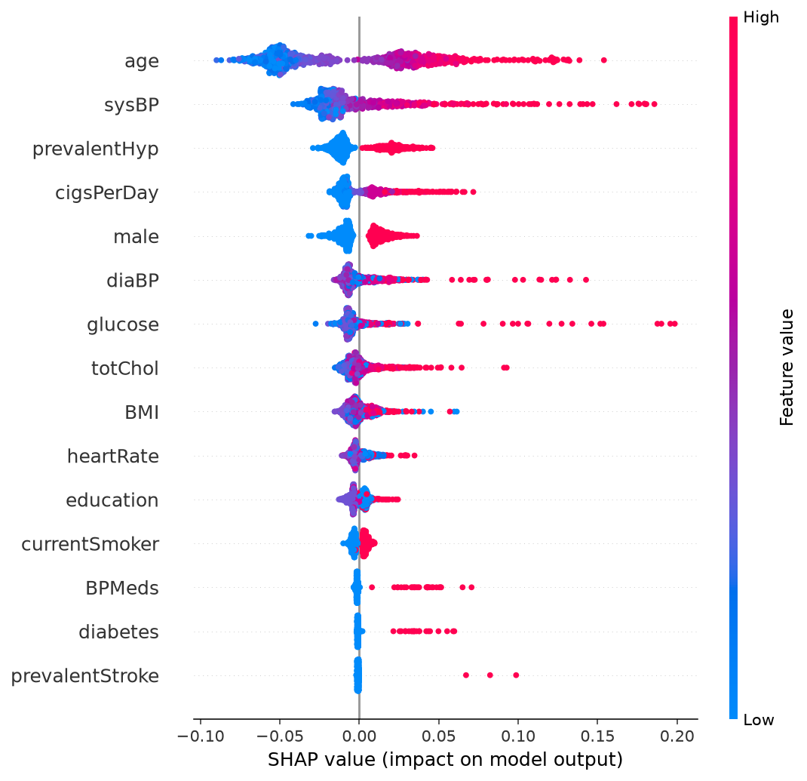
Explainability (SHAP)
• Age and systolic BP dominate
• Directions are clinically plausible
• Cholesterol/BMI/glucose add little out-of-sample
• Local SHAP explanation returned for every prediction

Slide 10
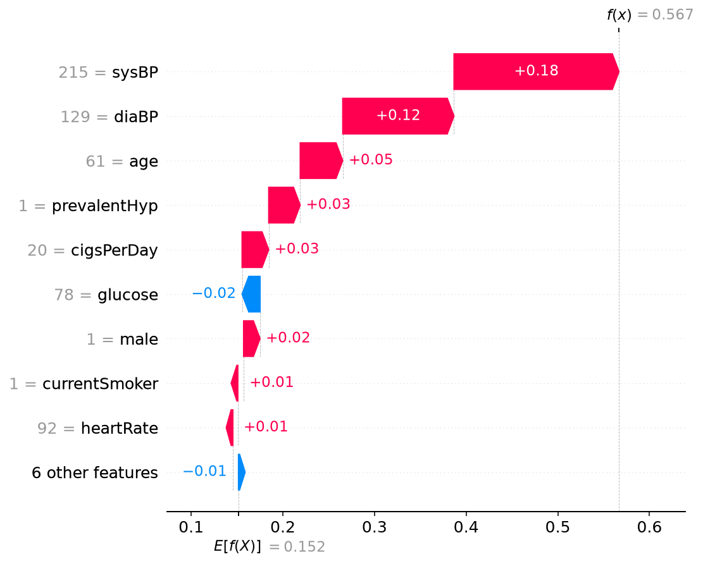
Step 5: Deployment
• Exported sklearn pipeline (joblib), chosen by a CV rule set before testing
• FastAPI: /predict, /health, /model-info, docs at /docs
• Streamlit: sliders, risk vs base rate, SHAP factors, model card tab
• Model card: data, metrics, intended use, limits

Slide 11
Reflections and limitations
• AutoML did well: fast, strong, validated baselines
• AutoML failed: used the leak, ignored imbalance, no warnings
• Weak signal (AUC ~0.7): not for clinical use
• Short budget (240s, 2 cores); small test set; single split
• Humans own validation design, leakage audit, bias and thresholds

