Slide 1
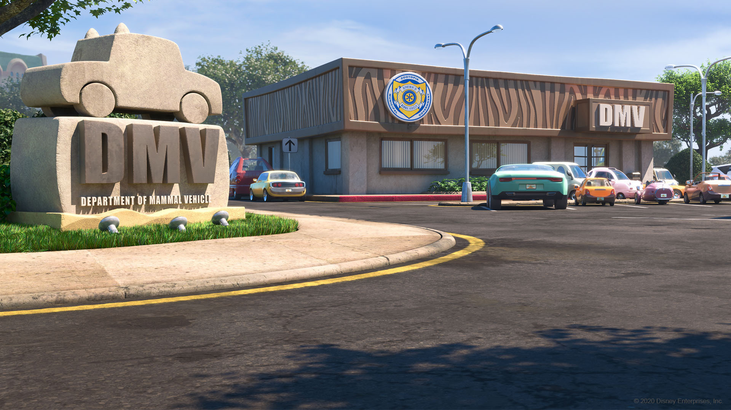
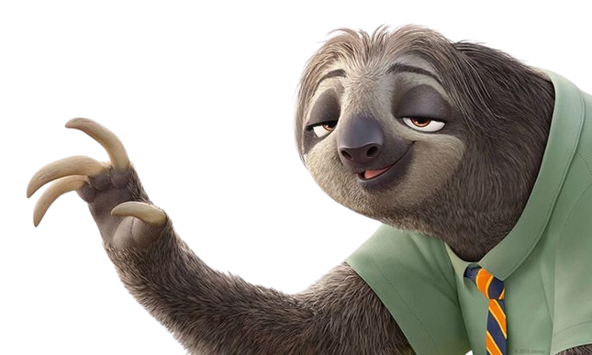

ywan5722
Hi... my name is... Flash... the... fastest... sloth... in... Zootopia.

Slide 2
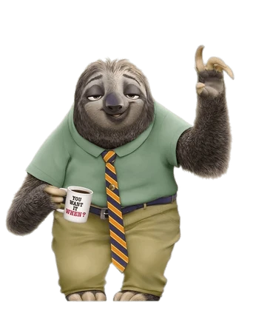

I... work... at... the DMV... where I... am responsible for... handling... vehicle... registrations... and... driver's license... renewals.
ywan5722
Oops

Slide 3
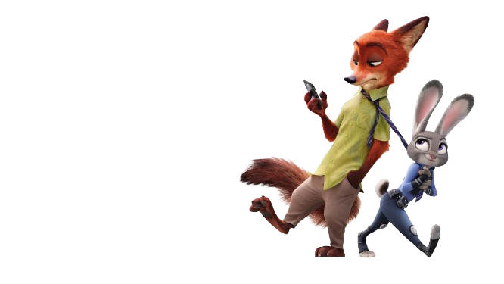
ywan5722
"Hey Nick! You kicked the ball and hit someone again!"

Slide 4
"Hold on, Judy, let me show you a magic trick."
ywan5722

Slide 5
ywan5722

