Slide 1


Paintings damage classification
Biasci linda
Computing methods for experimental physics and data analysis 2025/2026

Slide 2
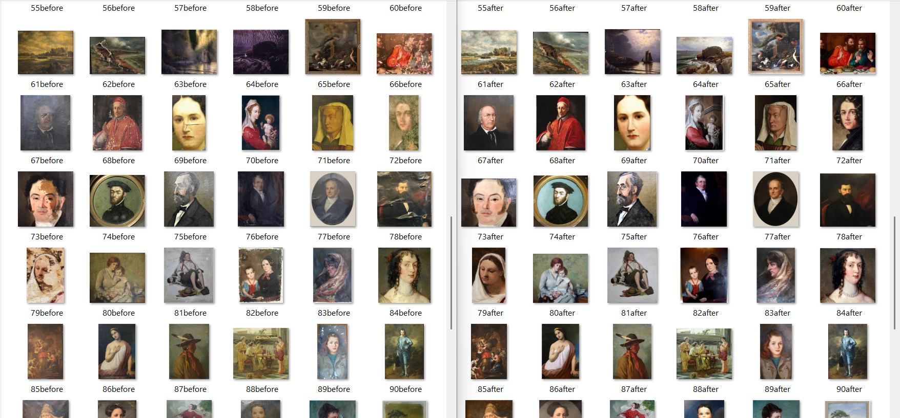
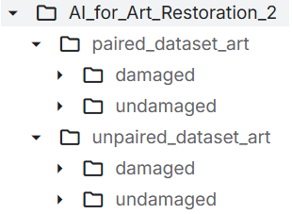

Project purposes
Classification of artworks and paintings into two diagnostic categories, damaged (class 1) and undamaged (class 0), for art restoration
Comparison between a traditional approach (handcrafted feature extraction + machine learning classification) and a deep learning approach (feature extraction with a pre-trained deep neural network + machine learning classification)
Dataset: “AI_for_Art_Restoration_2”, Kaggle
(DAMAGED_AND_UNDAMAGED_ARTWORKS)
$⇒$ labelled images

Slide 3
Image preprocessing (MATLAB)
Cleaned original dataset: removed duplicates, renamed images, converted all images to .jpg format
Preprocessing: resized to 224x224 pixels, preserving image proportions with padding; converted grey-scale images to RGB; normalised pixel intensities, from [0, 255] to [0, 1], for each RGB channel
Saved processed images preserving raw dataset’s directories
Manual feature extraction (MATLAB)
Define a custom function to extract features from images of the paired_dataset:
Texture features: contrast, homogeneity, energy and correlation from Grey-Level Co-occurrency Matrix; energy and entropy from Local Binary Pattern; global entropy;
Edge feature: max pooling over 4x4 grids of edge density with Canny algorithm
Sharpness feature: max pooling of Laplacian variance
Fourier spectral features: max pooling of spectral variance, high-frequency energy ratio, distance from spectral centroid
Colour features: mean intensity, standard deviation, skewness on the three RGB channels

Slide 4
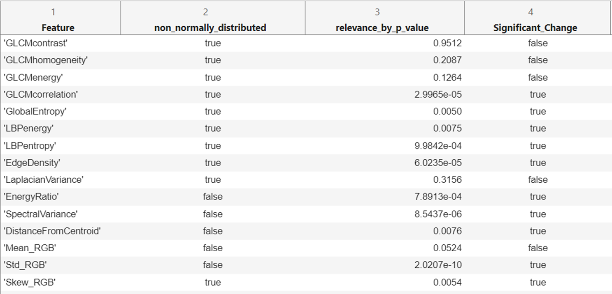
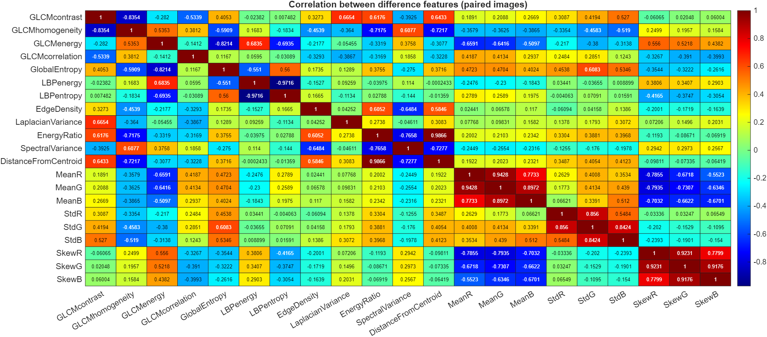
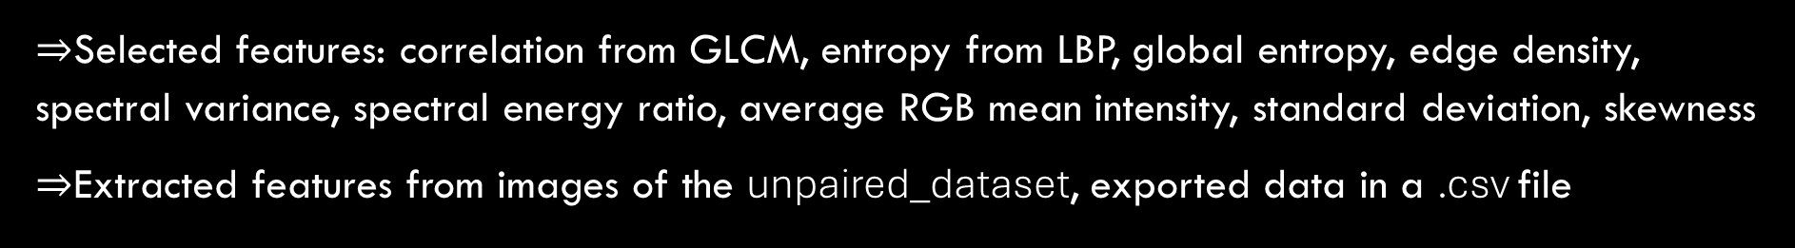
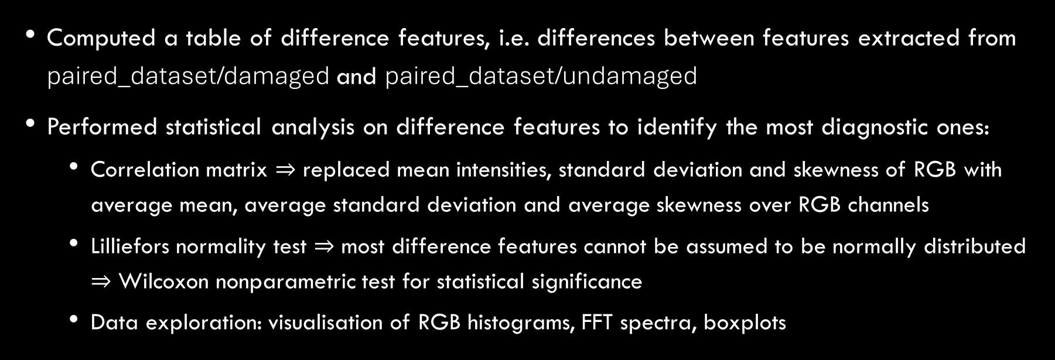
Statistical analysis on extracted features
Computed a table of difference features, i.e. differences between features extracted from paired_dataset/damaged and paired_dataset/undamaged
Performed statistical analysis on difference features to identify the most diagnostic ones:
Correlation matrix $⇒$ replaced mean intensities, standard deviation and skewness of RGB with average mean, average standard deviation and average skewness over RGB channels
Lilliefors normality test $⇒$ most difference features cannot be assumed to be normally distributed $⇒$ Wilcoxon nonparametric test for statistical significance
Data exploration: visualisation of RGB histograms, FFT spectra, boxplots
$⇒$Selected features: correlation from GLCM, entropy from LBP, global entropy, edge density, spectral variance, spectral energy ratio, average RGB mean intensity, standard deviation, skewness
$⇒$Extracted features from images of the unpaired_dataset, exported data in a .csv file

Slide 5
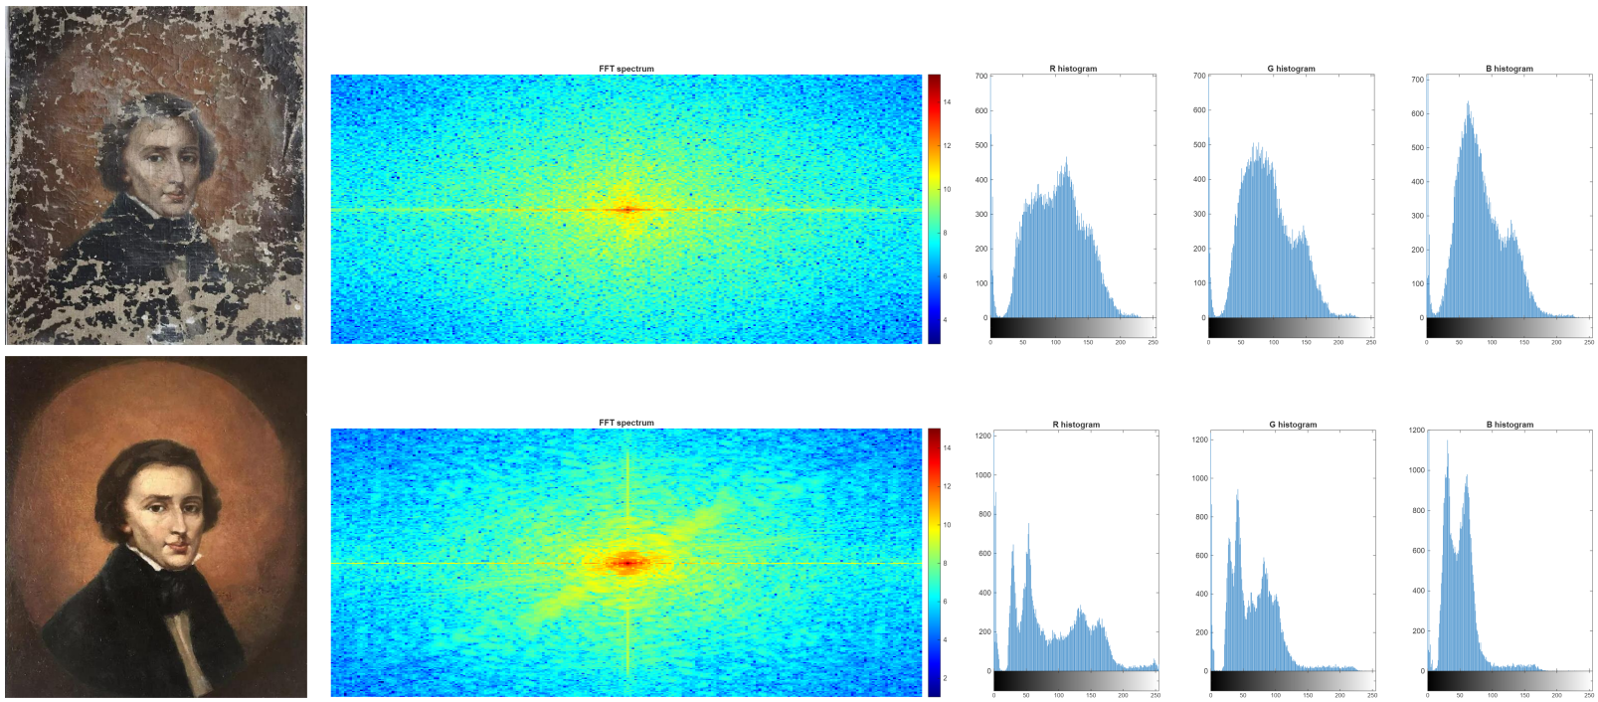
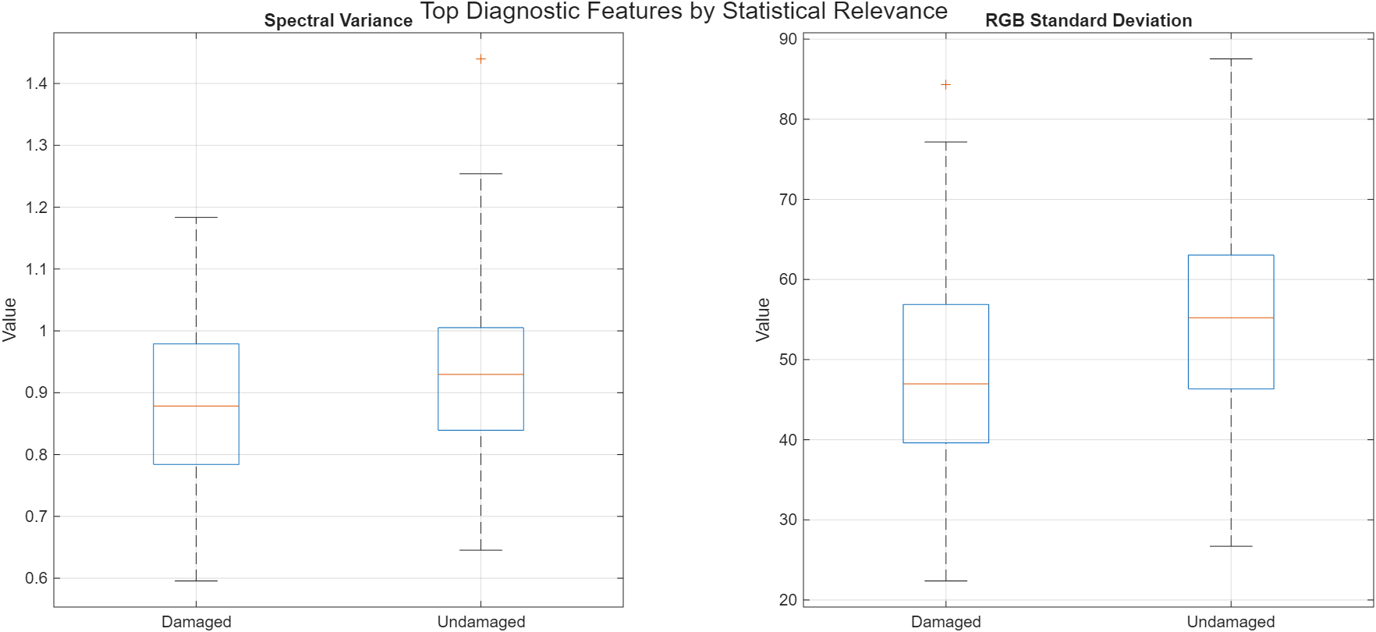
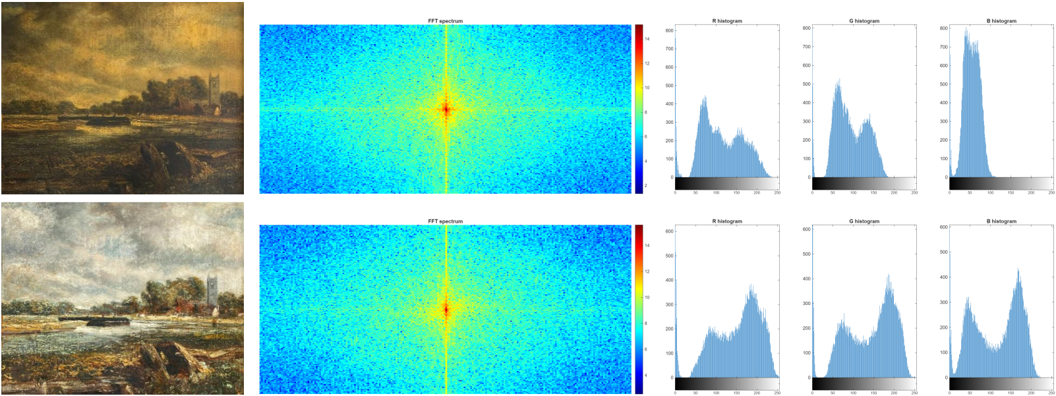

Slide 6

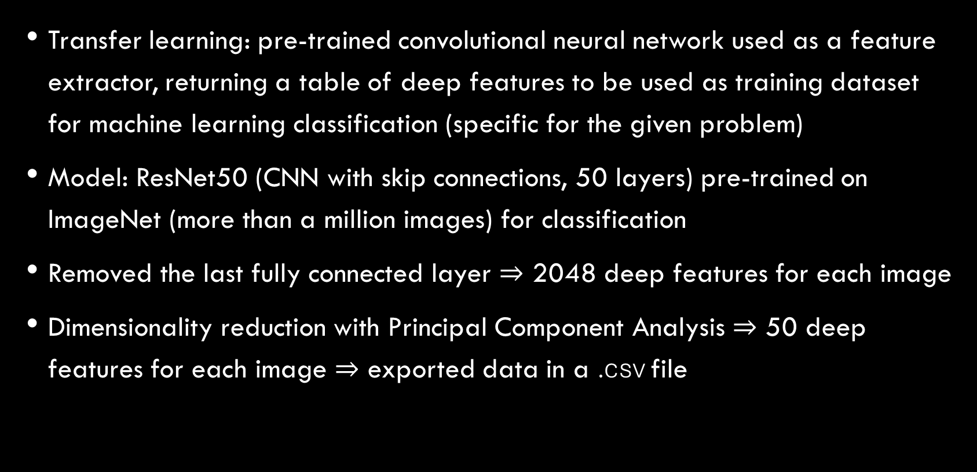
Deep feature extraction (Python)
Transfer learning: pre-trained convolutional neural network used as a feature extractor, returning a table of deep features to be used as training dataset for machine learning classification (specific for the given problem)
Model: ResNet50 (CNN with skip connections, 50 layers) pre-trained on ImageNet (more than a million images) for classification
Removed the last fully connected layer $⇒$ 2048 deep features for each image
Dimensionality reduction with Principal Component Analysis $⇒$ 50 deep features for each image $⇒$ exported data in a .csv file

Slide 7
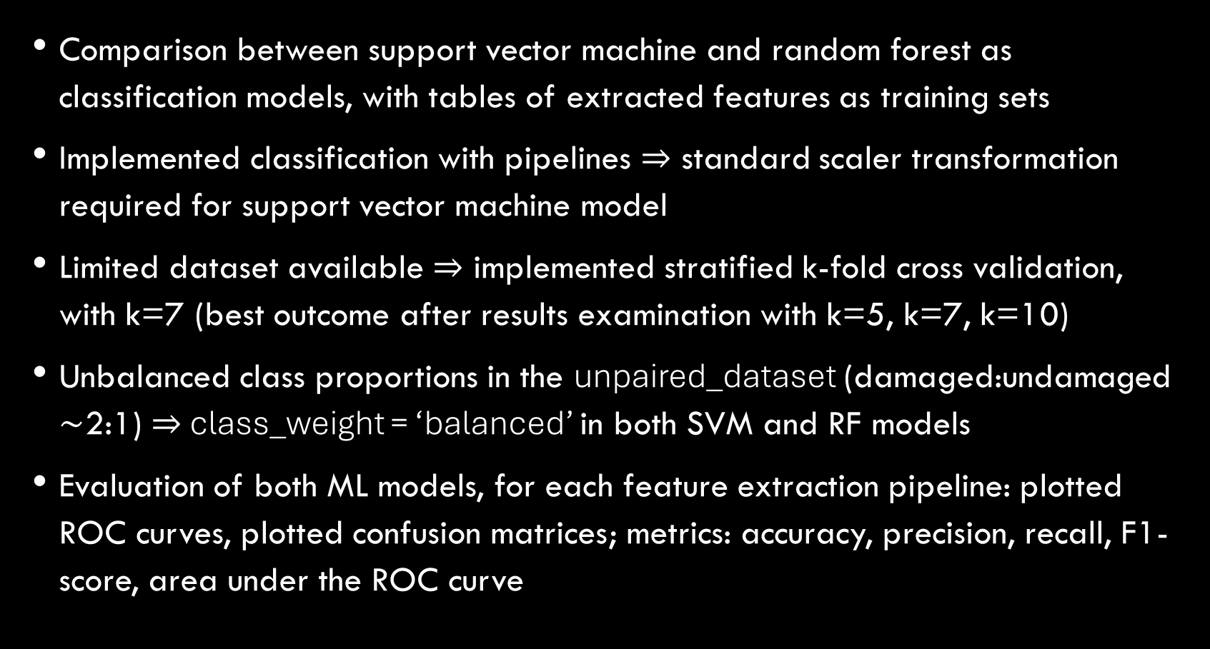
Machine learning classification (python)
Comparison between support vector machine and random forest as classification models, with tables of extracted features as training sets
Implemented classification with pipelines $⇒$ standard scaler transformation required for support vector machine model
Limited dataset available $⇒$ implemented stratified k-fold cross validation, with k=7 (best outcome after results examination with k=5, k=7, k=10)
Unbalanced class proportions in the unpaired_dataset (damaged:undamaged $\sim$2:1) $⇒$ class_weight = ‘balanced’ in both SVM and RF models
Evaluation of both ML models, for each feature extraction pipeline: plotted ROC curves, plotted confusion matrices; metrics: accuracy, precision, recall, F1-score, area under the ROC curve

Slide 8
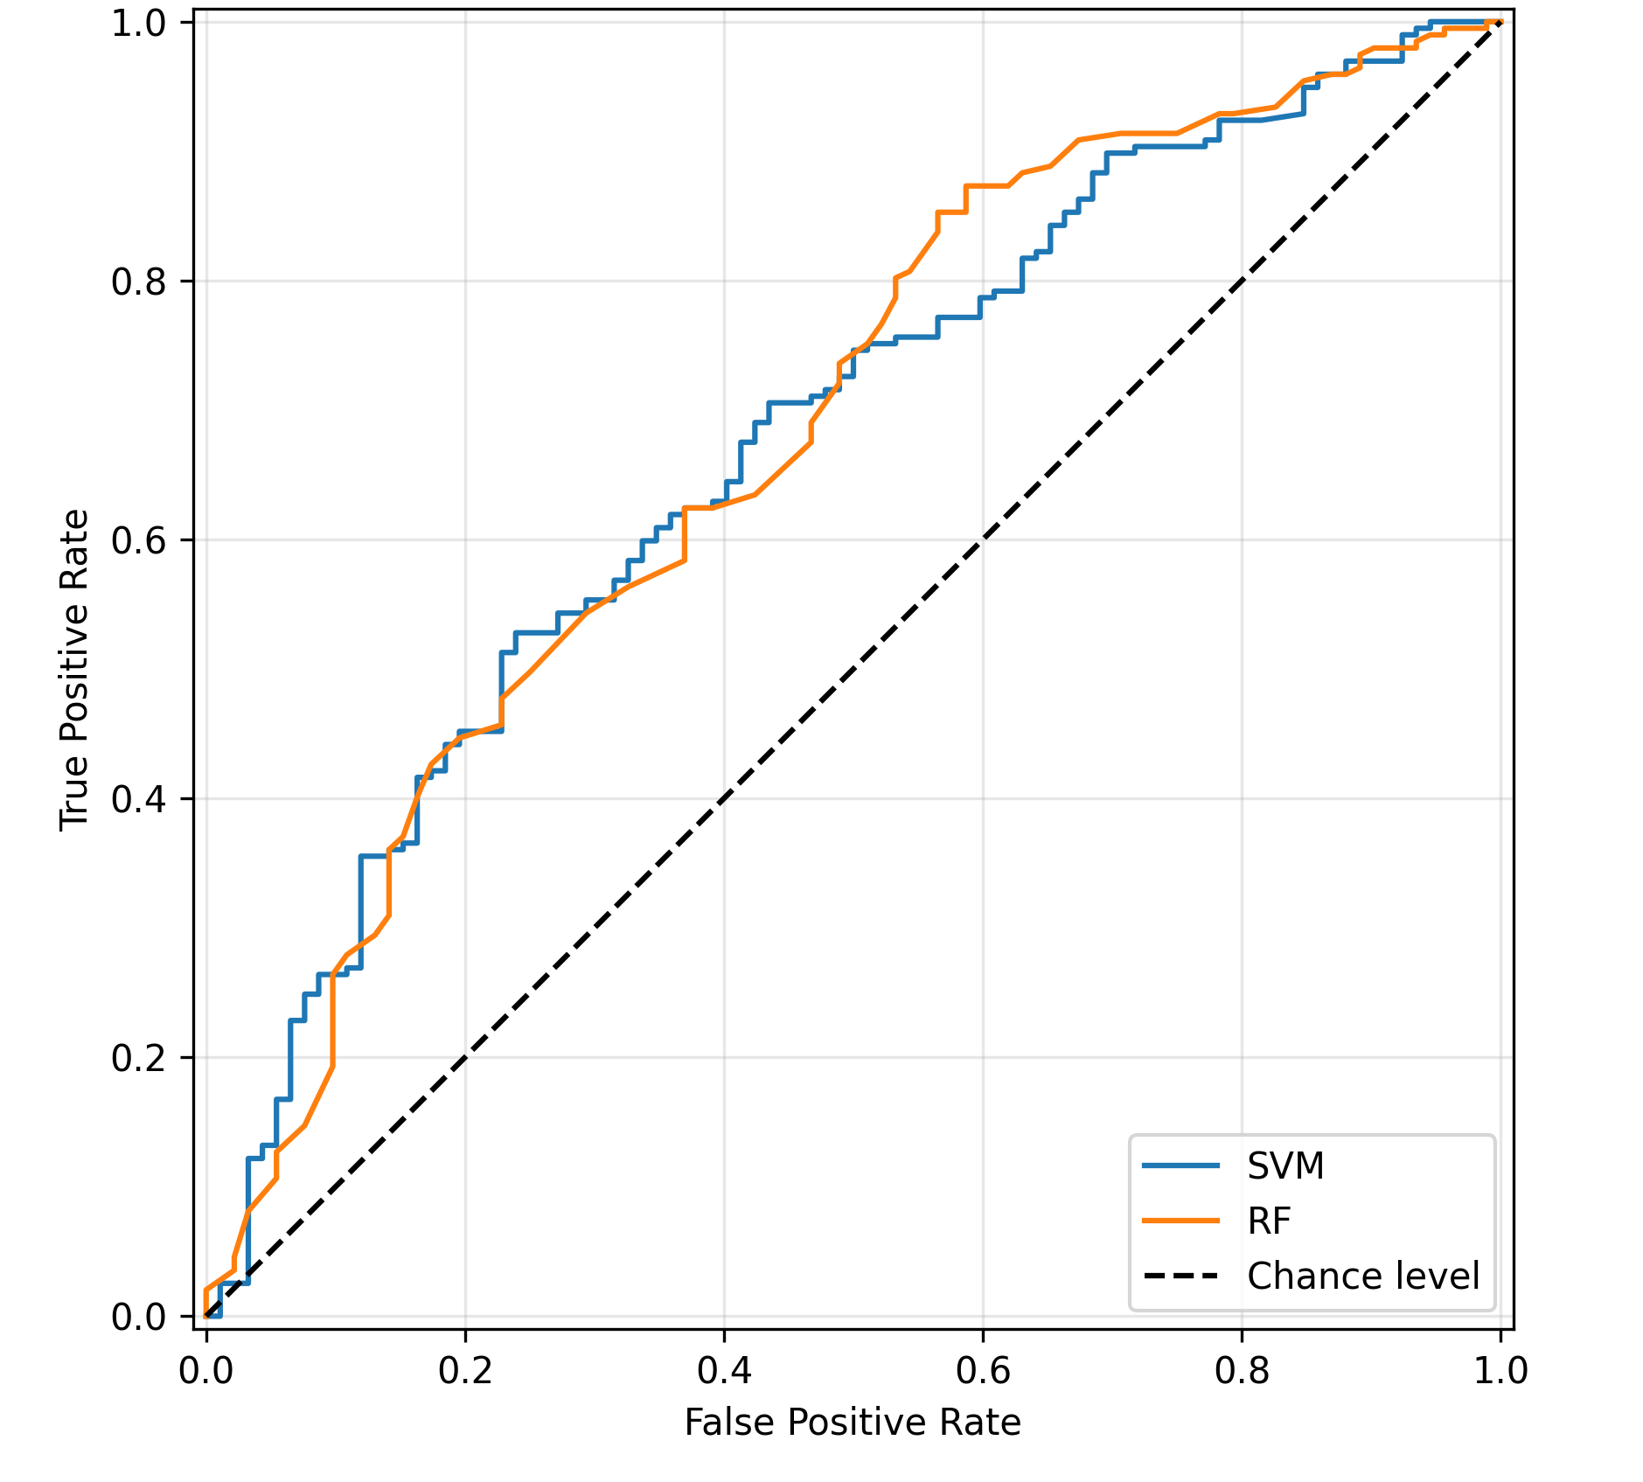
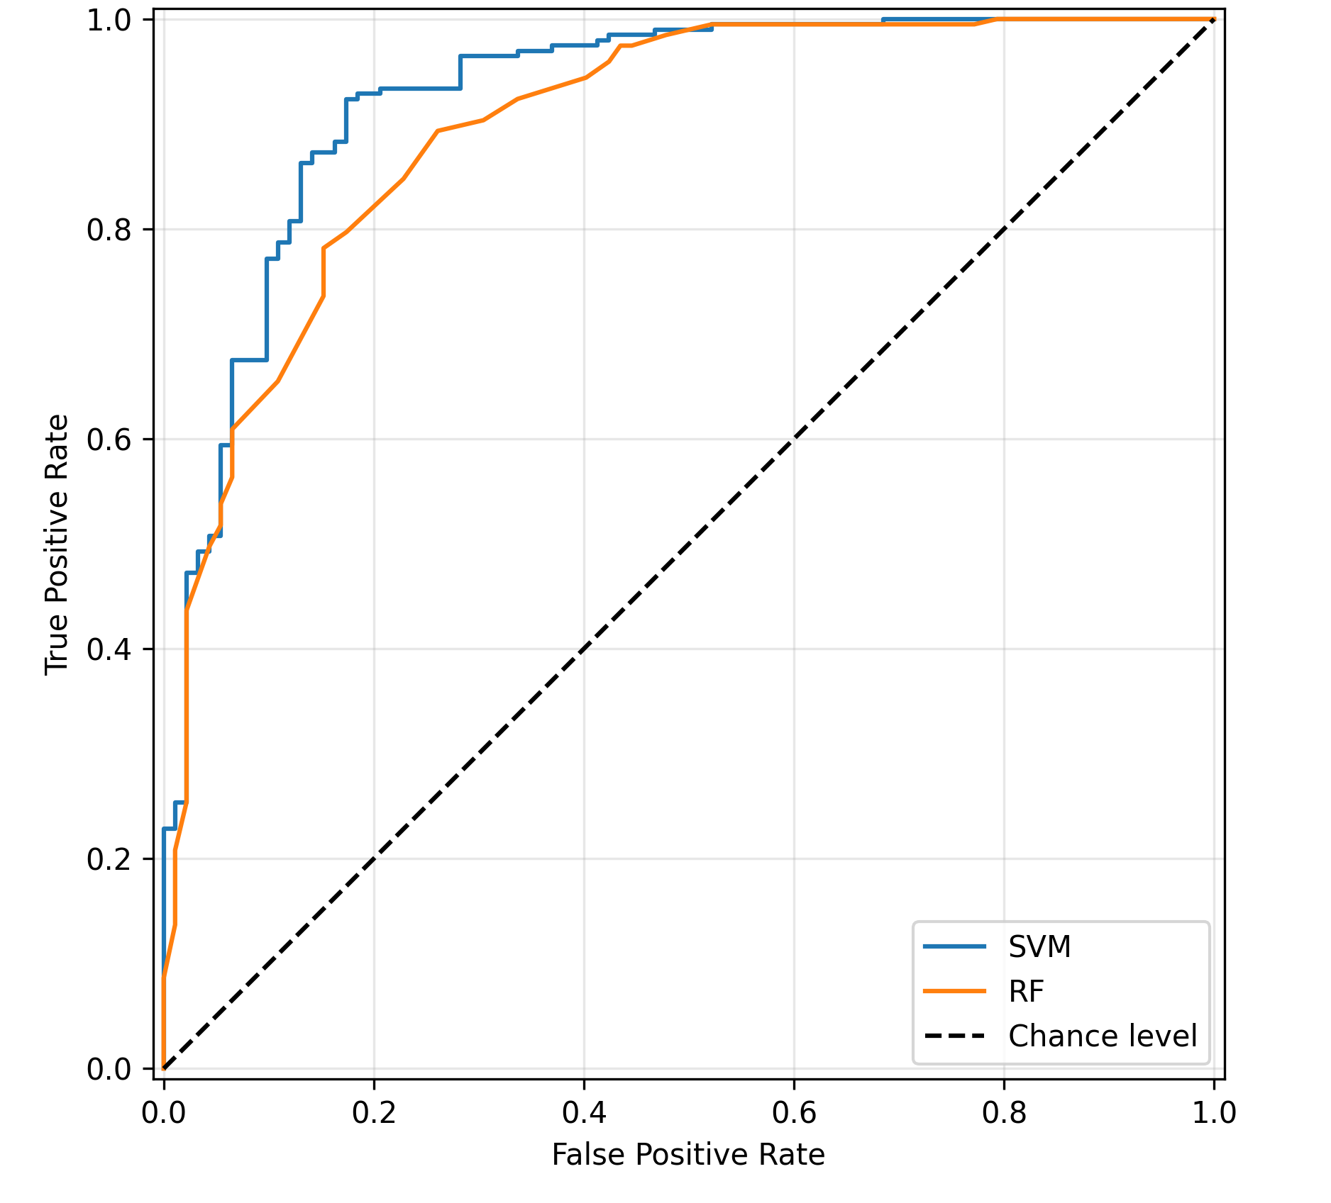
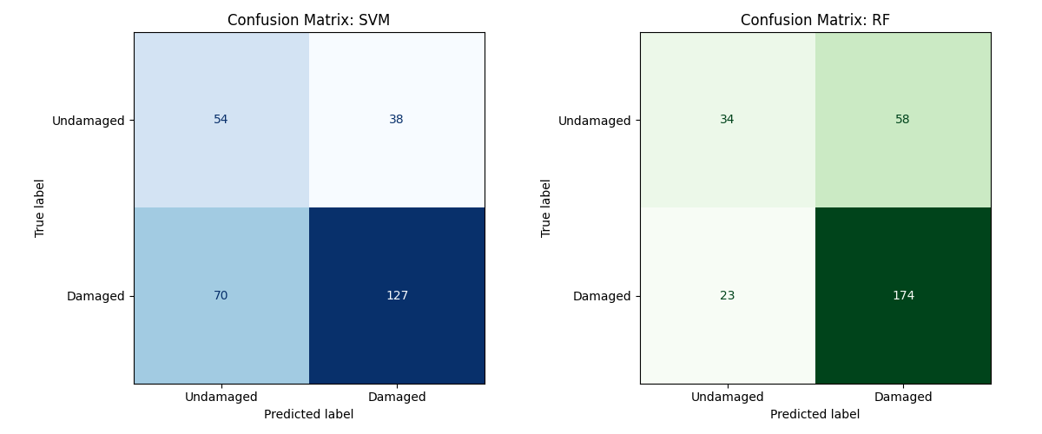
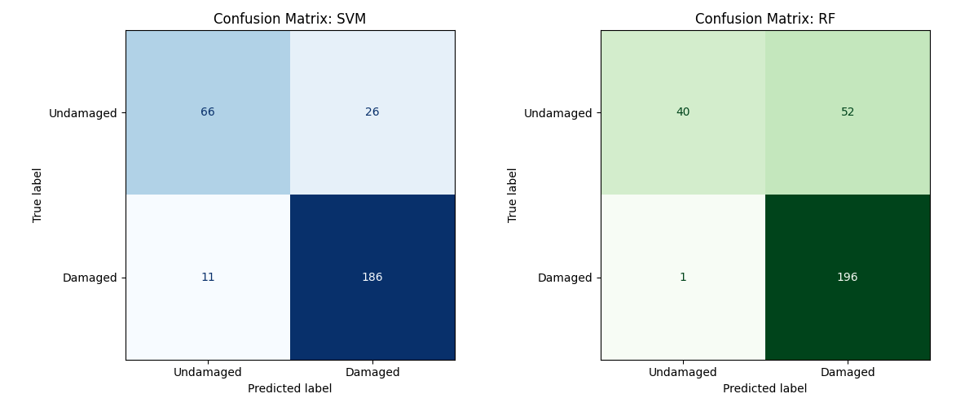
Results: traditional pipeline deep learning pipeline

Slide 9
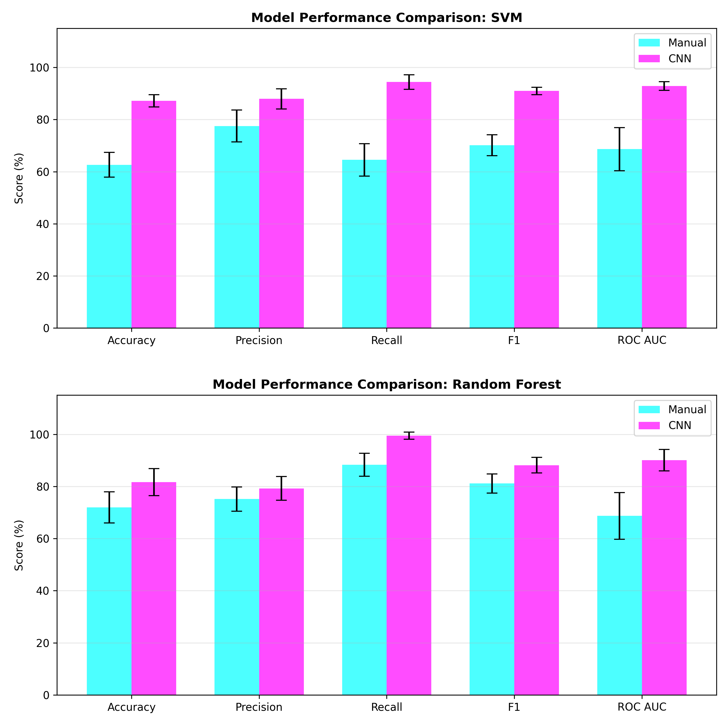
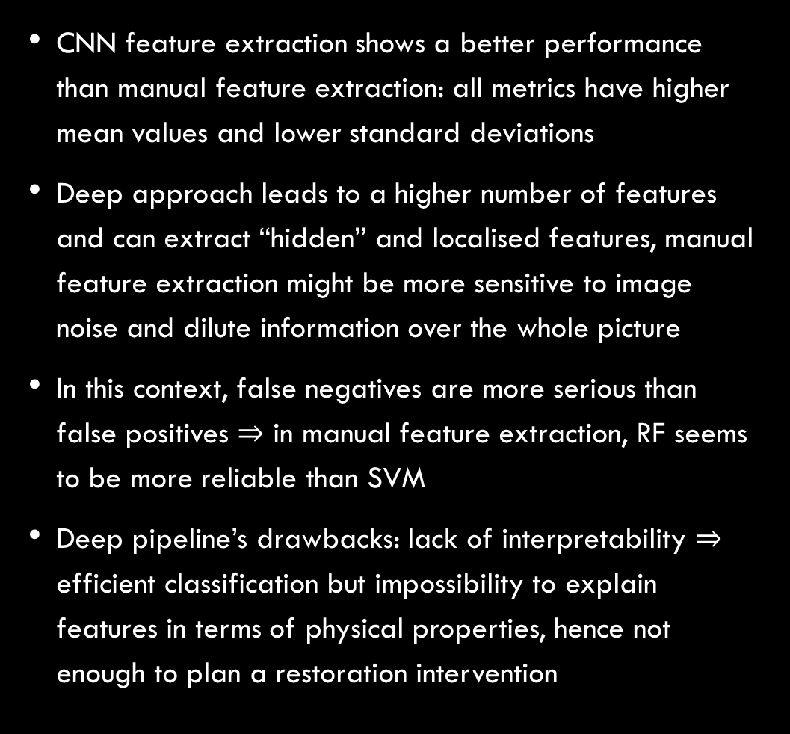
Results and conclusions
CNN feature extraction shows a better performance than manual feature extraction: all metrics have higher mean values and lower standard deviations
Deep approach leads to a higher number of features and can extract “hidden” and localised features, manual feature extraction might be more sensitive to image noise and dilute information over the whole picture
In this context, false negatives are more serious than false positives $⇒$ in manual feature extraction, RF seems to be more reliable than SVM
Deep pipeline’s drawbacks: lack of interpretability $⇒$ efficient classification but impossibility to explain features in terms of physical properties, hence not enough to plan a restoration intervention

Slide 10
Thank you for your attention
Biasci linda
Useful links
Raw dataset:
https://www.kaggle.com/datasets/pes1ug22am047/damaged-and-undamaged-artworks?select=AI_for_Art_Restoration_2
Clean dataset: https://drive.google.com/drive/folders/1MHRfAiGpdYqKGSp35vG3KYK0MP-80ScX?usp=sharing
Project’s repository: https://github.com/LindaBiasci/paintings-damage-classification.git

