Slide 1

Classes
By Ms. ENG MCNDHS
Linda.eng @mcndhs.com

Slide 2
Aim: How do put images next to text ?
Do now:

Slide 3
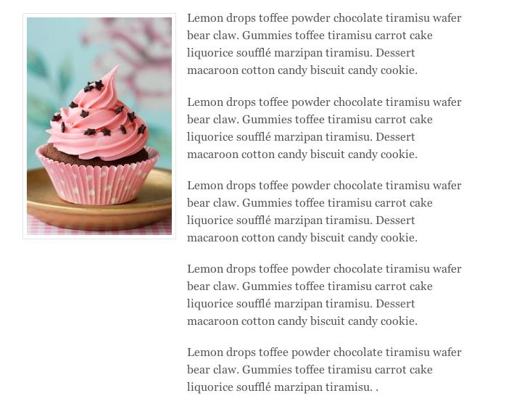
What are we learning today?

Slide 4
Classes:
Are used to control html inside a container.
<div class= “box1”>
<p>hello</p>
<img src=” “ height=” “ width=” “>
</div>
Css:
.box1{
}
P.box1{
}
img{
}

Slide 5
