Slide 1
Shopping Mall Customer Segmentation Analysis
Business Analyst Internship Project
Name: Linda Florentius KA
Date: May 2025

Slide 2
Project Overview
Objective:
Analyze customer demographics and spending behavior
Identify customer segments
Provide actionable business insights
Dataset:
15,079 customers
5 columns — ID, Age, Gender, Income, Spending Score
Source: Shopping Mall Records

Slide 3
Data Cleaning Results
No missing values found
No duplicate rows found
No outliers detected
All data types correct
Dataset is clean and ready for analysis!

Slide 4
Key Customer Statistics
54 Avg Age
$109,742 Avg Income
15,079
Customers

Slide 5
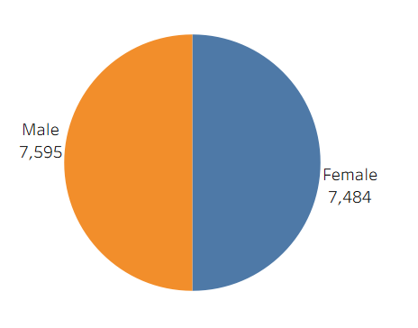
Gender-wise Spending Analysis
Key Finding:
Males spend slightly more (50.78) vs Females (50.39)
Difference is minimal — No significant gender gap

Slide 6
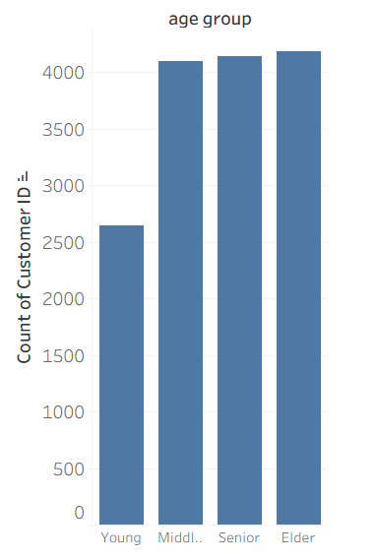
Age Group Spending Analysis
Key Finding:
Young customers (18-30) spend the most
Despite being the smallest group — highest value segment

Slide 7
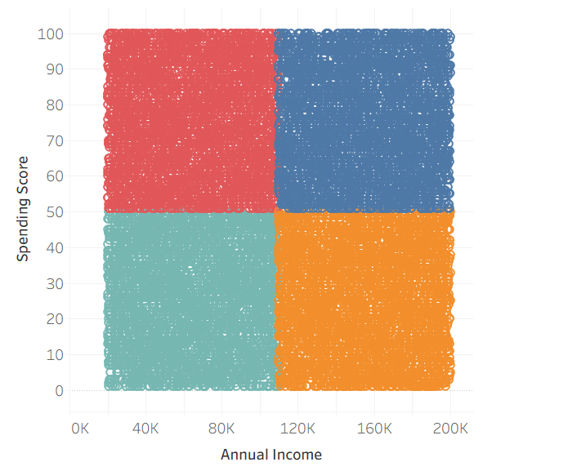
Income vs Spending Relationship
Key Finding:
No significant relationship between income and spending
All income groups score around 50/100
Mall should target ALL income groups equally

Slide 8
Customer Segmentation Results
Segment | Count | Share
High Income High Spending | 3,799 | 25.19%
High Income Low Spending | 3,687 | 24.45%
Low Income High Spending | 3,769 | 24.99%
Low Income Low Spending | 3,824 | 25.35%
All segments roughly equal, balanced customer base

Slide 9
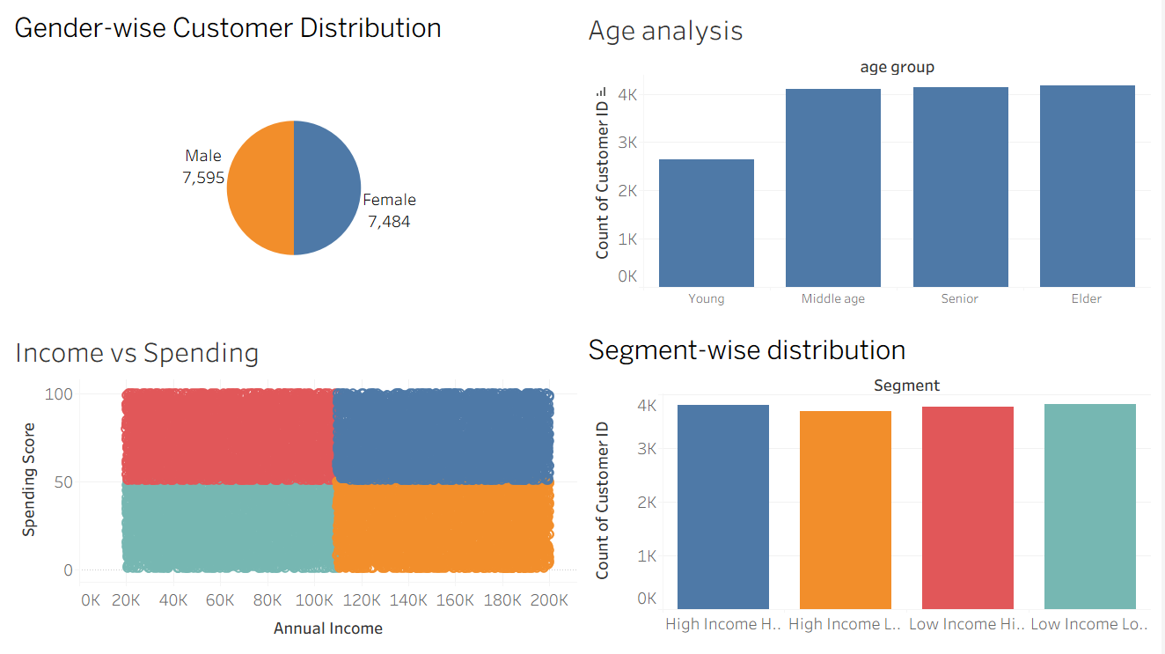
Interactive Dashboard

Slide 10
Business Recommendations
1. PRIMARY TARGET — High Income Low Spending
• 3,687 customers with high potential
• Offer: Premium brands, VIP lounges, Exclusive events
2. ATTRACT LOW SPENDERS
• High Income → Luxury experience, Membership cards
• Low Income → Discounts, Buy now pay later, BOGO offers
3. RETAIN HIGH SPENDERS
• 3,799 valuable customers
• Strategy: Loyalty programs, Personal shopping, Early access

Slide 11
Conclusion & Key Takeaways
15,079 customers analyzed across 5 dimensions
Spending behavior NOT driven by income level
Young customers are highest value despite small size
4 balanced segments — each ~25% of customers
High Income Low Spending = Biggest opportunity
Recommended: Premium experiences + Loyalty programs

