Slide 1


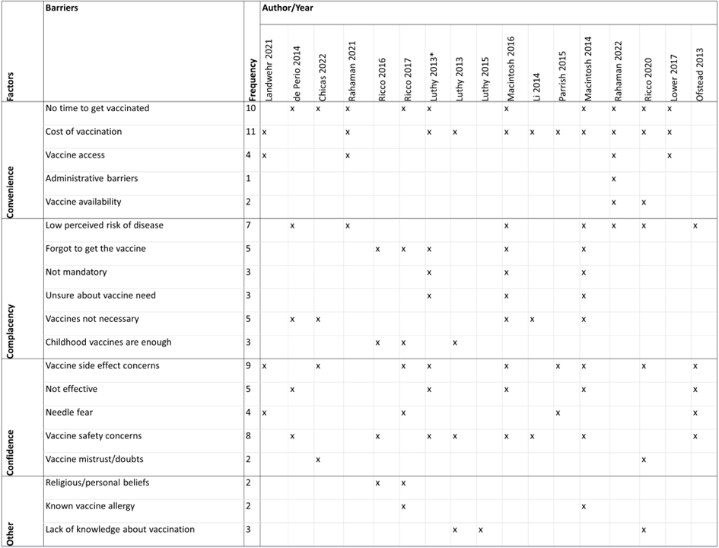
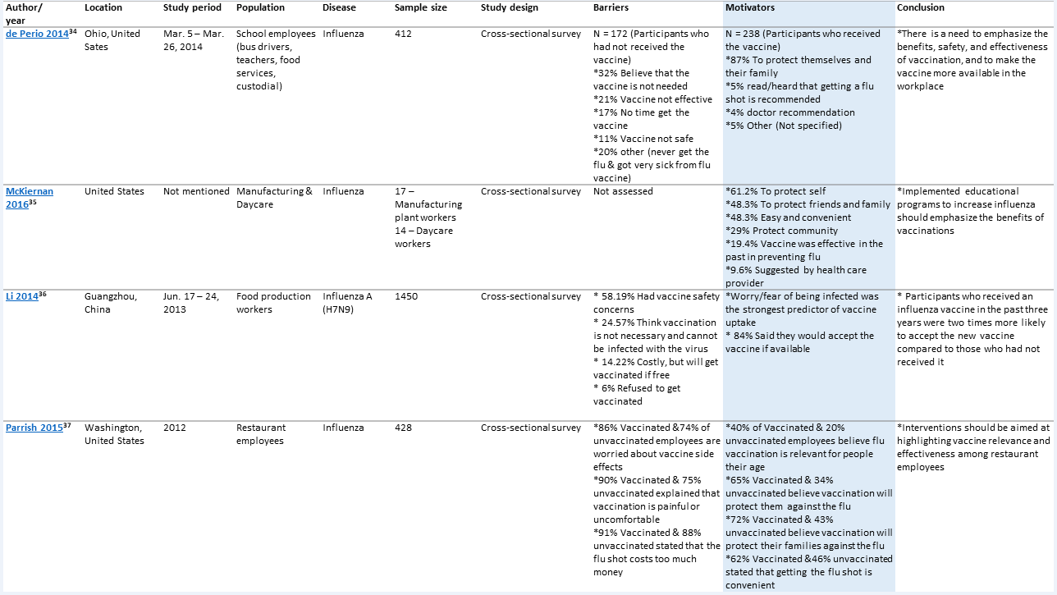
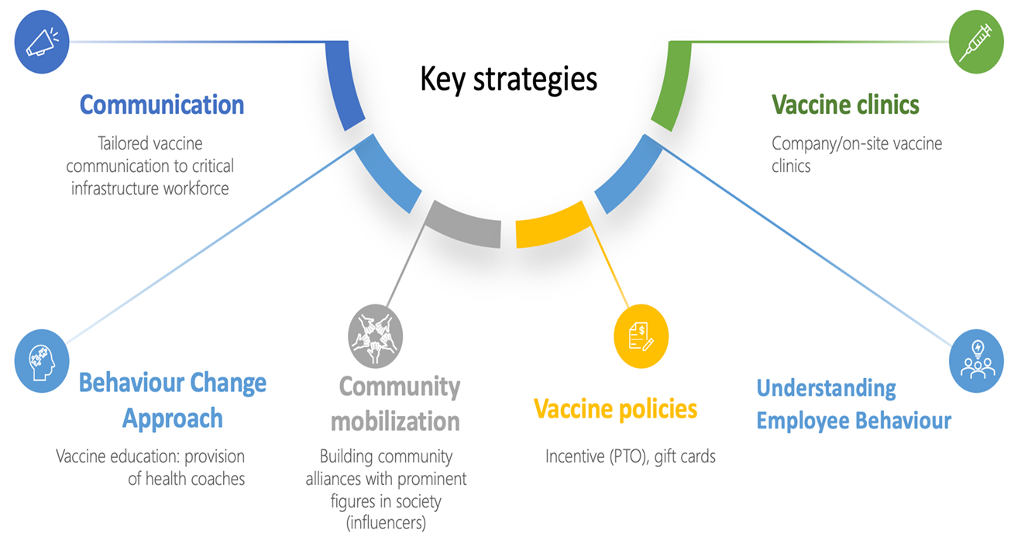
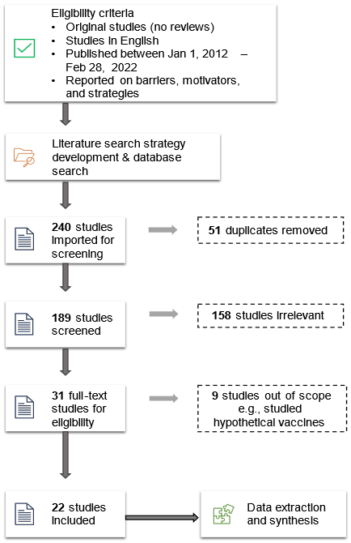
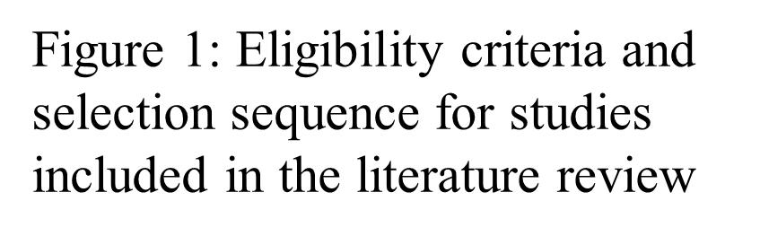

UNDERSTANDING VACCINE HESITANCY: AN ECOLOGICAL EPIDEMIOLOGY APPROACH
Linda Kalunga¹, Ece Bulut¹, Ziqian Chen², Yihong Li³, Renata Ivanek¹
¹Department of Population Medicine and Diagnostic Sciences, ²College of Human Ecology, ³Department of Public and Ecosystem Health, Cornell University, Ithaca NY
WHAT WE LEARNED
The COVID-19 pandemic has reaffirmed the importance of vaccination uptake to the functioning of the whole society. To identify what is known about barriers to employee vaccination, motivators for vaccination, and vaccine uptake strategies within critical infrastructure sectors, where employee vaccination is rarely mandated, we conducted a literature review.
We found that 1) barriers to vaccination differ by infectious disease and population; 2) common motivators for vaccination were about protecting self, family, and community; and 3) common uptake strategies for influenza (which accounted for 83% of uptake strategies in reviewed studies) addressed convenience and confidence barriers such as vaccination cost and education.
There is a need for employers, policymakers, and researchers to identify infectious disease- and population-specific barriers to vaccination and implement strategies aimed at addressing the identified barriers.
INTRODUCTION
RESULTS
The critical infrastructure sector includes vital sectors whose incapacitation would have negative effects on national economic security, public health, or safety. These sectors include food and agriculture, manufacturing, and government facility sectors such as education.
Studies show that employees within critical infrastructure sectors, especially those who hold service-related jobs (retail, manufacturing, food service, construction), are less likely to be vaccinated than non-critical infrastructure sector employees.
Therefore, to reduce the critical infrastructure sectors’ vulnerability to infectious diseases and eventual incapacitation, employers, researchers, policymakers, and other stakeholders need an understanding of the causes of vaccine hesitancy not only at a population level but also at an institutional level.
By frequency, we found that the most common barriers to vaccination for all studies were convenience related barriers such as employees not having time to get vaccinated, and the cost of vaccination (Table 1).
We found that barriers to vaccination vary by population and by infectious disease of interest. Employees within the food and agriculture sector experience barriers such as the cost of vaccination, not having time to get vaccinated, and difficulties with accessing vaccines.
Table 1: Barriers to employee vaccination categorized by WHO 3C model of vaccine hesitancy
RECOMMENDATIONS
We recommend the implementation of disease-specific vaccine uptake strategies because barriers to employee vaccination differ by infectious disease.
Where possible, employers should include employee families within workplace vaccination programs as this strategy has been effective at not only increasing workplace vaccination, but also community vaccination.
Depending on resource availability, critical infrastructure sectors can utilize the multicomponent strategy approach to determine which combination of strategies works best for their specific sector.
We recommend the implementation of evidence-based single component strategies that address the most common barriers to employee vaccination. To identify these barriers, sectors should consider conducting an employee needs assessment.
We also recommend understanding the concerns that vaccinated employees have about vaccines. This can be achieved by utilizing health professionals or respected community leaders in vaccine campaign events or by creating forums where employees can talk about vaccine concerns.
Table 2: Characteristics of included studies and barriers to employee vaccination (highlighted column)
OBJECTIVES
Review literature to:
Identify barriers to vaccination for employees in the non-health critical infrastructure sectors
Identify motivators for employee vaccination
Identify strategies have been effective at increasing vaccine uptake within critical sectors
The most common motivator for vaccination across all the represented critical infrastructure sectors and infectious diseases was protecting self/family/friends.
Other motivators included recommendations made by physicians or public health professionals and vaccination ease and convenience, and vaccine mandates (Table 2).
METHODS
Literature databases MEDLINE/PubMed, PsycINFO and Web of Science
We imported the identified articles into Covidence, where the citations underwent a two-stage screening performed by 2 authors independently (Figure 1).
We then extracted data from each of the 22 studies and inputted the data into two different excel sheets, one about employee vaccination attitudes and the other about strategies to increase vaccine uptake.
Vaccine uptake strategies for influenza focused on addressing convenience and confidence related barriers among employees. These strategies included the provision of on-site vaccination, vaccination at no cost to employees, education programs that explained the importance and benefits of vaccination, and program promotion by using posters and flyers (Figure 2).
Other strategies included incentives (gift cards, $25 deposit into employee or spouse health savings account), health professional-led education which addressed the benefits of immunization and answered employee questions about vaccination.
ACKNOWLEDGEMENTS
This project was supported by the USDA National Institute of Food and Agriculture Grant no. 2020-68006-32875
The authors acknowledge the contributions and consultations of librarian Matthew R. Kibbee.
Figure 2: Strategies used to increase vaccine uptake
REFERENCES
CONTACT
Kalunga L., Bulut E., Chen Z., Li Y., Ivanek R. Increasing vaccine uptake among employees within the non-health related critical infrastructure sectors: A Review. Human Vaccine and Immunotherapeutics. 2022. DOI: (In press with The Journal of Human Vaccines and Immunotherapeutics)
CISA Insights: COVID-19 Vaccination Hesitancy within the Critical Infrastructure Workforce.
Correspondence may be sent to Linda Kalunga (lk549@cornell.edu)

