Slide 1
Monotonic Optimal Binning (MOB)

Slide 2
What is MOB: The MOB package is a collection of R functions that generate the monotonic binning. Why need MOB: - Perform WoE (Weight of Evidence) transformation for numeric attributes in the scorecard development of consumer credit risk. - Convert missing values and outliers to WoE transformation through the discretization. - Derive IV (Information Value) to assess the variable importance through the calculation of WoE How to install MOB: - Download “mob_0.1.0.tar.gz” from https://github.com/statcompute/mob and then save the tar ball in the working folder - Make sure to install dependent packages, e.g. base, stats, parallel, gbm, Hmisc - Install MOB from the source by running install.packages(" mob_0.1.0.tar.gz ", repos = NULL, type = "source")

Slide 3
MOB Functionalities Binning functions: - qtl_bin(): The binning algorithm based on the iterative discretization by quantiles for the whole development data sample - iso_bin(): The binning algorithm based on the isotonic regression - bad_bin(): The binning algorithm based on the iterative discretization by quantiles for the data sample with Y = 1 - gbm_bin(): The binning algorithm based on the generalized boosted modeling with the monotone restriction. - arb_bin(): The binning algorithm based on the decision tree with the monotone restriction. - batch_bin(): A wrapper for above binning algorithms to apply to all numeric variables in the data frame with the last column as Y. Deployment functions: - cal_woe(): Perform WoE transformation based on the spec file from the binning output. - batch_woe(): A wrapper for cal_woe() to apply to all numeric variables in the data frame based on a list of spec from batch_bin().

Slide 4
Example 1: How to Use df <- readRDS("df.rds") head(df, 2) # tot_derog tot_tr age_oldest_tr tot_open_tr tot_rev_tr tot_rev_debt … # 6 7 46 NaN NaN NaN … # 0 21 153 6 1 97 … qtl_bin(df, bad, tot_derog) # $df # bin rule freq dist mv_cnt bad_freq bad_rate woe iv ks # 00 is.na($X) 213 0.0365 213 70 0.3286 0.6416 0.0178 2.7716 # 01 $X <= 1 3741 0.6409 0 560 0.1497 -0.3811 0.0828 18.9469 # 02 $X > 1 & $X <= 2 478 0.0819 0 121 0.2531 0.2740 0.0066 16.5222 # 03 $X > 2 & $X <= 4 587 0.1006 0 176 0.2998 0.5078 0.0298 10.6623 # 04 $X > 4 818 0.1401 0 269 0.3289 0.6426 0.0685 0.0000 # $cuts # [1] 1 2 4

Slide 5
bad_bin(df, bad, tot_derog) # $df # bin rule freq dist mv_cnt bad_freq bad_rate woe iv ks # 00 is.na($X) 213 0.0365 213 70 0.3286 0.6416 0.0178 2.7716 # 01 $X <= 2 4219 0.7228 0 681 0.1614 -0.2918 0.0563 16.5222 # 02 $X > 2 & $X <= 4 587 0.1006 0 176 0.2998 0.5078 0.0298 10.6623 # 03 $X > 4 818 0.1401 0 269 0.3289 0.6426 0.0685 0.0000 # $cuts # [1] 2 4 iso_bin(df, bad, tot_derog) # $df # bin rule freq dist mv_cnt bad_freq bad_rate woe iv ks # 00 is.na($X) 213 0.0365 213 70 0.3286 0.6416 0.0178 2.7716 # 01 $X <= 0 2850 0.4883 0 367 0.1288 -0.5559 0.1268 20.0442 # 02 $X > 0 & $X <= 1 891 0.1526 0 193 0.2166 0.0704 0.0008 18.9469 # 03 $X > 1 & $X <= 2 478 0.0819 0 121 0.2531 0.2740 0.0066 16.5222 # 04 $X > 2 & $X <= 3 332 0.0569 0 86 0.2590 0.3050 0.0058 14.6321 # 05 $X > 3 & $X <= 23 1064 0.1823 0 353 0.3318 0.6557 0.0931 0.4370 # 06 $X > 23 9 0.0015 0 6 0.6667 2.0491 0.0090 0.0000 # $cuts # [1] 0 1 2 3 23

Slide 6
### Binning in batch with qtl_bin() as the back-end batch_bin(df, 1) # |var | nbin| unique| miss| min| median| max| ks| iv| # |:--------------|-----:|-------:|-----:|----:|--------:|--------:|--------:|-------:| # |tot_derog | 5| 29| 213| 0| 0.0| 32| 18.9469| 0.2055| # |tot_tr | 5| 67| 213| 0| 16.0| 77| 15.7052| 0.1302| # |age_oldest_tr | 10| 460| 216| 1| 137.0| 588| 19.9821| 0.2539| # |tot_open_tr | 3| 26| 1416| 0| 5.0| 26| 6.7157| 0.0240| # |tot_rev_tr | 3| 21| 636| 0| 3.0| 24| 9.0104| 0.0717| # |tot_rev_debt | 3| 3880| 477| 0| 3009.5| 96260| 8.5102| 0.0627| # |tot_rev_line | 9| 3617| 477| 0| 10573.0| 205395| 26.4924| 0.4077| # |rev_util | 2| 101| 0| 0| 30.0| 100| 15.1570| 0.0930| # |bureau_score | 12| 315| 315| 443| 692.5| 848| 34.8028| 0.7785| # |ltv | 7| 145| 1| 0| 100.0| 176| 15.6254| 0.1538| # |tot_income | 4| 1639| 5| 0| 3400.0| 8147167| 9.1526| 0.0500| batch_bin(df, 1)$BinLst[["tot_income"]] # $df # bin rule freq dist mv_cnt bad_freq bad_rate woe iv ks # 00 is.na($X) 5 0.0009 5 1 0.2000 -0.0303 0.0000 0.0026 # 01 $X <= 2570 1947 0.3336 0 486 0.2496 0.2553 0.0234 9.1526 # 02 $X > 2570 & $X <= 4510 1995 0.3418 0 406 0.2035 -0.0086 0.0000 8.8608 # 03 $X > 4510 1890 0.3238 0 303 0.1603 -0.2999 0.0266 0.0000 # $cuts # [1] 2570 4510

Slide 7
### How to deploy the binning outcome ltv_bin <- qtl_bin(df, bad, ltv) ltv_woe <- cal_woe(df[sample(seq(nrow(df)), 1000, replace = T), ], "ltv", ltv_bin$df) str(ltv_woe, max.level = 1) # List of 2 # $ df :'data.frame': 1000 obs. of 13 variables: # $ psi:'data.frame': 7 obs. of 8 variables: # - attr(*, "class")= chr "psi" ltv_woe$psi # bin rule dist woe cal_freq cal_dist cal_woe psi # 01 $X <= 84 0.1638 -0.7690 177 0.177 -0.7690 0.0010 # 02 $X > 84 & $X <= 93 0.1645 -0.3951 143 0.143 -0.3951 0.0030 # 03 $X > 93 & $X <= 99 0.1501 0.0518 154 0.154 0.0518 0.0001 # 04 $X > 99 & $X <= 103 0.1407 0.0787 125 0.125 0.0787 0.0019 # 05 $X > 103 & $X <= 109 0.1324 0.1492 149 0.149 0.1492 0.0020 # 06 $X > 109 & $X <= 117 0.1237 0.3263 133 0.133 0.3263 0.0007 # 07 $X > 117 | is.na($X) 0.1249 0.5041 119 0.119 0.5041 0.0003 head(ltv_woe$df, 1) # ... bureau_score ltv tot_income bad woe.ltv # ... 667 83 2500 1 -0.769

Slide 8
### Generate a list of binning specifications binout <- batch_bin(df, 1) woeout <- batch_woe(df[sample(seq(nrow(df)), 2000, replace = T), ], binout$BinLst) woeout # tot_derog tot_tr age_oldest_tr tot_open_tr tot_rev_tr tot_rev_debt ... # psi 0.0027 0.0044 0.0144 0.0011 3e-04 0.0013 ... str(woeout, max.level = 1) # List of 2 # $ psi:List of 11 # $ df :'data.frame': 2000 obs. of 12 variables: # - attr(*, "class")= chr "psiSummary" head(woeout$df, 1) # idx_ woe.tot_derog woe.tot_tr woe.age_oldest_tr woe.tot_open_tr woe.tot_rev_tr ... # 1 -0.3811 -0.0215 -0.5356 -0.0722 -0.1012 ...

Slide 9
Example 2: Improve Logit Model bin_out <- batch_bin(df, 3) # binning in batch with iso_bin() as the back-end df_woe <- batch_woe(df, bin_out$BinLst) x1 <- paste("woe", bin_out$BinSum[bin_out$BinSum[["iv"]] > 0.1, ]$var, sep = ".") # parse vars with IV > 0.1 fml1 <- as.formula(paste("bad", paste(x1, collapse = " + "), sep = " ~ ")) sum1 <- summary(glm(fml1, data = cbind(bad = df$bad, df_woe$df), family = "binomial")) x2 <- paste(row.names(sum1$coefficients)[sum1$coefficients[, 4] < 0.05][-1]) # parse vars with p-value < 0.05 fml2 <- as.formula(paste("bad", paste(x2, collapse = " + "), sep = " ~ ")) mdl2 <- glm(fml2, data = cbind(bad = df$bad, df_woe$df), family = "binomial") # Estimate Std. Error z value Pr(>|z|) #(Intercept) -1.38600 0.03801 -36.461 < 2e-16 *** #woe.age_oldest_tr 0.30376 0.08176 3.715 0.000203 *** #woe.tot_rev_line 0.42935 0.06793 6.321 2.61e-10 *** #woe.rev_util 0.29150 0.08721 3.342 0.000831 *** #woe.bureau_score 0.83568 0.04974 16.803 < 2e-16 *** #woe.ltv 0.97789 0.09121 10.721 < 2e-16 ***

Slide 10
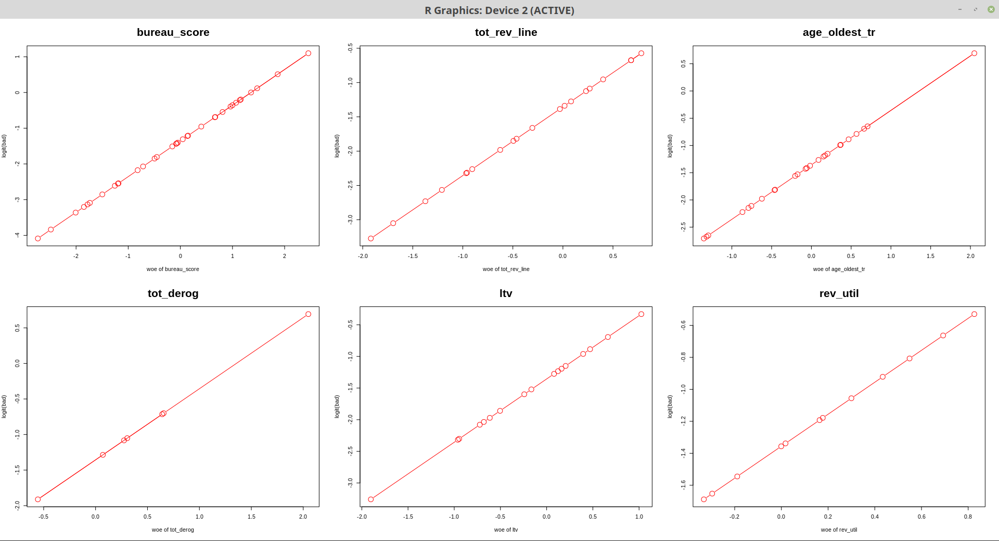
top <- paste(bin_out$BinSum[order(bin_out$BinSum[["iv"]], decreasing = T), ][1:6, "var"], sep = ‘’) par(mfrow = c(2, 3)) lapply(top, function(x) plot(bin_out$BinLst[[x]]$df[["woe"]], log(bin_out$BinLst[[x]]$df[["bad_rate"]] / (1 - bin_out$BinLst[[x]]$df[["bad_rate"]])), type = "b", main = x, cex.main = 2, xlab = paste("woe of", x), ylab = "logit(bad)", cex = 2, col = "red"))

Slide 11
Example 3: Improve General Regression Neural Network df1 <- read.table("credit_count.txt", header = T, sep = ",") df2 <- df1[which(df1$CARDHLDR == 1), ] Y <- df2$DEFAULT X <- scale(df2[, 3:ncol(df2)]) i <- sample(seq(length(Y)), length(Y) / 2) # WITHOUT BINNING Y1 <- Y[i] Y2 <- Y[-i] X1 <- X[i, ] X2 <- X[-i, ] net11 <- grnn.fit(x = X1, y = Y1)

Slide 12
test1 <- grnn.search_auc(net11, gen_latin(1, 3, 10), nfolds = 4) # $best # sigma auc # 2.198381 0.6297201 net12 <- grnn.fit(x = X1, y = Y1, sigma = test1$best$sigma) MLmetrics::AUC(grnn.parpred(net12, X1), Y1) # 0.6855638 MLmetrics::AUC(grnn.parpred(net12, X2), Y2) # 0.6555798 # WITH WOE Transformation df3 <- data.frame(df2[, 3:ncol(df2)], Y) bin_out <- batch_bin(df3, method = 3) df_woe <- batch_woe(df3, bin_out$BinLst) W <- scale(df_woe$df[, -1]) W1 <- W[i, ] W2 <- W[-i, ]

Slide 13
net21 <- grnn.fit(x = W1, y = Y1) test2 <- grnn.search_auc(net21, gen_latin(1, 3, 10), nfolds = 4) # $best # sigma auc # 2.198381 0.6820317 net22 <- grnn.fit(x = W1, y = Y1, sigma = test2$best$sigma) MLmetrics::AUC(grnn.parpred(net22, W1), Y1) # 0.7150051 MLmetrics::AUC(grnn.parpred(net22, W2), Y2) # 0.6884229

