Slide 1
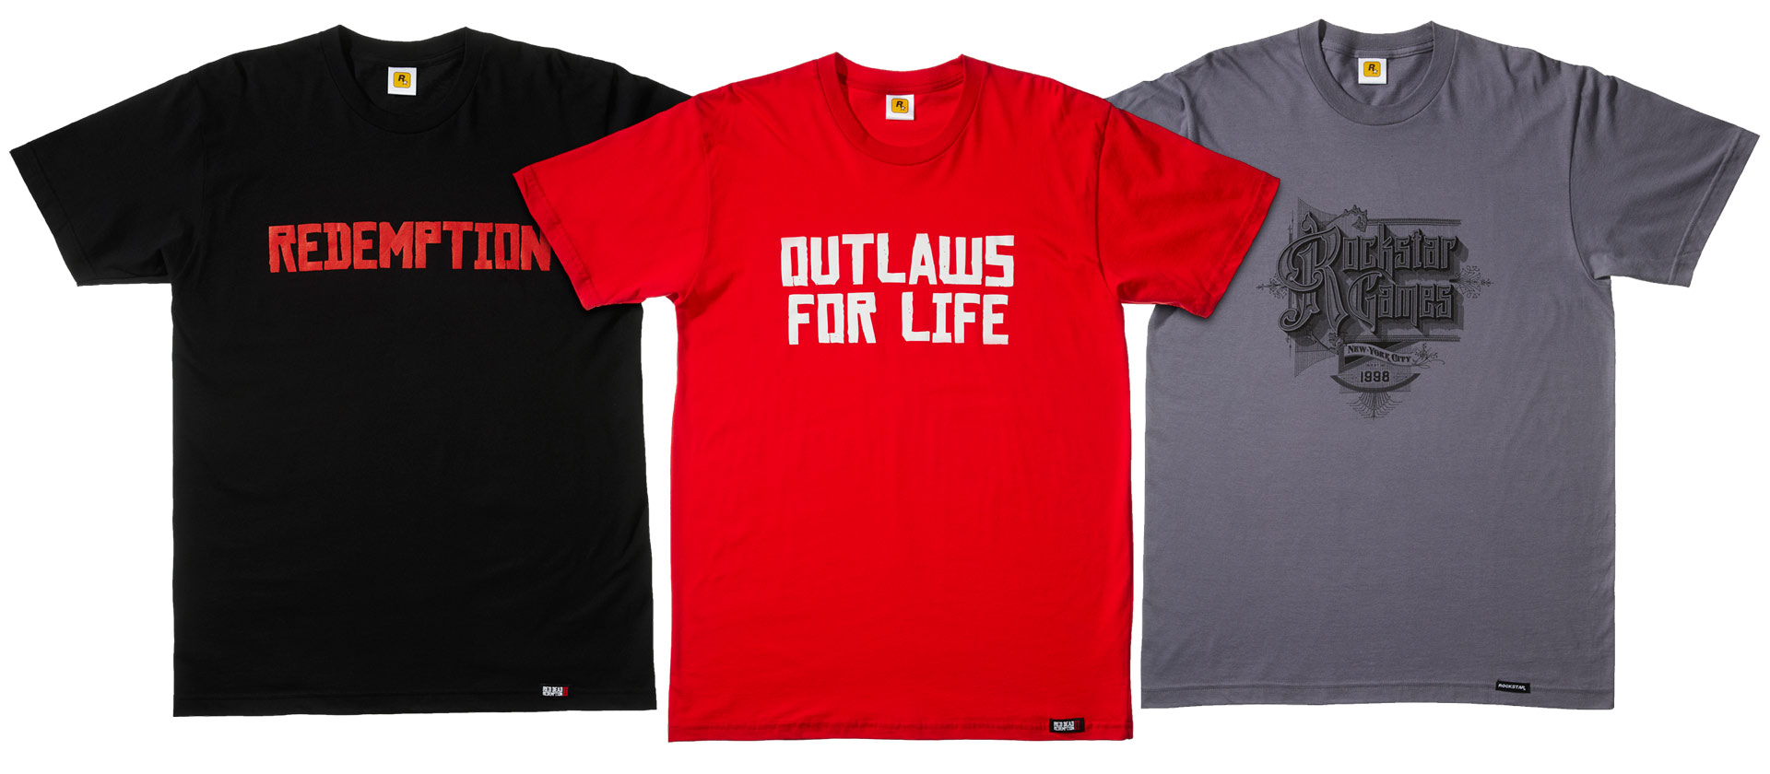


NewLook.com
Home
About
Support As
SIGN OUT
NEW ARrival T-SHIRT!!

Slide 2
LOGIN
USERNAME:
username
PASSWORD:
password
SIGN IN
CANCEL

Slide 3



HOME
50% OFF
Php400 =>Php200
Php500 =>Php250
UNTIL AUGUST 20 2019
Php600 => Php300

Slide 4
ABOUT
This website sells different kinds of clothes that is suitable and makes the consumers comfortable. We aim to be the best clothing brand in the world.

Slide 5
SUPPORT US
https://www.facebook/newlook/.com.ph
CLICK HERE

Slide 6
Principles :
Know the user - on this website we intended to give the adults new fashion taste.
Understand the Task – Sell clothes with a low price.
Reduce memory load – the details and backgrounds that we use to design are simple.
Strive for Consistency – the color and the pages of the background are same.
Guidelines:
Visual Display Layout – Simple but looks reliable.
User with Disability – any people have disabilities can use this website.
Graphical User Interface – Easy to use or click, not that confusing.

