Slide 1
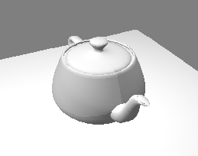
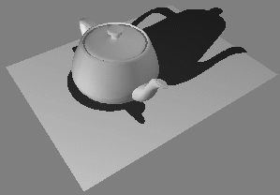
Shadows (1/5) – Simplest Hack
Render each object twice
First pass: render normally
Second pass: use transformations to project object onto ground plane, render completely black
Pros: Easy, can be convincing. Eye more sensitive to presence of shadow than shadow’s exact shape
Cons: Becomes complex computational geometry problem in anything but simplest case
Easy: projecting onto flat, infinite ground plane
How to implement for projection on stairs? Rolling hills?
http://web.cs.wpi.edu/~matt/courses/cs563/talks/shadow/shadow.html

Slide 2
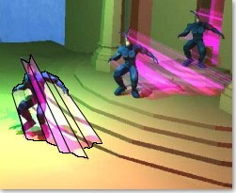
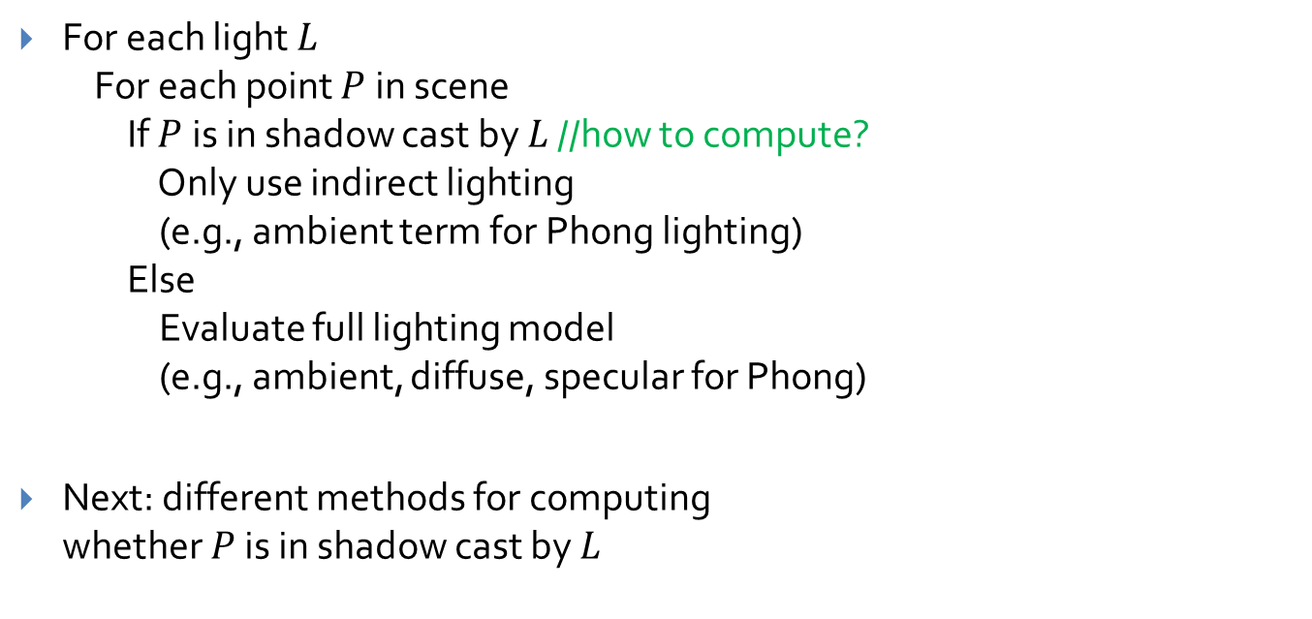
Shadows (2/5) – More Advanced
For each light $L$ For each point $P$ in scene If $P$ is in shadow cast by $L$ //how to compute? Only use indirect lighting (e.g., ambient term for Phong lighting) Else Evaluate full lighting model (e.g., ambient, diffuse, specular for Phong)
Next: different methods for computing whether $P$ is in shadow cast by $L$
Stencil shadow volumes implemented by former cs123 ta and recent Ph.D. Kevin Egan and former PhD student and book co-author Prof. Morgan McGuire, on nVidia chip

Slide 3
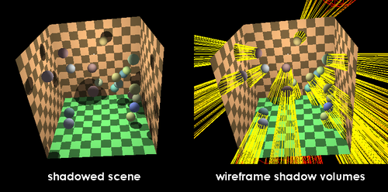
Shadows (3/5) – Shadow Volumes
For each light + object pair, compute mesh enclosing area where the object occludes the light
Find silhouette from light’s perspective
Every edge shared by two triangles, such that one triangle faces light source and other faces away
On torus, where angle between normal vector and vector to light becomes >90°
Project silhouette along light rays
Generate triangles bridging silhouette and its projection to obtain the shadow volume
A point P is in shadow from light L if any shadow volume V computed for L contains P
Can determine this quickly using multiple passes and a “stencil buffer”
More here on Stencil Buffers, Stencil Shadow Volumes
Original Silhouette
Projected Silhouette
Example shadow volume
(yellow mesh)
http://www.ozone3d.net/tutorials/images/stencil_shadow_volumes/shadow_volume.jpg

Slide 4
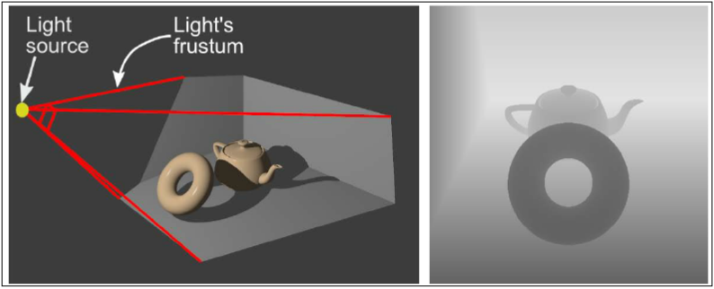
Shadows (4/5) – Another Multi-Pass Technique: Shadow Maps
Render scene using each light as center of projection, saving only its z-buffer
Resultant 2D images are “shadow maps”, one per light
Next, render scene from camera’s POV
To determine if point P on object is in shadow:
compute distance d_{P} from P to light source
convert P from world coordinates to shadow map coordinates using the viewing and projection matrices used to create shadow map
look up min distance d_{min} in shadow map
P is in shadow if d_{P} > d_{min ,} i.e., it lies behind a closer object
Shadow map (on right) obtained by rendering from light’s point of view (darker is closer)
Light
Camera
d_{min}
d_{P}
P

Slide 5
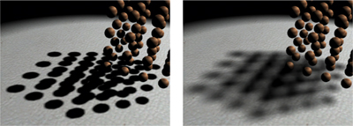
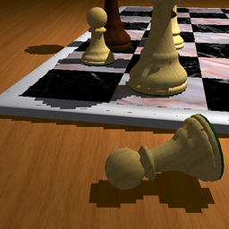
Shadows (5/5) – Shadow Map Tradeoffs
Pro: Can extend to support soft shadows
Soft shadows: shadows with “soft” edges
Stencil shadow volumes only useful for hard-edged shadows
Con: Naïve implementation has impressively bad aliasing problems
When the camera is closer to the scene than the light, many screen pixels may be covered by only one shadow map pixel (e.g., sun shining on Eiffel tower)
Many workarounds for aliasing issues
Percentage-Closer Filtering: for each screen pixel, sample shadow map in multiple places and average
Cascaded Shadow Maps: multiple shadow maps, higher resolution closer to viewer
Variance Shadow Maps: use statistical modeling instead of simple depth comparison
Hard shadows
Soft shadows
Aliasing produced by naïve shadow mapping
http://http.developer.nvidia.com/GPUGems3/gpugems3_ch08.html
http://www-sop.inria.fr/ reves/Marc.Stamminger/psm/

Slide 6
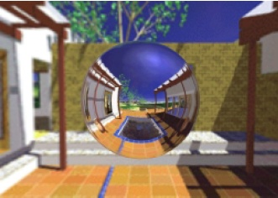
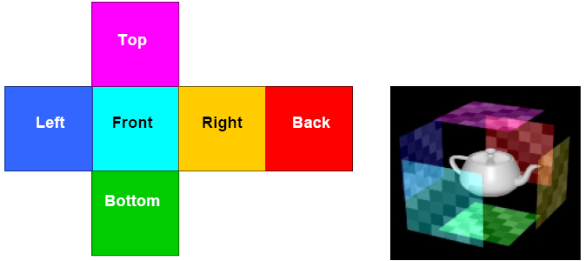
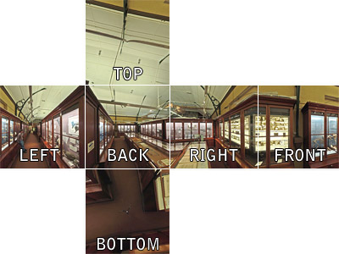
Environment Mapping (for specular reflections) (1/2)
Approximate reflections by creating a skybox a.k.a. environment map a.k.a. reflection map
Often represented as six faces of a cube surrounding scene
Can also be a large sphere surrounding scene, etc.
To create environment map, render entire scene from center point one face at a time
Can do this offline for static geometry, but must generate at runtime for moving objects
Rendering environment map at runtime is expensive (compared to using a pre-computed texture)
Can also use photographic panoramas
Skybox
Object

Slide 7
Environment Mapping (2/2)
Environment map
To sample environment map reflection at point P:
Computer vector E from P to eye
Reflect E about normal to obtain R
Use the direction of R to compute the intersection point with the environment map
Treat P as being center of map; equivalently, treat environment map as being infinitely large
R
P
N
E
eye

Slide 8
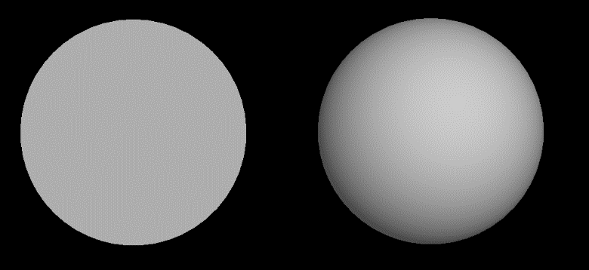
Overview: Surface Detail
Observation
What if we replaced the 3D sphere on the right with a 2D circle?
The circle would have fewer triangles (thus renders faster)
If we kept the sphere’s normals, the circle would still look like a sphere!
Works because human visual system infers shape from patterns of light and dark regions (“shape from shading”). Brightness at any point is determined by normal vector, not by actual geometry of model
Image credit: Dave Kilian, ‘13

Slide 9
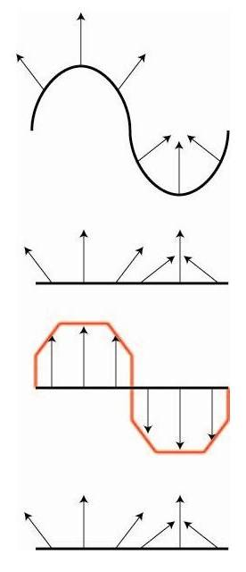
Idea: Surface Detail
Start with a hi-poly (high polygon count) model
Decimate the mesh (remove triangles)
Encode hi-poly normal information into texture
Map texture (i.e. normals) onto lo-poly mesh
In fragment shader:
Look up normal for each pixel
Use Phong shading to calculate pixel color normal obtained from texture
Original hi-poly model
Lo-poly model with hi-poly model’s normals preserved

Slide 10
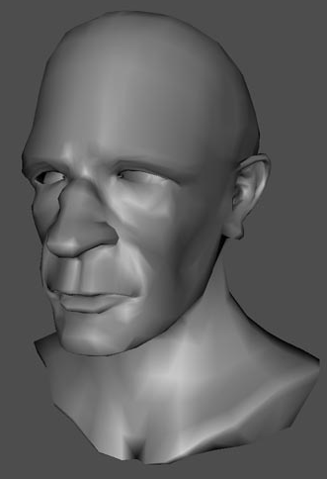
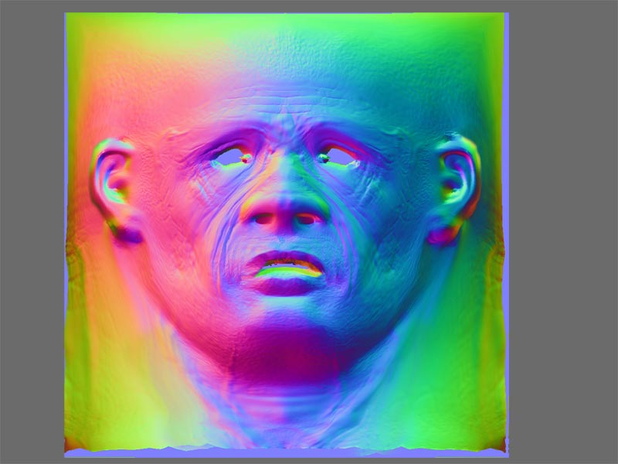
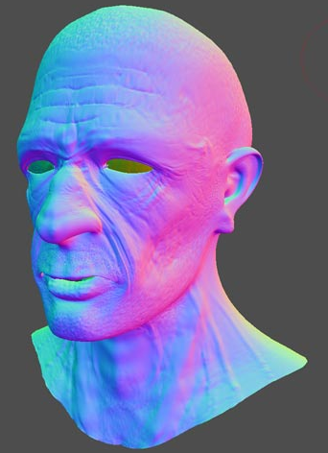
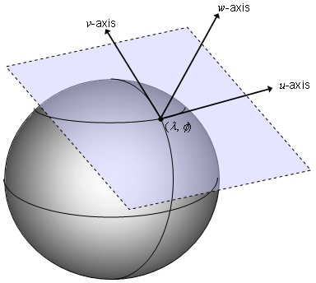
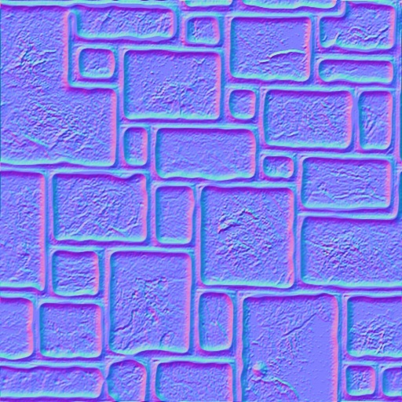
Normal Mapping
Idea: Fill a texture map with normals
Fragment shader samples 2D color texture
Interprets R as N_{x}, G as N_{y}, B as N_{z}
Easiest to render, hardest to produce
Usually need specialized modeling tools like Pixologic’s Zbrush; algorithm on slide 31
Variants
Object-space: store raw, object-space normal vectors
Tangent-space: store normals in tangent space
Tangent space: UVW system, where W is aligned with the original normal
Have to convert normals to world space to do lighting calculation
Original mesh
Object-space normal map
Mesh with normal map applied (colors still there for visualization purposes)
Tangent space
Tangent-space normal map
http://www.3dvf.com/forum/3dvf/Blender-2/modelisation-organique-tutoriel-sujet_16_1.htm

Slide 11
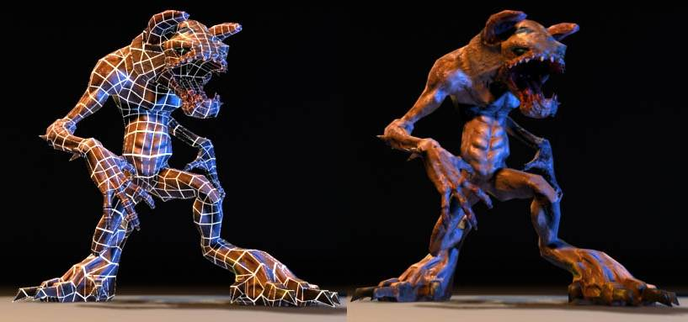
Normal Mapping Example
Render showing simple underlying geometry
Normal map gives model finer detail
Normal mapping can completely alter the perceived geometry of a model
Image courtesy of www.anticz.com

Slide 12
Creating Normal Maps
P_{M}
Algorithm
Original mesh M simplified to mesh S
For each pixel in normal map for S:
Find corresponding point on S: P_{S}
Find closest point on original mesh: P_{M}
Average nearby normals in M and save value in normal map
Manual
Artist starts with S
Uses specialized tools to draw directly onto normal map (‘sculpting’)
M
P_{S}
S
Normal map
Each normal vector’s X,Y,Z components stored as R,G,B values in texture

Slide 13
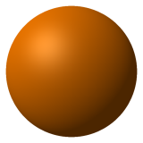
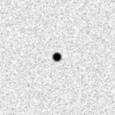
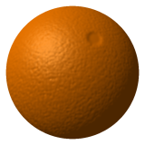
Bump Mapping: Example
+
=
Original object (plain sphere)
Bump map (height map to perturb normals - see next slide )
Sphere with bump-mapped normals
http://cse.csusb.edu/tong/courses/cs520/notes/texture.php

Slide 14
Bump Mapping, Another Way to Perturb Normals
Idea: instead of encoding normals themselves in the map, encode relative heights (or “bumps”)
Black: minimum height delta
White: maximum height delta
Much easier to create than normal maps
How to compute a normal from a height map?
Collect several height samples from texture
Convert height samples to 3D coordinates to calculate the average normal vector at the given point
Transform computed normal from tangent space to object space (and from there into world space)
You computed normals like this for a terrain mesh in the Lab 4!
Original tangent-space normal = (0, 0, 1)
Nearby values in (1D) bump map
Bump map visualized as tangent-space height deltas
Normal vectors for triangles neighboring a point. Each dot corresponds to a pixel in the bump map.
Transformed tangent-space normal

Slide 15
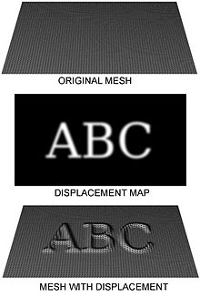
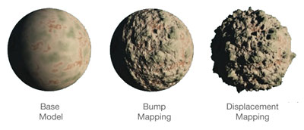
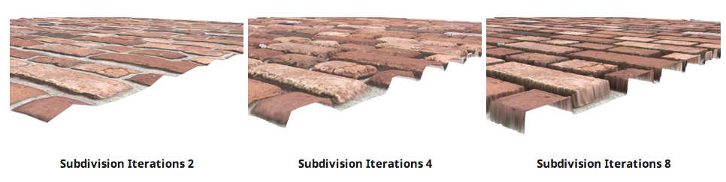
Other Techniques: Displacement Mapping
Actually move the vertices along their normals by looking up height deltas in a height map
Displacing the vertices of the mesh will deform the mesh, producing different vertex normals because the face normals will be different
Unlike bump/normal mapping, this will produce correct silhouettes and self-shadowing
By default, does not provide detail between vertices like normal/bump mapping
To increase detail level we can subdivide the original mesh
Can become very costly since it creates additional vertices
Displacement map on a plane at different levels of subdivision
http://en.wikipedia.org/wiki/Displacement_mapping http://www.nvidia.com/object/tessellation.html https://support.solidangle.com/display/AFMUG/Displacement

Slide 16
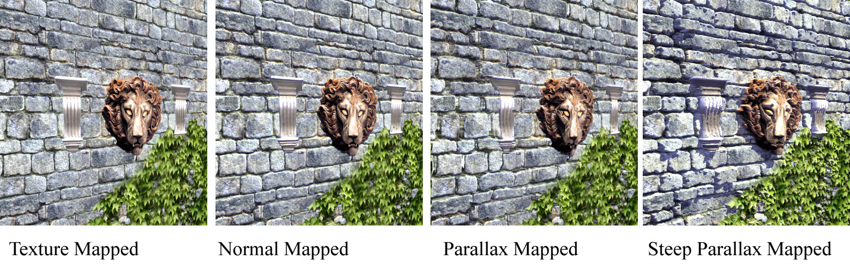
Comparison
Creases between bricks look flat
Creases look progressively deeper
Objects have self-shadowing

