Slide 1
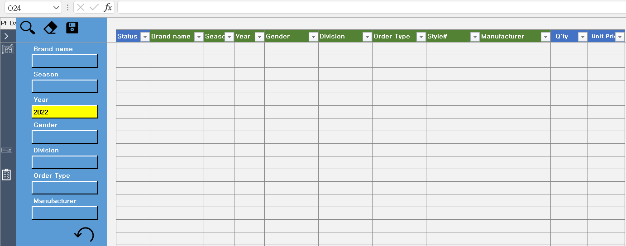



A
D
E
Data input area (all values are mandatory)
B
C
Data is retrieved according to the set search conditions
REVISE : If there is a row to be edited, select it.
A
Delete the data entered in the table
D
DELETE : If there is a row to be delete, select it.
Save data to the server
Activate : Data indicates the active state.
B
Set search conditions
All data fields must be filled in so that there are no blank values
E
C
Delete the data entered in the table

