Slide 2
UserProfile
Event
Category
Tag
Field | Type
User | User
Friend | UserProfile
Description | Char (1028)
Field | Type
Name | Char (128)
DateTime | DateTime
Description | Char (1028)
Address | Char (128)
LocationInfo | Char (128)
Category | Category
Tags | Tag
Interested | UserProfile
Host | UserProfile
Field | Type
Name | Char (128)
Field | Type
Name | Char (128)

Slide 3
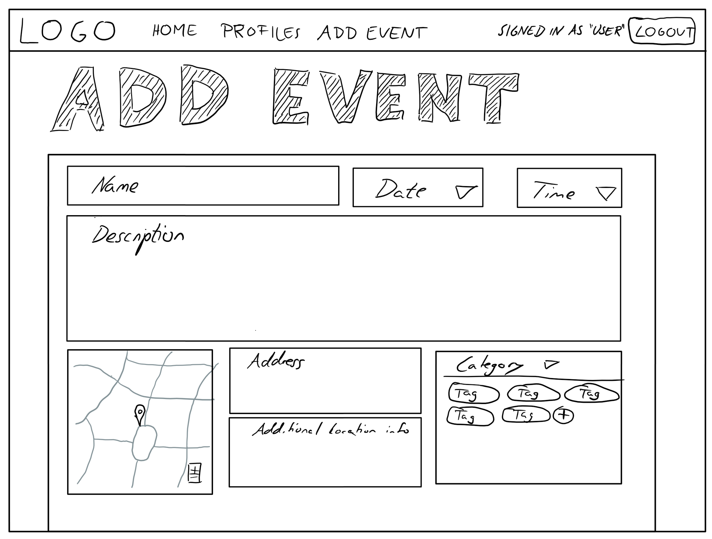

Slide 4
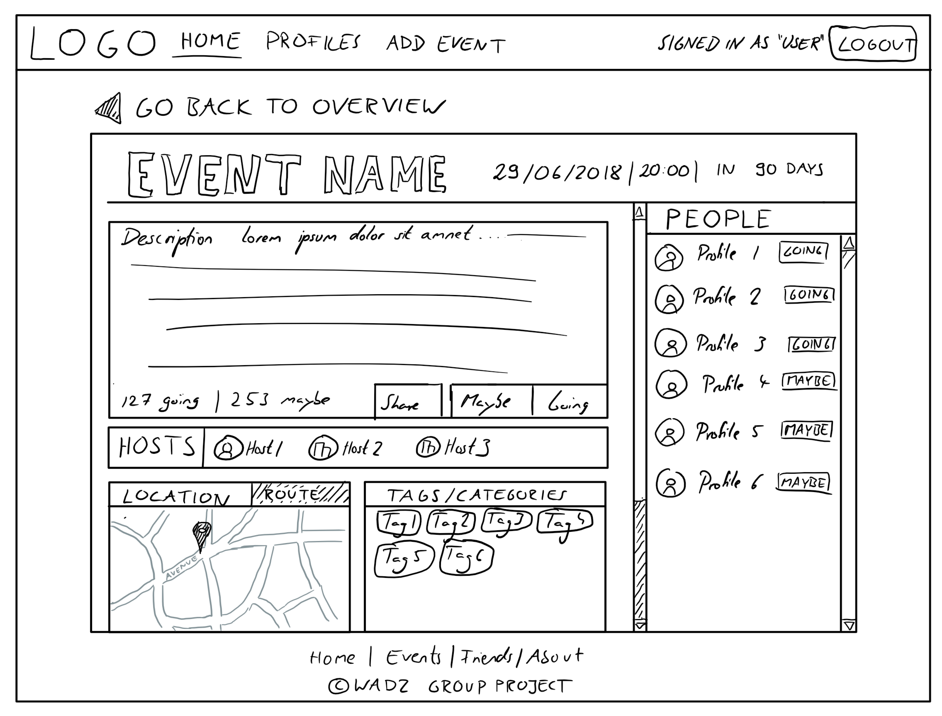

Slide 5
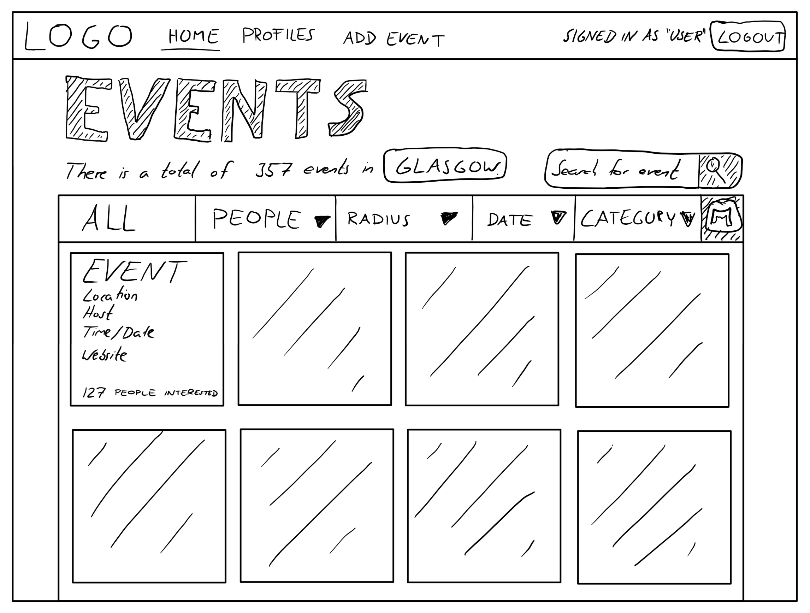

Slide 6
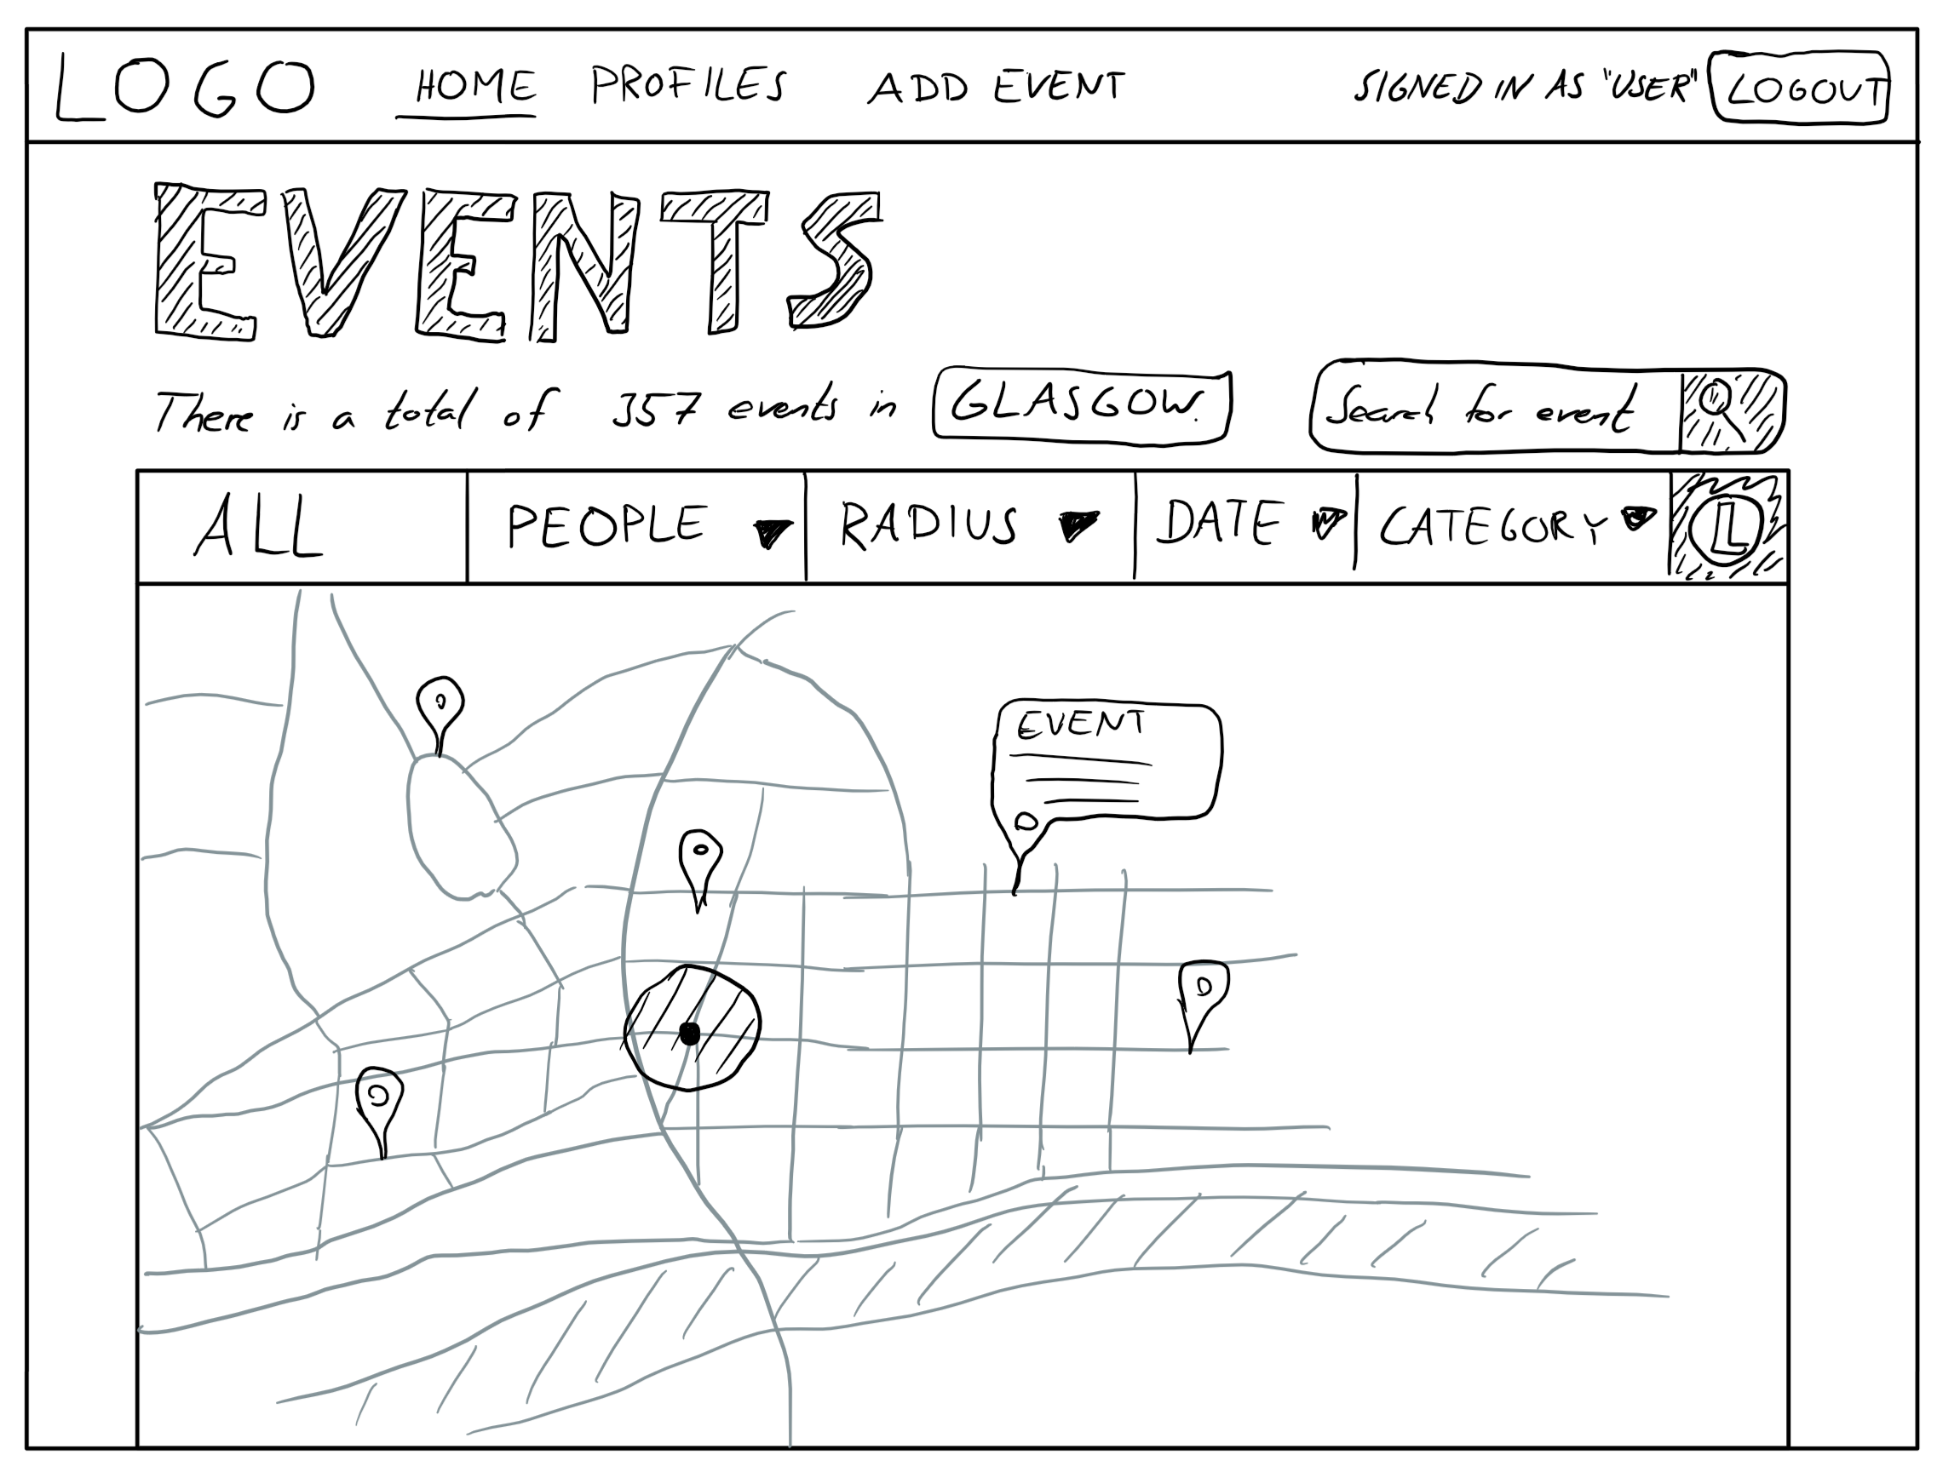

Slide 7
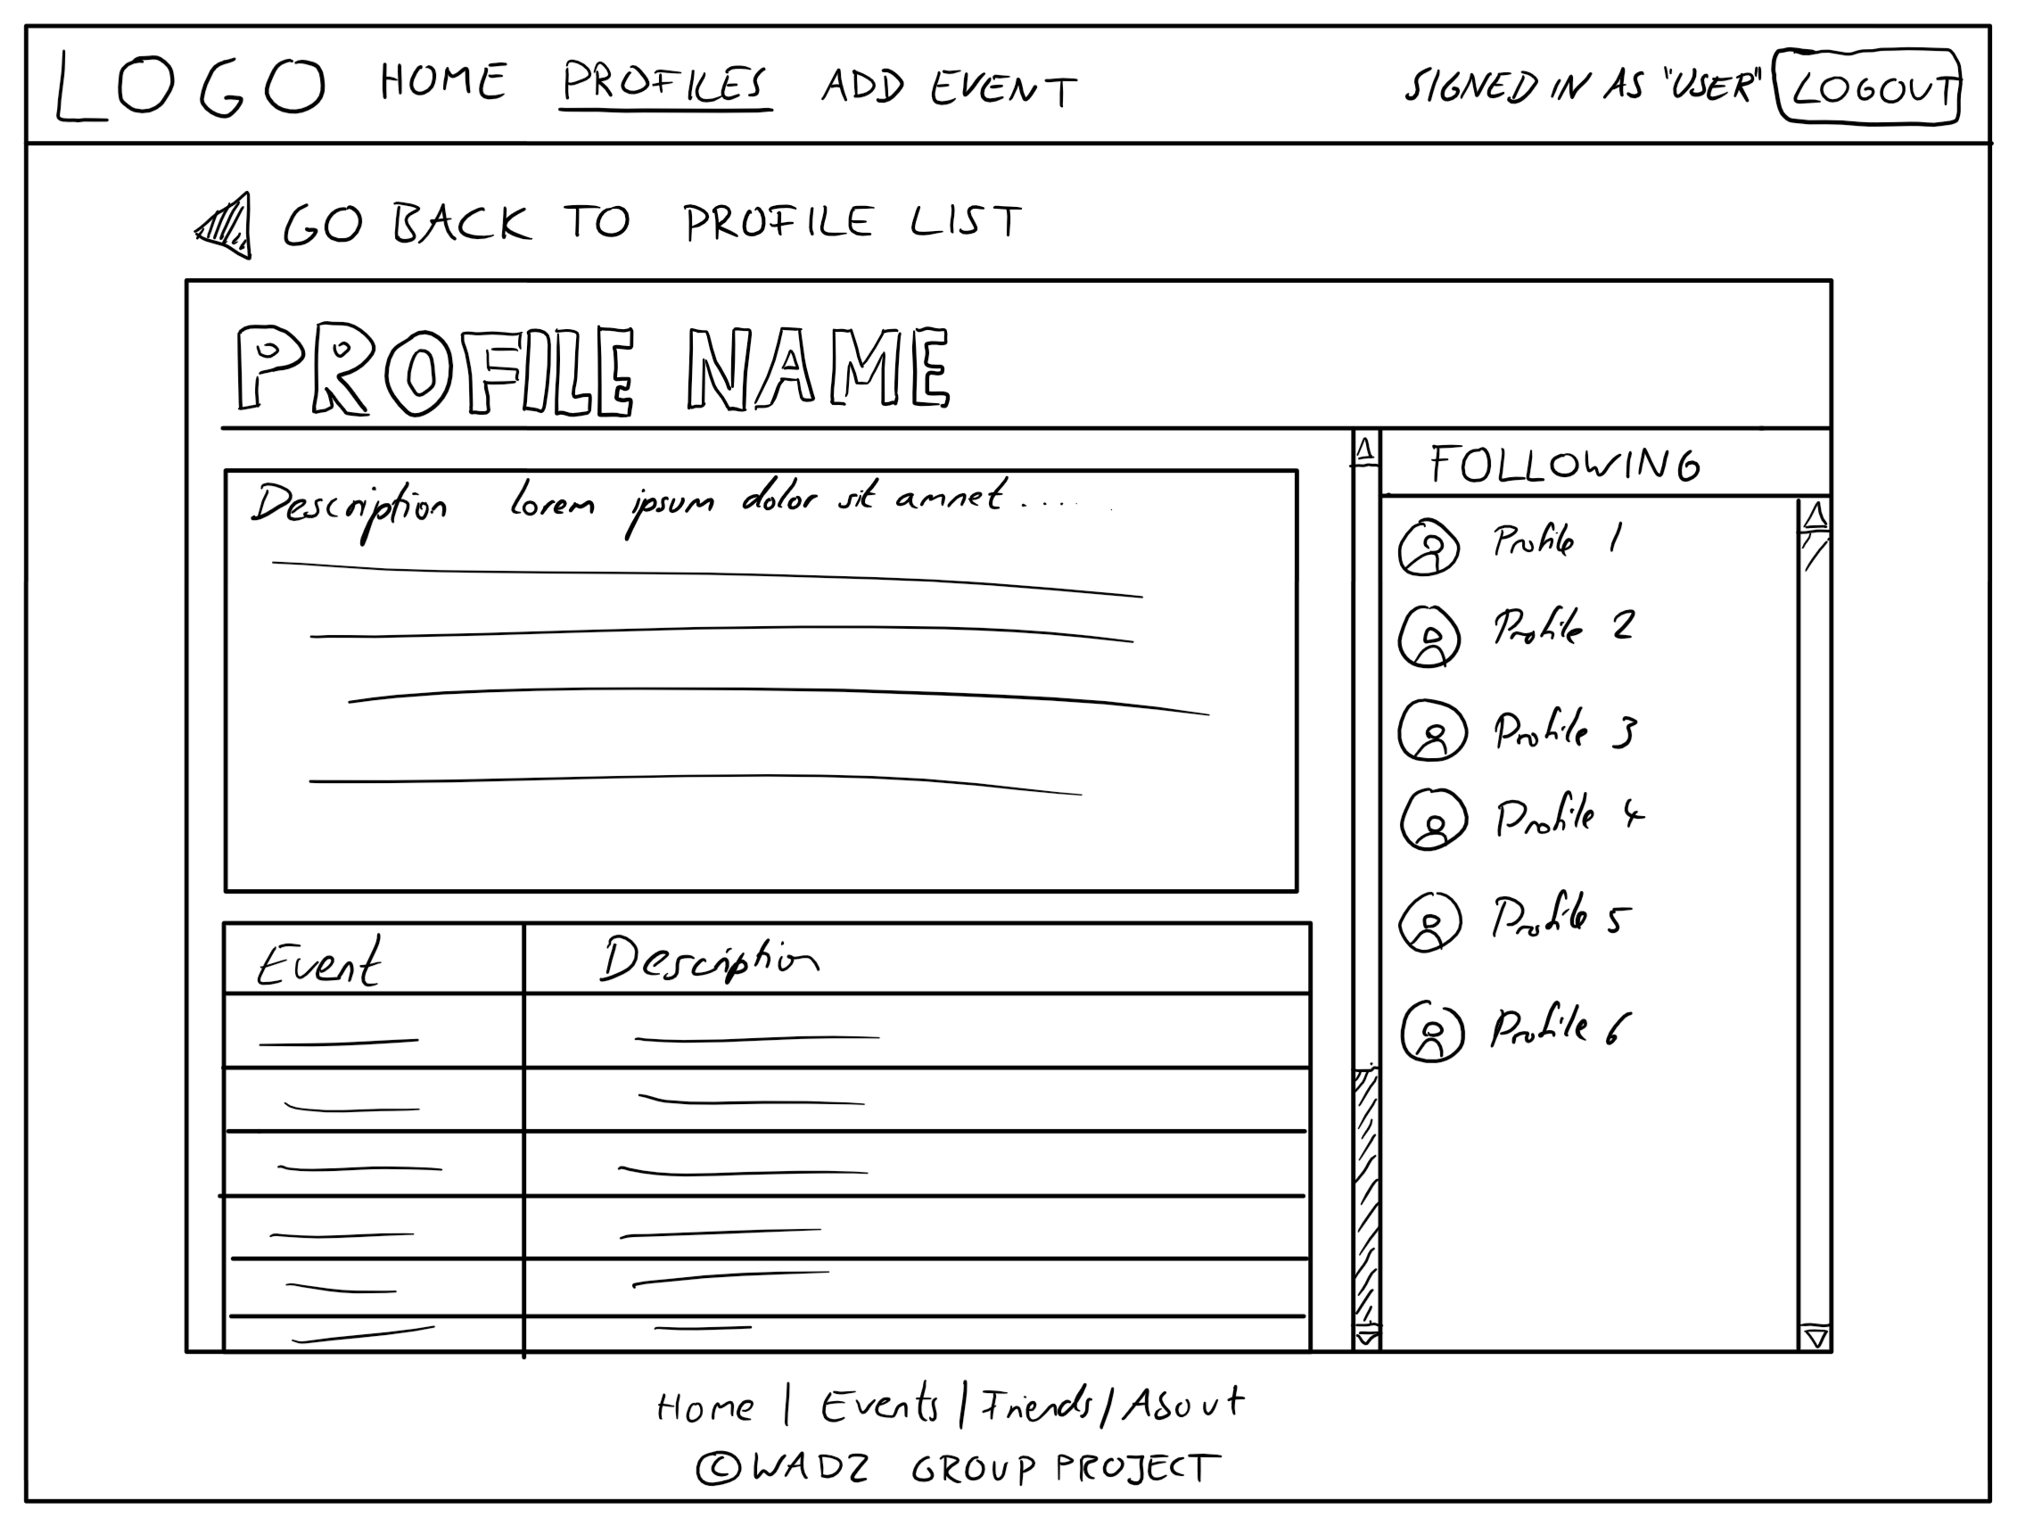

Slide 8
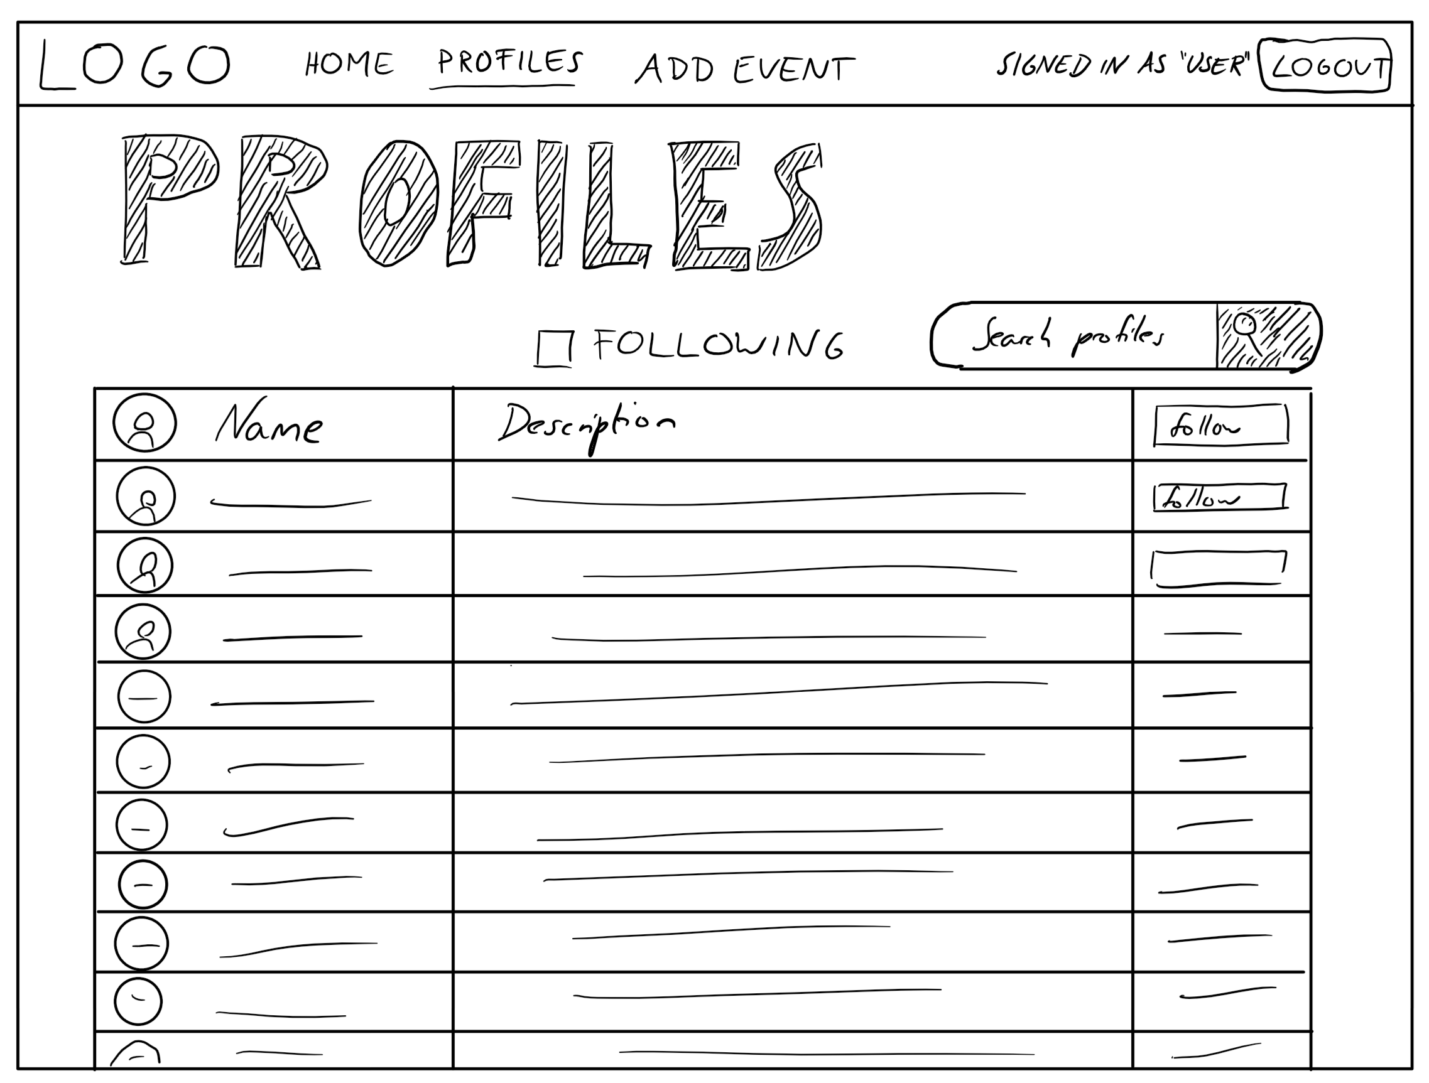

Slide 9
Google Maps/Search API
Post search request
Web + App server: generate requested event and user pages from models and web APIs
Client/Browser
URL+
Params
Location/search data in map form
Content
User
Presentation
HTML+CSS
Request models from search criteria
User and Event Models
Required model data

