Slide 2
Overview
Show users events local to them via list of event items or visually via Gmaps API
Events filterable based on tags, datetime of event, category, location etc.
Users that are logged in are able to create and event.
Anyone can view events
Follow certain users to be notified of their events

Slide 3

Personas - Mercedes
20-year-old promoter for club in Glasgow.
Her Job means she must promote her club and events to locals via social media.
Fed up of advertising via flyers to people new to the area as they don’t know any venues
Would prefer if she could list social events on an app that people new to the area check to see rather than doing strenuous manual labour. Allowing her to do all her work online.

Slide 4

Personas - Ken
18 yr old foreign exchange from Amsterdam
Doesn’t know anyone in his new city
Doesn’t know what’s going on in freshers
Doesn’t handle verbal directions well due to language barrier so has gotten lost
Wants to see socials that are happening in the near future so he can make friends and needs a map to guide him to the location so he won’t get lost again.

Slide 5

Personas - Sam
Member of several clubs and societies
Doesn’t use social media so ends up missing events as they’re only publicised on there
Wants to see events for all societies he is a part of in one place

Slide 6
Specification - Minimum Requirements
Event items show location, datetime, description and host
User sign in functionality
Signed in users can create events
Anyone can browse events and sort by date and location

Slide 7
System Architecture Diagram
Google Maps/Search API
Post search request
Web + App server: generate requested event and user pages from models and web APIs
Client/Browser
URL+
Params
Location/search data in map form
Content
User
Presentation
HTML+CSS
Request models from search criteria
User and Event Models
Required model data

Slide 8
UserProfile
Event
Category
Tag
Field | Type
User | User
Friend | UserProfile
Description | Char (1028)
Field | Type
Name | Char (128)
DateTime | DateTime
Description | Char (1028)
Address | Char (128)
LocationInfo | Char (128)
Category | Category
Tags | Tag
Interested | UserProfile
Host | UserProfile
Field | Type
Name | Char (128)
Field | Type
Name | Char (128)

Slide 9
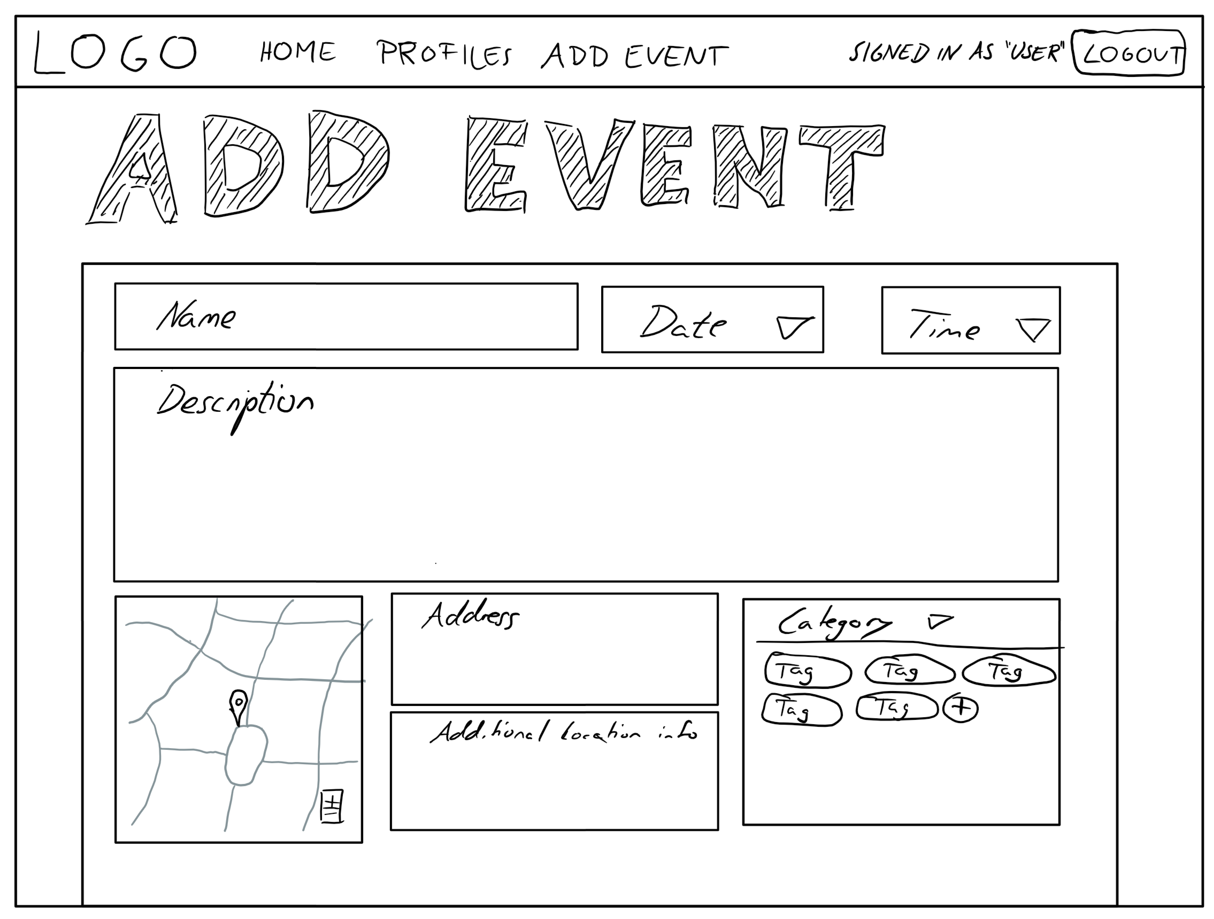

Slide 10
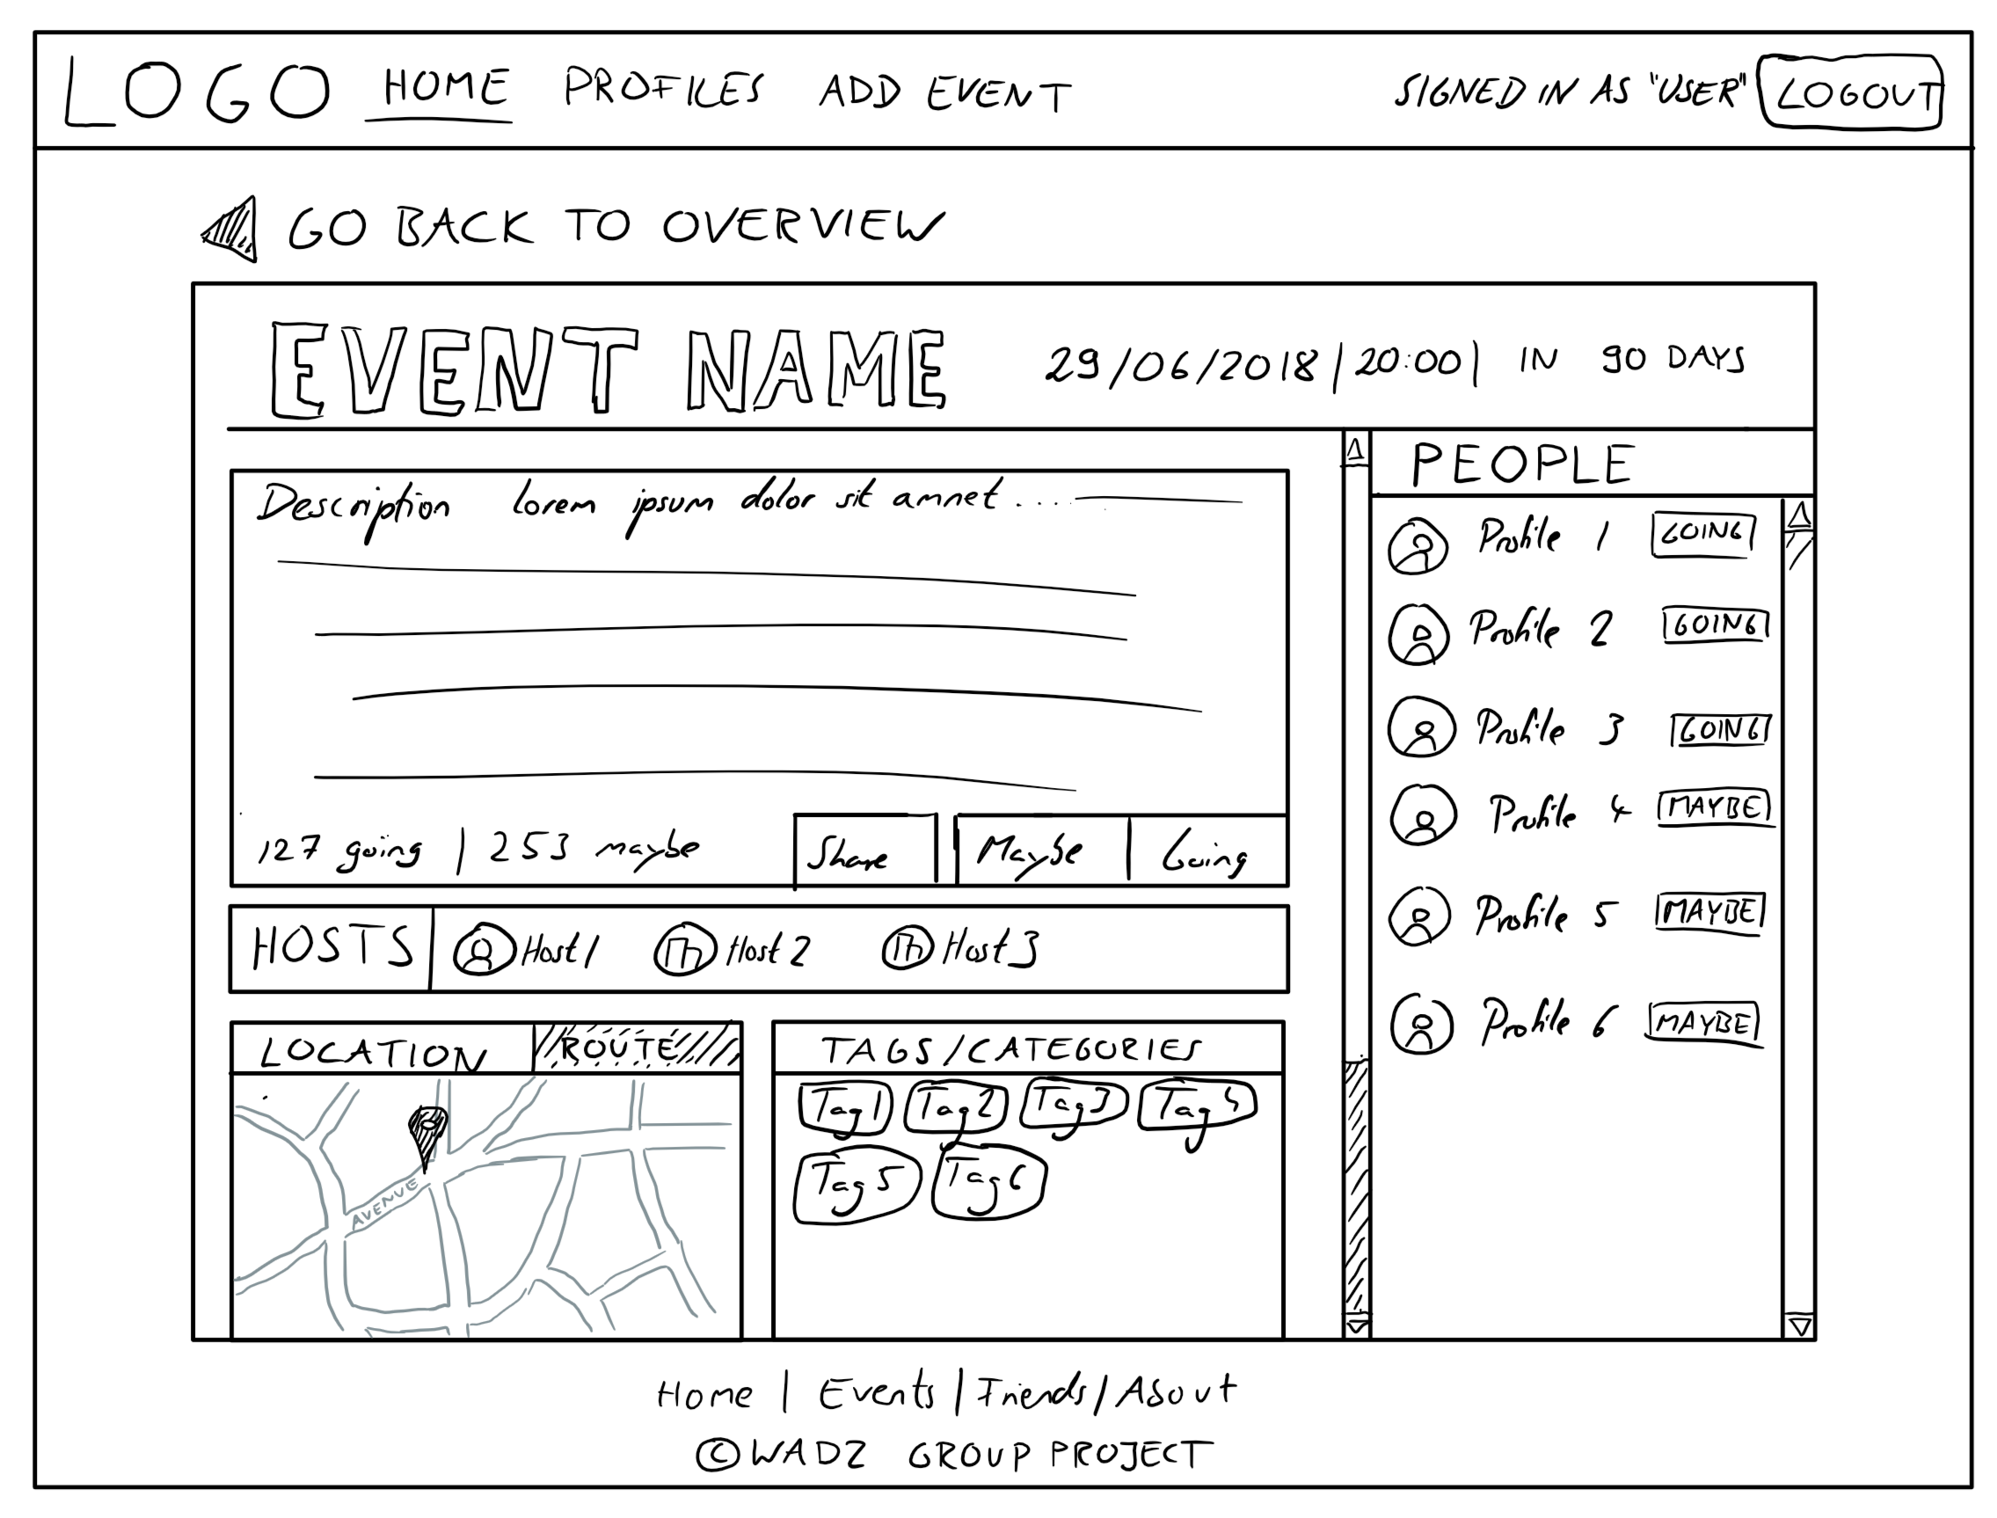

Slide 11
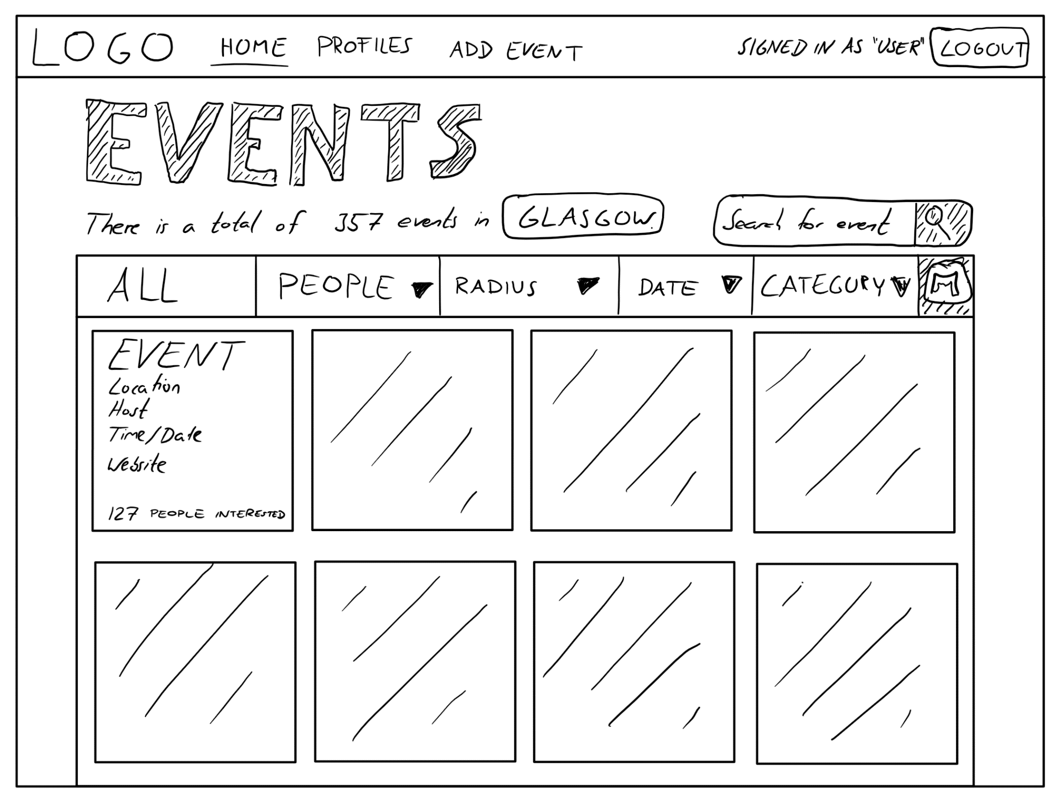

Slide 12
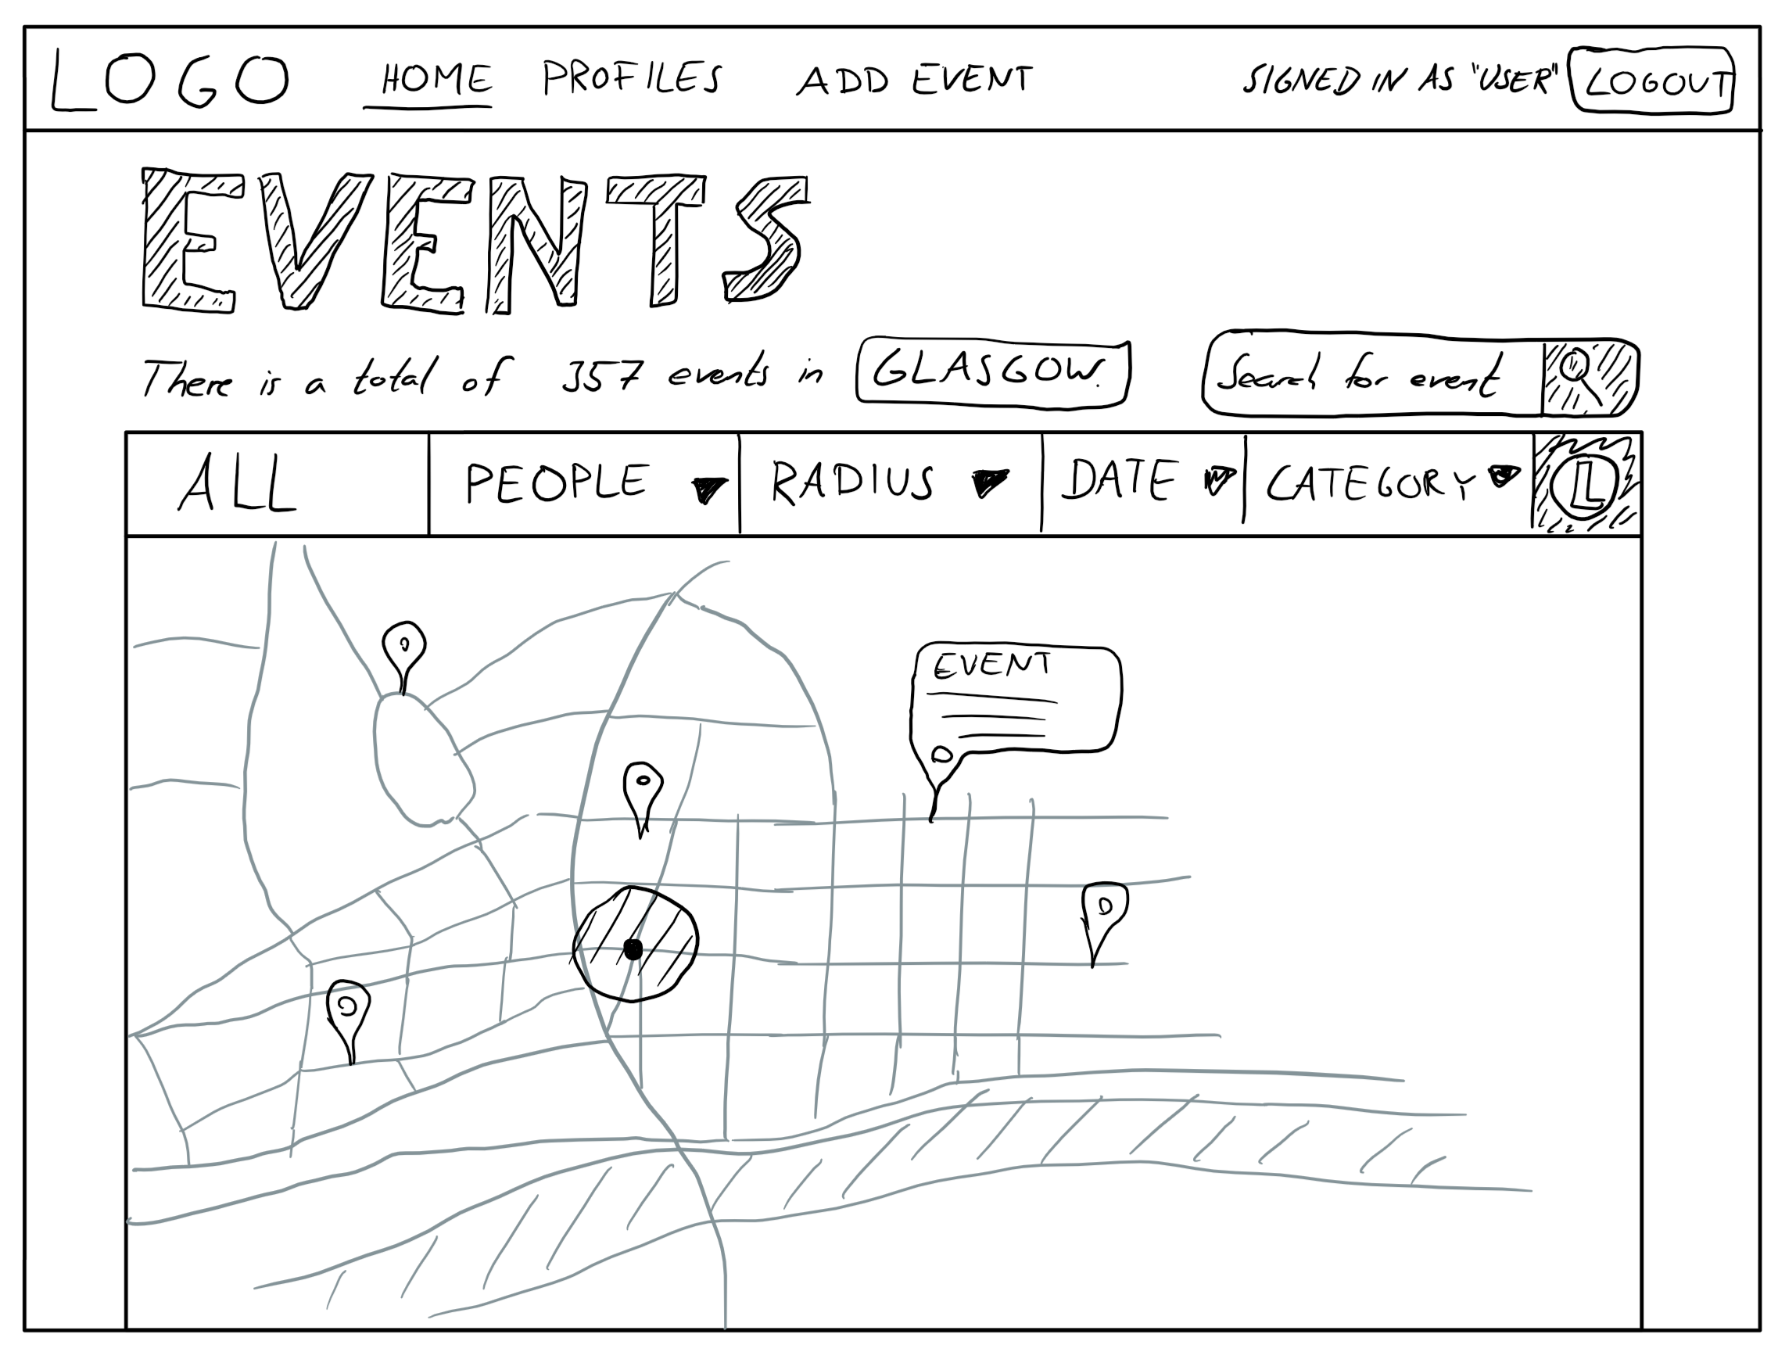

Slide 13
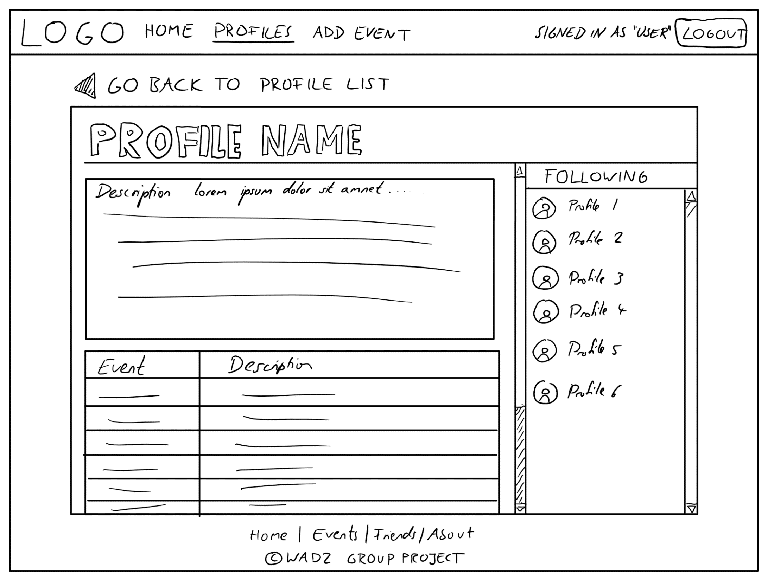

Slide 14
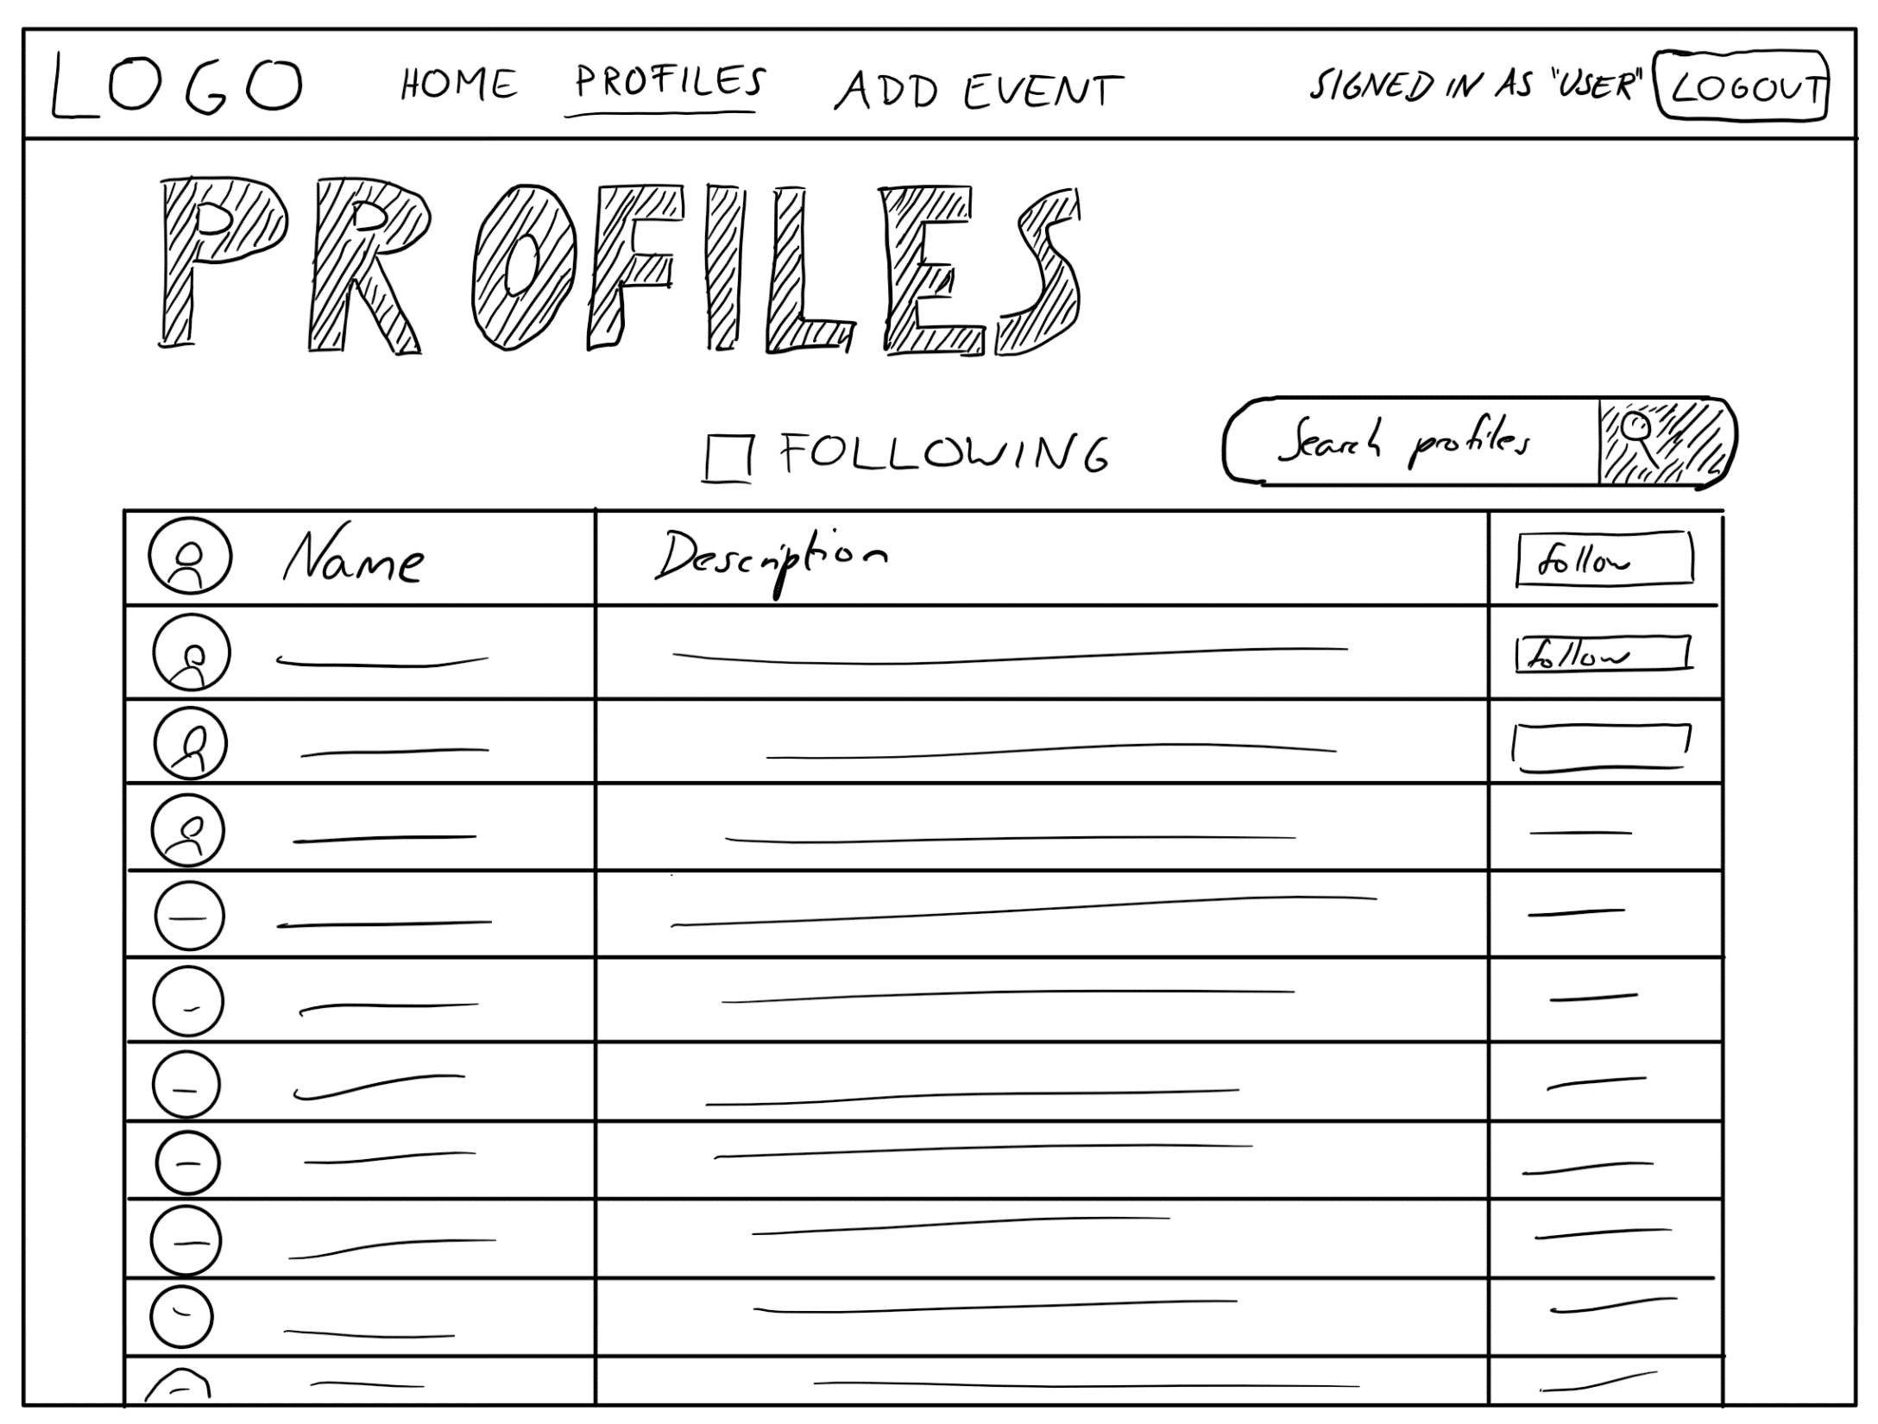

Slide 15
Walkthrough – Site Maps

