Slide 1

MyBarkChart
Any Pet. Every Record.

Slide 2
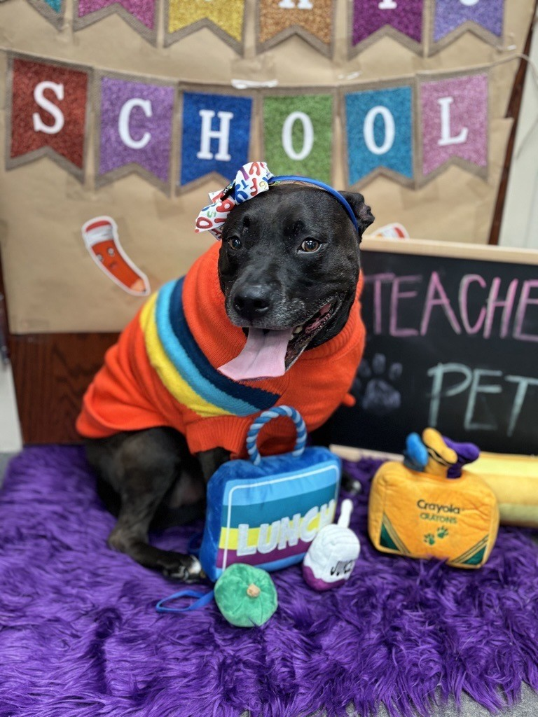
Add a title
The Inspiration
  This project was inspired by a dog named Sparky. As Sparky aged, her bloodwork kept coming back with more alarming values. She was referred to an internal medicine veterinarian, and started accumulating records between two veterinary offices.​ MyBarkChart became the solution.
What It Does
  MyBarkChart is built to be portable medical records. It is functional on mobile devices, making it easier to remember which medications your animal takes, or what their last weight was. If you see multiple vets, it will be an easy way to keep track of labs between offices.
Built For Everyone​
  Free to use. Designed for any animal, and every record.

Slide 3
What It Does
Keep track of your veterinarians across clinics | Keep track of your pet’s medications | Keep track of your pet’s lab work
Add clinic names, phone numbers, and veterinarians | Add medicines, dosages, and number of refills | Enter lab values and watch trends develop over time

Slide 4
How It Works
Create an account
Create a user account to access the features
Add pets
Add any pet here. Additional pets can be added later
Add clinics
Add clinics and veterinarian information
Add medications
Add medications, dosages, and refills
Add labs
Add bloodwork, urine results, and other labs

Slide 5
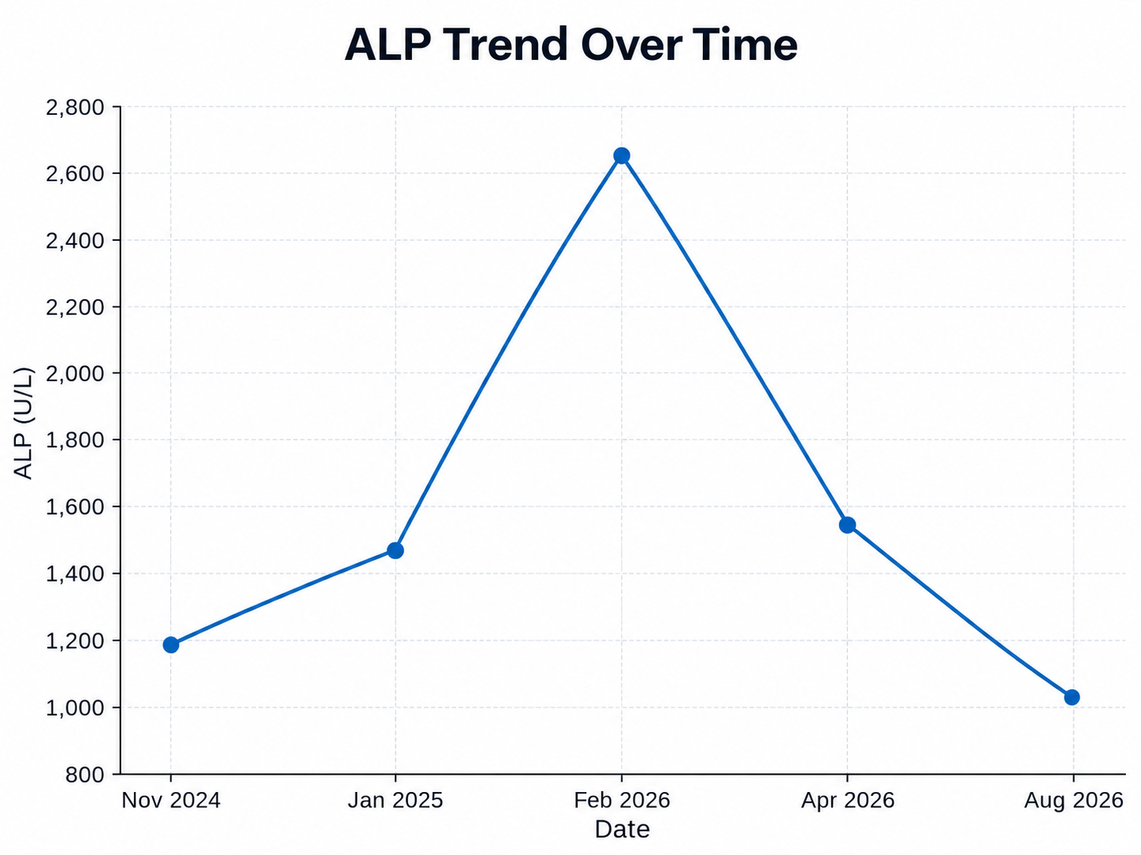
Track Trends Over Time
View lab trends over time in one place
Spot changes in lab values without digging through old records
Bring a clear history to every veterinary visit

Slide 6
Free For Pet Owners
No subscription. No monthly fee. No paywall for features.
Add as many pets as you need
Track labs, medications, clinics, and reminders
Access your records from any device

