Slide 1
Rig-I and MAVS Western Blots
Formatted film scans

Slide 2
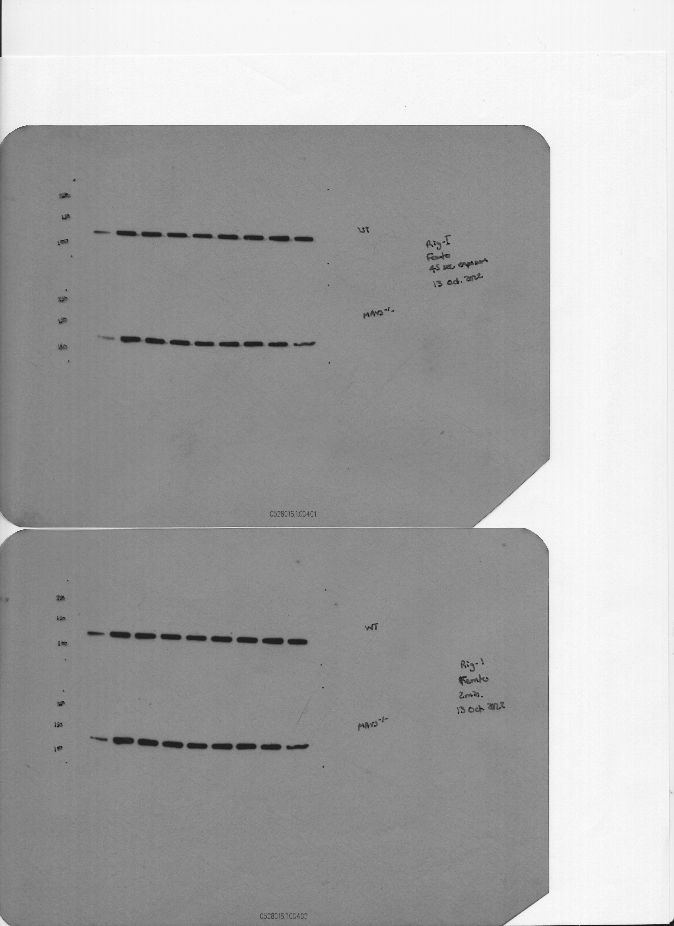
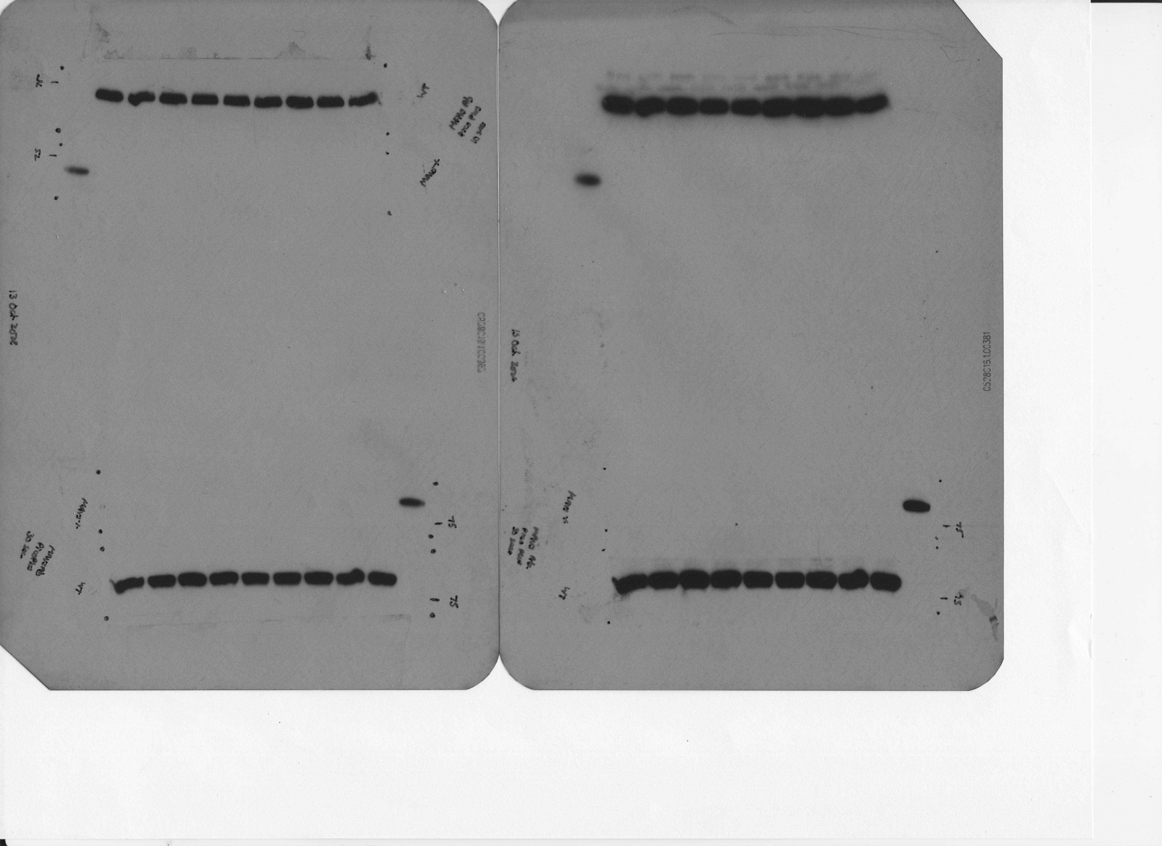
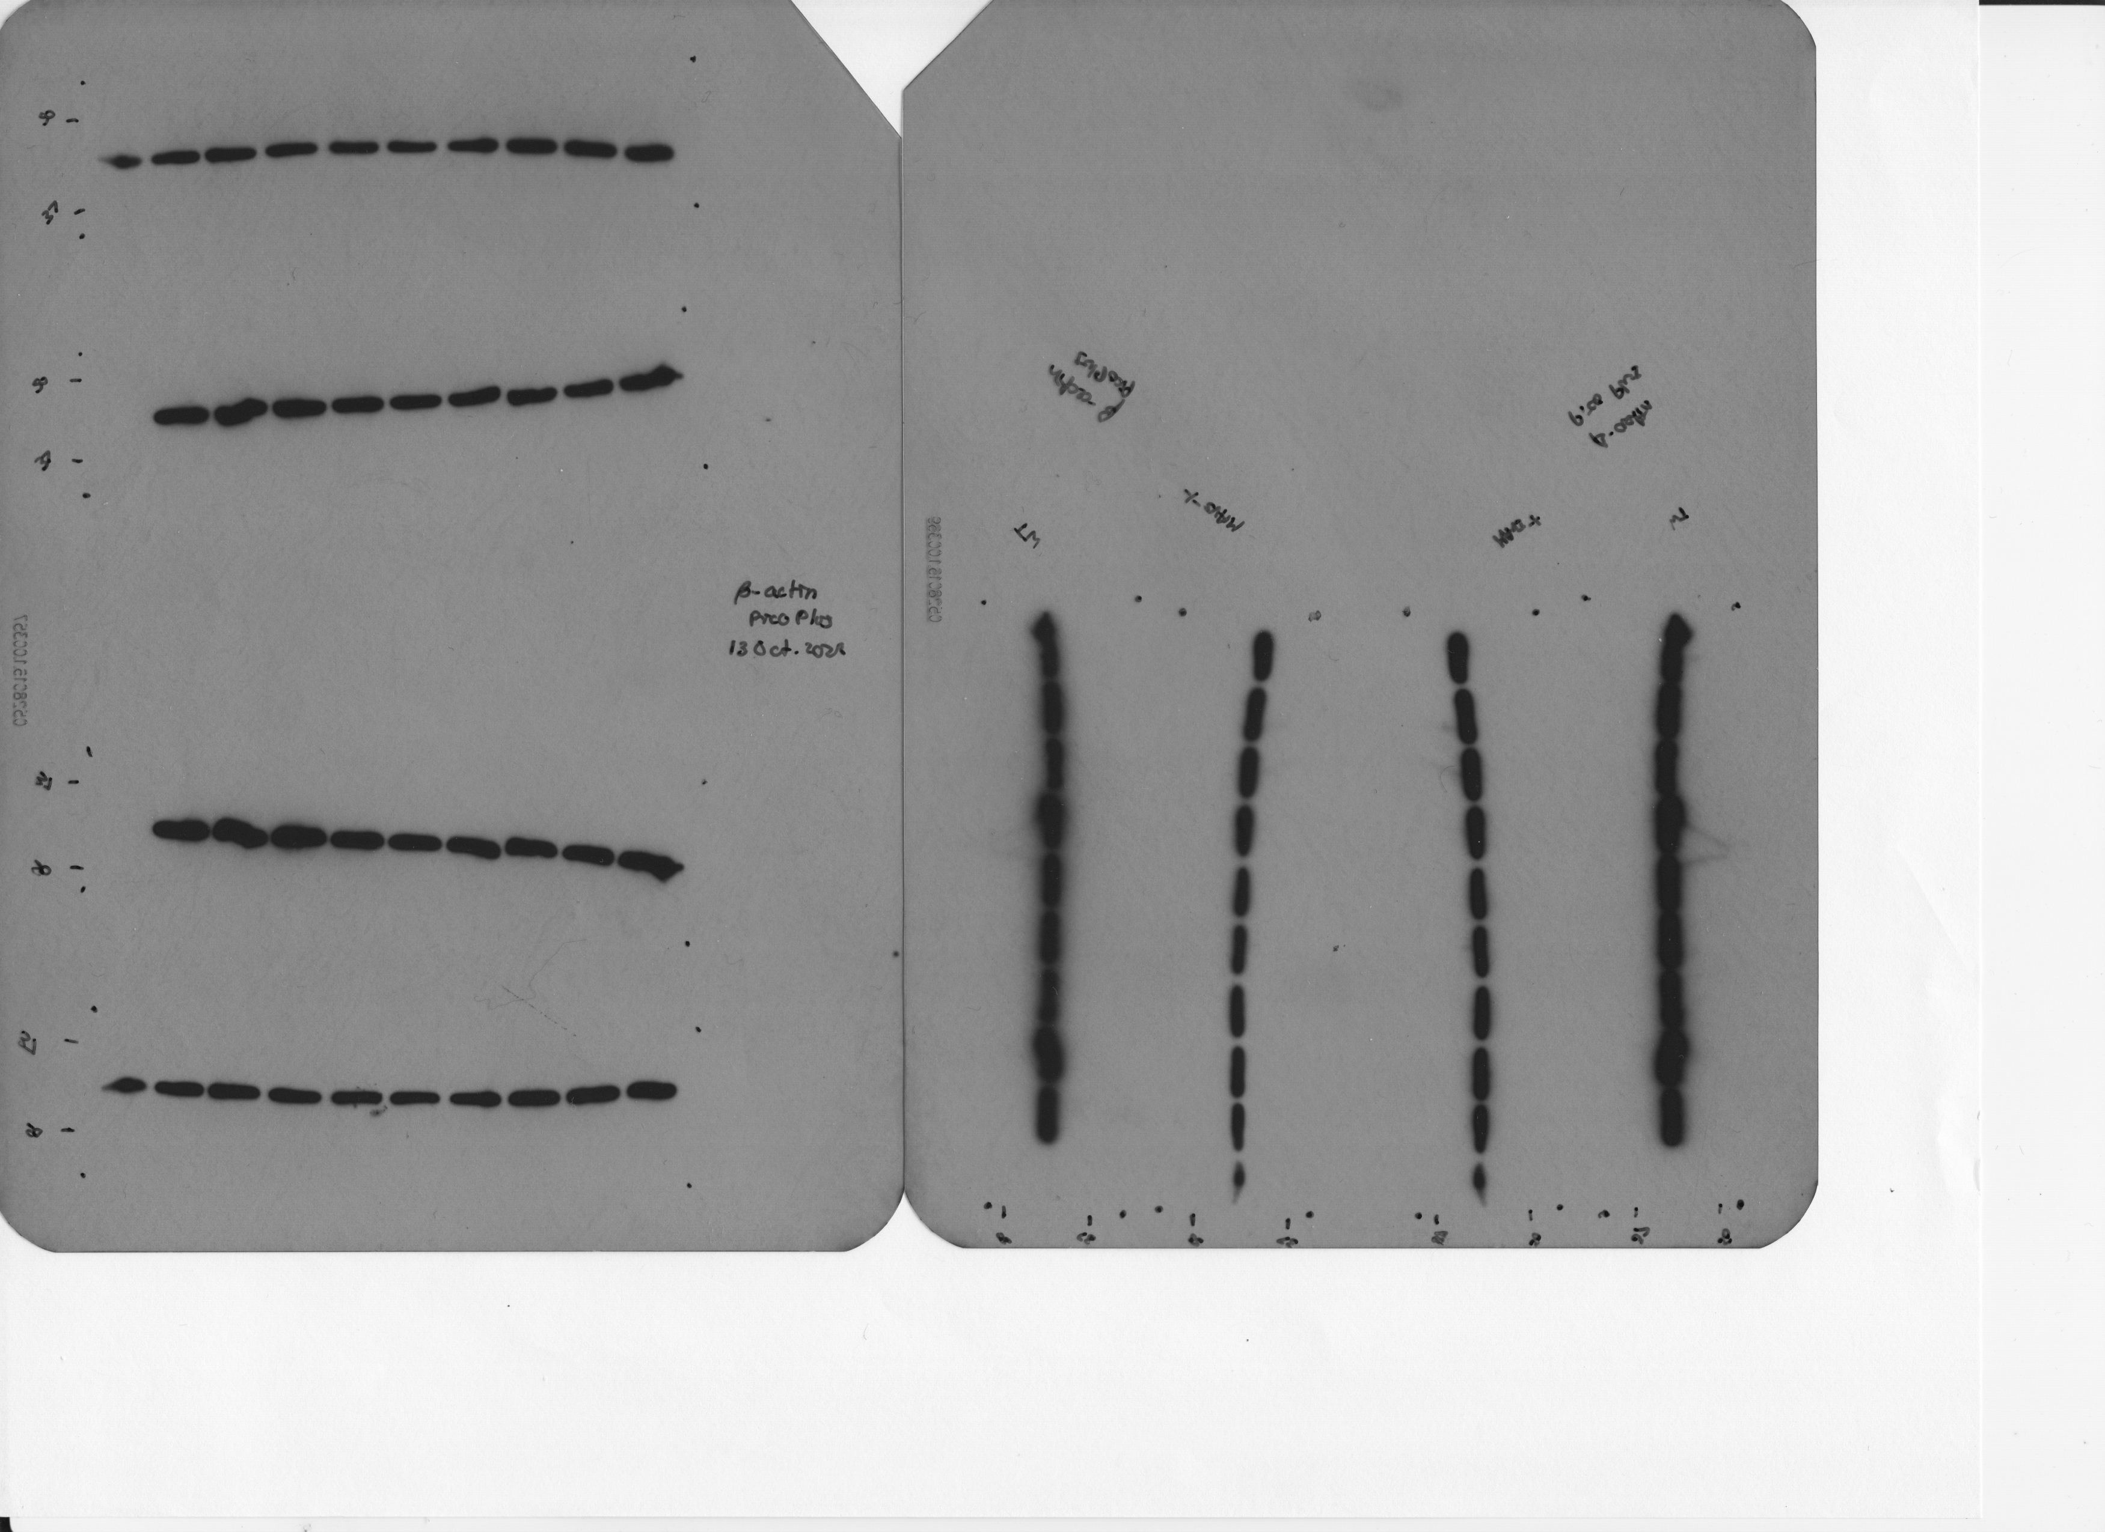
14 October 2022
WT BMDMs
WT BMDMs
MAVS^{-/-} BMDMs
Empty
Uninfected
WT
ΔsecA2_MOI1
ΔsecA2_MOI5
ΔsecA2secA2_MT
ΔsecA2//secA2_MM
ΔsecA2/secA2_MT
ΔesxBA
WT-HK
Uninfected
Uninfected
WT
ΔsecA2_MOI1
ΔsecA2_MOI5
ΔsecA2secA2_MT
ΔsecA2//secA2_MM
ΔsecA2/secA2_MT
ΔesxBA
WT-HK
250 kDa
α-Rig-I
250 kDa
150 kDa
150 kDa
α-Rig-I
100 kDa
100 kDa
75 kDa
α-MAVS
75 kDa
α-MAVS
50 kDa
α-β actin
50 kDa
α-β actin
α-β actin

Slide 3
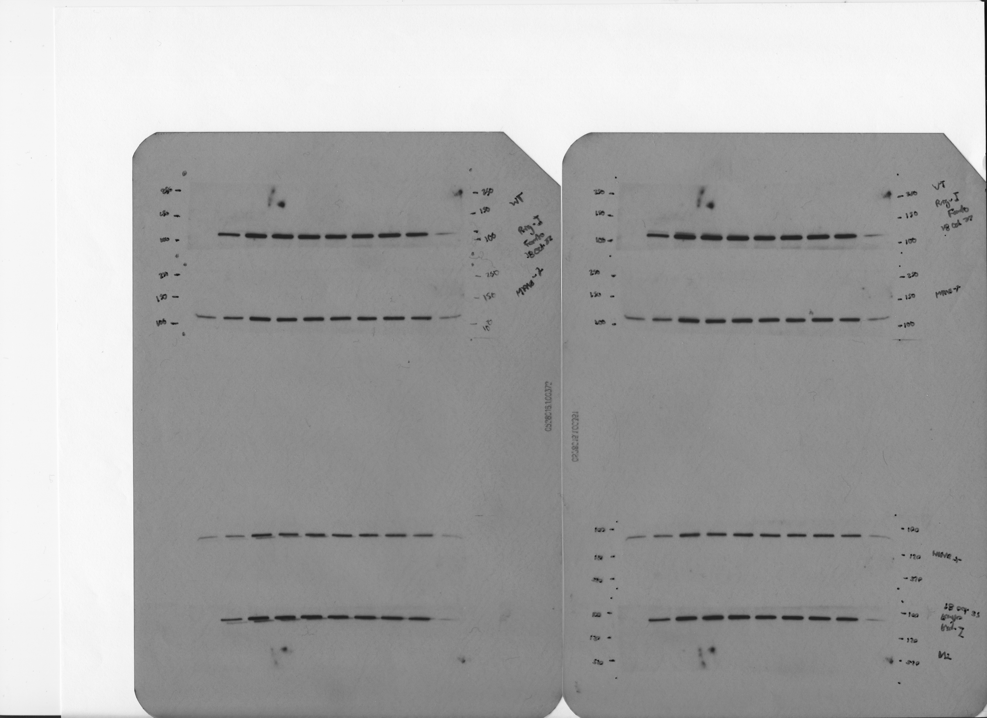
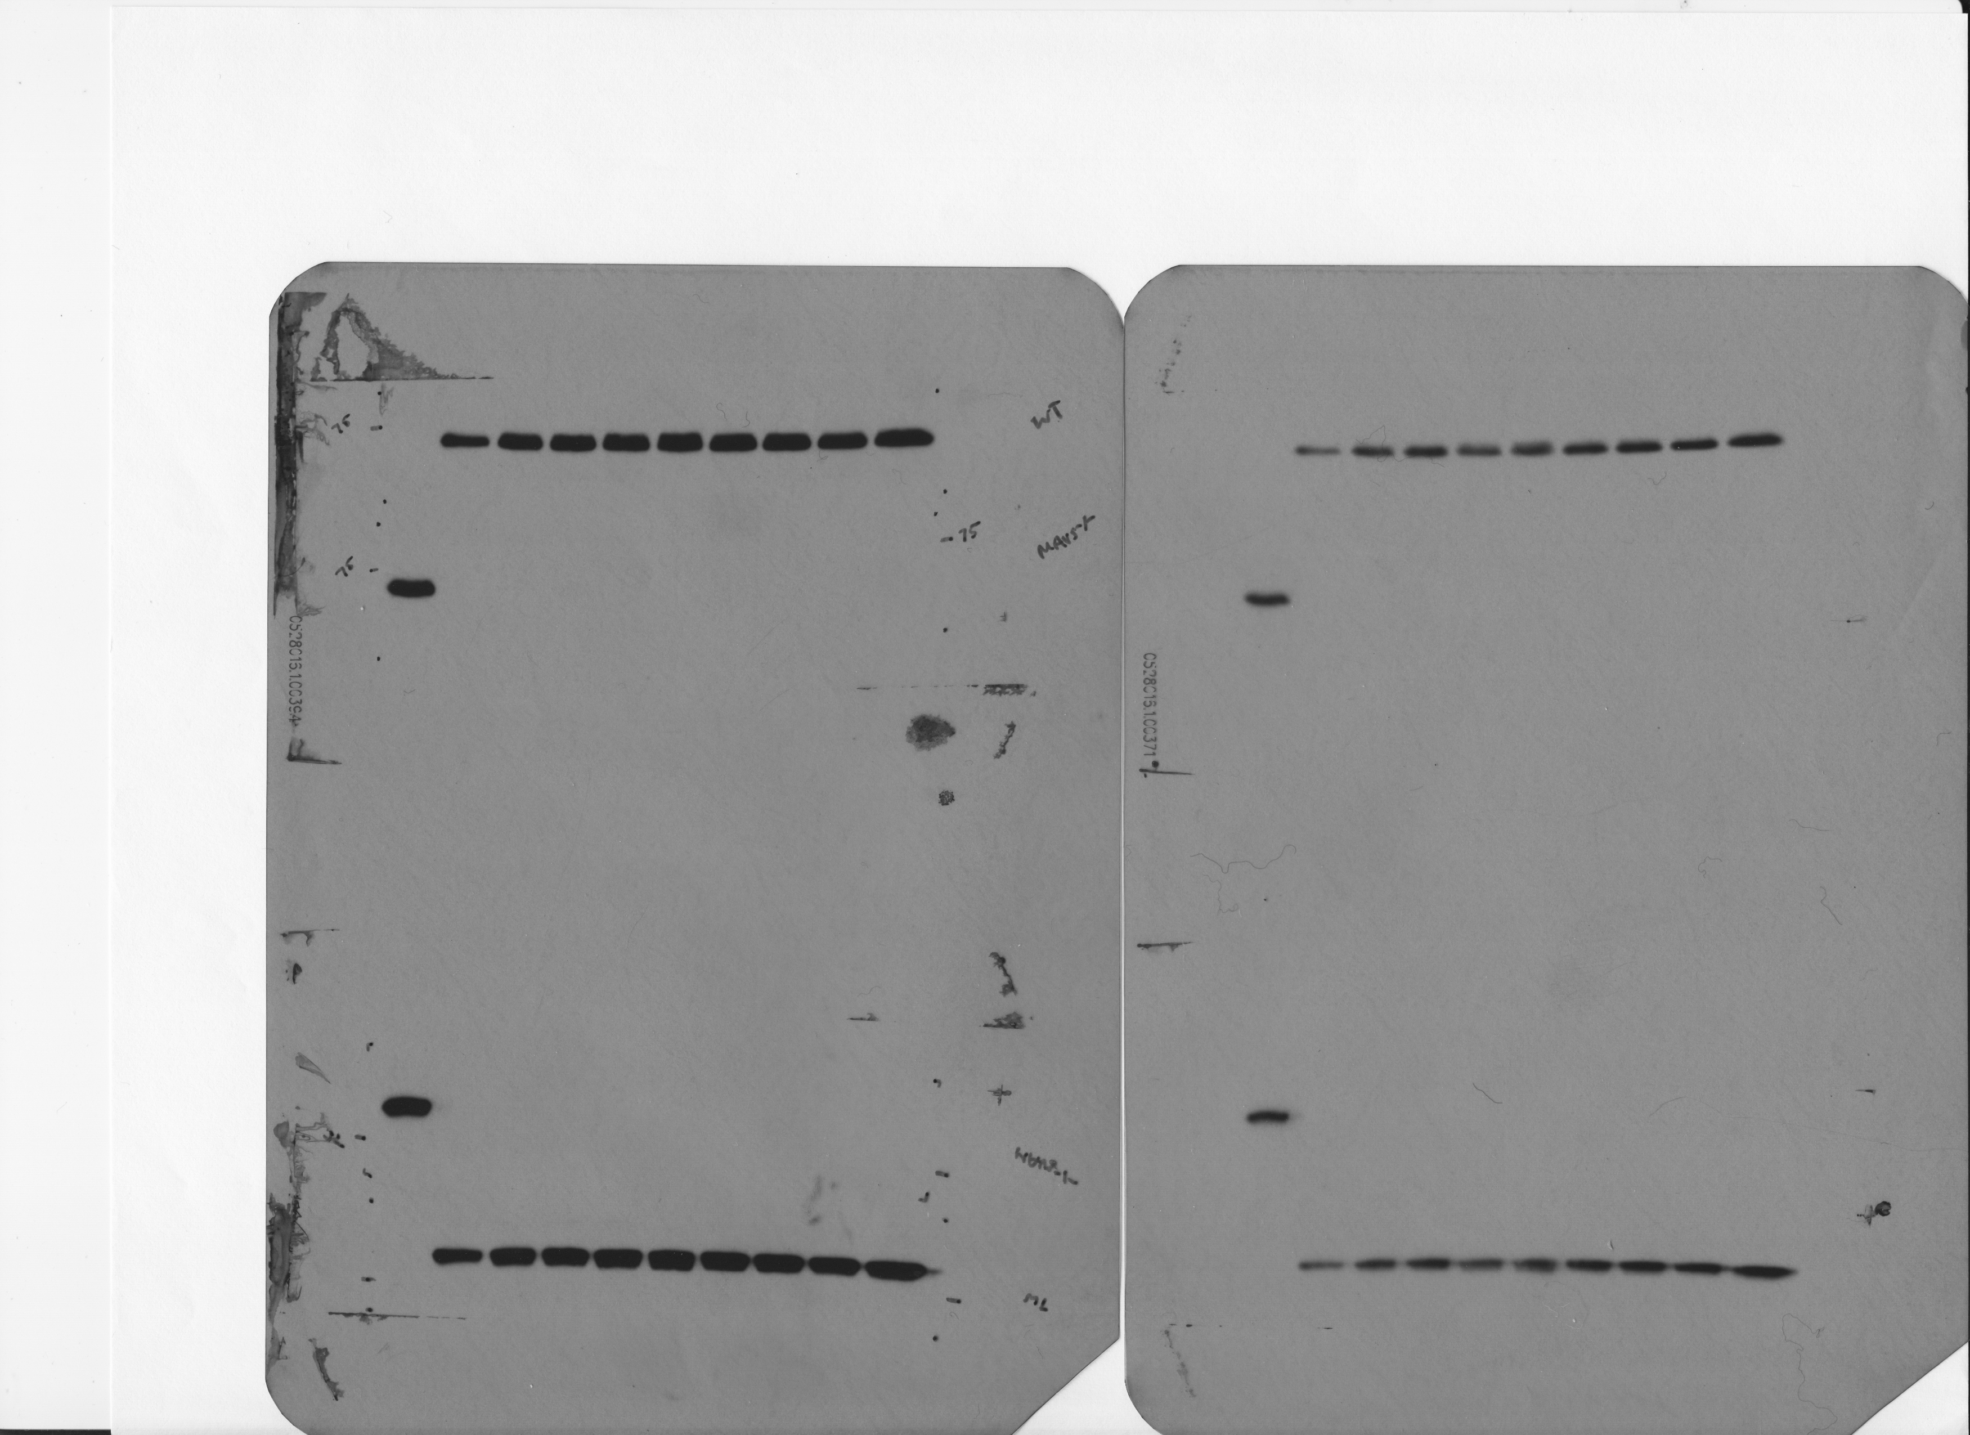
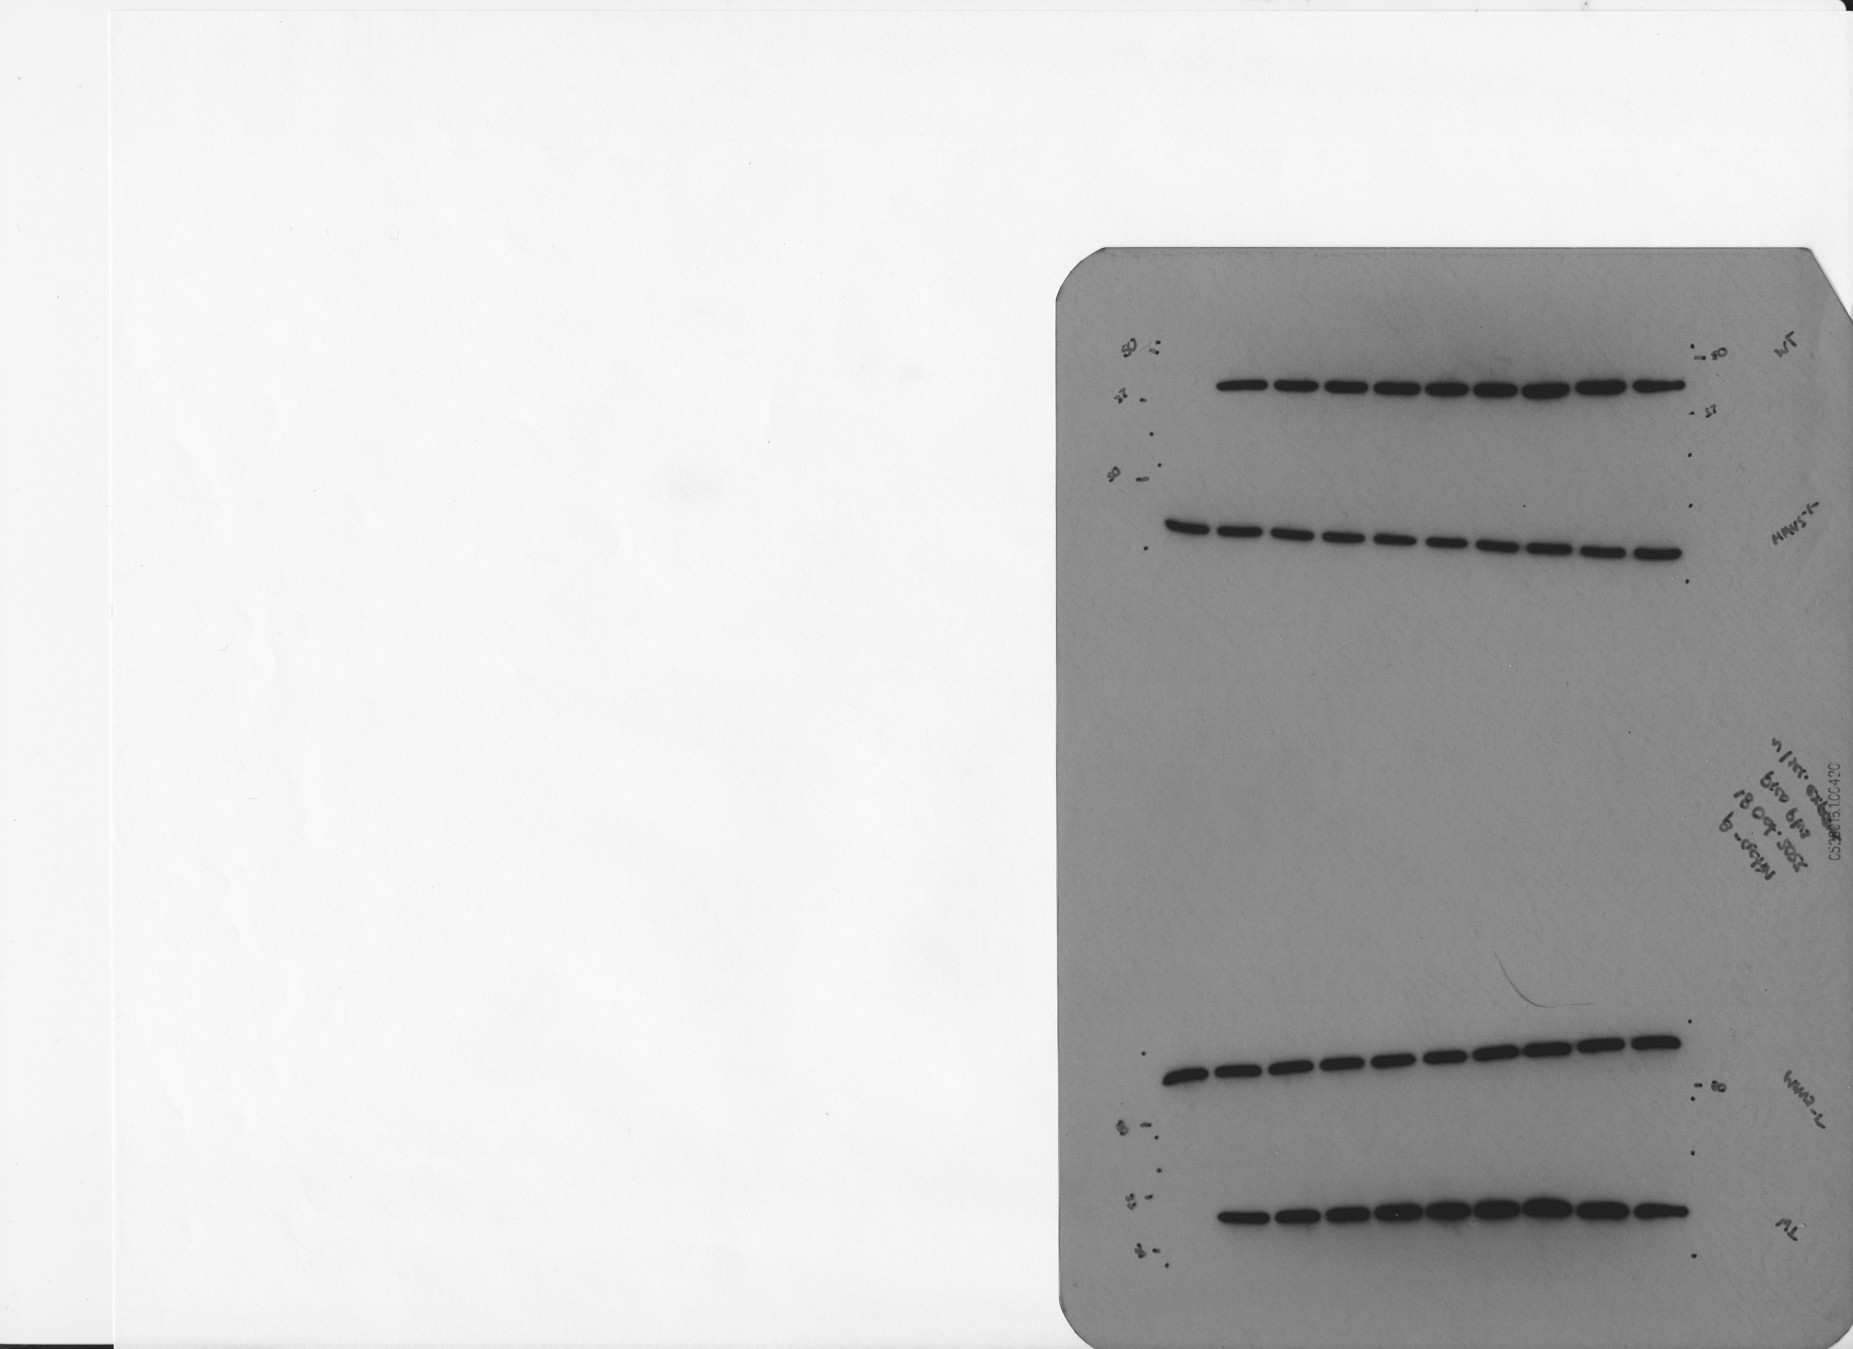
18 October 2022
WT BMDMs
WT BMDMs
MAVS^{-/-} BMDMs
Empty
Uninfected
WT
ΔsecA2_MOI1
ΔsecA2_MOI5
ΔsecA2_MOI10
ΔsecA2/psecA2MM
ΔsecA2/psecA2MT
ΔesxBA
WT-HK
Uninfected
Uninfected
WT
ΔsecA2_MOI1
ΔsecA2_MOI5
ΔsecA2_MOI10
ΔsecA2/psecA2MM
ΔsecA2/psecA2MT
ΔesxBA
WT-HK
250 kDa
α-Rig-I
250 kDa
150 kDa
150 kDa
α-Rig-I
100 kDa
100 kDa
75 kDa
α-MAVS
75 kDa
α-MAVS
50 kDa
α-β actin
50 kDa
α-β actin

Slide 4
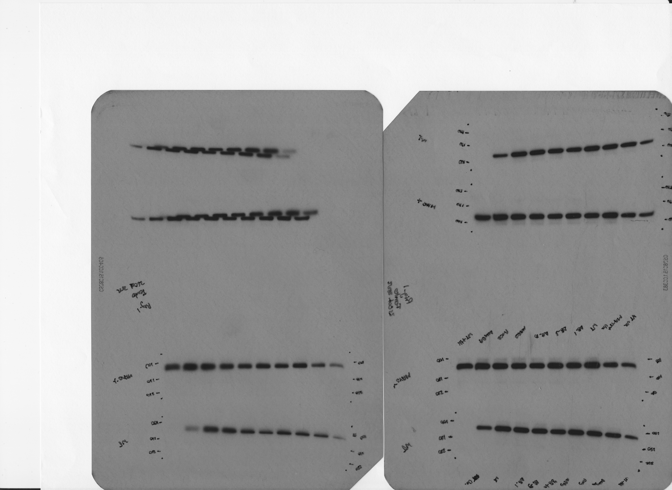
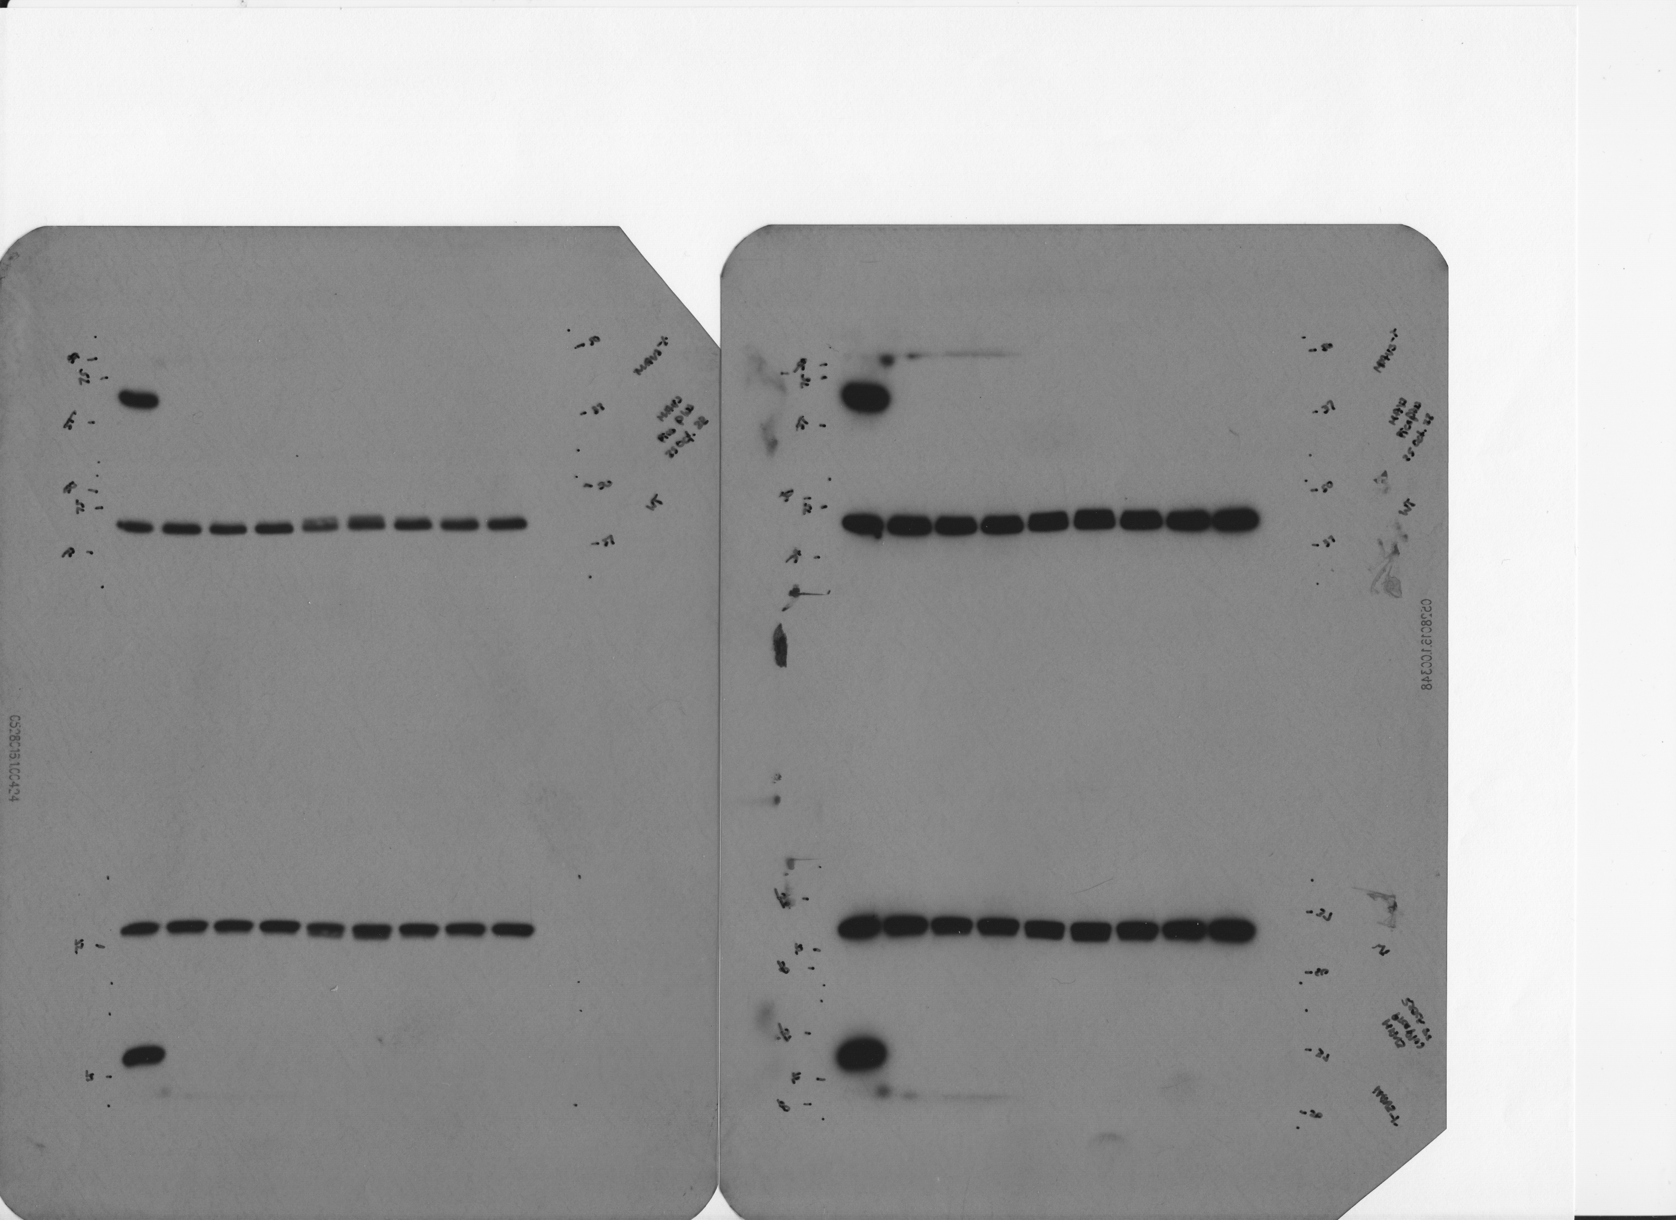
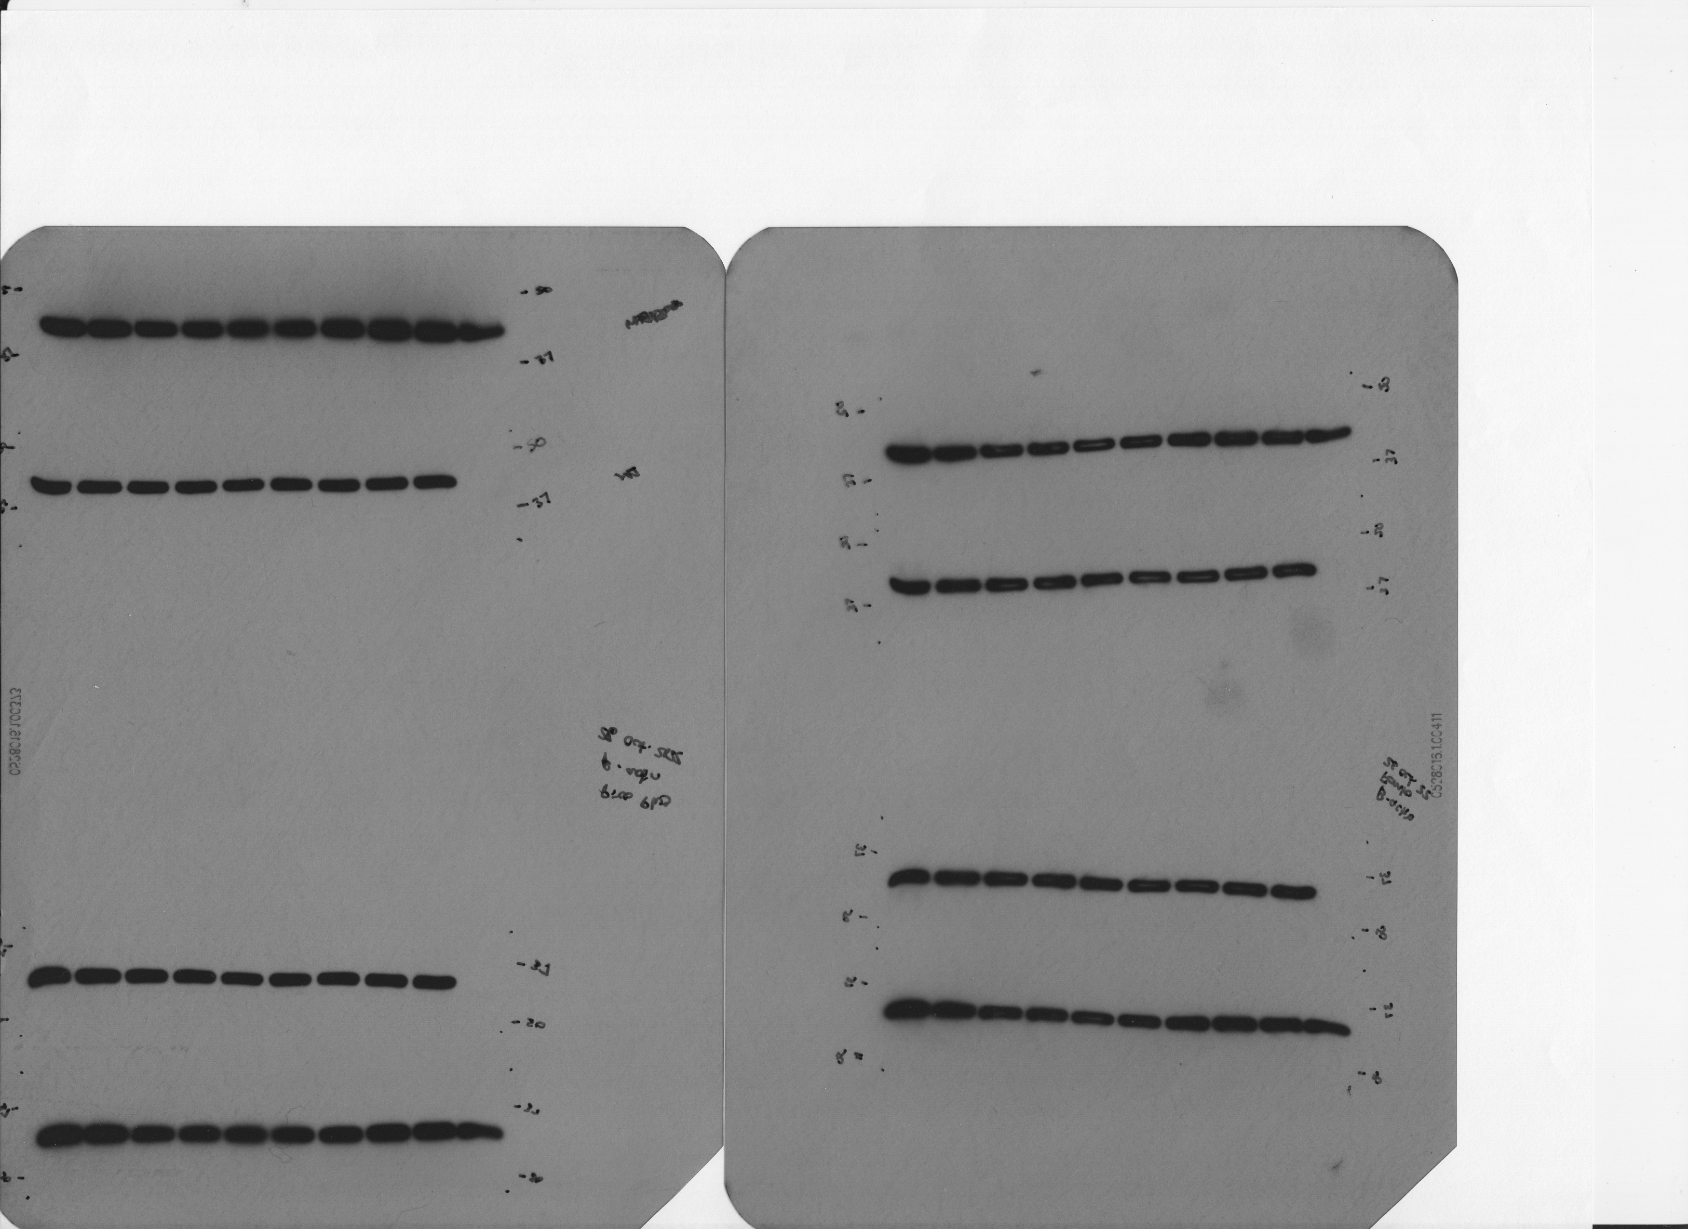
25 October 2022
WT BMDMs
WT BMDMs
MAVS^{-/-} BMDMs
Empty
Uninfected
WT
ΔsecA2_MOI1
ΔsecA2_MOI5
ΔsecA2secA2_MT
ΔsecA2//secA2_MM
ΔsecA2/secA2_MT
ΔesxBA
WT-HK
Uninfected
Uninfected
WT
ΔsecA2_MOI1
ΔsecA2_MOI5
ΔsecA2secA2_MT
ΔsecA2//secA2_MM
ΔsecA2/secA2_MT
ΔesxBA
WT-HK
250 kDa
α-Rig-I
250 kDa
150 kDa
150 kDa
α-Rig-I
100 kDa
100 kDa
75 kDa
α-MAVS
75 kDa
α-MAVS
50 kDa
α-β actin
50 kDa
α-β actin
α-β actin

