Slide 1
SecA2 and GroEL2 Western Blots

Slide 2
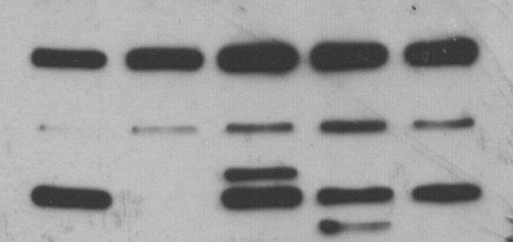
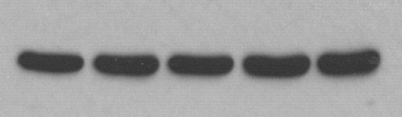
SecA2 and GroEL2_Rep. 1
Pellets from 23-25 Feb. 2022 in vitro growth curve
ΔsecA2/secA2_MM
ΔsecA2/secA2_MT
ΔesxBA
WT
ΔsecA2
For each, entire membrane the exposure was increased by 25% and brightness by 100%.
250 kDa
150 kDa
α-SecA2
100 kDa
75 kDa
α-GroEL2
(Loading control)
2 June 2022
From pellets 23 and 25 February 2022

Slide 3
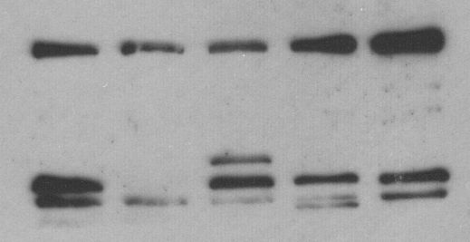
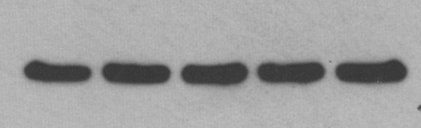
SecA2 and GroEL2_Rep. 2
Pellets from 16-18 March 2022 in vitro growth curve
ΔsecA2/secA2_MM
ΔsecA2/secA2_MT
ΔesxBA
WT
ΔsecA2
For each, entire membrane the exposure was increased by 25% and brightness by 100%.
250 kDa
150 kDa
α-SecA2
100 kDa
75 kDa
α-GroEL2
(Loading control)
6 June 2022
From pellets 16 and 18 March 2022

Slide 4
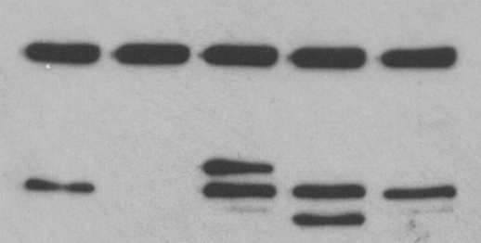
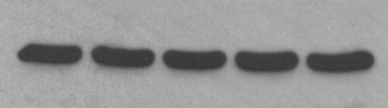
SecA2 and GroEL2_Rep. 3
Pellets from 23-24 March 2022 in vitro growth curve
ΔsecA2/secA2_MM
ΔsecA2/secA2_MT
ΔesxBA
WT
ΔsecA2
For each, entire membrane the exposure was increased by 25% and brightness by 100%.
250 kDa
150 kDa
α-SecA2
100 kDa
75 kDa
α-GroEL2
(Loading control)
8 June 2022
From pellets 23 and 24 March 2022

