Slide 1
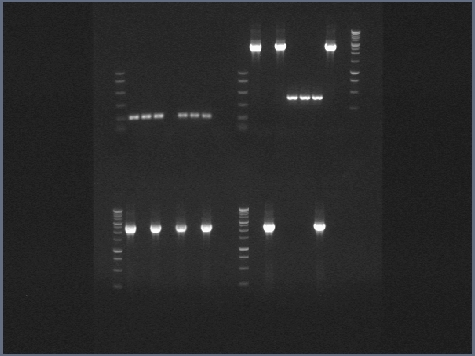
Replicate 1: Bacterial WCLs generated 23-25 February2022 and diluted 1:50 in nuclease free water.
WT
ΔsecA2
ΔsecA2/psecA2MM
ΔsecA2/psecA2MT
ΔesxBA
NTC
M. tuberculosis gDNA
Empty/Ladder
M. marinum gDNA
Original Image
secA2 (both)
150
A.
MMAR_2698
3000
B.
2000
300
150
MMAR_2698
3000
C.
2000
Rv1821
3000
D.
2000

Slide 2
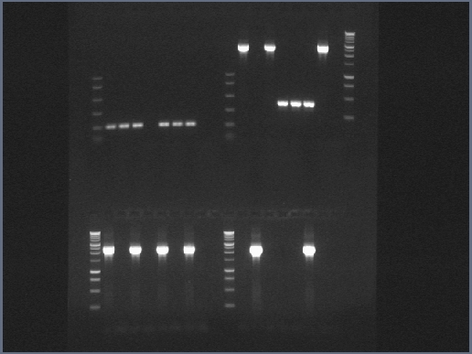
Replicate 2: Bacterial WCLs generated 16-18 March 2022 and diluted 1:50 in nuclease free water.
WT
ΔsecA2
ΔsecA2/psecA2MM
ΔsecA2/psecA2MT
ΔesxBA
NTC
M. tuberculosis gDNA
Empty/Ladder
M. marinum gDNA
Original Image
secA2 (both)
150
A.
MMAR_2698
3000
B.
2000
300
150
MMAR_2698
3000
C.
2000
Rv1821
3000
D.
2000

Slide 3
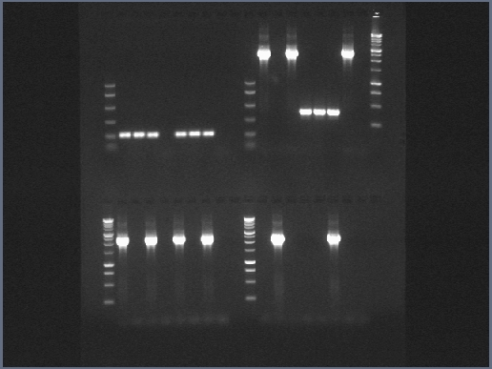
Replicate 3: Bacterial WCLs generated 23-24March 2022 and diluted 1:50 in nuclease free water.
WT
ΔsecA2
ΔsecA2/secA2MM
ΔsecA2/secA2MT
ΔesxBA
NTC
M. tuberculosis gDNA
Empty/Ladder
M. marinum gDNA
Original Image
secA2 (both)
150
A.
MMAR_2698
3000
B.
2000
300
150
MMAR_2698
3000
C.
2000
Rv1821
3000
D.
2000

